Slide 1

Spring Fundamentals
Spring Security
SoftUni Team
Technical Trainers
Software University
https://softuni.bg

Slide 2
Questions
sli.do #java-web

Slide 3
Table of Contents
Filters and Interceptors
Spring Security
Registration
Login
Remember Me
CSFR
Thymeleaf Security

Slide 4

Filters and Interceptors

Slide 5
Filters
A filter is an object used to intercept the HTTP requests and responses of your application
We can perform two operations at two instances:
Before sending the request to the controller
Before sending a response to the client

Slide 6
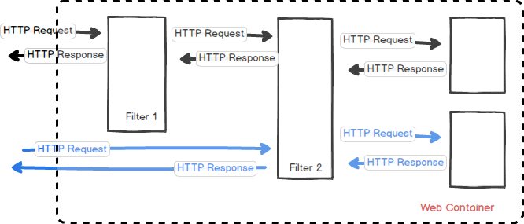
Filters Diagram

Slide 7
Filter Example(1)
GreetingFilter.java
@Component
public class GreetingFilter implements Filter {
@Override
public void doFilter(ServletRequest servletRequest, ServletResponse servletResponse, FilterChain filterChain) throws IOException, ServletException {
HttpServletRequest request = (HttpServletRequest) servletRequest;
HttpServletResponse response = (HttpServletResponse) servletResponse;
request.getSession().setAttribute('name', 'Pesho');
filterChain.doFilter(request, response);
}
}

Slide 8
Filter Example(2)
HomeController.java
@Controller
public class HomeController {
@GetMapping('/')
public ModelAndView index(ModelAndView modelAndView, HttpSession session) {
modelAndView.setViewName('index');
modelAndView.addObject('name', session.getAttribute('name'));
return modelAndView;
}
}

Slide 9
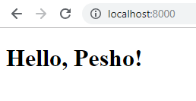
Filter Example(3)
index.html
<!DOCTYPE html>
<html lang='en' xmlns='http://www.w3.org/1999/xhtml' xmlns:th='http://www.thymeleaf.org'>
<head>
<meta charset='UTF-8'>
<title>Filter Demo</title>
</head>
<body>
<h1 th:text='|Hello, ${name}!|'></h1>
</body>
</html>

Slide 10
Interceptor
A Filter is used in the web layer only as it is defined in web.xml. We can not use it out of web context
While Spring Interceptors are defined in the Spring context
The interceptor include three main methods:
preHandle: executed before the execution of the target resource
afterCompletion: executed after the execution of the target resource (after rendering the view)
postHandle: Intercept the execution of a handler

Slide 11
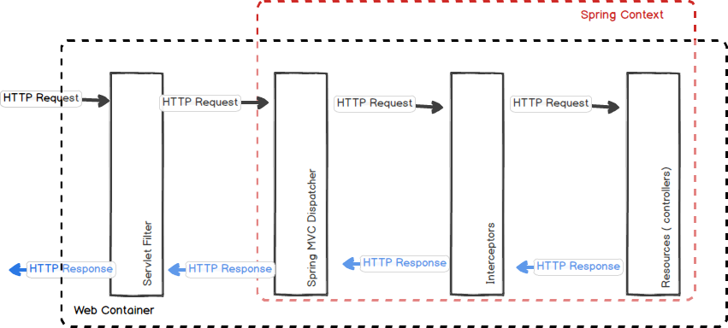
Interceptor Diagram

Slide 12
Interceptor Example
LogingInterceptor
public class LogingInteceptor implements HandlerInterceptor {
@Override
public boolean preHandle(HttpServletRequest request, HttpServletResponse response, FilterChain filterChain, Object handler) throws IOException, ServletException {
//Log some information ...
retrun true;
}
}

Slide 13
Register Interceptor in Configuration
To use interceptors we need to register them
@Configuration
public class WebConfiguration implements WebMvcConfigurer {
private final MyInterceptor myInterceptor;
public WebConfiguration(MyInterceptor myInterceptor) {
this.myInterceptor = myInterceptor;
}
@Override
public void addInterceptors(InterceptorRegistry registry) {
registry.addInterceptor(myInterceptor);
}
}

Slide 14
Spring Security

Slide 15


What is Spring Security?
A powerful and highly customizable authentication and access-control framework
It is the de-facto standard for securing Spring-based applications
Focuses on providing both authentication and authorization to Java applications

Slide 16

Spring Security
Authentication
Who is logged in
Authorization
What you are allowed to do

Slide 17
Spring Security Filter Chain
Client
FilterChain
SecurityFilterChain
Filter 0
Security Filter 0
DelegatingFilterProxy
FilterChainProxy
Filter 2
Security Filter N
Servlet

Slide 18
Security Context and Authentication
SecurityContextHolder
SecurityContext
Authentication
Principal
Credentials
Authorities
At the heart of Spring Security's authentication model is the SecurityContextHolder
It contains the SecurityContext

Slide 19






Spring Security Mechanism
Auth. manager
Access Decision Manager
Intercept
Request
Intercept
Request
Secured Resources
Web Client
GET username password
Valid Credentials
Valid Authorization
Validate
username password
Validate Roles
Database

Slide 20
Spring Security Maven/Gradle
Adding Spring Security.
pom.xml
<dependency>
<groupId>org.springframework.boot</groupId>
<artifactId>spring-boot-starter-security</artifactId>
</dependency>
build.gardle
dependencies {
implementation 'org.springframework.boot:spring-boot-starter-security'
}

Slide 21
Spring Security Configuration (1)
Creating the SecurityFilterChain bean.
SecurityConfiguration.java
@Configuration
public class SecurityConfiguration {
@Bean
public SecurityFilterChain filterChain(HttpSecurity httpSecurity){
//Configuration goes here
}
}

Slide 22
Spring Security Configuration (2)
Create the SecurityFilterChain
SecurityConfiguration.java
@Bean
public SecurityFilterChain filterChain(HttpSecurity httpSecurity){
http
.authorizeRequests()
.antMatchers('/', '/register').permitAll()
.anyRequest().authenticated();
…
return http.build();
}
Authorize Requests
Permit Routes
Require Authentication
Build SecurityFilterChain

Slide 23
Registration – User
We need to implement UserDetails interface
UserDetails.java (Spring)
public interface UserDetails {
Collection<? extends GrantedAuthority> getAuthorities();
String getPassword();
String getUsername();
boolean isAccountNonExpired();
boolean isAccountNonLocked();
boolean isCredentialsNonExpired();
boolean isEnabled();
}
UserDetails ud =
User.
withUsername(..).
password(..).
authorities(..).
build();

Slide 24
Registration – Roles
Implementing the GrantedAuthority interface.
Role.java
public class Role implements GrantedAuthority {
private String authority;
}
Role Interface

Slide 25
SimpleGrantedAuthority
If we want, we can use SimpleGrantedAuthority instead of creating Role class
Is a basic concrete implementation of a GrantedAuthority
Stores a String representation of an authority granted to the Authentication object

Slide 26
UserDetailsService
Implementing the UserDetailsService interface.
UserServiceImpl.java
public class UserDetailsServiceImpl implements UserDetailsService {
public UserDetailsServiceImpl() {
…
}
@Override
public UserDetails loadUserByUserName(String userName) {
// get the user and map to UserDetails
} }

Slide 27
PasswordEncoder and UserDetailsService (1)
Expose as beans
UserServiceImpl.java
@Configuration
public class SecurityConfig {
@Bean
public UserDetailsService userDetailsService(UserRepository
userRepository) {
return new UserDetailsServiceImpl(userRepository);
}
…
}

Slide 28
PasswordEncoder and UserDetailsService (2)
Expose as beans
UserServiceImpl.java
@Configuration
public class SecurityConfig {
@Bean
public PasswordEncoder passwordEncoder() {
return new Pbkdf2PasswordEncoder();
}
…
}

Slide 29


Login Mechanism
Web Client
Create Session
GET localhost:8080
Session Cookie
Validate Session
GET localhost:8080
Session Cookie

Slide 30
Login – Configuration
SecurityConfiguration.java
.and()
.formLogin().loginPage('/login').permitAll()
.usernameParameter('username')
.passwordParameter('password')
login.html
<input type='text' name='username'/>
<input type='text' name='password'/>

Slide 31
Login – UserService
User Service Interface
UserServiceImpl.java
@Service
public class UserServiceImpl implements UserDetailsService {
// Some userServiceImpl logic
@Override
public UserDetails loadUserByUsername(String username) throws UsernameNotFoundException {
//...
} }

Slide 32
Login – Controller
LoginController.java
@Controller
public class LoginController {
@GetMapping('/login')
public String getLoginPage(@RequestParam(required = false) String error, Model model) {
if(error != null){
model.addAttribute('error', 'Error');
}
return 'login';
} }
Error Handling

Slide 33
Logout
SecurityConfiguration.java
.and()
.logout().logoutSuccessUrl('/login?logout').permitAll()
Logout. No Controller is required

Slide 34
Remember Me
SecurityConfiguration.java
.and()
.rememberMe()
.rememberMeParameter('remember')
.key('remember Me Encryption Key')
.rememberMeCookieName('rememberMeCookieName')
.tokenValiditySeconds(10000)
login.html
<input name='remember' type='checkbox' />

Slide 35
Principal
This is the currently logged user
UserController.java
@GetMapping('/user')
public String getUser(Principal principal){
System.out.println(principal.getName());
return 'user';
}
Print Logged-In username

Slide 36
Pre / Post Authorize
Grant Access to specific methods
SecurityConfiguration.java
@EnableGlobalMethodSecurity(prePostEnabled = true)
public class SecurityConfiguration extends WebSecurityConfigurerAdapter { }
Enables PreAuthorize
UserService.java
public interface UserService extends UserDetailsService {
@PreAuthorize('hasRole('ADMIN')')
void delete();
}
Requires Admin Role to execute

Slide 37
No Access Handling
SecurityConfiguration.java
.and() .exceptionHandling().accessDeniedPage('/unauthorized')
AccessController.java
@GetMapping('/unauthorized')
public String unauthorized(){
return 'unauthorized';
}

Slide 38
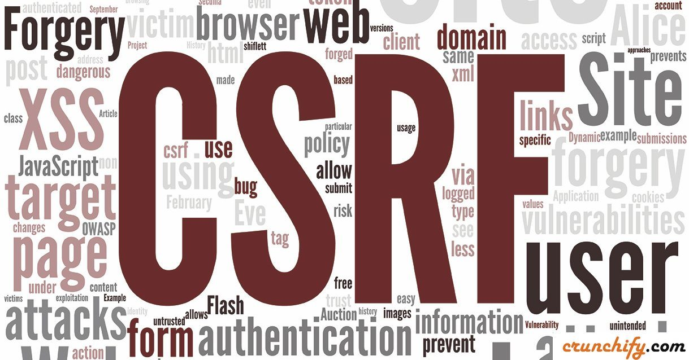
Cross-Site Request Forgery

Slide 39
Spring CSFR Protection
.csrf()
.csrfTokenRepository(csrfTokenRepository())
private CsrfTokenRepository csrfTokenRepository() {
HttpSessionCsrfTokenRepository repository = new HttpSessionCsrfTokenRepository();
repository.setSessionAttributeName("_csrf");
return repository;
}
form.html
<input type='hidden' th:name='${_csrf.parameterName}' th:value='${_csrf.token}' />

Slide 40
Thymeleaf Security

Slide 41
Thymeleaf Security
pom.xml
<dependency>
<groupId>org.thymeleaf.extras</groupId>
<artifactId>thymeleaf-extras-springsecurity5</artifactId>
</dependency>
Functionality to Thymeleaf

Slide 42
Principal
index.xml
<!DOCTYPE html>
<html lang='en'
xmlns:th='http://www.thymeleaf.org'
xmlns:sec='http://www.thymeleaf.org/extras/spring-security'>
<body>
<div sec:authentication='name'>
The value of the 'name' property of the authentication object should appear here.
</div>
</body>
</html>
Show the username

Slide 43
Roles
index.xml
<!DOCTYPE html>
<html lang='en'
xmlns:th='http://www.thymeleaf.org'
xmlns:sec='http://www.thymeleaf.org/extras/spring-security'>
<body>
<div sec:authorize='hasRole('ADMIN')'>
This content is only shown to administrators.
</div>
</body>
</html>
Show if you are admin

Slide 44

Summary
What is the difference between Filters and Interceptors
What is Spring Security and how to implement it
How to use Thymeleaf Security

Slide 45
Questions?
Notes:
45

Slide 46














SoftUni Diamond Partners

Slide 47

Educational Partners

Slide 48
Trainings @ Software University (SoftUni)
Software University – High-Quality Education, Profession and Job for Software Developers
softuni.bg, about.softuni.bg
Software University Foundation
softuni.foundation
Software University @ Facebook
facebook.com/SoftwareUniversity
Software University Forums
forum.softuni.bg
Notes:
48

Slide 49

License
This course (slides, examples, demos, exercises, homework, documents, videos and other assets) is copyrighted content
Unauthorized copy, reproduction or use is illegal
© SoftUni – https://about.softuni.bg/
© Software University – https://softuni.bg
Notes:
49

