Slide 1





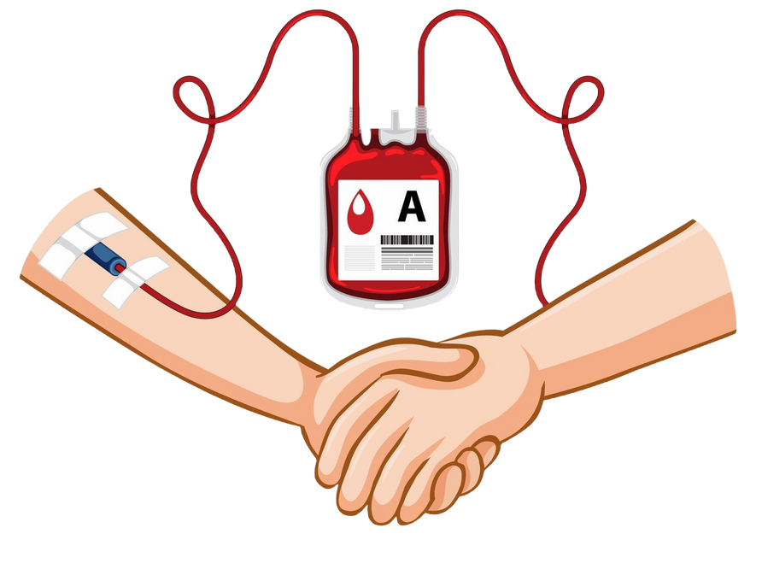

Rakt-Setu
Connecting people, strengthening lives...

Slide 2
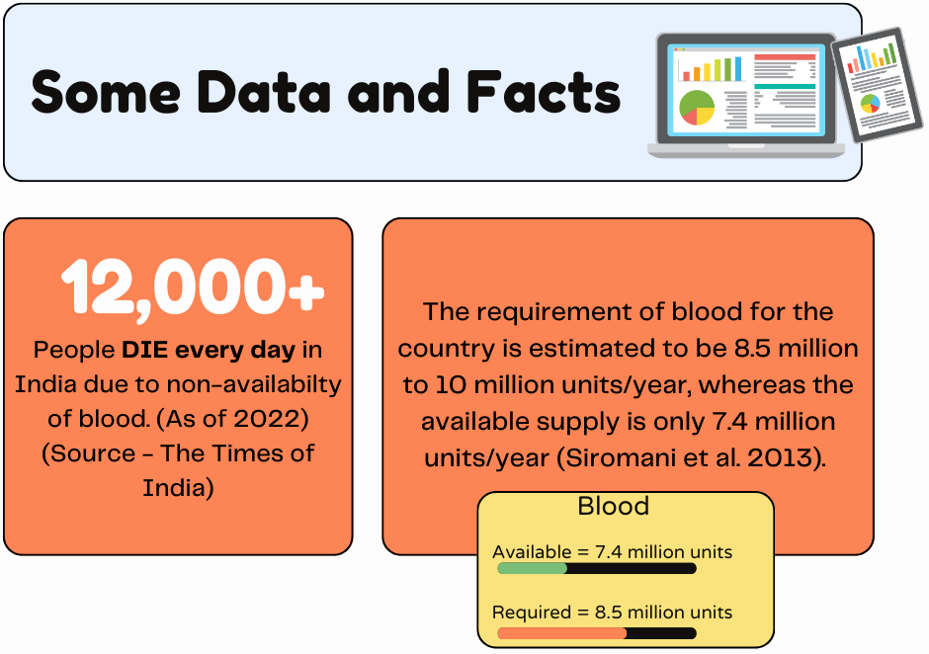

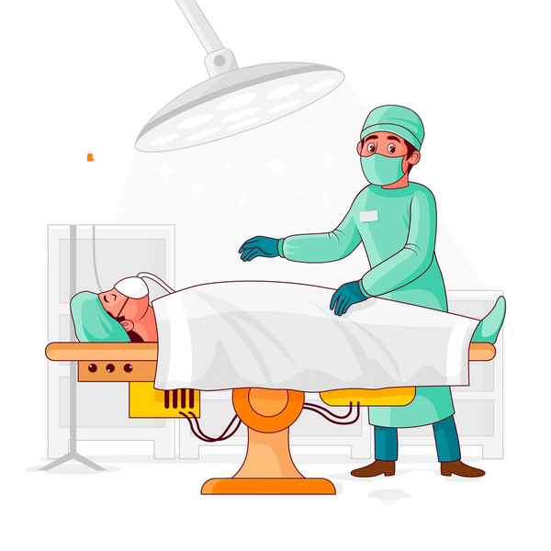

Slide 3
Project Abstract
Overview
This project aims to create a platform connecting blood donors and seekers, enabling location and blood-type searches, partnering with hospitals, and organizing donation drives for a stable supply.
Key Objectives
•Develop a platform that efficiently connects blood donors and seekers.
•Facilitate the search for blood by location and blood type.
•Collaborate with hospitals to streamline the donation process.
•Organize blood donation drives to ensure a steady blood supply.
Approach
•Develop a web-app to connect blood donors and seekers.
•Creating separate database for donors and seekers.
•Collaborate with hospitals to facilitate blood donation and storage.
•Providing real time availability of blood and contact details.
.

Slide 4


Our Goals and Objectives
1 - User Registration for Blood Donation and Request
Enable easy registration of users as blood donors or seekers, ensuring a streamlined
onboarding experience.
2 - Location-Based Search for Blood Donors
Provide seekers with a quick, accurate donor search based on selected location and
blood type.
3 - Seamless Donor-Recipient Communication Access
Facilitate direct communication between seekers and donors, ensuring safe, reliable
contact information exchange.
4 - Hospital Collaboration for Efficient Donation Processes
Partner with hospitals to organize, monitor, and improve donation and distribution
channels for blood.
5 - User-Friendly Interface and Data Security
Ensure intuitive navigation and robust data security to maintain privacy and user data
protection.

Slide 5
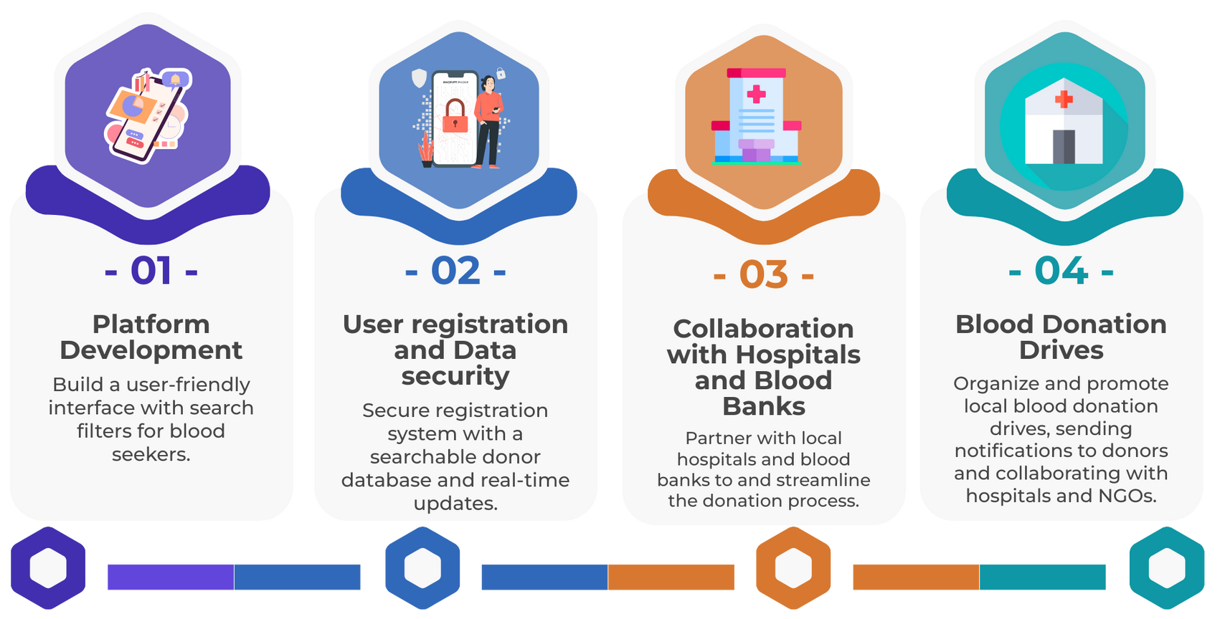
Methodology
A. Approach

Slide 6



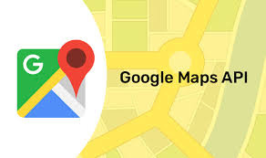


Methodology
B. Technology

Slide 7
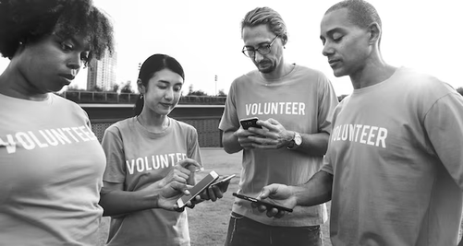
Expected Outcomes and Impacts
Increased Availability and Timely Access to Blood Donations
By facilitating quick connections between blood seekers and donors, the
platform reduces delays in obtaining blood, improving patient outcomes and
survival rates, especially during emergencies.
Strengthened Healthcare Collaboration and Efficiency
Partnering with hospitals streamlines the blood donation and distribution
process, enhancing healthcare efficiency and strengthening the response to
critical health situations in underserved areas.
Enhanced Community Awareness and Engagement in Blood Donation
The platform encourages a culture of regular blood donation, raising awareness
and building a resilient community committed to supporting public health
needs.

Slide 8

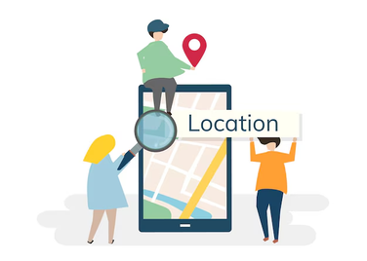

Key Project Deliverables
User-Friendly Platform for Blood Donor and Seeker Registration
Enable easy registration for users to join as blood donors or seekers.
Location-Based Search Feature for Blood Donors
Provide seekers with access to donors in their chosen location for quick support.
Secure Contact Information Exchange for Donor-Recipient Communication
Ensure safe and reliable communication between donors and seekers for
streamlined coordination.
Collaborative Portal for Hospitals to Manage Blood Donation Efforts
Offer hospitals a dedicated portal to organize and track blood donations
efficiently.

Slide 9
Our Team
SHAURYA JAIN (2200291530100)
PRAPTI SHARMA (2200291530082)
AYUSH SRIVASTAVA (2200291530034)
SHRIYANSH SRIVASTAVA (2200291530108)

Slide 10


THANK
YOU

