Slide 1
跨越2018 迎接2019
EOL Result of X1316
July 7, 2026

Slide 2
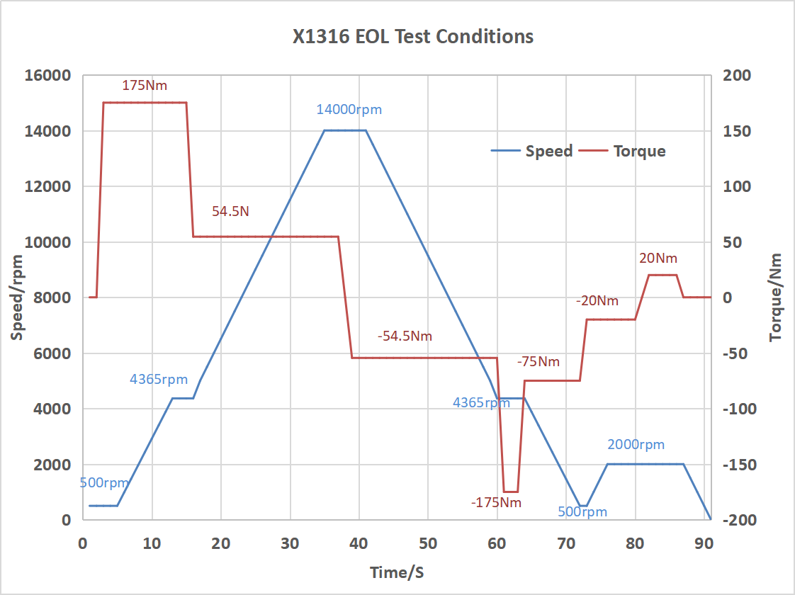
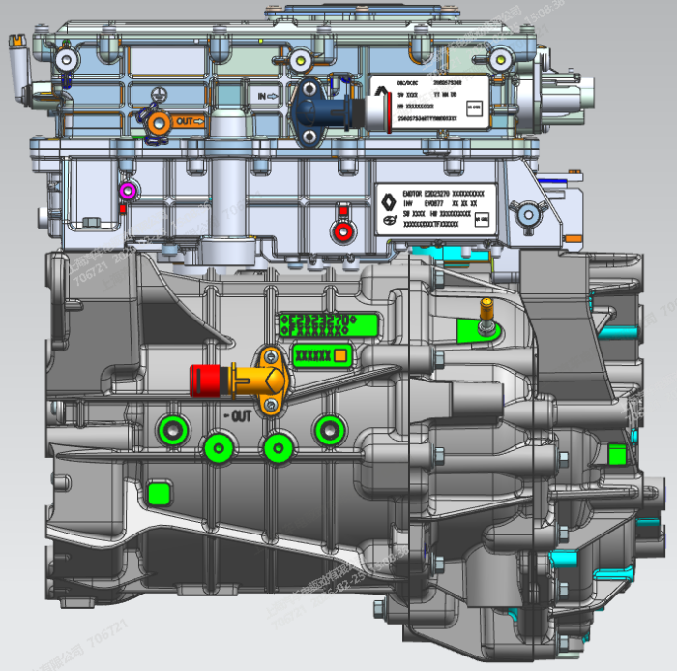
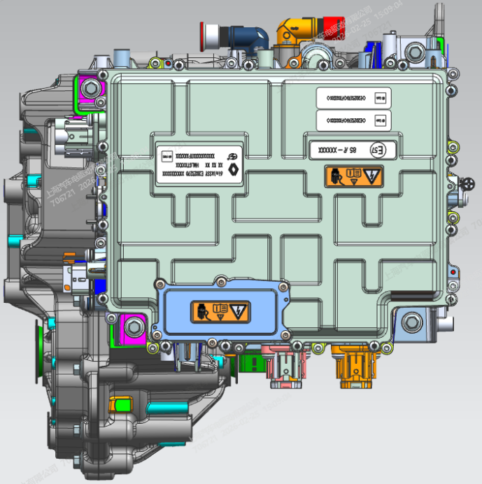
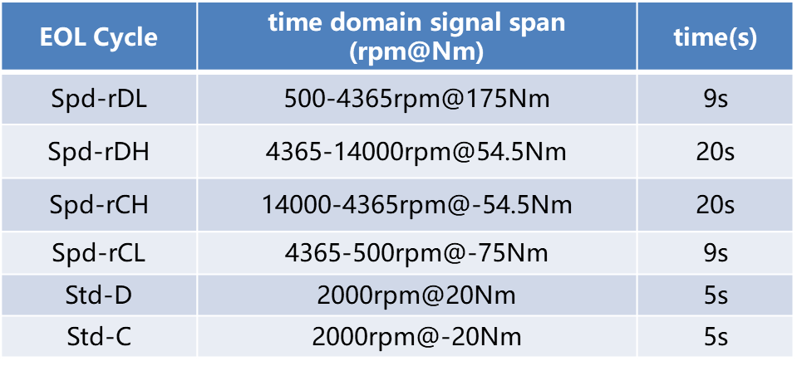
EOL Test conditions
EOL vibration sensor position
Spd-rDH
Spd-rCH
Std-D
Std-C
Spd-rDL
Spd-rCL
VSG point
VSO point
VSE point
Regarding the EOL thresholds
The EOL limit standards are set according to the self-learning algorithm of the Discom system. At the same time, they need to be dynamically adjusted based on the test results of the vehicle to achieve the optimal limit values.

Slide 3
Motor order EOL data

Slide 4
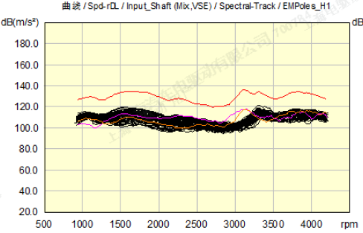
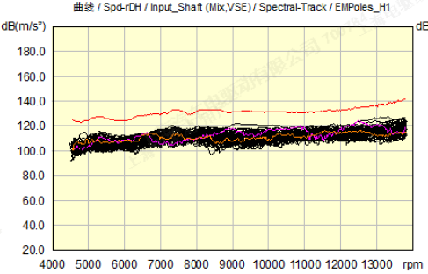
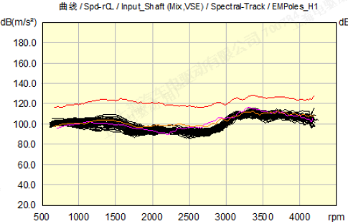
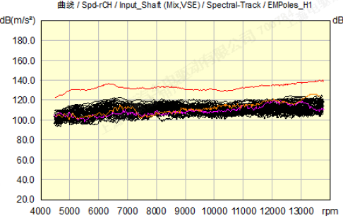
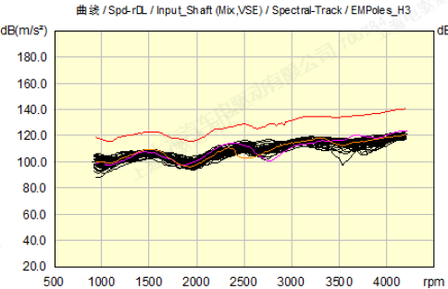
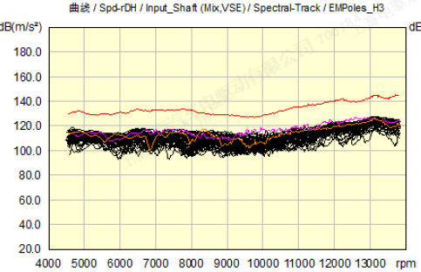
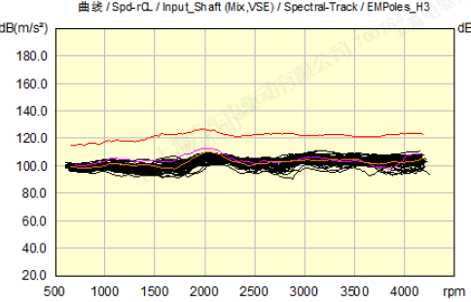
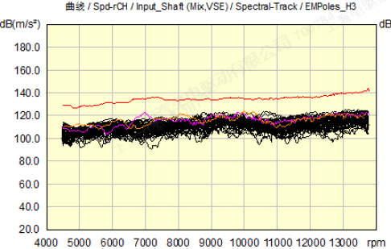
F000069
F000096
Motor order data — test bench 1#
Motor 6th order_VSE Test point
Unit: dB (m/s²)
rDL
rDH
rCL
rCH
Motor 18th order_VSE Test point
rDL
rDH
rCL
rCH

Slide 5
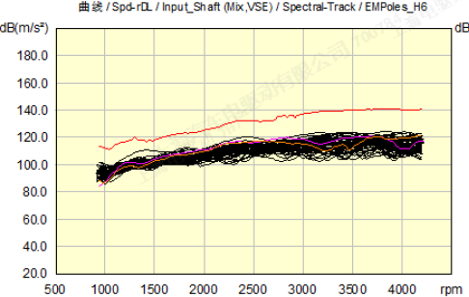
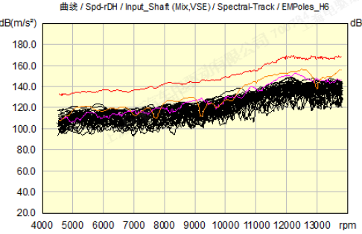
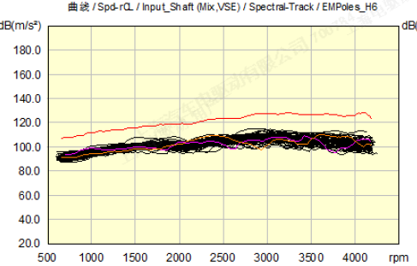
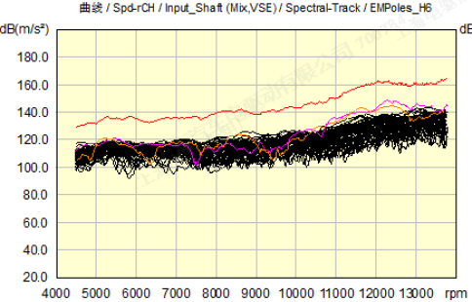
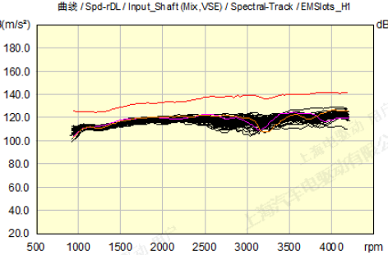
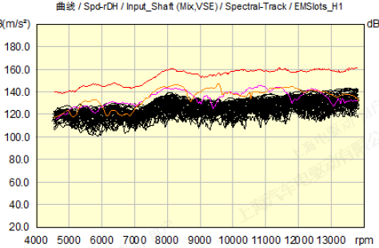
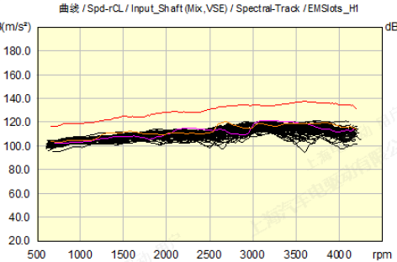
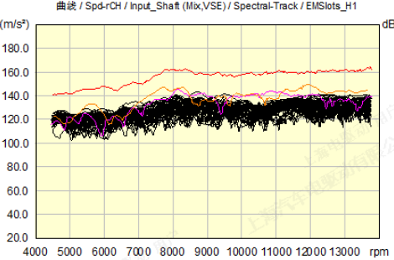
F000069
F000096
Motor order data — test bench 1#
Motor 36th order_VSE Test point
Unit: dB (m/s²)
rDL
rDH
rCL
rCH
Motor 54th order_VSE Test point
rDL
rDH
rCL
rCH

Slide 6
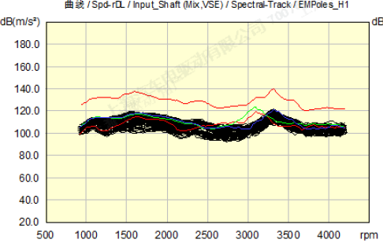
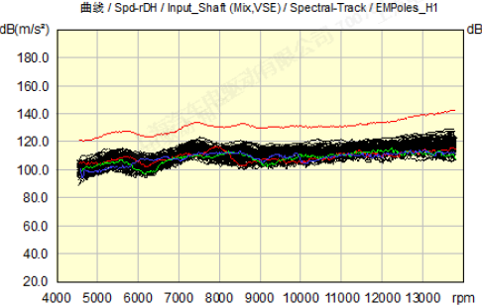
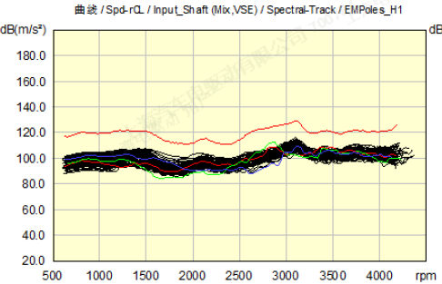
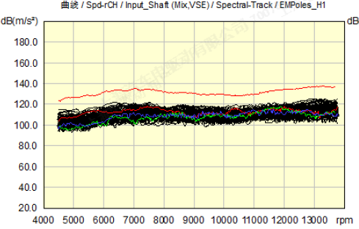
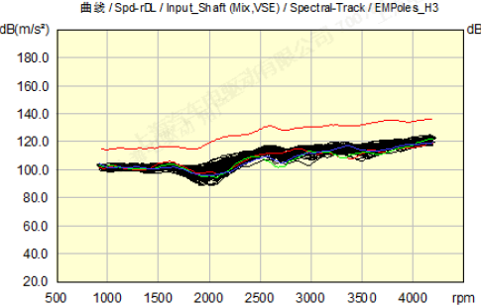
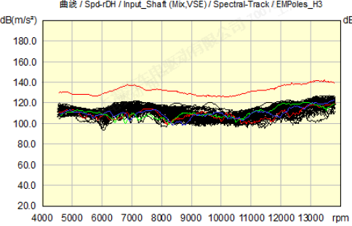
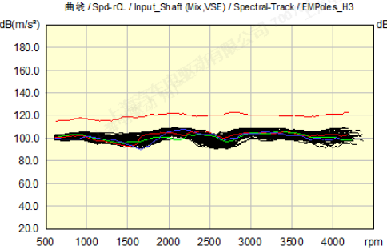
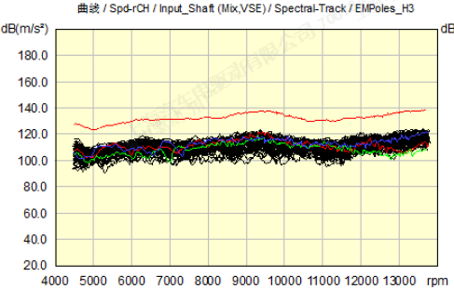
F000005
F000021
F000071
Motor order data — test bench 2#
Motor 6th order_VSE Test point
Unit: dB (m/s²)
rDL
rDH
rCL
rCH
Motor 18th order_VSE Test point
rDL
rDH
rCL
rCH

Slide 7
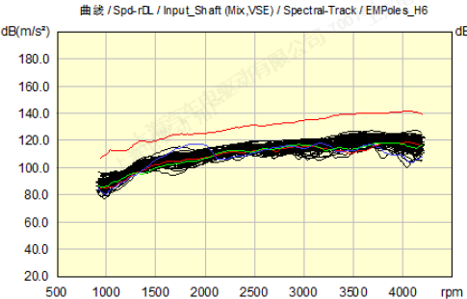
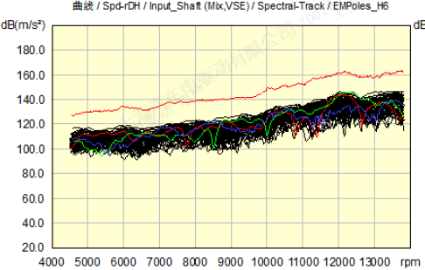
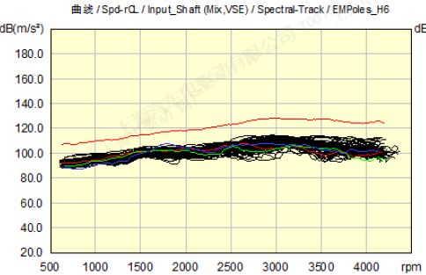
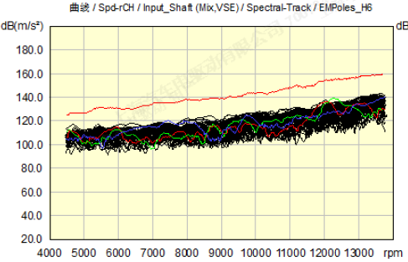
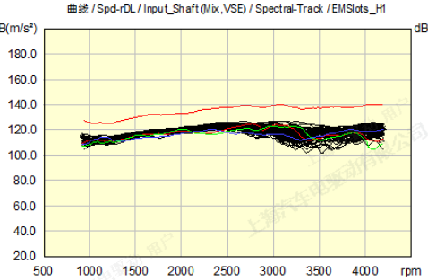
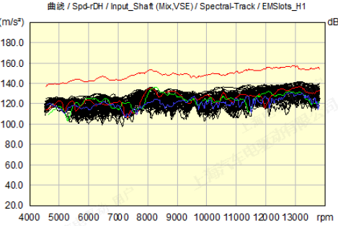
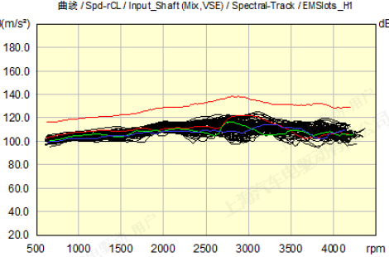
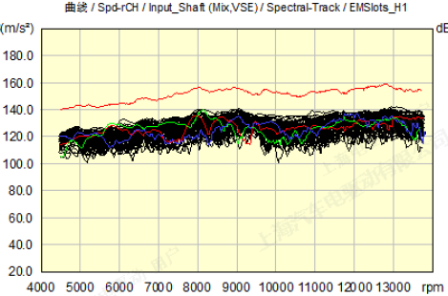
F000005
F000021
F000071
Motor order data — test bench 2#
Motor 36th order_VSE Test point
Unit: dB (m/s²)
rDL
rDH
rCL
rCH
Motor 54th order_VSE Test point
rDL
rDH
rCL
rCH

Slide 8
Reducer order EOL data

Slide 9
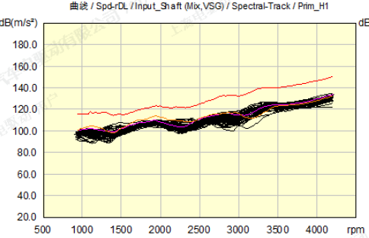
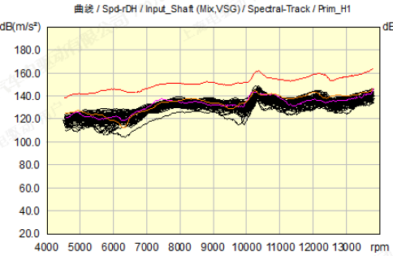
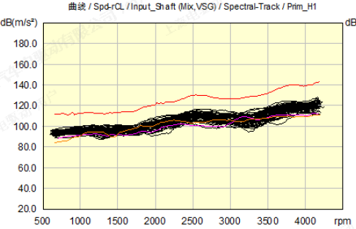
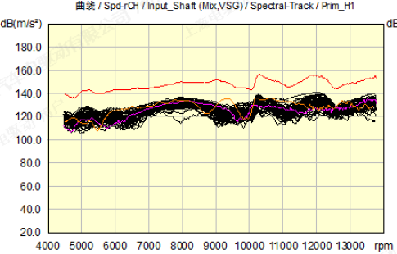
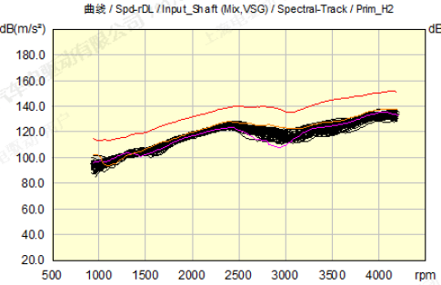
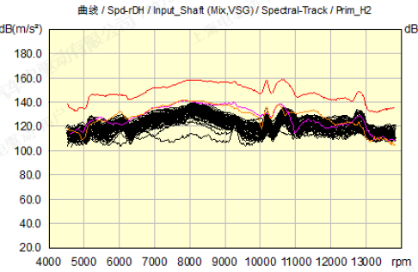
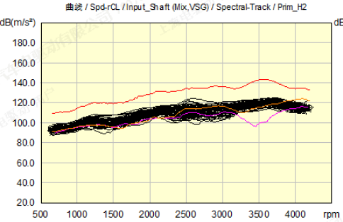
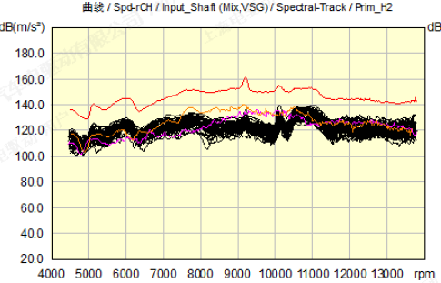
F000069
F000096
Reducer order data — test bench 1#
Reducer 28th order_VSG Test point
Unit: dB (m/s²)
rDL
rDH
rCL
rCH
Reducer 56th order_VSG Test point
rDL
rDH
rCL
rCH

Slide 10
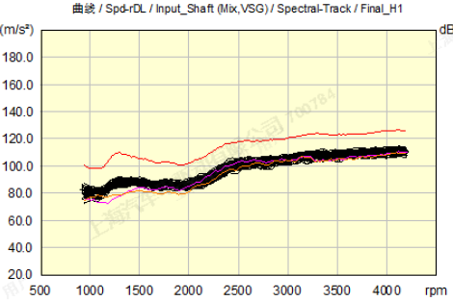
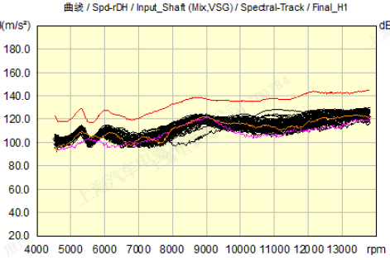
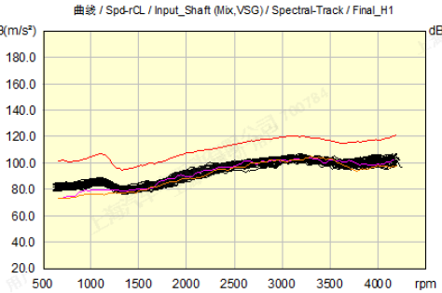
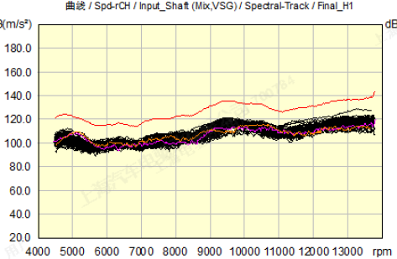
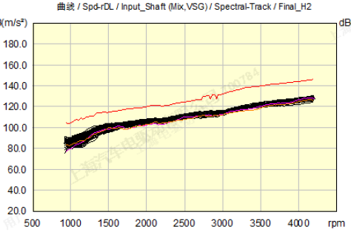
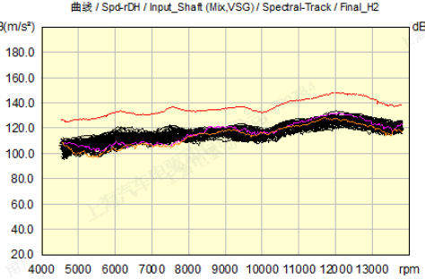


F000069
F000096
Reducer order data — test bench 1#
Reducer 7.4th order_VSG Test point
Unit: dB (m/s²)
rDL
rDH
rCL
rCH
Reducer 14.8th order_VSG Test point
rDL
rDH
rCL
rCH

Slide 11








F000005
F000021
F000071
Reducer order data — test bench 2#
Reducer 28th order_VSG Test point
Unit: dB (m/s²)
rDL
rDH
rCL
rCH
Reducer 56th order_VSG Test point
rDL
rDH
rCL
rCH

Slide 12








F000005
F000021
F000071
Reducer order data — test bench 2#
Reducer 7.4th order_VSG Test point
Unit: dB (m/s²)
rDL
rDH
rCL
rCH
Reducer 14.8th order_VSG Test point
rDL
rDH
rCL
rCH

Slide 13
THANKS

