Slide 1
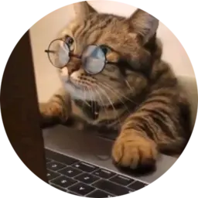
<coding.kitty />
SPONSOR PARTNERSHIPS
Coding concepts,
explained by cats.
Developer education with a playful, memorable format for builders, beginners, and dev-curious audiences.
/\_/\\
( o.o )
/> <\\
Instagram @coding.kitty · TikTok @coding.kitty7 · Discord community · hackthekitty.com
Public sites and internal notes snapshot. Contact: contact@thecodingkitty.com

Slide 2
01 / What it is
A simple hook with real educational utility
coding.kitty makes technical ideas approachable without losing the developer audience.
Short-form educational explainers
Not just meme content.
Technical concepts in plain English
Cat-led identity people remember
Beginner-friendly without feeling childish
Educational content packaged in a format people remember and share.
Connected to website, Discord, and events
Positioning verified from thecodingkitty.com and internal social audit.

Slide 3
02 / Reach
A multi-platform developer education audience
Public snapshot from internal notes captured May 25, 2026; replace with live analytics before final sponsor send.
173K
74.8K
894K
128
Instagram followers
TikTok followers
TikTok likes
Videos on site / TikTok
Audience quality matters as much as audience size: the brand attracts people who actively want coding concepts made easier to understand.
Metrics: internal Social Presence Audit, 2026-05-25. Public site confirms Instagram/TikTok/YouTube/Discord links.

Slide 4
03 / Ecosystem
Sponsors can show up across an ecosystem
This is more than a single sponsored reel: content, owned web, Discord, and event surfaces can compound.
Instagram
TikTok
TikTok
Website
Discord
Topic voting
#hackthekitty
Workshops / AMAs
Sponsor value shifts from impressions to repeated, contextual touchpoints with builders.
Surfaces verified from thecodingkitty.com, hackthekitty.com, Linktree/social audit, and Discord community notes.

Slide 5
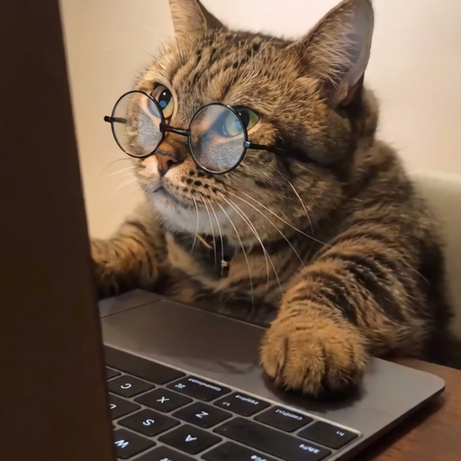
04 / Event
#hackthekitty turns audience into participation
A virtual, global hackathon gives sponsor partners a deeper way to meet the community.
June 24
14 days
500 cap
2026 virtual launch
Build window
Participants
$5,500
304
6 criteria
Prize pool
Current notify count on site
Anonymous judging rubric
World Cat Domination Day Hackathon
Hackathon facts: hackthekitty.com and internal overview. Public page opened 2026-06-08 showed 304 keen kitties.

Slide 6
05 / Sponsor fit
Best-fit partners are technical, useful, and teachable
The strongest integrations turn a sponsor product into a practical example, not an interruption.
Developer tools
Security tooling
Cloud / DevOps
AI dev tools
Databases / APIs
Builder ecosystems
Rule of thumb: if the product can help explain a real coding concept, it probably fits.
Sponsor categories drawn from internal monetization strategy notes.

Slide 7
06 / Activation
Five sponsor formats that feel native
Each format keeps education first and makes the sponsor part of the lesson, workflow, or community moment.
Sponsored explainer
One technical concept, sponsor as relevant tool or workflow.
Scenario-led video
Cat-based story, problem setup, sponsor in the solution layer.
Mini-series
3-5 videos around one sponsor-owned topic cluster.
Website + Discord add-on
Partner placement, CTA, AMA, workshop, or Q&A.
Hackathon package
Content + community + challenge/prize/judging visibility.
Activation formats adapted from internal Sponsor Deck Outline and Sponsorship Inventory notes.

Slide 8
07 / Packages
Productized packages make sponsorship easy to buy
Starting prices from internal notes; final quotes should adjust for usage rights, exclusivity, and technical review complexity.
Starter
Growth
Category
Ecosystem
£1,500
£3,500
£6,500
from £5,000
1 sponsored explainer
Disclosure + CTA
Basic reporting
2-3 sponsored videos
Website placement
Optional Discord mention
3-5 video theme
Website + Discord
Stronger recap/report
Hackathon/community bundle
Workshop or AMA
Prize/judging tie-in
Add-ons: paid usage rights, whitelisting, extra website placement, Discord AMA/workshop, landing page/resource tie-in, exclusivity.
Pricing: internal Sponsor Deck Outline, 2026-05-25.

Slide 9
08 / Next step
Let’s build a sponsor story people actually watch
The goal is not to interrupt the audience with ads. It is to integrate useful products into content the audience already wants.
Choose the campaign goal
Book a partnership call
Pick a topic or category
Agree sponsor format and add-ons
contact@thecodingkitty.com
Produce, publish, and report
thecodingkitty.com · hackthekitty.com
Deck created 2026-06-08 from public websites and Sameer's Coding Kitty notes.

