Slide 1

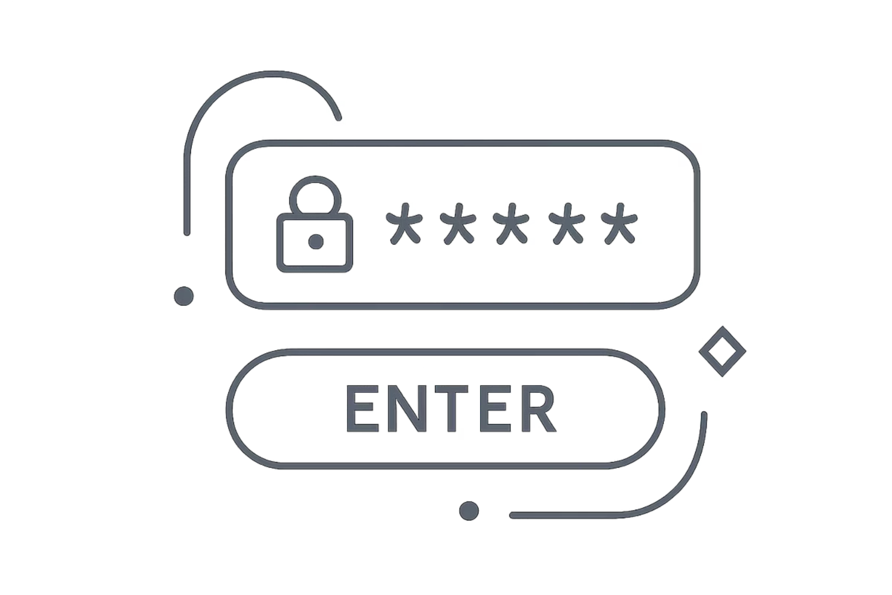
CyberCrypt Pro
Multi-Layer Secure Text Encryption System — Learn Encryption by Seeing Every Layer
Student
Course Details
Sams Alif
ID: 221902392
Course Code : CSE-323 Cybersecurity & Cryptography
Presented To
Md. Mahbubur Rahman
Lecturer, CSE

Slide 2

Why This Project?
Most cryptography demonstrations operate as black boxes — the learner sees input and output, but never the transformation in between. CyberCrypt Pro was built to break that barrier.
TRADITIONAL APPROACH
CYBERCRYPT PRO
The Black Box Problem
Full Transparency Pipeline
Plain Text → [BLACK BOX] → Cipher Text
The learner observes only the boundary conditions. The mechanics — substitution, shifting, XOR — remain entirely hidden. Understanding cannot be built from opacity.
Plain Text → Caesar → Vigenère → Random XOR → Cipher Text
Every transformation is visible, labeled, and explained in real time. The learner watches each layer apply its logic step by step.
Core thesis: Learning by visualization, not just producing ciphertext. The goal is comprehension, not confidentiality.

Slide 3
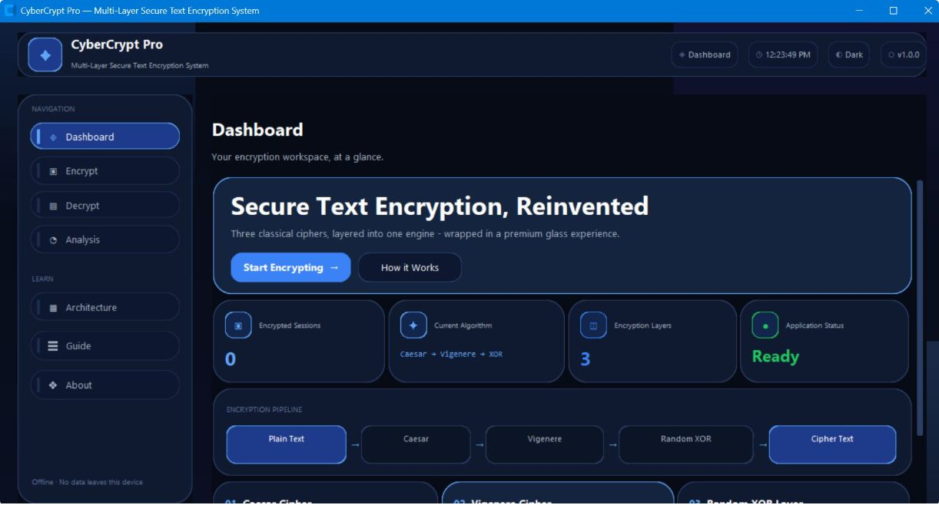
Project Goal & Scope
Primary Objectives
Scope & Constraints
1
Demonstrate multi-layer encryption
Fully Offline
Desktop Application
Three classical ciphers composed sequentially into a single pipeline.
No network dependency whatsoever. All computation is local.
Built with CustomTkinter for a native desktop experience.
2
Visualize reverse-order decryption
Decryption reverses the exact encryption order, illustrating invertibility.
Educational Scope
3
Show every transformation step
Demonstrates classical cryptography concepts, not production security.
Intermediate states between layers are exposed and annotated.
4
Interactive educational environment
Users experiment with keys, observe results, and build intuition through doing.

Slide 4
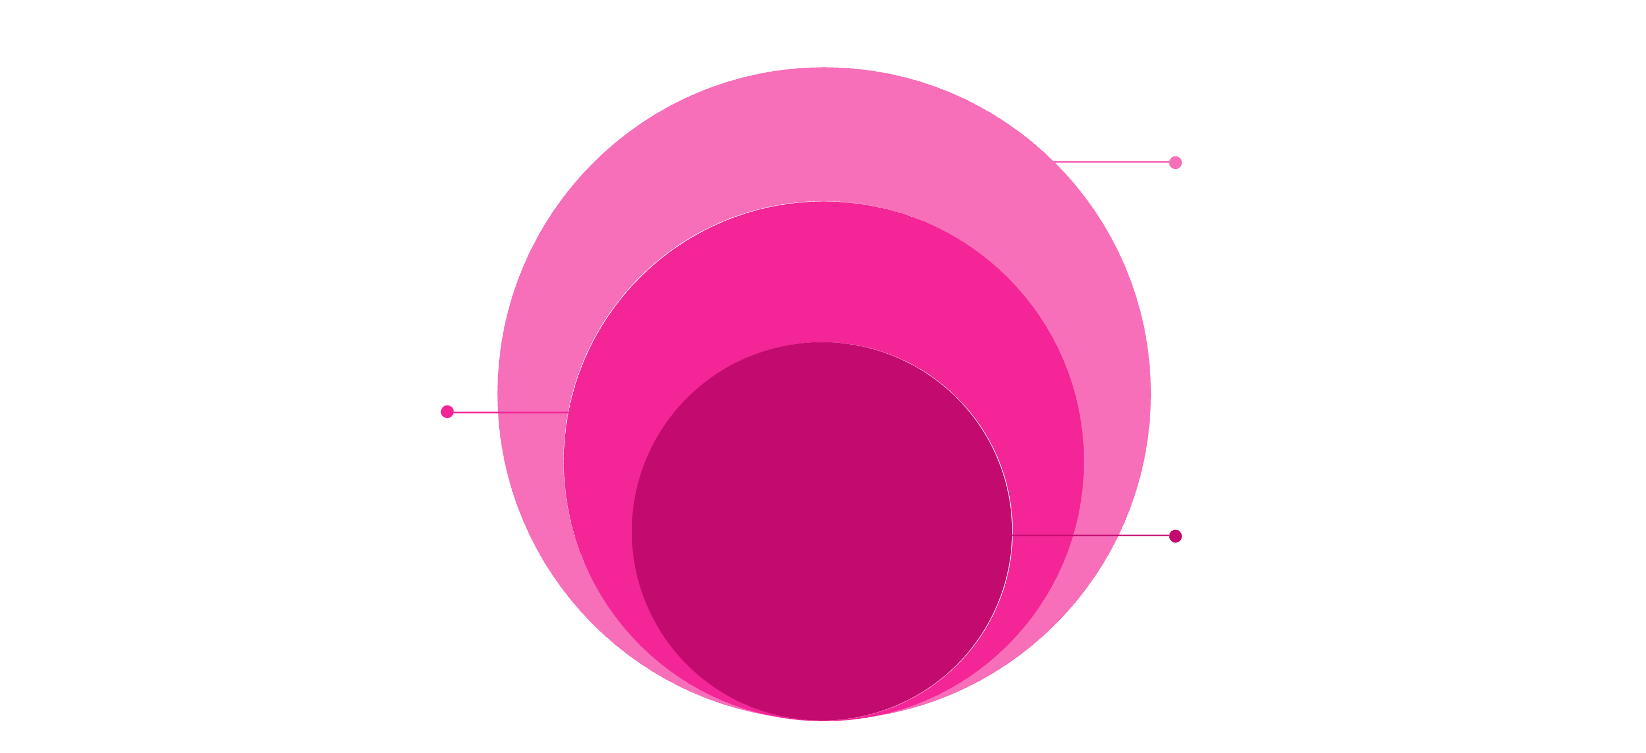
System Architecture
CyberCrypt Pro is organized into four discrete, decoupled layers. The UI and cryptographic engine are intentionally separated so that the core logic is fully testable without any graphical interface.
User Interface
CustomTkinter glassmorphism UI
App Layer
Screen management, navigation, session state
Core Crypto
Caesar, Vigenère, Random XOR engines
The separation of concerns is a deliberate engineering choice: the cryptographic core can be invoked, tested, and verified entirely independently of the UI layer. This architectural discipline enabled the project's comprehensive test suite of 54 automated tests.

Slide 5





Three-Layer Encryption Pipeline
Encryption applies three ciphers sequentially in forward order. Decryption applies the exact same three operations in strict reverse order, using identical keys.
Plain Text
Caesar
Vigenère
Raw input from user
Fixed character shift
E(x) = (x+s) mod 128
Keyword-driven shifts
E(x) = (x+k[i]) mod 128
Random XOR
Cipher Text
LCG keystream XOR
E(x) = x XOR stream(i)
Final encrypted output
Decryption: Exact Reverse Order
Key Properties
Cipher Text → XOR⁻¹ → Vigenère⁻¹ → Caesar⁻¹ → Plain Text
Same keys required for both directions
Deterministic recovery — identical output every time
Order reversal is mandatory; wrong order yields garbage

Slide 6


The Three Cipher Layers — Technical Specifications
Layer 1 — Caesar Cipher
Layer 2 — Vigenère Cipher
Layer 3 — Random XOR
Every character is shifted forward by a single fixed amount over the full 128-character ASCII alphabet. Modulo arithmetic handles wrap-around at the boundary.
Example: HELLO + shift 3 → KHOOR
Limitation: Only 128 possible shifts exist. Brute-force exhaustion is trivial — never deploy alone.
A numeric seed drives a Linear Congruential Generator (LCG) to produce a pseudo-random keystream. Each character is XOR-ed with the next keystream value.
Key Property: XOR is self-inverse: (a \oplus b) \oplus b = a. Encryption and decryption use identical code with the same seed.
Each character receives a different shift, determined by the corresponding position in the repeating keyword. Longer keywords create more variation across the ciphertext.
Defeats: Simple single-frequency analysis. Limitation: Short or repeated keywords leak periodic patterns — Kasiski examination can break it.
All three ciphers are implemented from scratch — no external cryptographic libraries are used. Every line of encryption logic was written by the student.

Slide 7
Why Combine Three Layers?
The layered architecture is a pedagogical choice, not a security guarantee. Each layer teaches a distinct cryptographic concept; their composition demonstrates how transforms can be chained.
Layer
Algorithm Class
Teaching Concept
Key Parameter
1 — Caesar
Monoalphabetic substitution
Fixed-shift character substitution
Integer shift (0–127)
2 — Vigenère
Polyalphabetic substitution
Keyword-driven varying shifts
String keyword
3 — Random XOR
Stream cipher (LCG-based)
Keystream-based XOR transformation
Numeric seed
Educational Value of Composition
⚠ Critical Clarification
Sequential layering shows how distinct cryptographic principles interact. Observing the intermediate state after each layer makes the contribution of each cipher tangible and measurable — something no single-layer demo can provide.
Three weak classical ciphers do NOT compose into military-grade encryption. This system demonstrates composition and visualization, not cryptographic strength. The educational strength score displayed in the app reflects pedagogical progress, not security assurance.

Slide 8

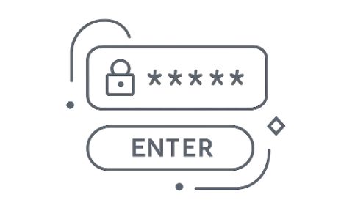


Live Application Walkthrough
CyberCrypt Pro presents a four-screen workflow that guides users from context-setting through encryption, decryption, and finally analytical reflection. Every screen reinforces the educational objective.
01 — Dashboard
02 — Encrypt
03 — Decrypt
04 — Analysis
Project overview, pipeline diagram, and live session statistics. Establishes context before any keys are entered.
User inputs plaintext and sets three independent keys. Layer-by-layer transformation plays out in real time with intermediate states shown.
Cipher text pasted; keys pre-filled from session. Reverse-order recovery is animated, reinforcing the mathematical inverse relationship.
Session metrics, educational strength score, timeline of operations, and exportable PDF/text reports for review and study.

Slide 9









Interactive Learning Features
CyberCrypt Pro extends well beyond basic encryption. Eight distinct learning features transform it from a tool into a complete interactive educational environment.
Live Encryption Visualization
Architecture Flowcharts
Watch each character transform as the cipher applies — no black boxes.
Built-in system diagrams explaining the four-layer structure visually.
Layer-by-Layer Pipeline
Presentation Mode
Intermediate states after each cipher layer are surfaced and labeled.
Distraction-free display designed for classroom or viva demonstration.
Step Details & Explanations
Viva Q&A Mode
Contextual explanations accompany every transformation step.
Pre-loaded examination questions with structured answer prompts.
Security Analysis Dashboard
User Guide & Shortcuts
Educational strength score, vulnerability notes, and layer comparison metrics.
Integrated reference manual and keyboard shortcuts for efficient navigation.
Encrypt + Visualize + Analyze + Explain — four verbs that define the complete interactive learning experience CyberCrypt Pro delivers.

Slide 10

Testing & Verification
The cryptographic core is backed by a structured test suite ensuring correctness, invertibility, and edge-case robustness — entirely decoupled from the GUI.
54
Test Categories
Unit Tests
Roundtrip Tests
Automated Tests
Individual cipher functions tested in isolation with known input-output pairs.
Encrypt → Decrypt cycle verified to recover exact original plaintext.
Full suite covering all three cipher layers and integration scenarios.
3
Edge Case Tests
Integration Tests
Cipher Layers Tested
Empty strings, boundary ASCII values, maximum shift values, single characters.
Full three-layer pipeline tested end-to-end without GUI involvement.
Caesar, Vigenère, and Random XOR each have dedicated unit tests.
100%
Invertibility Verified
Every test confirms that decrypt(encrypt(x)) = x for all inputs.

Slide 11

Limitations & Conclusion
HONEST ASSESSMENT
PROJECT CONCLUSION
Known Limitations
What CyberCrypt Pro Achieves
Classical ciphers only
CyberCrypt Pro successfully delivers a transparent, interactive cryptography learning environment. By exposing every intermediate transformation, it converts abstract mathematical operations into visible, tangible experiences.
The project demonstrates:
Caesar, Vigenère, and LCG-XOR are historically significant but cryptographically broken by modern standards.
No authenticated encryption
Three from-scratch cipher implementations
Clean four-layer decoupled architecture
54 automated tests confirming correctness
Eight interactive educational features
Glassmorphism UI matching the domain aesthetic
The system provides no integrity verification — a modified ciphertext will silently decrypt to garbage.
LCG is not cryptographically secure
Linear Congruential Generators are predictable given sufficient output — unsuitable for real key generation.
The educational honesty of clearly positioning this as a classical cryptography demonstration — rather than overstating its security properties — is itself a lesson in responsible engineering communication.
Desktop-only, offline scope
No network protocol, no key exchange, no multi-user capability by design.

