Slide 1
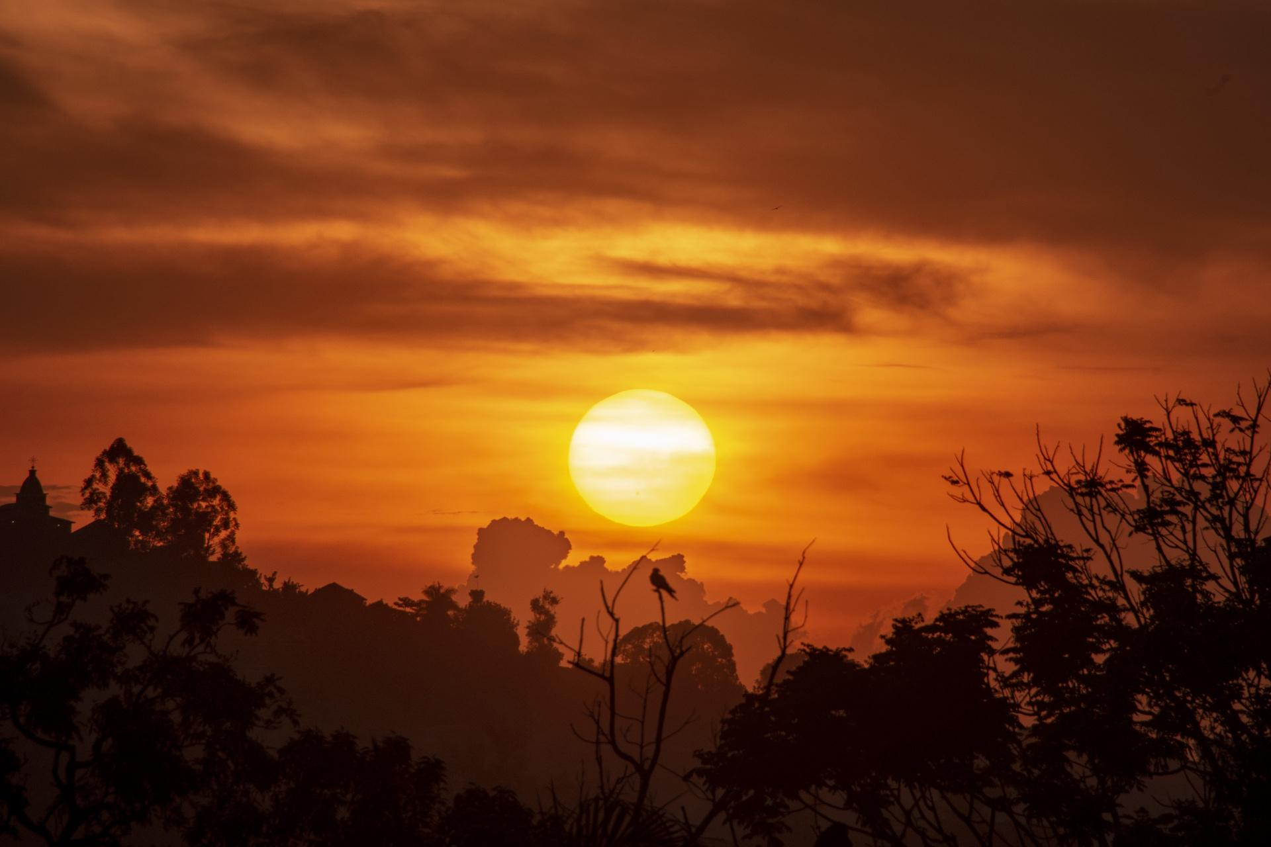

SONGHAI
SONGHAI
EMPIRE
EMPIRE
Facts about the rise and fall
Made By:Kano G, Aries W, Abraham Munoz

Slide 2
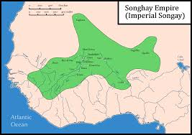
INTRODUCTION
The Songhai built an empire
The birth of the empire
Growth and conquest
Askia The Great
Religion and education
Notes:
Image link: Wikipedia

Slide 3
Areas’s SONGHAI CONQURED
Red=Conqered Areas

Slide 4
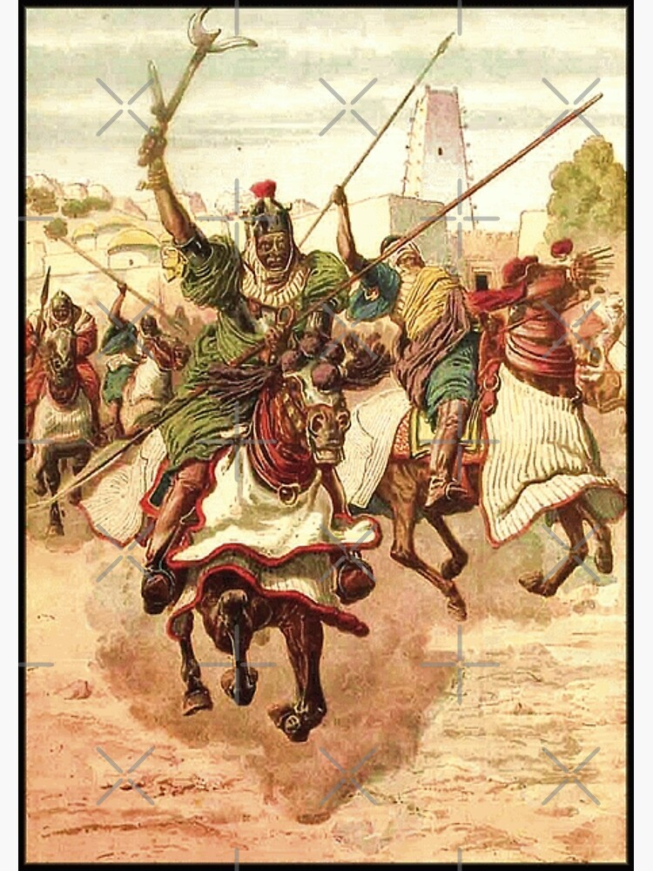
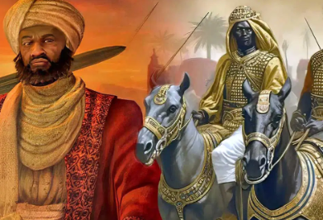
THE SONGHAI BUILT AN EMPIRE
Mali was having trouble with Songhai
Songhai started in the capital of Gao
Songhai used Mali’s trade to get resources
Songhai got the attention of Mansa Musa
Mansa Musa went to conquer Songhai
Gao became a important city in Mali
Notes:
https://www.thecollector.com/songhai-empire-africa/ and https://www.redbubble.com/i/postcard/Songhai-Empire-by-maarifa/83137233.V7PMD

Slide 5

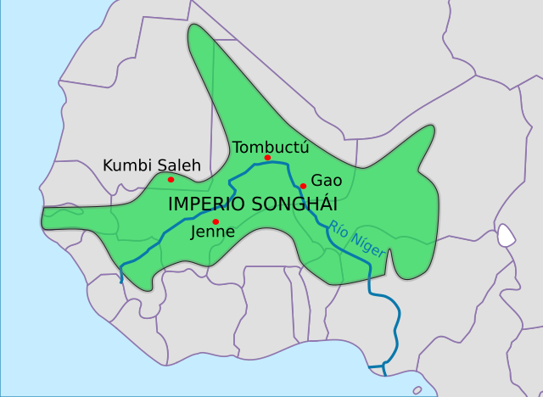
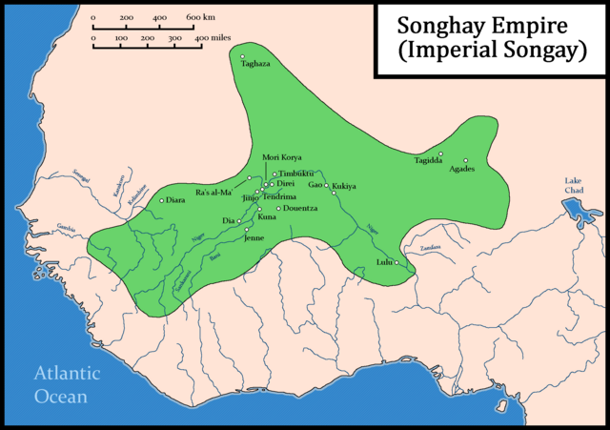
THE BIRTH OF THE EMPIRE
Songhai used to be part of Mali
But Mali’s government grew weaker
Songhai regained their freedom
Leaders of Songhai had become Muslims
Due to this, they received more trades
Because of this, Songhai became richer
Notes:
https://es.m.wikipedia.org/wiki/Archivo:Mapa_shonghai.svg and https://en.wikipedia.org/wiki/Songhai_Empire

Slide 6
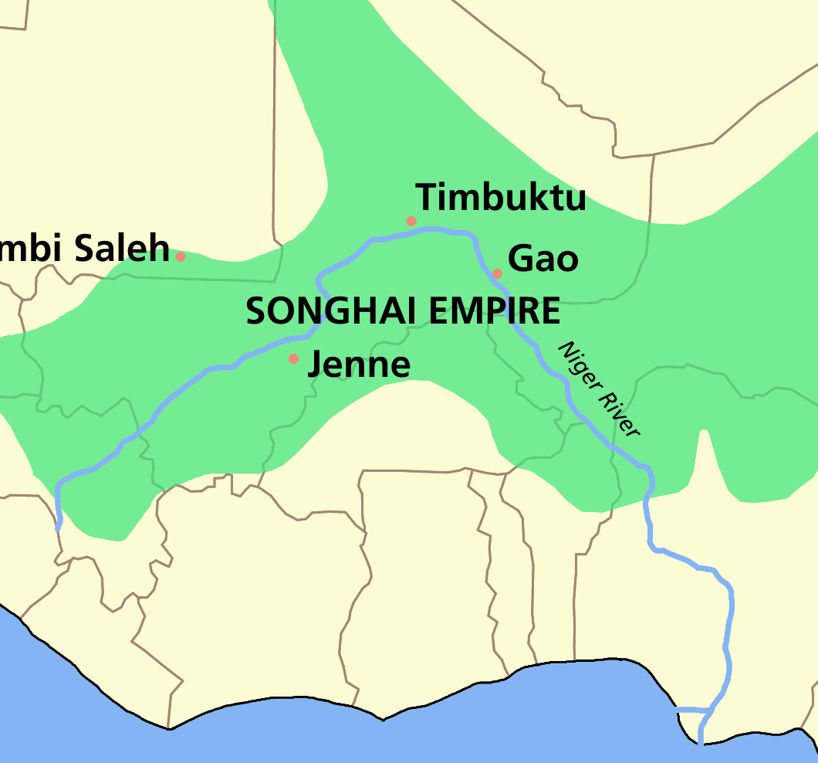
Growth And Conquest
Songhai grew richer from Trans-saharan trade
They grew in an empire from territory growth
Sunni Ali Became ruler in 1464
Songhai was disorganized before Ali
Mali Asked Songhai for help fighting timbuktu
Encouraged people to work together building peace
bought peace and stability to songhai
Notes:
https://en.wikipedia.org/wiki/Songhai_Empire

Slide 7
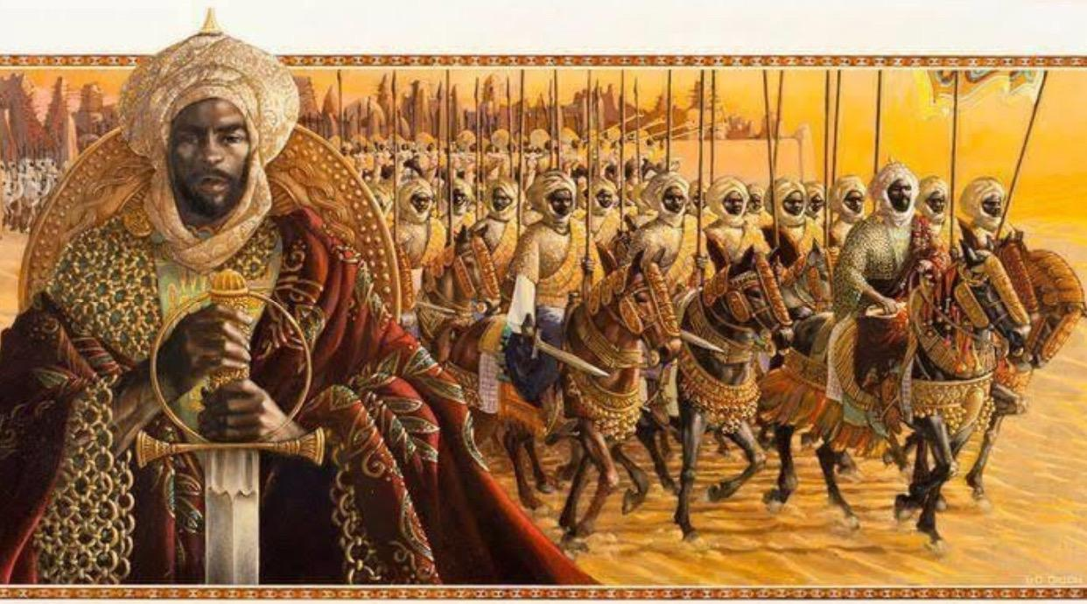

ASKIA THE GREAT
Sunni ali died in 1492
Sunni Baru was not Muslim
Most of town was Mulsim
People were scared their town would fall
A general was choose to lead instead
This General was named Muhhamed Ture
He later was named “Askia the Great”
Notes:
https://theafricanhistory.com/762 and https://clipart-library.com/clipart/overthrow-cliparts_3.htm removed background with remove.bg

Slide 8
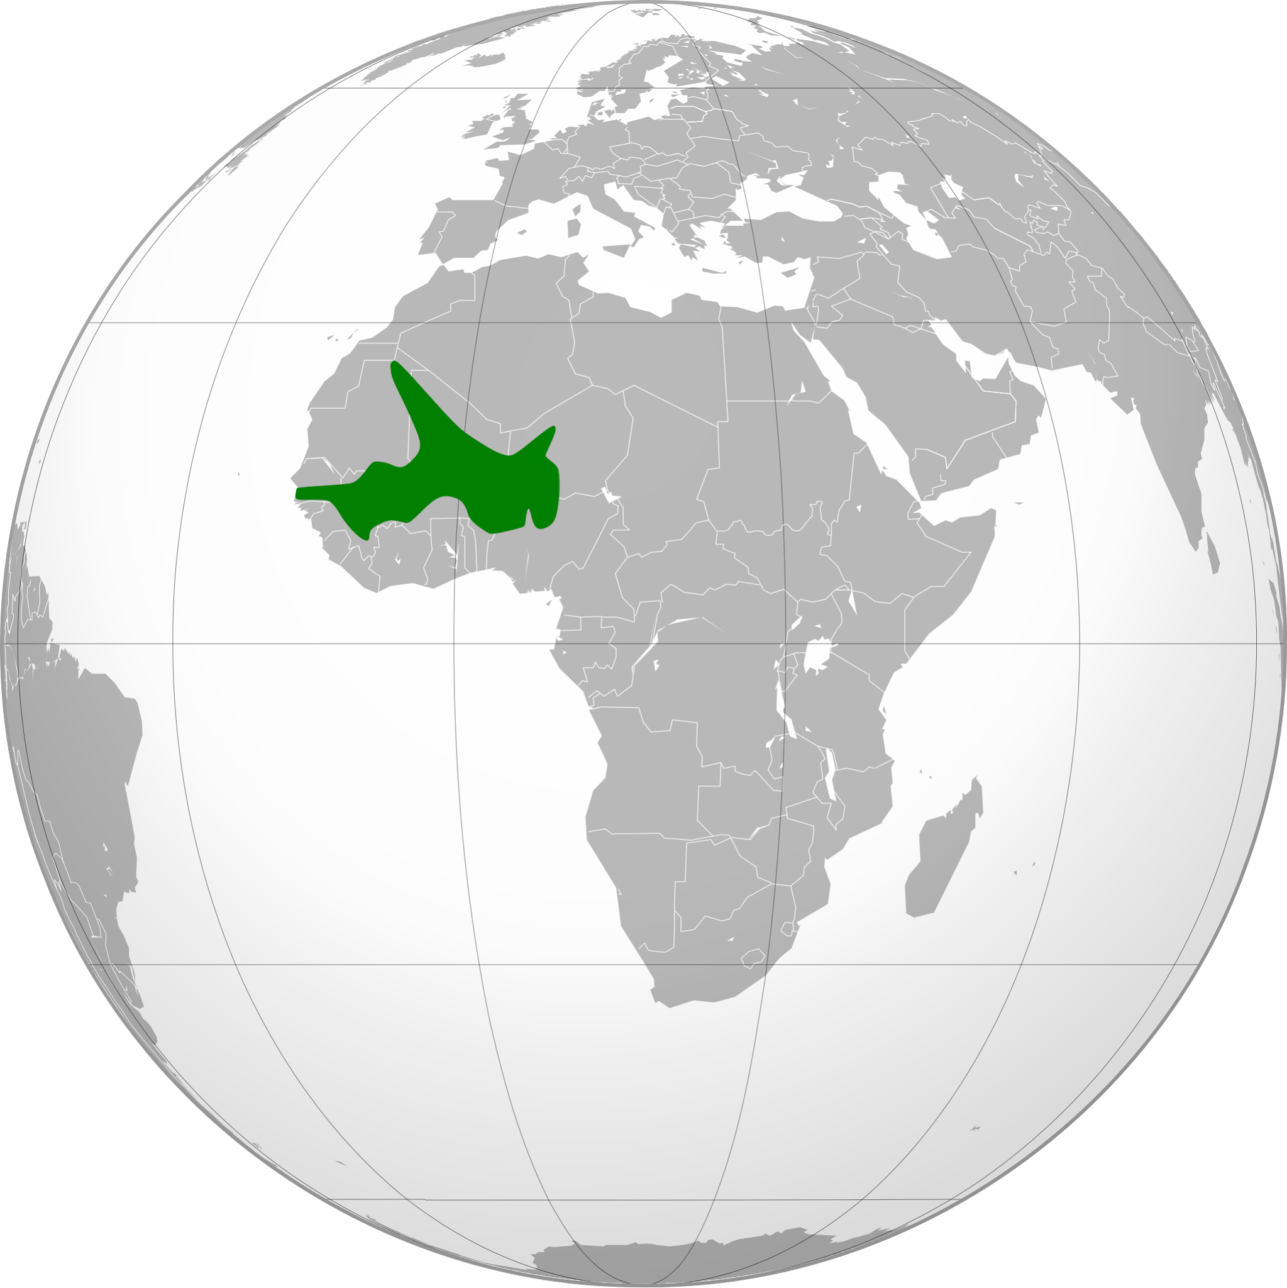
RELIGION AND EDUCATION
Askia worked to support education
The great city had schools, and universities
People arrived from all over the world
The school had a great education
Subjects: Mathematics, science, medicine, grammar, and law
Notes:
https://en.m.wikipedia.org/wiki/File:Songhai_Empire_%28orthographic_projection%29.svg and https://en.wikipedia.org/wiki/Songhai_Empire

Slide 9

RESOURCES WE USED
Theme made by Kano G on Canva
TheSchoolMediaticDrive (Made By Kano And Aries)
Wikipedia

Slide 10
ICONS Backup (DON'T REMOVE THIS IS USING BY SLIDES)

