Slide 1
Using Wikidata to link connections in Oxford and beyond
Dr Martin Poulter
@mlpoulter

Slide 2





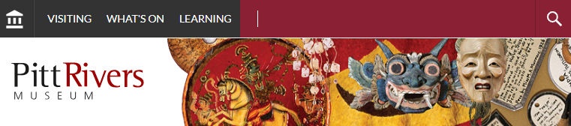

Lakshmi
Lakshmi
Lakshmi
Lakshmi

Slide 3
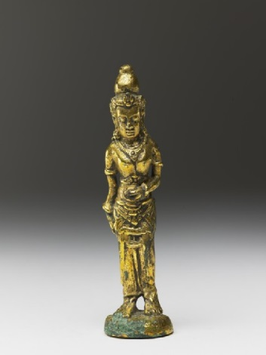

Lakshmi
Hindu Goddess of wealth, love, and prosperity
depicts
depicts
Standing figure of Sujata
Ashmolean Museum
[Lakshmi, with four arms, holding a lotus and a conch shell]
Bodleian Library

Slide 4
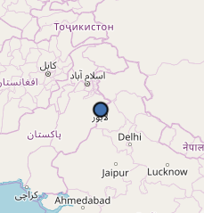
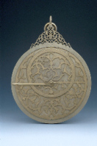
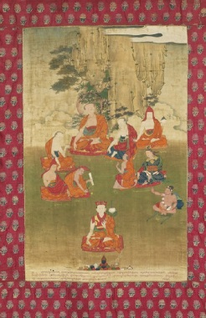
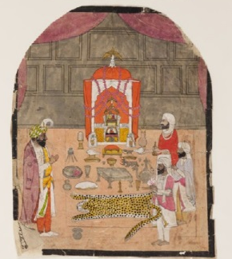
Astrolabe, by Allah-dad Museum of the History of Science
Place of construction
The 8th Tai Situ Lama with nine great teachers Ashmolean Museum
Map location
Shah Jahan
Depicted in
Place of birth
Place of birth
Naropa
Lahore
Indian Buddhist Mahasiddha
Place of birth
Worshippers at a Shrine
Ashmolean Museum
Kharak Singh
Depicted in
2nd ruler of the Sikh Empire

Slide 5
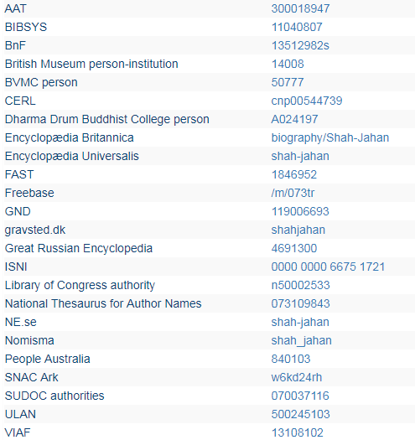
Shah Jahan

Slide 6
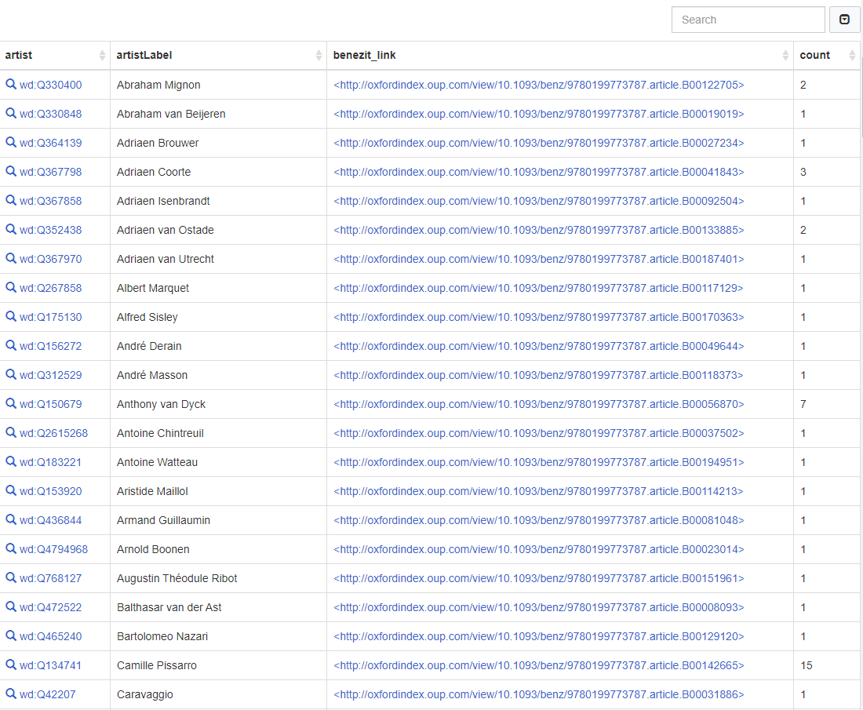
Benezit biographies of Ashmolean artists
https://w.wiki/4Rj

Slide 7
The pilot
2,002 manuscripts and other items in the Bodleian Libraries
3,409 art works from the Ashmolean Museum
2,106 works by the botanical illustrator Ferdinand Bauer from the Sherardian Library of Plant Taxonomy
Small number of art works from the Pitt Rivers Museum
3,239 doctoral theses from Oxford Research Archive
3,317 identifiers from the Electronic Enlightenment database

Slide 8
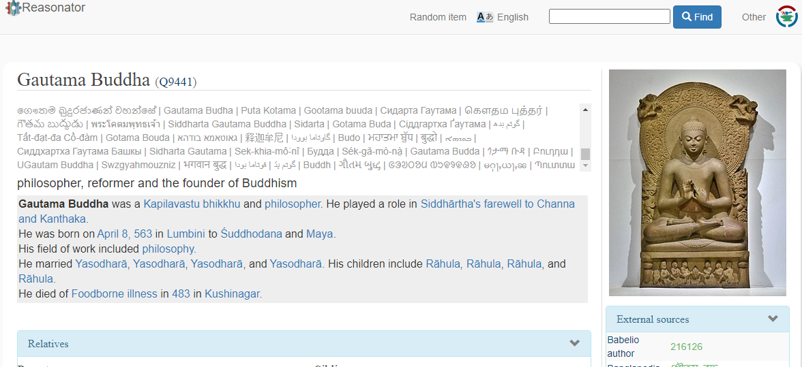
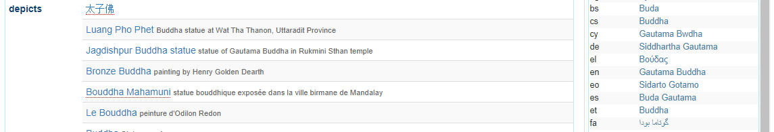
Reasonator: https://reasonator.toolforge.org/

Slide 9
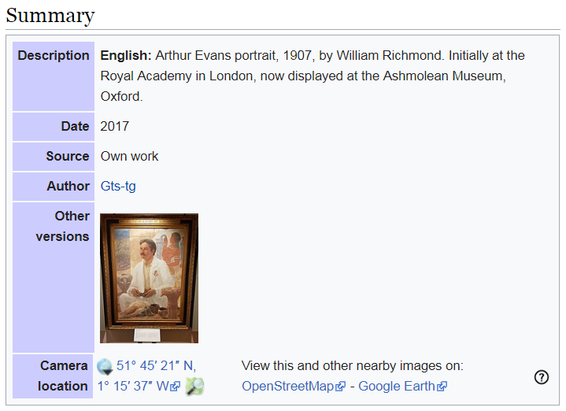
Wikidata on Wikimedia Commons

Slide 10
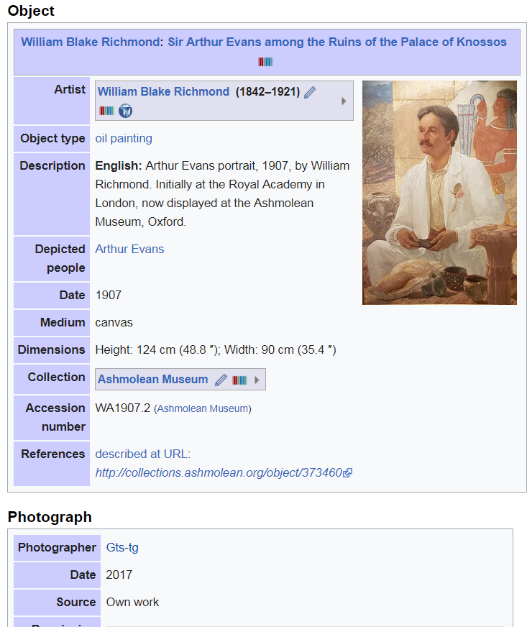

Slide 11
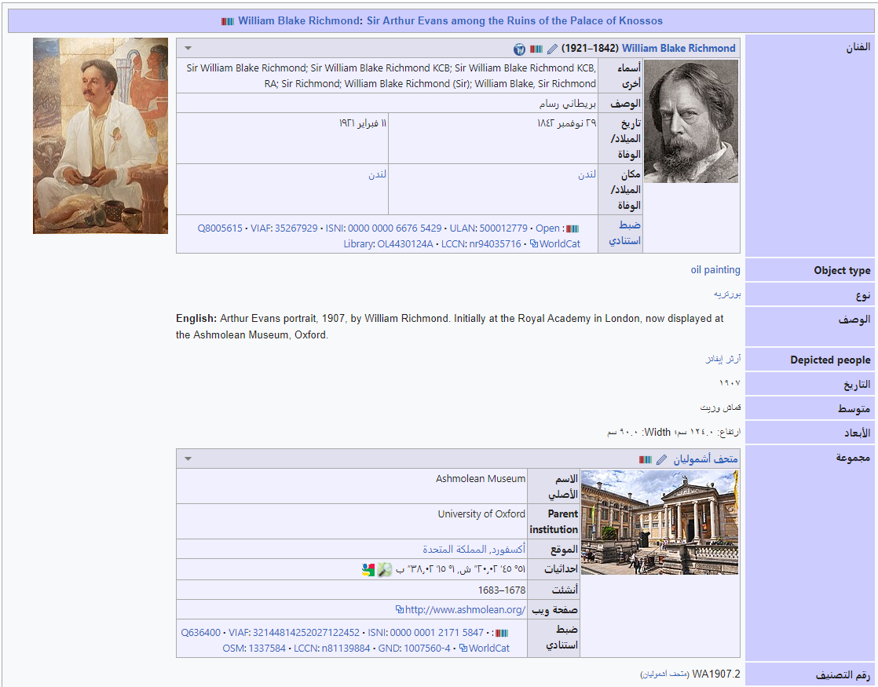

Slide 12
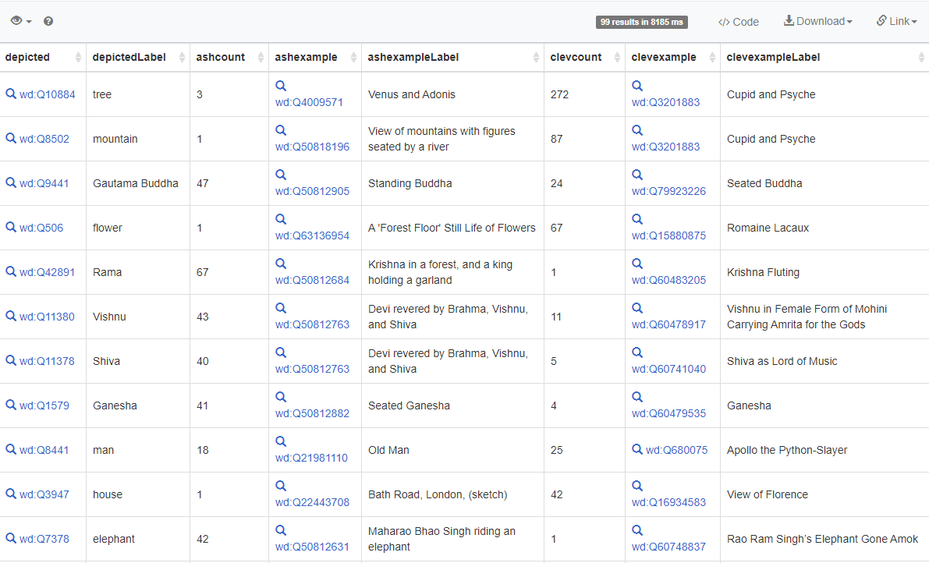
Objects depicted in the Ashmolean Museum and the Cleveland Museum of Art
https://w.wiki/5Z6

Slide 13
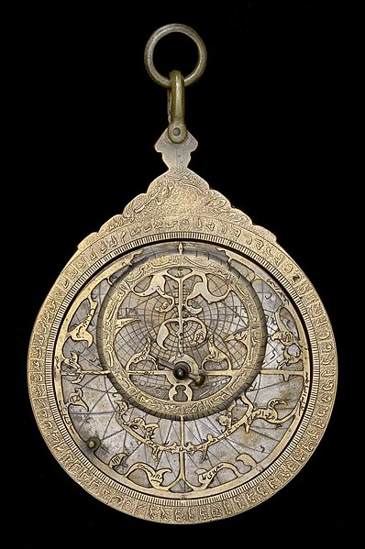
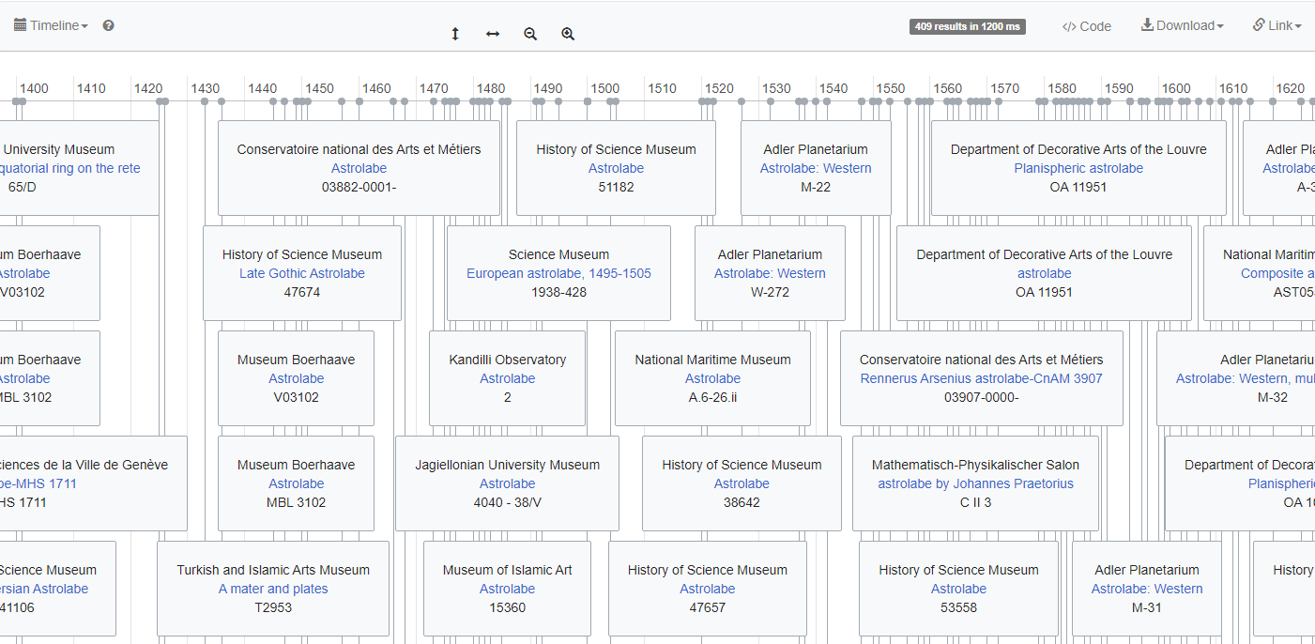
Timeline of Astrolabes
Astrolabe 38235,
CC-BY-SA History of Science Museum
https://w.wiki/UUM

Slide 14
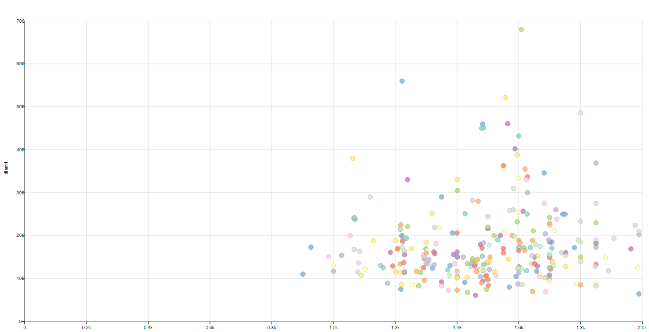
Astrolabe diameters versus year of creation
https://w.wiki/UUZ

Slide 15
Lessons for the sector
Wikidata doesn’t want to replace existing catalogues and databases, but share tombstone data and create links to existing resources.
For any question we ask it, Wikidata has a lot of stuff but is incomplete.
NB: There are more people actively working on Wikidata than students in the University of Oxford, UG and PG combined.
Wikidata is in this for the long term.
It doesn’t require us to anticipate future interfaces.
That said, it has some very nice interfaces.

Slide 16
Questions?
My contact details:
@mlpoulter on Twitter
User:MartinPoulter on Wikidata/ Wikipedia/ Wikisource etc.
m.l.poulter@bristol.ac.uk

Slide 17
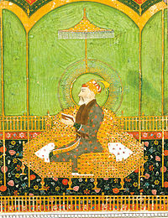
Human
13108102
instance of
5th Mughal emperor
VIAF link
Short description
Agra
Place of death
Shah Jahan
Thumbnail
Place of birth
Names in other languages
Lahore
শাহ জাহান | شاہجہان | شاه جهان | Ŝaho Jahano | षाजकाऩ् | Шах-Джахан | Шах Џахан | Şah-ı Cihan | Шах Джахан | शाहजहाँ | Džahan-šah | Sultan Şahcahan| שאה ג'האן | 샤 자한 | Shâh Jahân | Šahs Džahāns | ഷാജഹാൻ | シャー・ジャハーン | शाहजहानः | शाह जहाँ | Шах Жахан | ಷಹ ಜಹಾನ್ | จักรพรรดิชาห์ชะฮัน | Xa Jahan | Šáhdžahán | शाह जहान| షాజహాన్ شہاب الدین شاہ جہاں اول | | Džahanšachas | შაჰ-ჯაჰანი | શાહજહાં | ਸ਼ਾਹ ਜਹਾਂ | Շահ Ջահան |شاه ‌جہاں | شاهجهان | 沙賈汗 | Σα Τζαχάν | I Шаһ Жаһан | Шаһ Йыһан | Жахан -Шах

