Slide 1
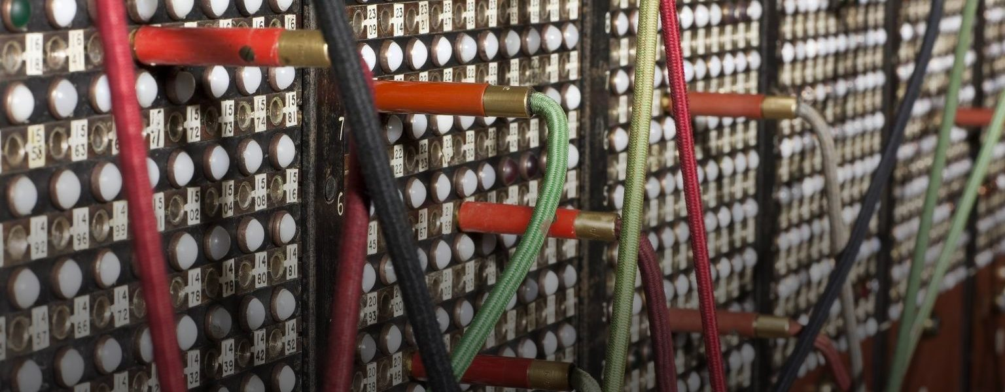

Heritage Connector
Jane Winters, School of Advanced Study, University of London

Slide 2
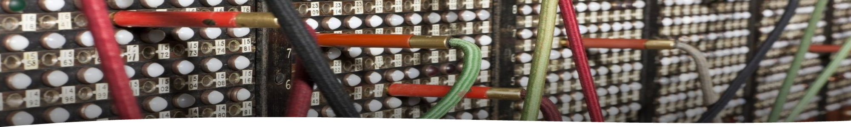
The project team
Science Museum Group (John Stack, Kalyan Dutia and Jamie Unwin)
V&A (Angela Wolff and Richard Palmer)
University of London (Jane Winters and Rhiannon Lewis)

Slide 3
The project
How can existing digital tools and methods be used to build relationships at scale between digitised collection objects and other content sources?
How might confidence in these relationships impact on their usefulness in research and discovery?
What (and where) is the best use of human input in supporting such an approach? What skills are required and who can get involved?
What gaps and biases emerge when these relationships are created, and which hitherto unexpected connections are made?
How might these new automatically established relationships help museums to gain greater understanding of how their collections are being used and interpreted now, and might be in the future?

Slide 4
Project activities
To conduct a review of relevant literature and tools
To experiment with digital tools / computational methods to create speculative identifications between different records within a test dataset from the Science Museum Group (NER, NEL, ML for classifying and clustering, etc.)
To work on successively larger and more varied datasets over the course of the project
To develop an open-source ‘Heritage Connector’ prototype, capable of holding a web of links between object records and knowledge graphs such as Wikidata

Slide 5
Literature review
Building an open Zotero Library, which currently lists 104 items, ranging from academic articles to blog posts and conference presentations (www.zotero.org/groups/2439363/heritage_connector)
Distilling common themes, challenges and opportunities
It is an ongoing process, and all suggestions are very welcome!

Slide 6
Preliminary findings
Motivations for working with Linked Open Data include:
a concern to make cultural heritage more visible
an interest in exposing ‘hidden’ collections, or ‘hidden’ aspects of relatively well-known collections
the enrichment of catalogues and metadata
the encouragement of data reuse in new contexts
the desire to create a better user experience, which ‘empowers patrons to draw their own conclusion about cultural heritage artifacts’ (Marden et al, 2013)
the challenges of dealing with ever-growing volumes of data at a time when resources are increasingly scarce

Slide 7
Preliminary findings
There is a generally shared vision of ‘multiple institutions collaborating to merge their data together in order to create new research paths for their users’ (Marden et al., 2013), but many projects involve only one, or at most two institutions, and international collaboration is relatively rare
Cultural heritage databases are rich, large and complex, and there is limited standardisation – one study found as many as 20 vocabularies and ontologies in use (Hall et al., 2015)
Institutional histories and culture can make standardisation challenging – it is not just a technical problem
Barriers to LOD in the cultural heritage sector fall under three broad headings: technical, conceptual and legal (Hallo et al., 2015) – to which I would add financial!

Slide 8
Preliminary findings
This is time-consuming and resource-intensive work - ‘The range of data preparation tasks is open-ended and ad hoc’ (Szekely et al., 2013)
A lot of LOD work to date has focused on people rather than objects, and on linkage with resources like DBpedia and VIAF
It is not a question of if human intervention and curation is needed, but at what point in the pipeline
What are the most useful human contributions, and how does this vary across potential contributing groups? What part does co-creation have to play?
Many LOD projects envisage personalisation as an important outcome - but this remains a mid- to long-term goal

Slide 9
Preliminary findings
Quality, authority and trust are crucial for cultural heritage organisations, but this can hold back experimentation and present a challenge for scalability – ‘In order to help assessment of data quality, it is important to explicitly indicate that a certain edit was informed by an algorithm; but it is also very valuable to be able to trace specific edits back to specific (trusted or less trusted) users’ (Fauconnier, 2019)
There have been numerous promising experiments, which have produced results suggestive for the sector as a whole, but it is rare for these to move beyond the prototype stage

Slide 10





Thank you!
All references can be found in the project’s open Zotero library: www.zotero.org/groups/2439363/heritage_connector
Heritage Connector website: https://www.sciencemuseumgroup.org.uk/project/heritage-connector/
Towards a National Collection: https://ahrc.ukri.org/research/fundedthemesandprogrammes/tanc-opening-uk-heritage-to-the-world/

