Slide 1

PUBLIC HEALTH
TEAM NAME :Maxi code
TEAM MEMBERS:SAI RISHI,HARSHITH

Slide 2
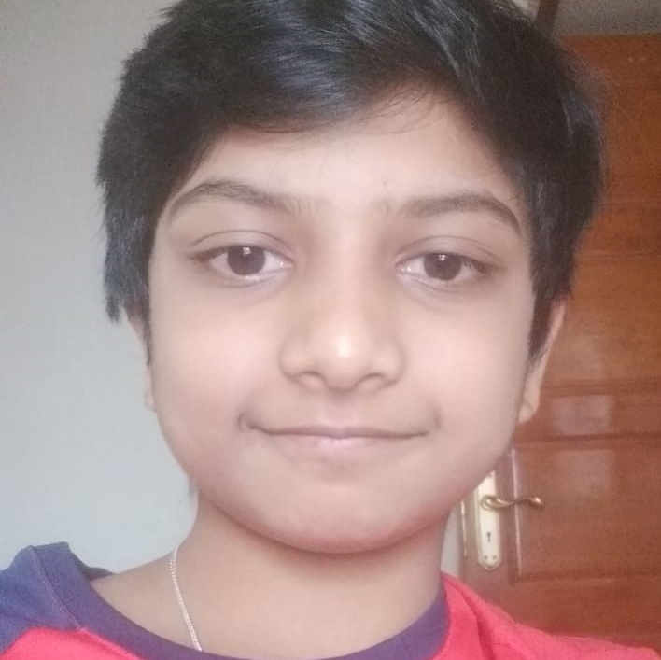
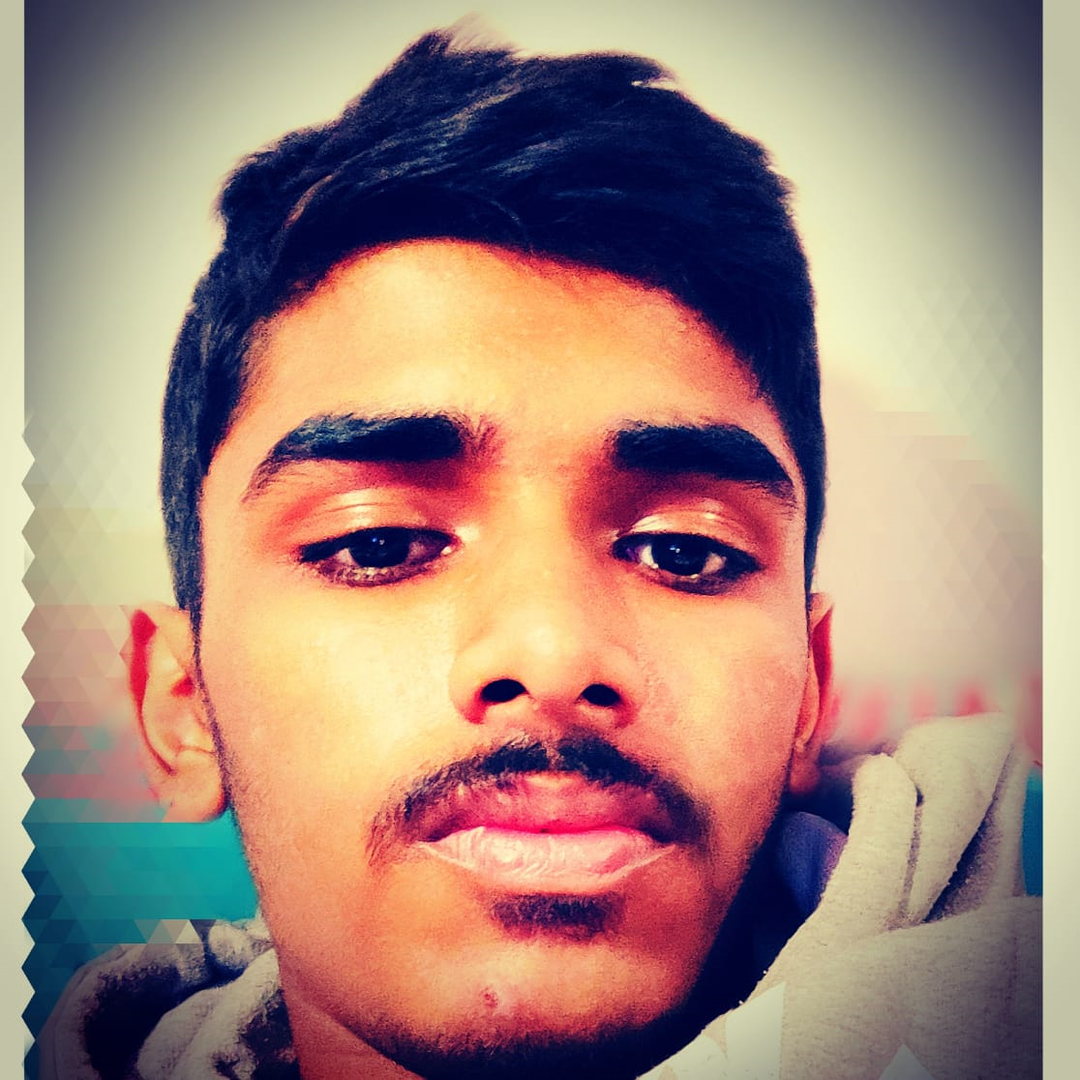
Team introduction
Our is comprised of two team members:
Sai Rishi : The leader and first team member . The researcher and coder makes sure every thing is going smoothly.
Harshith : The second team member, primary coder and executor of what ever is going on.The man who is mainly in charge of the code.

Slide 3
The problem addressing
Our team had choosen the topic of public health . So during lockdown our fitness reduced and some people even would have forgotten to put vaccines for their babies (new born to 15 months).
So to address these problems we have created a simple code which solves the problems written above.

Slide 4
Background information
Health is the most vital aspect of life and during this pandemic exercising rate has decreased and some people have forgotten at which time or what time or for how much time a particular vaccine should be taken.
We are solving the issues of health monitoring and taking vaccines for babies (new –born to 15 months old ).
We are using the programming language of python and created a simple code of inputs and generate solutions for the problems we intend to address

Slide 5
Solution summarized
So our code comprises a series of inputs and formulas which generates an output on the basis of given inputs.
So it is like a answering machine or a very simple help desk in which it will give an output from the inputs of the user
The working of the program is explained in the following slide

Slide 6
The working of our code
THE WORKING OF THE CODE
Firstly you need to give an input of your phone number then an otp is generated
After entering the correct otp then the code asks for futhur inputs
So the page is confidential

Slide 7
The working of our code
Our code comprises of three parts :
FIRST PART
Bmi – calaulator:
It’s a body mass index which tells that if you are fit or not.
So our code what does is it takes the input of your name , age , hieght ,weight , gender (The gender number will come play later)
After entering the following inputs the bmi formula which we entered will generate a value in inter form and indi cate wether you are underweight , ovrweight ,healthy , obese and extremely obese.
This is way of keeping track of your body fitness and health

Slide 8
THE WORKING OF OUR CODE
THE SECOND PART OF OUR CODE :
The future hieght predictor:
Here we add an additional input of your mother's and father's hieght. Here the gender comes into play . If you had entered your gender as a male then the formula will be (mom's hieght + dad's hieght +.13m )/2
;if you are a female then in the place of +.13cm. these formulea help in calculating your future hieght and this is and approximate value not pinpoint.
The resulting outpoint is your approximate future hieght.

Slide 9
The Working of our code
THE THIRD AND LAST PART OF OUR CODE :
OTP accesisible vaccine sheet:
So the phone number which we entered in the starting comes into play here.So to that particular phone number there will be and otp of three to four digits.By entering the correct otp you can access the vaccine sheet . There is an additional input of addin g your baby's age (new born ie 0 months to 15 months).After entering your correctotp and babies age you can find out which vaccine should be taken at what time and for how much time.

Slide 10
THE IMPORTANT ASPECTS OF OUR CODE
SOME IMPORTANT THINGS OF OUR CODE:
Firstly about the inputs:
The age age input should be entered form the range of 1 – 119 years only
The phone_number input is restricted to 10 digits only
The otp should be entered correctly or else an error will be raised and the vaccine sheet wont be accesed
The vaccine sheet is only for babies from newborn babies ie 0 months to 15 months

Slide 11
Important aspects of our code
Secondly about our code :
So the code takes the input of weight in kilograms(decimal value is accepted); hieght in metres(decimal value is accepted) ; fathers and mothers hieght takes the input in metres(decimal value is accepted)
Formulea
Bmi for male and female is the same =
Weight/Hieght^2 (^2 is only for hieght)
Future hieght male =
(moms hieght + dads hieght +0.13m)/2
Future hieght female =
(moms hieght +dads hieght –0.13m)/2

Slide 12
Important aspects of our code
The confidentiality of our code:
We made this page only accesisible by an otp only.
Suppose if the otp entered is correct then the page is accesisible and if the otp entered is wrong then the code will end and it wont take further inputs.

Slide 13
Next steps for the program
WOULD YOU LIKE TO FURTHER DEVELOP IT:
Yes we would like to furthur develop it
And give a beneficial result to the society and hope that this would be helpful
If we had more skills we wanted to make it interactive userface and apply on different devices
CAN IT BE A SELLABLE PRODUCT?
It could have been the many many many more developments

Slide 14
Worked cites
The sites we worked on were:
Visual studio code
Google colab
Microsoft powerpoint
Google chrome
Google
https://www.cdc.gov/vaccines/schedules/hcp/imz/child-adolescent.html the site for the vaccine sheet
The main inspiration was the overall scenenario and to make things better

Slide 15
Thank you for giving us the wonderful opportunity to take part in this competition

