Slide 1

Sprint Review 3
Thursday, 15th October

Slide 2



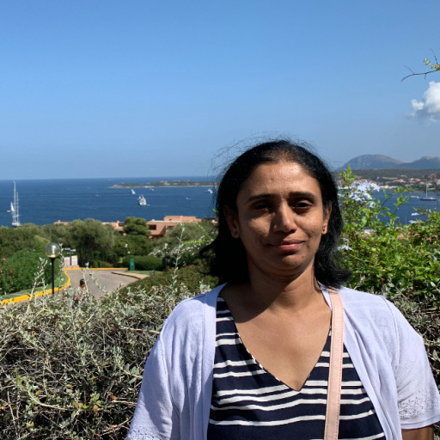




Hello Again 👋
...Jyothsna

Slide 3
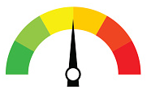
What we’re building 👷‍♀️
A tool that helps internet users understand the intent behind the news they read
Using multiple sources of information and analysis to provide a result: website credibility, underlying tone/sentiment, and other useful indicators
To help users answer the question: should I trust this information?
...Jyothsna

Slide 4
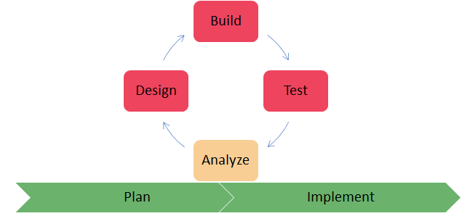
Quick Outcomes 🙌
We have been...
Building the blocks
Evaluating, reconstituting - architecture, libraries, testing, summarizing
Creating pipelines, automate
Understanding each other with Lumina profiles
Proof of Concept …..
...Next Ellie

Slide 5
Demo
Proof of Concept
... Ellie

Slide 6
The Frontend 🕹
Implemented the main container structure and design, which will hold all components to be rendered
Researched and tested different types of data display, such as gauges, pie-charts and bar graphs
Built a working gauge that displays the credibility score
Lots of pairing around the different ways we can display our data, as well as how we plan to develop on these for the next Sprint.
...Next Ana

Slide 7
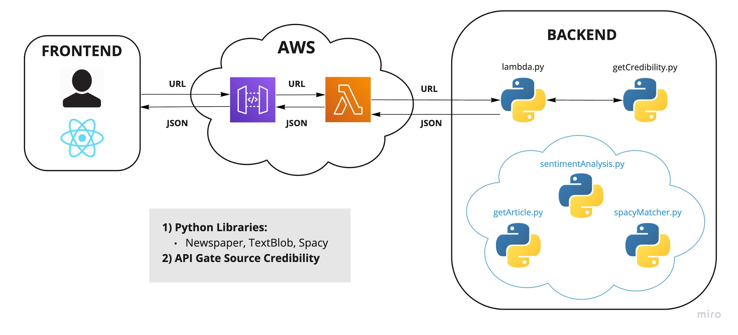
System Overview ⚙️
...Ana

Slide 8



Backend ⚙️
Python code deployed with Pytest modules in place
Input URL being validated / completed
Website Credibility obtained via API call
Python libraries implemented in the backend:
Newspaper
TextBlob
Spacy
...Next Jamie

Slide 9
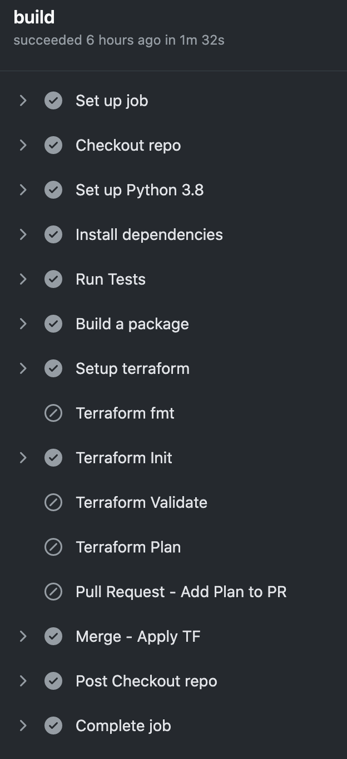
How it’s deployed ⚡️
Shared terraform modules in infrastructure repo + core resource state/implementation
CI/CD pipeline in backend to deploy infrastructure and code
On pull request, builds dependencies, runs tests and creates a terraform plan which is posted for review inside the PR
On merge, applies the terraform plan
Failed tests, dependency checks or plan blocks deployment
Next up: build a pipeline for the frontend!
… Jamie

Slide 10
Next Sprint Goals 🏆
Check the priorities for delivering our MVP: v1.0.
Implement the outstanding v1.0 features, error handling on the Frontend for example.
… Jamie

Slide 11
Questions?

