Slide 1

Pointers
Lecture 5
Data Structures and Abstractions

Slide 2
Error Types Reminder
Don’t forget the different error types when coding.
Debugging is an absolute necessity when coding and even more so when coding pointers, so discussing this briefly here is appropriate.
There are five types of common errors:
  Syntax errors are those that prevent your code from compiling because of incorrect use of language grammar.
  Semantic errors are errors in meaning. For example, if you have an apple object and you try to add to an orange object. Much more common ones are when you try to assign a float value to an integer variable. These can also be called type errors.
  When your code compiles and your program runs as planned, but the output is incorrect, you have a logic error. That is why you need a test plan! And why you actually run through it! You had to use the test tables in the revision exercise.
  When your program crashes it is a run-time error. You need a test plan and testing.
  Finally if the input data is incorrect in some way, then your output will be incorrect also: a GIGO error.

Slide 3
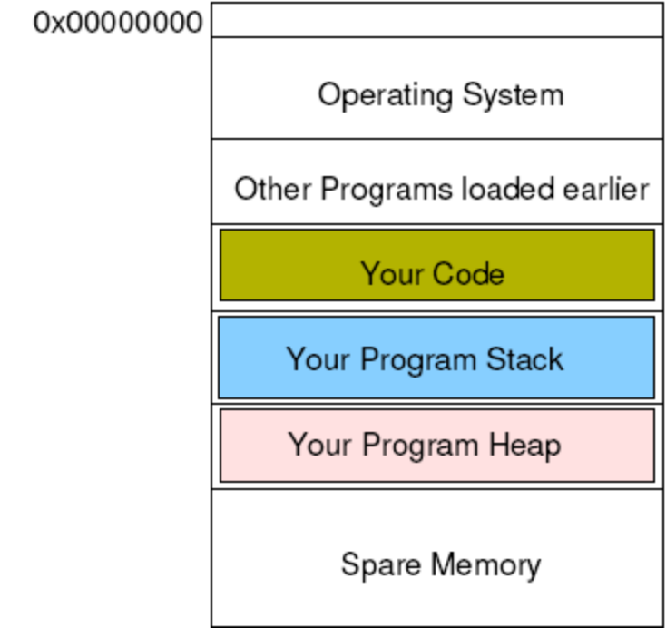
RAM
When your program runs, the OS allocates RAM for its use. [1]
This RAM is divided up into different sections for use in different ways by your program. The layout shown below can be different for different architectures and OS. Covered in your first year unit.
The program stack stores variables, parameters etc. that are defined when you write your program.
The program heap is used for memory locations that are defined as your program runs: dynamically allocated variables.
Notes:
[1] The diagram shown is one example. There are other arrangements.

Slide 4
Pointers
Pointers cause more heartache than is really necessary. [1]
All they are is a variable that stores the address of another variable.
Of course it is also possible to continue this ad-infinitum, which means that you can end up with an address, of an address, of an address...
But in actually fact it is rare that you go beyond one, or two, levels of dereference.
Notes:
1.
All a pointer does is point to some where else in memory. The pointer does this by storing the address of the location it is pointing to in the pointer variable.

Slide 5
Declaring Pointers
This declares a pointer to an integer sized memory location.
It does not allocate the memory location for you to store the actual data.
Memory to store ptr itself but not the data. [1]
Contents of ptr is whatever happens to be there by chance.
 | 0x00000000
 |  | ...
 |  | Your program stack
 | ptr | ??
 |  | Your program heap
int f1()
{ // local vars on stack
int *ptr;
}
Dynamic memory
Available for use with
“new” instruction
Notes:
[1]
The address to which the pointer is pointing to is stored as the value in the pointer.
If you don’t put in a value, the value in the pointer is whatever happened to be there in the first place.
Local variables and parameters on the run time stack.
If these local variable values are not set by you, they will contain whatever value happens to be there – the so-called garbage values. In the declaration of ptr in routine f1 above, ptr will have “garbage values” as the code doesn’t set it to some value. Very
Dangerous situation – can cause you a lot of grief trying to debug code with issues like this.
Global variables or static variables in static area. Typically, a compiler will generate code to make the values 0.
Anything created with the new operator will be on the heap.

Slide 6
Declaring Pointers
 | 0x00000000
 |  | ...
 |  | Your program stack
 | ptr | ??
 |  | Your program heap
This means that trying to use the memory location contained in the pointer variable will crash the program or cause strange events.
This is because the contents of ptr could be anything; i.e. it could be pointing anywhere in memory. [1]
??
int *ptr;
Notes:
1
If you try to access the memory via the pointer that does not have a proper value put in by you, your program will get killed by the OS, or you will damage memory belonging to your own program.
If it gets killed by the OS, it is good. But if it is damaging your program’s memory, the program will continue running but you wouldn’t know that there is a serious problem.
So given the declaration:
int *ptr; // ptr is a pointer to int
*ptr = 20; // put the value 20 to where ptr is pointing.

Slide 7
Declaring Pointers Safely
 | 0x00000000 | 0
 |  | ...
 |  | Your program stack
 | ptr | 0x00000000
 |  | Your program heap
To prevent accidental alteration of anything important, pointers should always be initialised to NULL.
The zero^{th} memory location of RAM is kept empty for this reason. [1]
int *ptr = NULL;
Notes:
1
Trying to access memory 0, will result in your program being killed by the OS – a good thing as that will alert you about a problem.

Slide 8
Allocating Memory
 | 0x00000000 | 0
 |  | ...
 |  | Your program stack
 | ptr | 0xaf556808
 | 0xaf556808
 |  | Your program heap
The allocation of memory is then done with the new keyword.
This allocates a memory location on the heap of the given size (in this case an int).
int *ptr = NULL;
ptr = new int; [1]
Notes:
new requests the OS for a block of memory the size of an int. If this memory is available, the OS reserves this memory, marks it a belonging to your process (running program) and returns an address to that area. The address is assigned (copied) into the ptr variable. So ptr would now point to that area.
To access that newly created area, you write *name_of_pointer. In this case, it will be
*ptr
To put a value of 5 in this new area:
*ptr = 5;
*ptr is just another name of a memory area

Slide 9
Using Pointers
 | 0x00000000 | 0
 |  | ...
 |  | Your program stack
 | ptr | 0xaf556808
 | 0xaf556808 | 345
 |  | Your program heap
To place a value in the memory location, the * dereferencing operator is used. [1]
int *ptr = NULL;
ptr = new int;
*ptr = 345;
Notes:
1.
To recap:
A pointer stores a memory address
When a pointer stores an address it points to that address
When it points to that address, that memory at that address has a new name: *name_of_pointer
In the examples I have used ptr. So the name_of_pointer is ptr, hence *ptr is the name of the new memory area.

Slide 10
Using Pointers
 | 0x00000000 | 0
 |  | ...
 |  | Your program stack
 | ptr | 0xaf556808
 | 0xaf556808 | 345
 |  | Your program heap
This is also used for accessing the location for output etc.
int *ptr = NULL;
ptr = new int;
*ptr = 345;
cout << *ptr << endl;

Slide 11
Where is the Pointer Pointing?
 | 0x00000000 | 0
 |  | ...
 |  | Your program stack
 | ptr | 0xaf556808
 | 0xaf556808 | 345
 |  | Your program heap
You could also output the location of the memory being used, rather than the contents of the memory location.
int *ptr = NULL;
ptr = new int;
*ptr = 345;
cout << ptr << endl;

Slide 12
Releasing Memory
 | 0x00000000 | 0
 |  | ...
 |  | Your program stack
 | ptr | 0xaf556808
 | 0xaf556808 | 345
 |  | Your program heap
Every new must have a matching delete, so that memory is released back to the OS.
int *ptr = NULL;
ptr = new int;
...
delete ptr;

Slide 13
Releasing Memory Safely
 | 0x00000000 | 0
 |  | ...
 |  | Your program stack
 | ptr | 0x00000000
 | 0xaf556808 | 345
 |  | Your program heap
Followed, of course, by reassigning the pointer to NULL, so that it does not point to memory over which it no longer should have control.
int *ptr = NULL;
ptr = new int;
...
delete ptr;
ptr = NULL; // to be safe

Slide 14
Pointing at Other Variables
 | 0x00000000 | 0
 |  | ...
 |  | Your program stack
 | num | 10
 | ptr | 0x00000000
 |  | Your program heap
Pointers can also point at other variables:
int *ptr = NULL;
int num = 10;

Slide 15
Pointing at Other Variables
 | 0x00000000 | 0
 |  | ...
 |  | Your program stack
 | num | 10
 | ptr | 0x00000000
 |  | Your program heap
Pointers can also point at other variables.
int *ptr = NULL;
int num = 10;
ptr = &num;

Slide 16
Pointing at Other Variables
 | 0x00000000 | 0
 |  | ...
 |  | Your program stack
 | num | 23
 | ptr | 0xacf56124
 |  | Your program heap
And change their value.
int *ptr = NULL;
int num = 10;
ptr = &num;
*ptr = 23;

Slide 17
Memory Leaks
 | 0x00000000 | 0
 |  | ...
 |  | Your program stack
 | ptr | 0xaf55721f
 | num | 12
 | 0xaf55721f | 345
 |  | Your program heap
However care must be taken not to cause a memory leak.
int num = 12;
int *ptr = new int;
*ptr = 345;

Slide 18
Memory Leaks
 | 0x00000000 | 0
 |  | ...
 |  | Your program stack
 | ptr | 0xaf556808
 | num | 12
 | 0xaf55721f | 345
 |  | Your program heap
However care must be taken not to cause a memory leak.
int num = 12;
int *ptr = new int;
*ptr = 345;
ptr = &num;

Slide 19
Memory Leaks
 | 0x00000000 | 0
 |  | ...
 |  | Your program stack
 | ptr | 0xaf556808
 | num | 12
 | 0xaf55721f | 345
 |  | Your program heap
The circled memory location is ‘lost’ until the program ends.
int num = 12;
int *ptr = new int;
*ptr = 345;
ptr = &num;

Slide 20
Avoiding Memory Leaks
 | 0x00000000 | 0
 |  | ...
 |  | Your program stack
 | ptr | 0xaf556808
 | num | 12
 | 0xaf55721f | 345
 |  | Your program heap
Of course, there should have been a delete between the last two lines of code.
This releases the memory back to the OS again.
int num = 12;
int *ptr = new int;
*ptr = 345;
delete ptr;
ptr = &num;

Slide 21
Care with delete
 | 0x00000000 | 0
 |  | ...
 |  | Your program stack
 | ptr | 0xaf556808
 | num | 12
 | 0xaf55721f | 345
 |  | Your program heap
But beware where you put it: trying to delete stack memory will cause trouble.
int num = 12;
int *ptr = new int;
*ptr = 345;
ptr = &num; //num not on heap
delete ptr; // oops

Slide 22
Uses of Pointers
There are two main uses for pointers.
The first is for array and string access.
The second is where pointers are used to create lists or trees: data structures where the next piece of data can only be found by traversing a link from the last piece:

Slide 23
Malik: Chapter on Pointer - exercises
2. Given the declaration:
int x;
int *p;
int *q;
Mark the following statements as valid or invalid.
If a statement is invalid, explain why:
a. p = q;
b. *p = 56;
c. p = x;
d. *p = *q;
e. q = &x;
f. *p = q;

Slide 24
3. What is the output of the following C++ code?
int x;
int y;
int *p = &x;
int *q = &y;
*p = 35;
*q = 98;
*p = *q;
cout « x « " " « y « endl;
cout « *p « " " « *q « endl;

Slide 25
4. What is the output of the following C++ code?
int x;
int y;
int *p = &x;
int *q = &y;
x = 35;
y = 46;
p = q;
*p = 18;
cout « x « " " « y « endl;
cout « *p « " " « *q « endl;

Slide 26
Readings
Textbook (by Malik): Chapter on Pointers, Classes, .. etc. See subsections on Pointer Data Type and Pointer Variables; Address of operator; Dereferencing operator. A different edition may have a different chapter number and pages.
101 Coding Standards: Rules 51 and 52. It is one of the important references (see unit outline) we use in the unit. See 101 C++ Coding Standards online resource. [1]
Watch the videos on pointers “Video Lecture on Pointers.htm” Function pointers are covered when we cover the tree data structure later on.
Find out about “RAII”. Why is the RAII concept so important that you should not violate it?
Notes:
1.
See the sections on Design Style and Coding Style
Please note that the importance of this reference text and the other
one, "Introduction to Algorithms" is so high that if there is any
conflict in advice or understanding, the material in the reference
texts would prevail.

Slide 27
Videos
Pointers - Stanford University
  https://www.youtube.com/watch?v=H4MQXBF6FN4
Bits and bytes; floating point representation - Stanford University
  https://www.youtube.com/watch?v=jTSvthW34GU
How pointers get used; usage of void pointers
  https://www.youtube.com/watch?v=_eR4rxnM7Lc

