Slide 1

MAPS
Lecture 20
Data Structures and Abstractions

Slide 2
Note 1 (legacy code only)
When you compile some STL code in VC++ you might get a warning: [1]
  ICT283\Code\Sets\SetDifference.cpp(59) : warning C4786: 'std::pair<std::_Tree<int,int,std::set<int,std::less<int>,std::allocator<int>>::_Kfn,std::less<int>,std::allocator<int> >::const_iterator,std::_Tree<int,int,std::set<int,std::less<int>,std::allocator<int>>::_Kfn,std::less<int>,std::allocator<int> >::const_iterator>' : identifier was truncated to '255' characters in the debug information
This is the only warning you can ignore completely (a debug identifier)
If it really annoys you, then add the following code before the includes in the file that is generating the warning:
  #pragma warning (disable : 4786)
Do not disable any other warning!!
  DO NOT JUST DISABLE THE WARNING IF YOU ARE NOT GETTING THE WARNING.
  Warning is only on older implementations of Visual C++, so you are not likely to see it now. If you do see it, please let me know. As we
  Legacy code and compilers may generate this issue, so just for noting
  You wouldn’t see this error in the work you are doing in this unit but be aware of issues like this with legacy code and older compilers.
Notes:
1
Not likely these days. Might happen in older versions of VC++

Slide 3
Note 2 (relevant now)
If you get an error message such as:
  ICT283\Code\Map\Map.cpp(57) : error C2440: 'initializing' : cannot convert from 'class std::_Tree<class std::basic_string<char,struct std::char_traits<char>,class std::allocator<char> >,struct std::pair<class std::basic .....
  No constructor could take the source type, or constructor overload resolution was ambiguous.
Then it almost always means that you are passing an object as a const reference to a function that uses iterators. Iterators expect references not const references. So, for example, the code below would probably generate this error: [1]
  void DoSomething (const IntSet &aset) //IntSet is some type with an iterator
  // typically, this type has had a typedef
  // typedef set<int> IntSet;
  {
  IntSet::iterator itr = aset.begin(); // itr can be used to modify - error
  }
To solve it, use a const_iterator, instead of an iterator: [2]
  void DoSomething (const IntSet &aset)
  {
  IntSet::const_iterator itr = aset.begin();
  }
Notes:
[1]
Stuff like this is covered in the textbook – so please read the textbook.
See section on typedef const_iterator, Chapter on STL
Lecture notes wouldn’t contain everything in the textbook.
It is also covered in the QandA for the labs where we deal with setters (mutators) and getters (accessors). Getters are const, naturally.
[2]
Note that aset is declared as a const reference.
Setting a normal iterator can’t guarantee the const declaration, so the compiler would not be happy as it
can’t enforce **your** design decision. The compiler is only enforcing what you have asked to enforce.
so you need a const iterator.

Slide 4
Maps
An association (pairing) is a connection between two things, for example the word “sanity” (key) is associated with the definition (value) “the state of having a normal healthy mind”*
A dictionary or map is then a collection of key-value associations [1].
The first part of the pair is often called a key.
The data in maps is inserted, deleted and found using the key. So key needs to be unique but value need not be. [2]
For example, if one had a map that was an English dictionary, then we would expect to be able to retrieve the definition of sanity using something like:
  dictionary.GetDefinition (“sanity”);
  or even
  dictionary[“sanity”];
* Australian Dictionary, Collins, 2005
Notes:
[1] Sometimes called Associative array
[2] Multimaps are used if keys are not unique.
Also see unordered_map (C++11). Hashing is used on the key for fast access. Operator[] is fast.

Slide 5
The STL Map
The STL map is a very nice template indeed.
The declaration requires two data types, the first being the key and the second being the data to be stored in association with the key. [1]
For example, consider a class taking a vote on who should be the class president. We want to associate names with an integer number of votes:
  #include <map>
  ...
  map<string, int> Popularity;
  ...
  Popularity pop;
Notes:
[1]
Like set in STL, map in STL is an associative container so sorted automatically on insertion. It is sorted on Key called first.

Slide 6
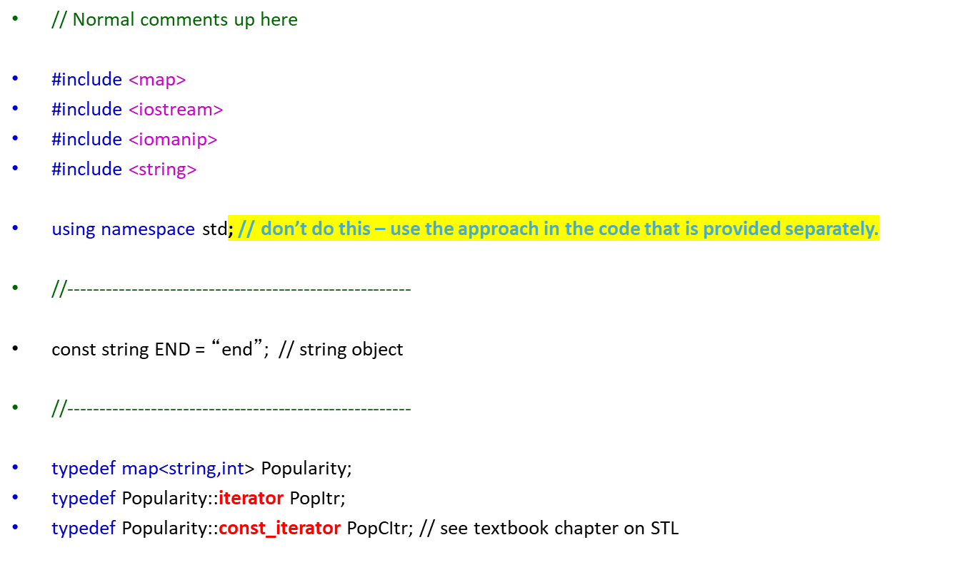
A Simple Map Program
It can be really useful to define an iterator for each STL type you use

Slide 7
//------------------------------------------------------
void AddData (Popularity &pop);
void Output (const Popularity &pop);
//------------------------------------------------------
int main ()
{
Popularity pop;
AddData (pop);
Output (pop);
cout << endl;
return 0;
}
//------------------------------------------------------

Slide 8
void AddData (Popularity &pop)
{
string name;
// Prime the while loop
cout << "Enter vote name, or “ << END << “ to finish: ";
getline (cin, name);
while (name != "end") // is this comparison efficient? [1]
{
// If they are part of the map already, this adds 1
// to their score. If they are not, it puts them
// in the map and gives them a score of 1.
// see missing code in the notes section [2]
cout << "Enter vote name, or 'end' to finish: ";
getline (cin, name);
}
}
Notes:
[1]
What is happening behind the scenes? name is a string object, but “end” is a null terminated char array. Types are different.
If it was some other class comparison?
What happens if the user enters “end” as the first data?
[2]
// If this person is not yet in the map
if (pop.find(name) == pop.end())
{
// Add them to the map
pop[name] = 1;
}
else
{
// Otherwise just increment the number of votes in the map
pop[name]++;
Just using pop[name] on its own can insert the value in name into pop, with this value being a new key, with the corresponding value an empty string.
So, it is better to use find.
Operator[] of map has logrithmic complexity. BigO
This operator on unordered_map is faster – constant complexity, as hashing is used

Slide 9
//------------------------------------------------------
void Output (const Popularity &pop)
{
PopCItr winner = pop.begin(); // set a temp winner as the first item
// For each entry in the map
for (PopCItr itr = pop.begin(); itr != pop.end(); itr++)
{
// Output the first and second parts of the pair (association)
cout << setw(20) << itr->first << “ : " << itr->second << endl;
// Now check if this person should be the winner
if (winner->second < itr->second) // compare the value [1]
{
winner = itr;
}
}
// Output the winner
cout << endl << "The new class president is " << winner->first
<< " with " << winner->second << " votes" << endl; [2]
}
//------------------------------------------------------
Notes:
[1] the map is sorted by key but we are not interested in sorting by key, but looking for the highest value.
Members first and second are public of struct pair. Map stores elements of struct pair.
[2] What happens if all candidates get the same vote?

Slide 10
Readings
Textbook: Chapter on Standard Template Library.
Map: https://en.cppreference.com/w/cpp/container/map
Multimap: https://en.cppreference.com/w/cpp/container/multimap

