Slide 1

Complexity
The STL Vector [1] and
Iterators
Lecture 10
Data Structures and Abstractions
Notes:
[1]
The Standard Template Library’s Vector data structure exists in the std namespace.
You can use it after assignment 1 is completed. You can’t use it in any assessed work before assignment 1.

Slide 2
Complexity
The complexity of algorithms is measured in terms of how long they take to execute or how much resources they utilise. Our current interest is on the execution time of the algorithm.
This in turn is often measured in terms of the number of operations that are required.
Complexity is described in two ways: descriptively and using O notation. [1]
O notation means ‘in the order of’. It is that value multiplied by some constant. The order represents the rate of growth. The constant is something that can depend on a particular computer and can vary from computer to computer.
  So we don’t consider this constant and only look at the algorithm.
For all algorithms, the measurement is relative to how many items are being processed.
The number of items is designated as ‘n’ and Big-O is a measure of the upper bounds of the number of operations carried out by the algorithm as n grows large.
Notes:
[1] e.g. used to describe worst case scenarios or typical scenarios, .etc
In the worst-case situation, it describes the performance limits of algorithms when the inputs to the algorithm tend to be very large.

Slide 3
NAME | O notation | DESCRIPTION | Examples | n=1 | n=10 | n=20
constant time | k | It takes the same amount of time (k) no matter how many elements are being dealt with. If k is small this is the best case of all, as it will take the same time for 1 element as for 10,000. | t = k | k | k | k
logarithmic time | O(log n) | The time taken increases very slowly as n increases. | t = log₁₀(n) | 0 | 1 | 1.3
linear time | O(n) | The time taken increases in a straight line as n increases. | t = n | 1 | 10 | 20
 | O(n log n) | The time taken increases faster than n, but at a slower speed than the two below. | t = n log₁₀(n) | 0 | 10 | 26
polynomial time | O(n^{p}) | The time taken increases much faster than does n. | t = n² t = n³ | 1 1 | 100 1000 | 400 8000
exponential time | O(c^{n}) | The time taken increases at a much, much higher rate than n. As n becomes very large, the time taken becomes almost infinite. | t = 2^{n} t = 10^{n} | 1 1 | 1024 10¹⁰ | 1048576 10²⁰

Slide 4
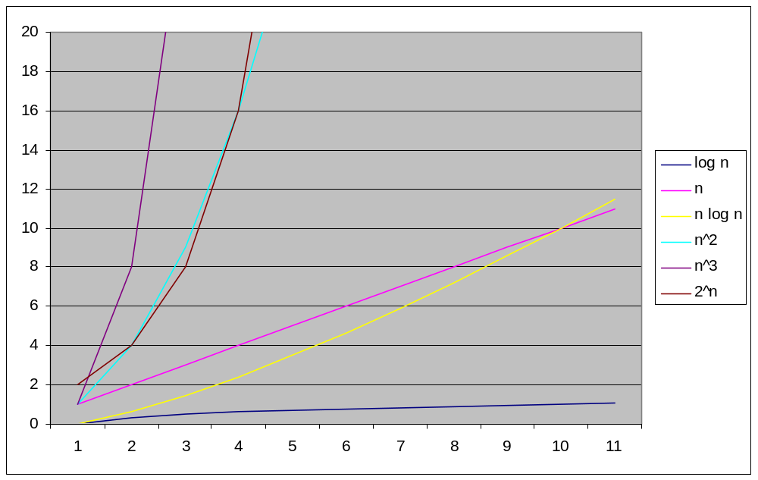
Comparison at Scale 0-20 (textbook has a nicer diagram in the section on Big-O Notation)
Notes:
A nicer plot can be done using wxMaxima.
wxplot2d([log(x),x*log(x),x,2^x,x^2,x^3], [x,1,15], [y,1,3000])$
Vary upper value for y from 10 to 3000
to see how 2^n dominates in terms of computational cost

Slide 5
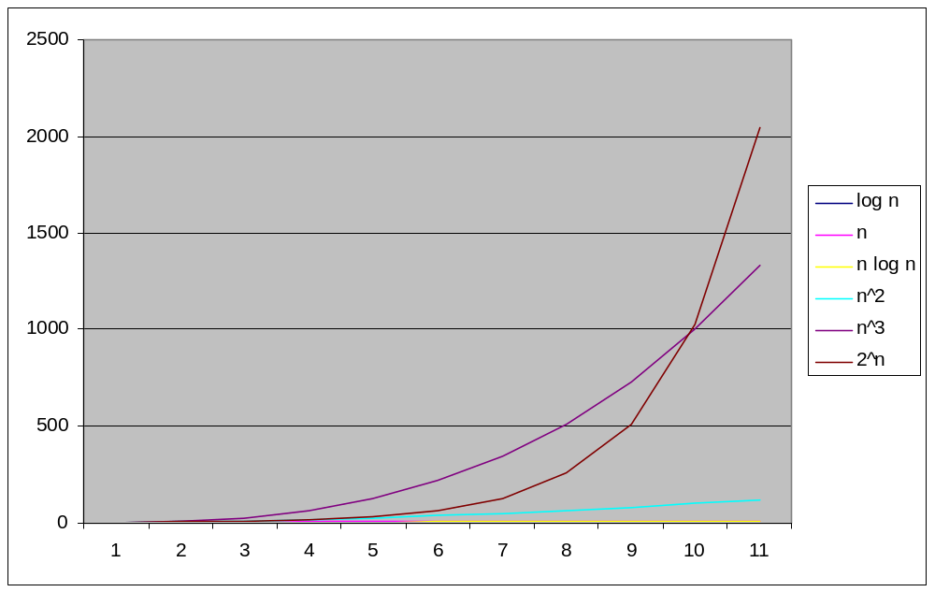
Comparison at Scale 0-2500

Slide 6
The STL Vector [1] (can’t be used for assignment 1 – not the same)
The STL vector is an array-like template class, but not an array.
It can be instantiated as any type that you choose, including ones designed by you.
It has lots of inbuilt methods, as well as having functions within the algorithm class that operate on it.
Note that, like all STL classes, there is no bounds checking done.
To use the vector template, you must include the <vector> header file.
Accessing a particular element or adding an element to a vector takes constant time.
Finding an element or inserting an element at a particular location within the vector takes linear time.
Notes:
[1] For lab 5 and assignment 1, the STL Vector can’t be used.
So do not have any #include that looks like the following in lab 5 or assignment 1
#include <vector>
The Vector (upper case V) for lab 5 and assignment 1 is a templated Array. The closes analogy to the Vector that we need for lab 5 and assignment 1 is the Java ArrayList that was covered in ict167, except that you have build Vector from the ground up in C++, and the use it in your application.

Slide 7
Using the STL vector
#include <iostream>
#include <iomanip>
#include <vector>
using namespace std;
//--------------------------------------------------------------------
// Declare a new type that is a vector (array) of integers
typedef vector<int> IntVec;
// Declare an iterator for this type of structure
typedef IntVec::iterator IntVecItr;
// Declare a new type that is a vector of vectors of integers
// i.e. create a two dimensional array
typedef vector<IntVec> IntTable;
//--------------------------------------------------------------------
<number> of 31

Slide 8
IntVec array;
IntTable table;
// Seeding a random number generator
srand (time(NULL));
// Adding random data to a vector
for (int index1 = 0; index1 < SIZE; index1++)
{
// Add a number between 0 and 100 to the end of the array
array.push_back (rand() % 100);
}
// Outputting the single array:
for (int index3 = 0; index3 < SIZE; index3++)
{
cout << array[index3] << endl;
}

Slide 9
// Make a table with identical rows
for (int index2 = 0; index2 < SIZE; index2++)
{
table.push_back (array);
}
// Outputting the table in columns
for (int row = 0; row < SIZE; row++)
{
for (int col = 0; col < SIZE; col++)
{
cout << setw(5) << table[row][col] << " ";
}
cout << endl;
}

Slide 10
Vector Methods
Like strings, vectors have many methods.
Again like strings, most of the methods have multiple overloads.
A good listing of information can be found at
http://www.cppreference.com/cppvector/index.html
Unlike strings, there are only a few operators that apply to vectors.
= and == are the two most useful operators that can be used with vectors.

Slide 11
Only some examples shown – there are more.. [1]
vec.clear () | Empties the vector.
vec.empty () | Returns true if the vector is empty.
vec.erase (<various>) | Erases a part of the vector.
vec.insert (<various>) | Add data to the vector.
vec.push_back (data) | Add one piece of data to the end of the vector.
vec.pop_back () | Delete the last item in the vector.
vec.begin() | Returns an iterator that points to the first item in the vector.
vec.end() | Returns an iterator that points to just after the last item in the vector.
vec.size() | Returns the size of the vector.
vec.swap (vec2) | Swaps the contents of the two vectors.
Notes:
[1] check these out for yourself. Not everything will be covered or explained in the lecture. Only some will be done to get you started and the rest you will have to find out for yourself.

Slide 12
Vector Allocation
When you push_back data into a vector, space needs to be allocated to the vector. This is done dynamically and the programmer doesn’t need to worry about creating storage. This is normal for STL containers.
The space is not allocated one ‘slot’ at a time.
Instead it is allocated as follows: [1]
IF size > allocation/2
allocate (size+1) new slots
ELSE
allocate 1 new slot
This results in the vector always being less than half full, which must give some efficiency advantage.
However it means that vectors are space wasters.
Furthermore, if the vector shrinks later, this does not result in released memory: the memory allocated stays allocated until the vector goes out of scope.
Notes:
[1] A client of the vector class must not make any assumption that this is the case. If the vector’s implementation changes, the client program will be unreliable.
In some implementations, the amount allocated is double.
It doesn't have to be double. Other strategies can be used. The main
thing is to strike a balance between allocating memory when needed
(processing needed) and the amount of memory used (and left empty, thus
wasted). One approach is in the lecture notes. There are others. The
idea is that over the lifetime of the vector, the average (a
more accurate term is "amortised") time for inserting at the end of
the vector is a constant value. The actual multiplier by which to
increase is implementation dependant. See complexity of push_back
http://www.cplusplus.com/reference/vector/vector/push_back/
For the STL vector, I have come across multipliers of 1.5 and 2. VS2010
uses 1.5. The STL vector can start with no memory. Do not use values larger
than 2 as it will over the lifetime of the vector waste memory. There is
a need to balance memory space and time to allocate and then copy
elements. Some discussion about this was made some time ago by Koenig
and Moo at
http://www.drdobbs.com/c-made-easier-how-vectors-grow/184401375. Koenig
was at the same lab as Stroustrup, the creator of C++. In a discussion
forum some years ago, Koenig worked out the value of 1.5.

Slide 13
Example of Iterator Use
Lets suppose we have a vector containing integers.
We decide, for some reason, that we want to remove all the elements that are equal to some particular number, entered by the user.
This will require:
  An iteration through the vector
  Erasure of each target as we find it
The easiest way to do this is using an iterator.

Slide 14
Defined earlier
int target;
cout << “Enter number to be deleted: “;
cin >> target;
IntVecItr itr = array.begin();
while (itr != array.end())
{
if (*itr == target)
{
itr = array.erase(itr); [1] [2]
}
else
{
itr++;
}
}
erase returns an iterator to the next item
so we only need to increment itr if we did not delete an item
Notes:
[1] The return value is after the last erased element.
[2] Is this a good idea? An assumption is being made that the iterator is valid after the modification of IntVec. Is this the case? If an item not at the end is deleted, then the rest of the items must be shifted across.

Slide 15
Example
target
125
array.begin()
array.end()
array
125
256
12
125
324
7
81
125
34
itr
IntVecItr itr = array.begin();

Slide 16
Example
target
125
array.begin()
array.end()
array
125
256
12
125
324
7
81
125
34
itr
*itr == target ??
YES

Slide 17
Example
target
125
array.begin()
array.end()
array
125
256
12
125
324
7
81
125
34
itr
itr = array.erase(itr);

Slide 18
Example
target
125
array.begin()
array.end()
array
125
256
12
125
324
7
81
125
34
itr
itr = array.erase(itr);

Slide 19
Example
target
125
array.begin()
array.end()
array
256
12
125
324
7
81
125
34
itr
*itr == target ??
NO

Slide 20
Example
target
125
array.begin()
array.end()
array
256
12
125
324
7
81
125
34
itr
itr++

Slide 21
Example
target
125
array.begin()
array.end()
array
256
12
125
324
7
81
125
34
itr

Slide 22
Example
target
125
array.begin()
array.end()
array
256
12
125
324
7
81
125
34
itr

Slide 23
Example
target
125
array.begin()
array.end()
array
256
12
324
7
81
125
34
itr

Slide 24
Example
target
125
array.begin()
array.end()
array
256
12
324
7
81
125
34
itr

Slide 25
Example
target
125
array.begin()
array.end()
array
256
12
324
7
81
34
itr
What is the Big-O value for erase on vectors?
END
Notes:
Looking at the diagrams, what is the Big-O value for erase on vectors?

Slide 26
The Algorithm Class
You may have noticed that there were no ‘find’ or ‘sort’ methods for the vector.
That is because they are part of the STL algorithm class instead.
To use this class, you must include the <algorithm> header file.
The following code does the same repetitive delete as the previous code, but uses the ‘find’ algorithm.

Slide 27
int target;
cout << "Enter target to delete: ";
cin >> target;
IntVecItr itr = find (array.begin(), array.end(), target);
while (itr != array.end())
{
array.erase(itr);
itr = find (itr, array.end(), target);
}
Note how much tighter (shorter) the code is now.

Slide 28
Available Algorithms
The algorithm class contains over forty algorithms.
Please see the following links which have examples of use:
  http://www.cppreference.com/cppalgorithm/index.html
  http://www.cplusplus.com/reference/algorithm/
The use of them assumes various operators are available for the data with which they are instantiated.
This is no problem for a vector of integers or floats etc, as these already have all arithmetic and logical operators defined.
Later on when we code classes, we will have to overload these operators if we wish to use the algorithm class’s algorithms.

Slide 29
Iterators Again
If you actually have the index of something you want to delete or erase, you can ‘add’ index to the .begin() iterator to get the correct thing to delete (or insert).
For example:
array.erase (array.begin() + 10);

Slide 30
The STL deque class
Pronounced as “deck”
The STL deque (double ended queue) class is almost identical to the vector class, except that it has as extra:
  push_front(const DataType &data)
  pop_front ()
As well as the ones that work at the back.
deque can grow dynamically at either end.
Both of these functions work in constant time.
Notes:
“Deck” according to D. E. Knuth – see his algorithms book.

Slide 31
deque
Study the deque examples in the textbook in the chapter on “Standard Template Library”

Slide 32
Exercise
Using the STL vector as your data structure: [1]
Write a simple program that will read in numbers from a file and output the mean and median to screen.
Modify the program to output the standard deviation.
Notes:
[1]
The STL vector cannot be used in your assignment. You need to write you own minimal but complete template Vector class. This template Vector class is no more than an encapsulated template array.

Slide 33
Readings
Textbook: Chapter on Searching and Sorting algorithms, section on Asymptotic Notation: Big-O Notation. If this is not found in your edition of the textbook please see the reference book “Introduction to Algorithms” chapter on Growth of Functions, section on O-notation.
For a more comprehensive coverage of algorithms and their efficiency, see the reference book, Introduction to Algorithms. Chapters 1 to 3.
Textbook Chapter on STL:
  Sections related to the sequence container vector and iterators related to the sequence container vector.
  The sequence container deque is also found in the above chapter.
  Skip sections on ostream iterator and copy function.
Website: “C++ Reference”, http://www.cplusplus.com/reference/ [1]
Website: CPP reference, http://www.cppreference.com/wiki/ [2]
Notes:
[1] From main site http://www.cplusplus.com/
[2] This is the main site of the links given earlier.

