Slide 1

Composition, Aggregation & Templates
Lecture 15
Data Structures and Abstractions

Slide 2
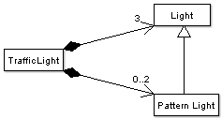
Composition
Composition is where one class has a data member that is an object of another class.
The example given in Lecture 11, was TrafficLight, which had three Lights and 0..2 PatternLights.
<number> of 26

Slide 3
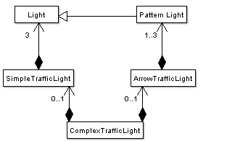
Design Change
Lets say that after thinking about the problem a design change was needed as shown below.
<number> of 26

Slide 4
Another Design Change
And then when working on the algorithm, it was realised that the behaviour changed depending on the number of lights in a traffic light.
This would have meant that within the code there would be lots of if statements to do with how many of each type of light.
This was a sure sign that the design was still incorrect, so another change was made to the design.
<number> of 26

Slide 5
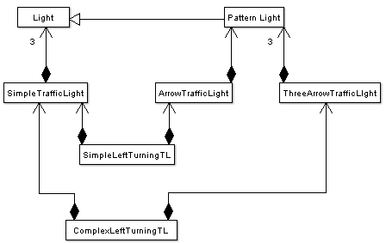
<number> of 26

Slide 6
Yet Another Design Change
However, after a while I hit problems again.
The composition seemed forced and the whole thing very complicated: a sure sign it was still incorrect.
So I went out for a drive to look at traffic lights in action.
I quickly realised that a complex traffic light was not composed of a simple traffic light and a three arrow traffic light, it was actually composed of three single and three pattern lights.
So my ‘final’ design was:
<number> of 26

Slide 7
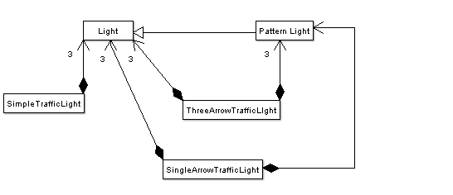
<number> of 26

Slide 8
Design Changes Continued
Of course there would be lots more types of traffic light than just these. [1]
And if I was really coding the whole thing, I might well decide that my original design (or something else entirely) was more correct.
Which is the wonderful advantage of software engineering over conventional engineering: design need not be static but the most important lesson is when starting on a problem solving task, find out what is the real problem!!!
  Don’t try to just imagine what the problem is going to be.
  Do some “leg work”, talk to end users, as changes in design (even in software engineering) has costs associated with it.
Remember:
  Code incrementally.
  If everything is becoming too complicated: you have almost certainly stuffed up the design.
  Don’t be afraid to change your design. Implementing a wrong design will make the solution useless.
  Don’t be afraid to question the design of others.
  Refactor incrementally.
  Test everything after every change.
<number> of 26
Notes:
[1] If light is to become a base class, watch out for implementation.

Slide 9
Finite State Machines
The traffic light classes are examples of Finite State Machines.
An FSM has a limited set of states that are visited one after the other.
It is not possible to have two states at once: you cannot have both a red and green light showing in a normal FSM. There are fuzzy FSMs but these are outside the scope of this unit.
FSM are used in simulation and modelling of many industrial and mechanical processes. Even the compiler you are using to compile your code uses state machines.
A single Change() method replaces all the Set() methods.
A single StateIs() method replaces all Get() and output methods.
The term Initialise() is used rather than Clear(), as it is only usually called at the start.
<number> of 26

Slide 10
// Constants.h
// Required by several classes
//------------------------------------------------------------------
#ifndef CONSTANTS
#define CONSTANTS
// Traffic light colours
const int RED_LIGHT = 0; [1]
const int ORANGE_LIGHT = 1;
const int GREEN_LIGHT = 2;
// FSM error state
const int ERROR_STATE = -1;
// Size of a traffic light
const float TL_RADIUS = 12.5; // cm
#endif
Constants that are required by multiple classes are put in a header file of their own.
<number> of 26
Notes:
[1] Would it be better from an abstraction point of view to have the traffic light colours as an enumerated type? This would mean that a variable used to store colour can only have the predefined values instead of an integer with the possibility that the variable being assigned any number by mistake. See textbook, section on Enumeration type.
The same argument applies to the shapes earlier.

Slide 11
// SimpleTrafficLight.h
// Comments and includes etc up here as per normal – use doxygen comments instead
// friend operator used for debugging. Design does not require it.
//-------------------------------------------------------------------
const int STL_NUMBER = 3;
//-------------------------------------------------------------------
class SimpleTrafficLight
{
public:
SimpleTrafficLight () {Initialise();}
~SimpleTrafficLight () {};
// Initialise the class
void Initialise ();
// Change the light to the next state
bool Change ();
// Output the state – for debugging/demo purposes only.
friend ostream& operator << (ostream &ostr, const SimpleTrafficLight &light);
<number> of 26

Slide 12
private:
int m_state;
vector<Light> m_lights; [1]
// Clear all old data
void Clear ();
// Set the light sizes and colours
void InitialiseLights ();
};
#endif
<number> of 26
Notes:
[1] Need to #include the STL vector.
#include <vector>
How good is your template Vector? Try using your version of the template Vector instead.

Slide 13
// SimpleTrafficLight.cpp
// Comments and includes as per normal
//-------------------------------------------------------------------
void SimpleTrafficLight::Initialise ()
{
Clear ();
// Add the correct number of lights to the vector
Light light;
for (int index = 0; index < STL_NUMBER; index++)
{
m_lights.push_back (light); // think about this. Is it the same light?
}
InitialiseLights ();
}
<number> of 26

Slide 14
//-------------------------------------------------------------------
void SimpleTrafficLight::Clear ()
{
m_lights.clear();
m_state = ERROR_STATE;
}
//-------------------------------------------------------------------
<number> of 26

Slide 15
void SimpleTrafficLight::InitialiseLights()
{
// Set the radii of the lights
for (int index = 0; index < STL_NUMBER; index++)
{
m_lights[index].Set(TL_RADIUS);
}
// Set the colours
m_lights[RED_LIGHT].Set("red");
m_lights[ORANGE_LIGHT].Set("orange");
m_lights[GREEN_LIGHT].Set("green");
// Switch the red light on
m_lights[RED_LIGHT].Switch();
// Set the state
m_state = RED_LIGHT;
}
<number> of 26

Slide 16
bool SimpleTrafficLight::Change()
{
switch (m_state)
{
case RED_LIGHT:
m_lights[RED_LIGHT].Switch();
m_lights[GREEN_LIGHT].Switch();
m_state = GREEN_LIGHT;
break;
case GREEN_LIGHT:
m_lights[GREEN_LIGHT].Switch();
m_lights[ORANGE_LIGHT].Switch();
m_state = ORANGE_LIGHT;
break;
case ORANGE_LIGHT:
m_lights[ORANGE_LIGHT].Switch();
m_lights[RED_LIGHT].Switch();
m_state = RED_LIGHT;
break;
}
return (m_state != ERROR_STATE);
}
<number> of 26

Slide 17
// As an exercise convert this to non-friend, non-member operator
ostream& operator << (ostream &ostr, const SimpleTrafficLight &light)
{ [1]
for (int index = 0; index < STL_NUMBER; index++)
{
string colour;
light.m_lights[index].Get(colour);
if (index == light.m_state)
{
ostr << "O " << colour << endl;
}
else
{
ostr << "o" << endl;
}
}
return ostr; [2]
}
<number> of 26
Notes:
[1] Having this operator as a friend is terrible in terms of design – a hole in the class encapsulation. How can you have this operator but do not have it as a friend? See Lab 4
[2] Why return ostr? Revise previous study of this.

Slide 18
Simple Unit Test Program
int main() // not a complete unit test until you have code to test each method.
{
SimpleTrafficLight light;
cout << "Each time you press <Enter> the lights will change,"
<< "use <Ctrl>-C to end the program." << endl;
while (true)
{
cout << light << endl;
light.Change();
getchar(); // clunky!!
}
cout << endl;
return 0;
}
<number> of 26

Slide 19
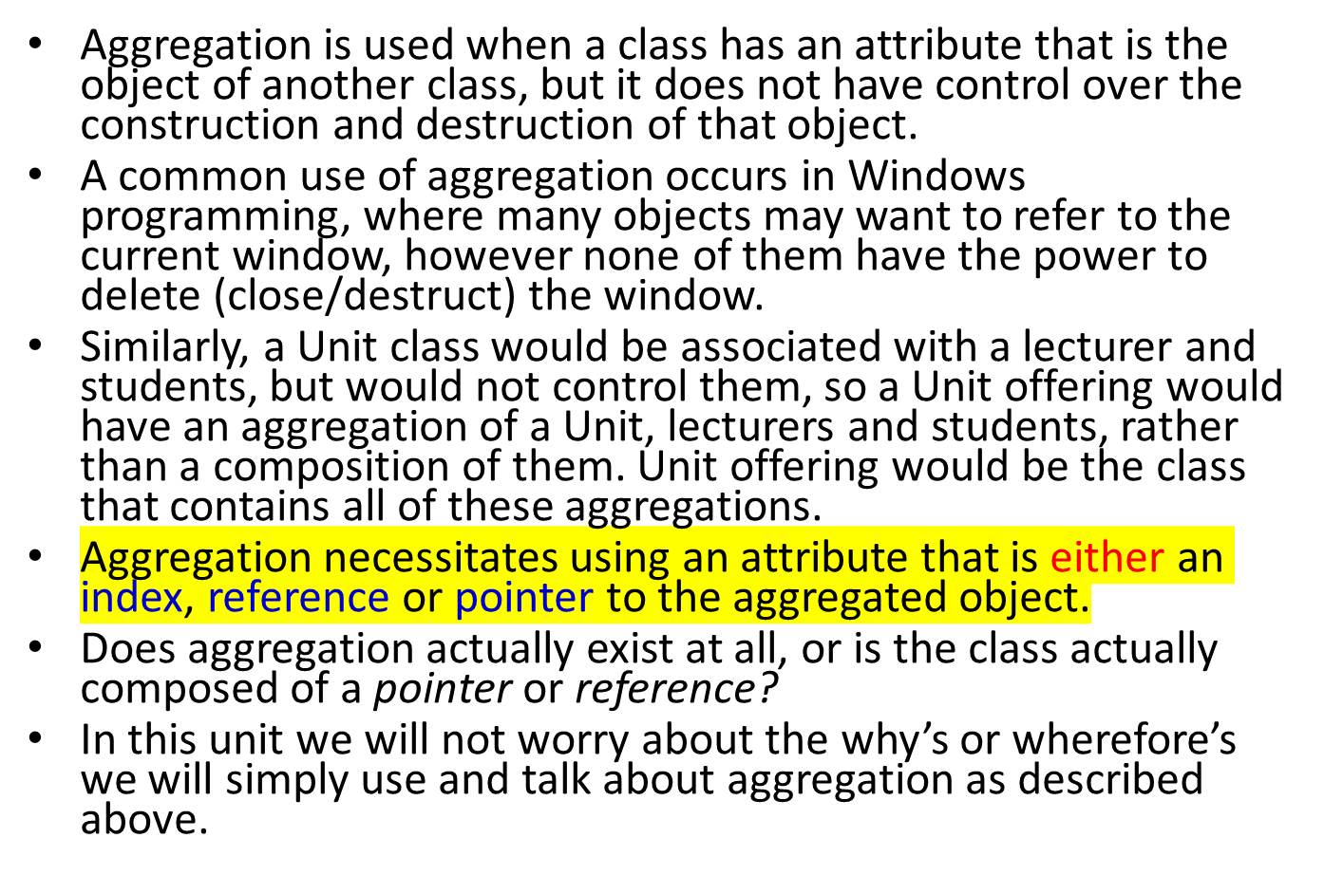
Aggregation

Slide 20
Linked Lists
A good example of aggregation is what occurs in a linked list.
A linked list is exactly what it sounds like: each piece of data is combined with a link (pointer) to the next piece of data. This combination is called a node.
In that situation the node class is composed of the data, but aggregates the next node.
This is because if we delete/remove a node, it does not automatically delete the following node.
We will cover lists again in a later lecture. For this topic, you need to know the basics.

Slide 21
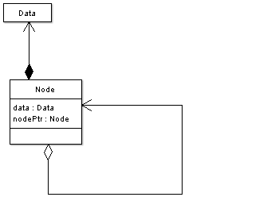
Linked List Diagrams
Abstract View
UML Diagram
When you have this notation, is Node responsible for deleting itself?
Notes:
Destroying a Node implies destroying the associated data but not the next node. The filled diamond (composition) means a strong relation and the unfilled diamond (aggregation) is a weak relation.
This node has a pointer (pointer to the next node). Would the Node have a destructor that deletes this pointer?

Slide 22
In C++, a simplified node class that stores a single integer piece of data, might look like this:
class Node [1] // class or struct – think carefully
{
public:
Node () {m_next = NULL;} // or nullptr. Always initialise to null
~Node () {} // [2]
Node *GetNext ();
void SetNext (Node *next) {m_next = next;}
int GetData () {return m_data;}
void SetData (int data) {m_data = data;}
private:
int m_data; // data is strongly associated with Node – see UML
Node *m_next; // aggregation. Would the destructor delete this?
};
<number> of 26
Notes:
[1] Should this be a class or a struct?
Would a struct Node together with Node constructors be sufficient as shown below? Think in terms of behaviours of a
Node object. Setters and getters provide controlled access but what control is needed for Node? Is there any restriction
on what values m_data and m_next can hold? If there are no restrictions, why is controlled access needed?
struct Node { // class or struct?
Node(int data, Node *next = nullptr) { // having a constructor ensures that the pointer always initialises to null.
m_next = next;
m_data = data;
}
int m_data;
Node *m_next;
};
Given that there will be a LinkedList class that manages Node objects to create the linked list, consider the following:
class LinkedList; // forward declaration
class Node { // class or struct, now that everything is private
private:
friend class LinkedList; // everything is private and the only thing that access internals of Node is the friend LinkedList – strong encapsulation, so good use
Node(int data, Node *next = nullptr) { // having a constructor ensures that the pointer always initialises to null.
m_next = next;
m_data = data;
}
int m_data;
Node *m_next;
};
[2] what if the destructor deletes m_next? Remember the rules for classes having pointer data?
Think through this:
~Node () {delete m_next;}
Can the design be improved?
What changes do you need to make to Node so that it can store data of any type (not just int)?

Slide 23
Templates <>
The Node class is almost identical no matter what type of data is stored within it.
Therefore, rather than re-write it every time we want to store a different data type, we use a template.
Templates are descriptions of types which have to be instantiated with a particular type at run time.
We have already used them when using the STL.
A template node class would look like this:

Slide 24
template <class DataType> [1]
class Node
{
public:
Node () {m_next = NULL;}
~Node () {}
Node *GetNext ();
void SetNext (Node *next) {m_next = next;}
void Data (DataType &data) {data = m_data;}
void SetData (const DataType &data) {m_data = data;}
private:
DataType m_data; // same idea as before about relationship
Node *m_next;
};
We tell the compiler it is a template. The type is now a parameter.
We use DataType to replace ‘int’ everywhere
<number> of 26
Notes:
You can use the word DataType, eleType. Or you could use any word you think of here, but that is not the preferred approach.
I am happy with:
template <class T>
T, by convention is the parameterised type.
Or you may use
template <typename T>

Slide 25
Within our program, we then instantiate a node in the same way as with the STL:
  typedef Node<int> IntNodeType; //IntNode is a type
  IntNodeType intNode;
IntNodeType is a type; in this case an integer Node class.
The template Node can’t contain anything as T is not bound to a type. Once bound to a type, it is realised, and can be used in an application.
There are limitations to templates:
  They can only be used where all the methods and attributes are the same for every class.
  They require all the code to go in the header file or else the code file has to be included! See textbook chapter on, Overloading and Templates for further discussion.
  They can make the code very difficult to debug.
They should be avoided except for very simple classes with only a few, clearly defined methods and attributes – generic classes.

Slide 26
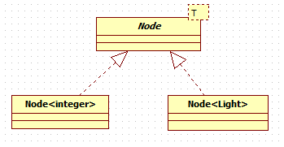
In UML
The box (with T) should have a dashed border. Arrows are diamond shaped. Lines are dashed. (Realisation [1] created in StarUml tool)
The Realised types Node<integer> and Node<Light> can contain data.
The template Node cannot contain data.
Notes:
[1]
See topic 1 notes

Slide 27
Exercise
How would you the Law of Demeter [1] be applied when applied to objects that are composed of other objects (composition or aggregation)?
Would there be situations where it would make sense to violate this law?
Notes:
[1]
When you were designing and implementing the setters/getters for lab 4, did you violate the Law of Demeter?

Slide 28
Readings
Textbook: Chapter on Classes and Data Abstractions.
Chapter on User-Defined simple data types, Namespaces and the string Type.
Chapter on Inheritance and Composition.
  You should go through the Programming example: Grade Report in the chapter on Inheritance and Composition.
Entire chapter on Pointers, Classes, Virtual Functions, Abstract classes, and Lists.
Chapter on Overloading and Templates.

