Slide 1
SharePoint Server 2019
What's New in SharePoint Server 2019

Slide 2



Trevor Seward
Over a Decade of SharePoint Experience
Office Apps and Services MVP
SharePoint MSDN/TechNet Forums Moderator
https://thesharepointfarm.com
@NaupliusTrevor

Slide 3
SharePoint Server 2019 – A Cloud Story
Deprecated and Removed Features
New and Updated Features
Workflow Manager
Modern UI
Hybrid Features
What’s new
What’s not
New PowerShell cmdlets for old tasks
Upgrade
Cloud Ready
Farm Architecture

Slide 4
Deprecated Features
All Service Applications/Instances not available in SharePoint Online
Access Services (2010/2013)
Document Conversion Services
Machine Translation Services
Lotus Notes Connector
PerformancePoint Services
PowerPoint Conversion Services
Visio Graphics Service
Word Automation Services
Custom Help
No need to use Install-SPHelpCollection

Slide 5
More Deprecated Features
InfoPath Forms Services
Variations
SOAP Services
List SOAP Service (Lists.asmx)
Site Manager
Site Move
SharePoint Designer

Slide 6
Removed Features
Aggerated Newsfeed
Site Newsfeed still available
Code-based Sandbox Solutions
Digest Authentication (removed in IIS)
Incoming Email in Automatic Mode – due to removal of IIS6 APIs
Multi-tenancy
PowerPivot Gallery and Refresh
SQL Server Reporting Services
Visio file interactivity (VGS)

Slide 7
Workflow Manager
It’s still Workflow Manager
RIP SharePoint Workflow Manager
WFM CU5
Azure Service Bus 1.1
WFM Client CU4
Supported on modern platforms
Same OS/SQL Server support as SharePoint 2019!

Slide 8


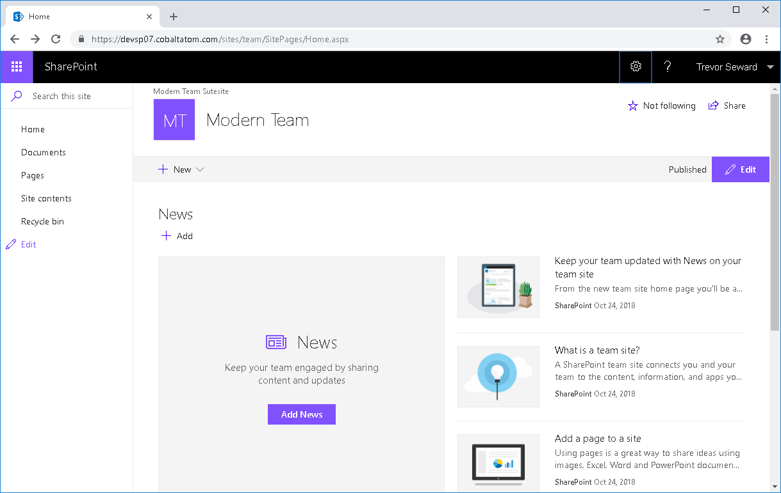



Modern Team Sites

Slide 9
Modern Team Sites – What’s Missing
Certain Modern Webparts
Excel-like List Formatting
Modern PDF Viewer

Slide 10
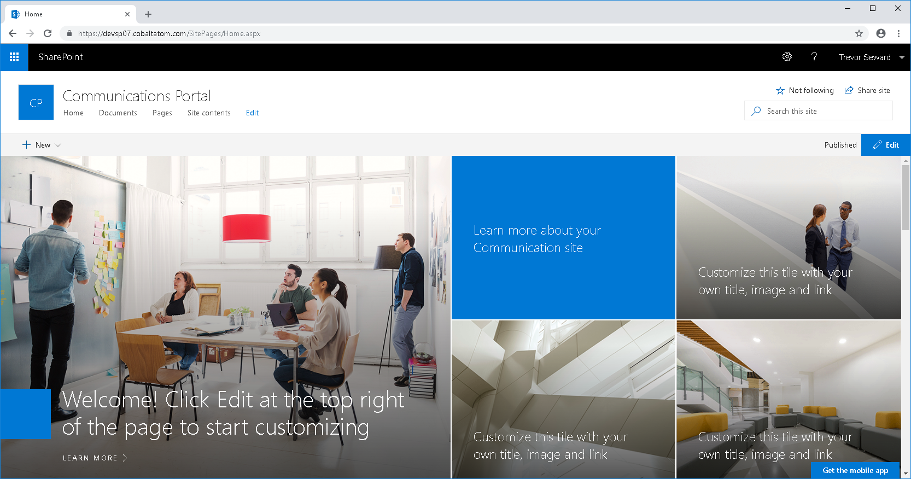
Communication Sites

Slide 11
Hybrid
Cloud Search Service
Hybrid Taxonomy/Content Types
Hybrid OneDrive for Business and Sites
(It’s a bug!)
Hybrid Self-Service Site Creation
Hybrid Search
Hybrid Insights?

Slide 12
Administrative Improvements
Self-Service Site Creation
Configuration
Usage
PowerShell
Get-SPContentDatabaseOrphanedData
Set-SPApplicationCredentialKey (and Remove)
Get-SPContentDatabase –DaysSinceLastProfileSync
Clear-SPContentDatabaseSyncData –DaysSinceLastProfileSync
Update-SPProfileSync

Slide 13
More Administrative Improvements
SMTP Authentication
Health Rules
People Picker
SMTP Authentication
Distributed Cache
backgroundGC=true
CU7
New Templates
SPSPERS#10 – OneDrive site
STS#3 – Modern Team Site
SITEPAGEPUBLISHING#0 – Communications Site

Slide 14
End User Improvements
SharePoint Home
New App Launcher Experience
Modern Search Experience
List items?
Modern Pages
Modern Lists/Libraries
# and %! … with 400 characters
Up to 15GB File Size Supported
Folder Upload

Slide 15
More End User Improvements
OneDrive to sync them all
Same sharing experience as SPO (sans anonymous and external)
Recycle Bin
Contribute access? You can restore it!
Microsoft Stream modern webpart

Slide 16
Upgrade!
Same upgrade process
You must be on SharePoint Server 2016 RTM+
Supported Database Upgrades
Business Data Connectivity Service Application
Content Databases
Managed Metadata Service Application
PerformancePoint Service Application
Search Service Application
Secure Store Service Application
User Profile Service Application
Remove BI

Slide 17
Cloud Ready
Hybrid Search, Taxonomy/Content Types, OneDrive/Sites
Being Cloud Ready
Service Applications
Service Instances (Features)

Slide 18
Farm Architecture
If you’ve built 2016, you’ve built 2019
Minimum hardware requirements are identical to 2016 (…and 2013)
Windows Server 2016/SQL Server 2016 Minimum; Windows Server 2019 and SQL Server 2017 Supported
Recommended minimum of 4 SharePoint Servers, 2 SQL Servers in AOAG (Enterprise), 2 Office Online Servers, 3 Workflow Manager Servers
Data Management Gateway
Flow and PowerApps

