Slide 1
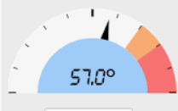
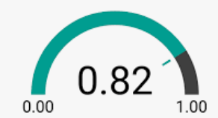

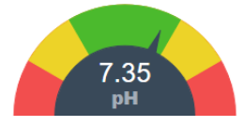
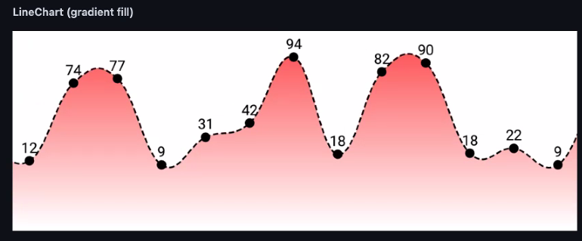
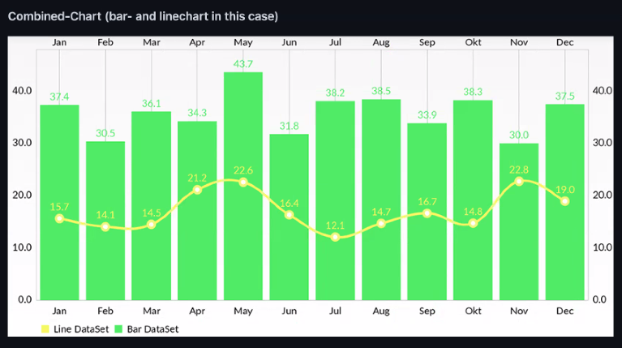

Inv_active_power
EFFICIENCY
PKR SAVED
101
Yield Today KWh
Inverter Max Production
101
101
TREES SAVED
Yield Total KWh
Recorded On
Inv_rated_power
10021
10021
12 MAR 2022
Inv_A_volt
Inv_B_volt
Inv_C_volt
Inv_Frequency
Inv_A_Curr
Inv_B_Curr
Inv_C_Curr
Inverter ID
Inverter Brand
Inverter Model
3
Growatt
60KTL
Inverter Serial
Installed PV
ABDCFERFASDASD
55.2
KW last 24 Hours
Module Serial
Site Name
M-14-10003
APS Campus 2, Khariyan
Inverter Status
Inverter Comms
ON GRID
Inverter Fault Code
Monitor Comms
E-3456
KWh last 31 Days VS Savings

Slide 2
Inv_active_power
EFFICIENCY
PKR SAVED
101
Yield Today KWh
Inverter Max Production
101
101
TREES SAVED
Yield Total KWh
Recorded On
Inv_rated_power
10021
10021
12 MAR 2022
Param | PV-1 | PV-2 | PV-3 | PV-4 | PV-5 | PV-6 | PV-7 | PV-8 | PV-9 | PV-10
Voltage
Current
Power
Inv_PV1_Volt
Inv_PV1_Curr
Inv_PV1_Volt * Inv_PV1_Curr
KWH last 12 months VS Savings

Slide 3
Recorded Data
Last 24 Hours (/10mins record KWh Production)
Last 30 Days (Record KWh Production / Day)
Last 12 Months (Record KWh Production / Month)
Maximum KW recorded against date

Slide 4
Non functional requirements
- Auto Bluetooth reconnect
Always open same application on reboot, uer must not be able to goto OS level or exit
Logo on boot screen
Piracy protection
No screen saver or lock screen
On the air updates

Slide 5
Serial Data format from Controller to Android
#Inv_id(int)^ Inv_enabled(int)^Inv_status(string)^Inv_status_manip(int)^
Inv_yield_today(float)^Inv_yield_total(float)^Inv_active_power(float)^
Inv_reactive_power(float)^Inv_rated_power(float)^Inv_PV_installed(float)^
Inv_PF(float)^Inv_Frequency(float)^Inv_A_Curr(float)^Inv_B_Curr(float)^
Inv_C_Curr(float)^Inv_A_volt(float)^Inv_B_volt(float)^Inv_C_volt(float)^Inv_temp(float)^ Inv_PV1_Curr(float)^Inv_PV1_Volt(float)^Inv_PV2_Curr(float)^Inv_PV2_Volt(float)^
Inv_PV3_Curr(float)^Inv_PV3_Volt(float)^Inv_PV4_Curr(float)^Inv_PV4_Volt(float)^
Inv_PV5_Curr(float)^Inv_PV5_Volt(float)^Inv_PV6_Curr(float)^Inv_PV6_Volt(float)^
Inv_PV7_Curr(float)^Inv_PV7_Volt(float)^Inv_PV8_Curr(float)^Inv_PV8_Volt(float)^
Inv_PV9_Curr(float)^Inv_PV9_Volt(float)^Inv_PV10_Curr(float)^Inv_PV10_Volt(float)*

Slide 6
Serial Data format from Android to Controller
#Inv_num(int)^
Inv1_id(int)^Inv1_brand(int)^Inv1_model(int)^
Inv2_id(int)^Inv2_brand(int)^Inv2_model(int)^
Inv3_id(int)^Inv3_brand(int)^Inv3_model(int)^
Inv4_id(int)^Inv4_brand(int)^Inv4_model(int)^
Inv5_id(int)^Inv5_brand(int)^Inv5_model(int)*

