Slide 1

BTP · CMD 20:58 IST
Team : Fluxbit
PREDICTIVE TRAFFIC COMMAND
Reduce traffic gridlock with
predictive hotspot dispatch.
Atlas forecasts where congestion will spike next, then dispatches officers to the right junctions before the jam forms. Built on ST-GATv2 spatiotemporal forecasting and ILP optimization.
RISK MODEL
CRITICAL
HIGH
MODERATE
LOW
MINIMAL

Slide 2



01 · THE PROBLEM
Congestion is fought after it's already gridlocked
THE CITY
THE OPERATOR
THE CONSEQUENCE
Bengaluru corridors choke at predictable times — yet congestion is handled reactively, only once a junction is already jammed.
A BTP control room has limited officers and no objective way to decide where to send them. Deployment runs on gut-feel and radio chatter.
Officers arrive late. One mismanaged junction cascades delay across the corridor — multiplying response time, fuel burn and risk.
₹90,000
Projected annual cost of traffic congestion in Delhi by 2030.
Up from ≈ ₹54,000 cr in 2013 — the gap Atlas is built to close by acting before congestion forms, not after.
CR / YEAR
SOURCE: IIT MADRAS CONGESTION-COST STUDY (VIA CSE INDIA)
BTP · CMD
02 / 11

Slide 3





02 · THE SOLUTION
One pipeline, run before the congestion happens
→
→
→
→
01
02
03
04
05
Raw data
Corridor snapping
Forecast
Cluster
Dispatch
Violations, road type, lanes, weather & logistics hubs per junction and time window.
Cleanse noisy points and snap them onto real Bengaluru road corridors.
ST-GATv2 spatiotemporal graph model predicts demand & risk for the next window.
GIS kernel-density clustering groups hotspots into deployable zones.
ILP optimizer allocates officers — one click: Send to Optimizer.
The whole loop runs before the congestion happens. That timing — not the model count — is the product.
BTP · CMD
03 / 11

Slide 4
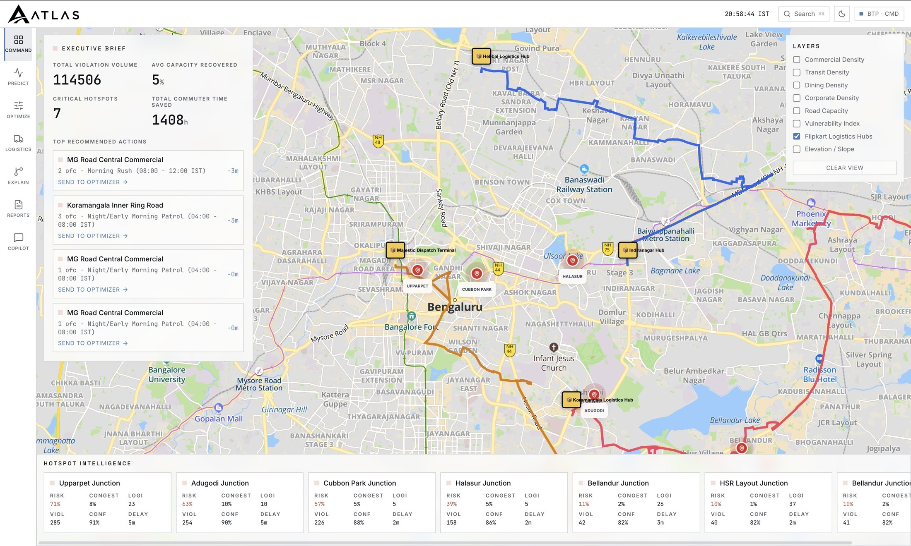

03 · LIVE DEMO
The command console, watching Bengaluru live
01
Live map
OSM base with a real-time risk heat overlay across the city.
02
Hotspot intelligence
Every junction scored — risk, congestion, logistics, violations, delay.
03
Recommended actions
Top junctions with officer counts & patrol windows, ready to dispatch.
04
Before / after
Send to Optimizer and watch capacity recovered update live.
The recommendation re-ranks in real time as officers drop offline or demand spikes.
BTP · CMD
04 / 11

Slide 5
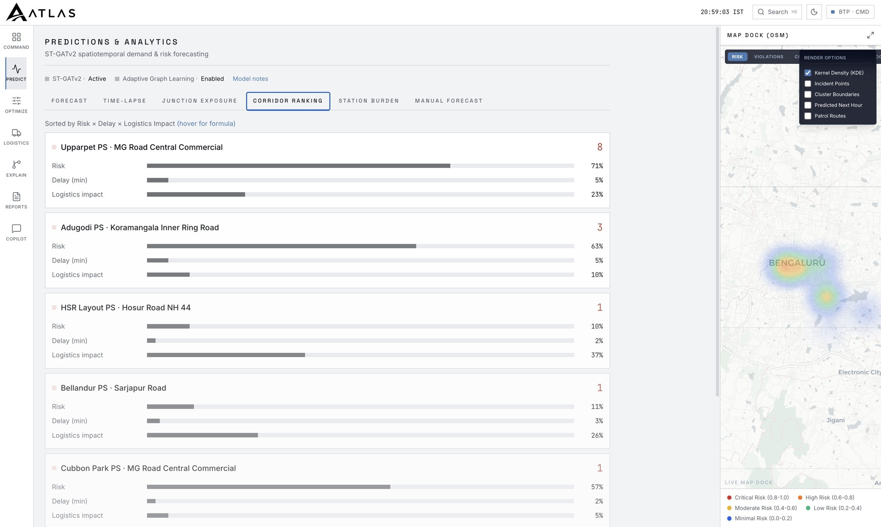
04 · THE FORECAST ENGINE
ST-GATv2 ranks every corridor by Risk × Delay × Logistics
ST-GATv2 spatiotemporal demand & risk forecasting, with Adaptive Graph Learning enabled.
CORRIDOR RANKING
RISK
Upparpet · MG Road
71
Adugodi · Koramangala
63
Cubbon Park · MG Road
57
Halasur · MG Road
39
Bellandur · Sarjapur
11
BTP · CMD
05 / 11

Slide 6
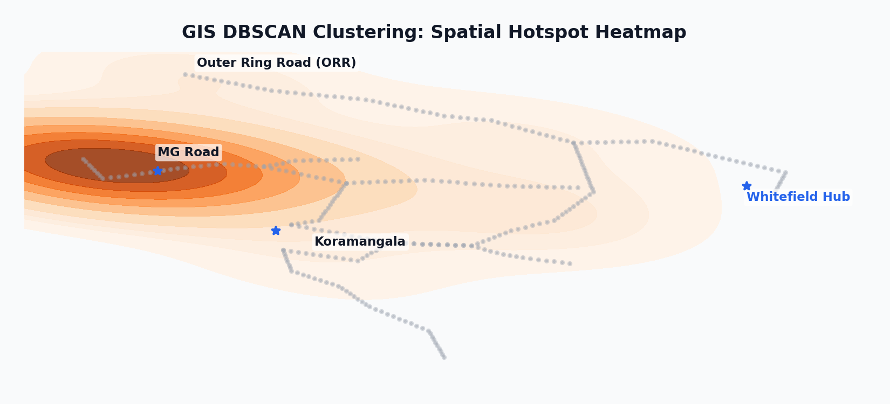
05 · MODEL ARCHITECTURE
Physics-Coupled Spatiotemporal Graph Attention Network
01 · MULTI-SOURCE INPUTS
02 · ST-GATv2 GNN ENGINE
03 · CRITERIA & DISPATCH
Road Network Graph (cKDTree)
• Snaps coordinates to corridor network segment
• Graph Grid: 338 Nodes, 784 Directed Edges
Parallel Spatial Embeddings
• GATv2Conv attention captures local topology
• Learnable embeddings map dynamic covariance
Tuned Optimization Objectives
• Weighted Huber Loss (node deltas) limits outliers
• Evening Bias Vulnerability Index overrides shift gap
Hyper-Local Context Ingestion
• Snaps Flipkart hubs & courier boxes (eLocs)
• Queries POIs and Mappls slope gradients
→
Sequential GRU Cell
• Aggregates spatial embeddings over shift timelines
• Models temporal congestion spillover effects
→
Density-Based GIS Clustering
• DBSCAN aggregates risk segments into hotspots
• Filters reporting noise; maps police boundaries
Temporal Time Encodings
• Periodic sine/cosine vectors encode temporal cycles
• Captures shifting daily & weekly traffic grids
Decoder & Transformation
• MLP decodes GRU outputs to physical scale
• Supports exponential target inverse transforms
SciPy MILP Dispatch Solver
• scipy.optimize.milp models capacity bounds
• Outputs recommended patrol officer counts
STAGE 4 · GIS KERNEL DENSITY HOTSPOT CLUSTERING (DBSCAN)
DBSCAN aggregates adjacent GNN risk-forecasted segments into geographical hotspots matching police station boundaries. The 2D Kernel Density Estimate (left) visualizes predicted traffic violation hotspots across key Bengaluru commercial corridors (MG Road, Koramangala, Whitefield), filtering spatial reporting noise and framing patrol constraints for the SciPy MILP dispatcher. It highlights snapped Flipkart eLoc hubs (blue stars) as high-priority logistics patrol zones.
BTP · CMD
06 / 11

Slide 7
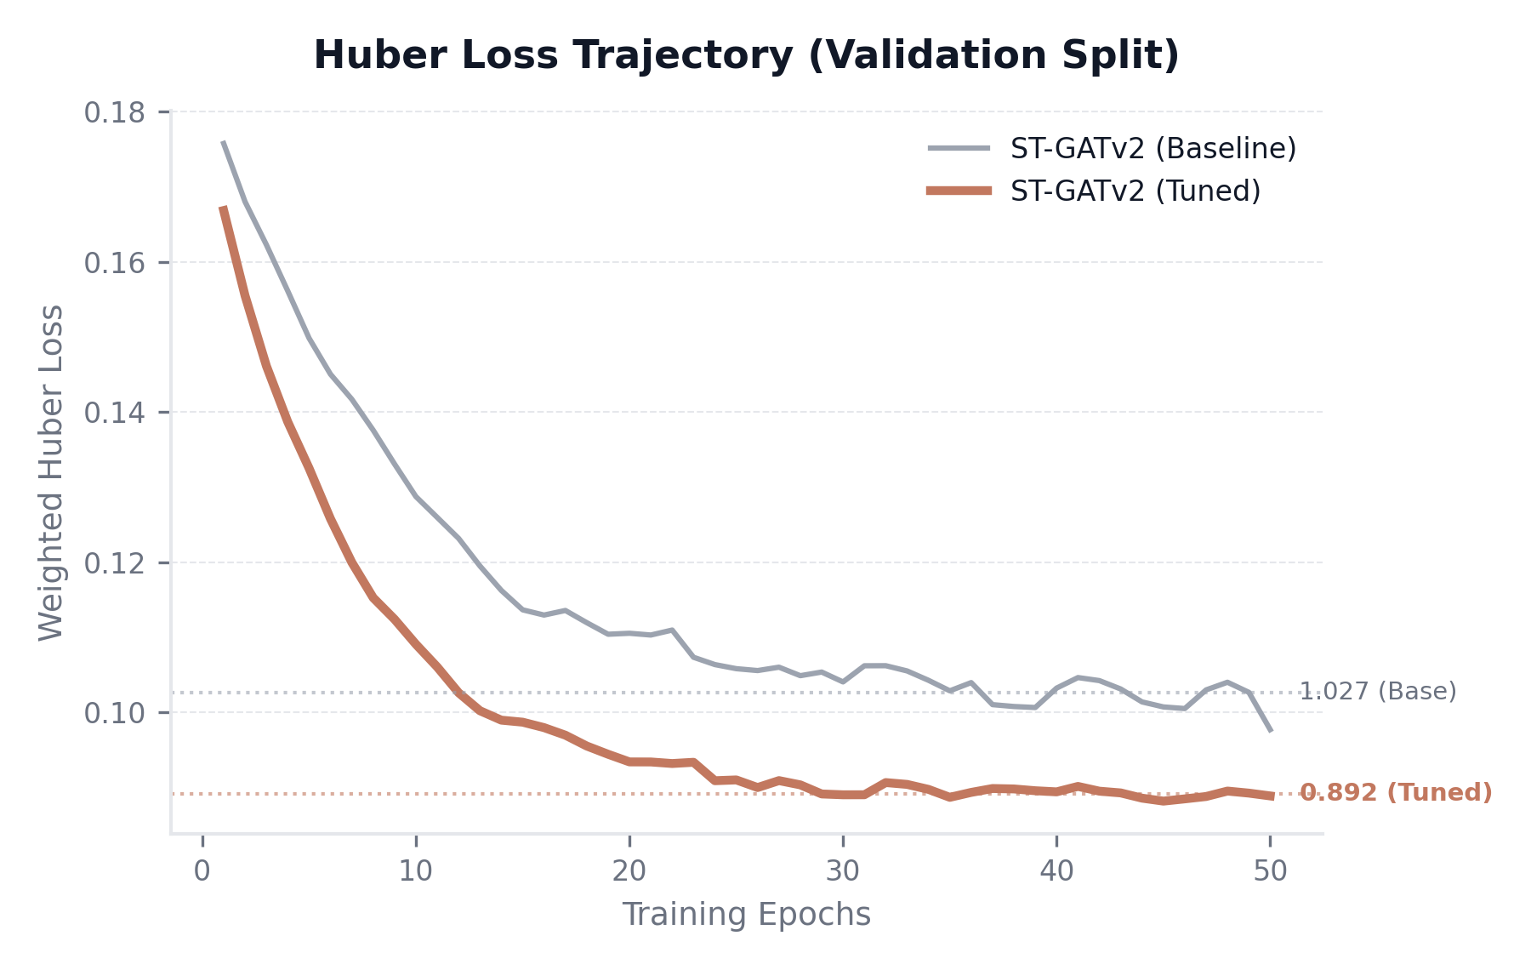
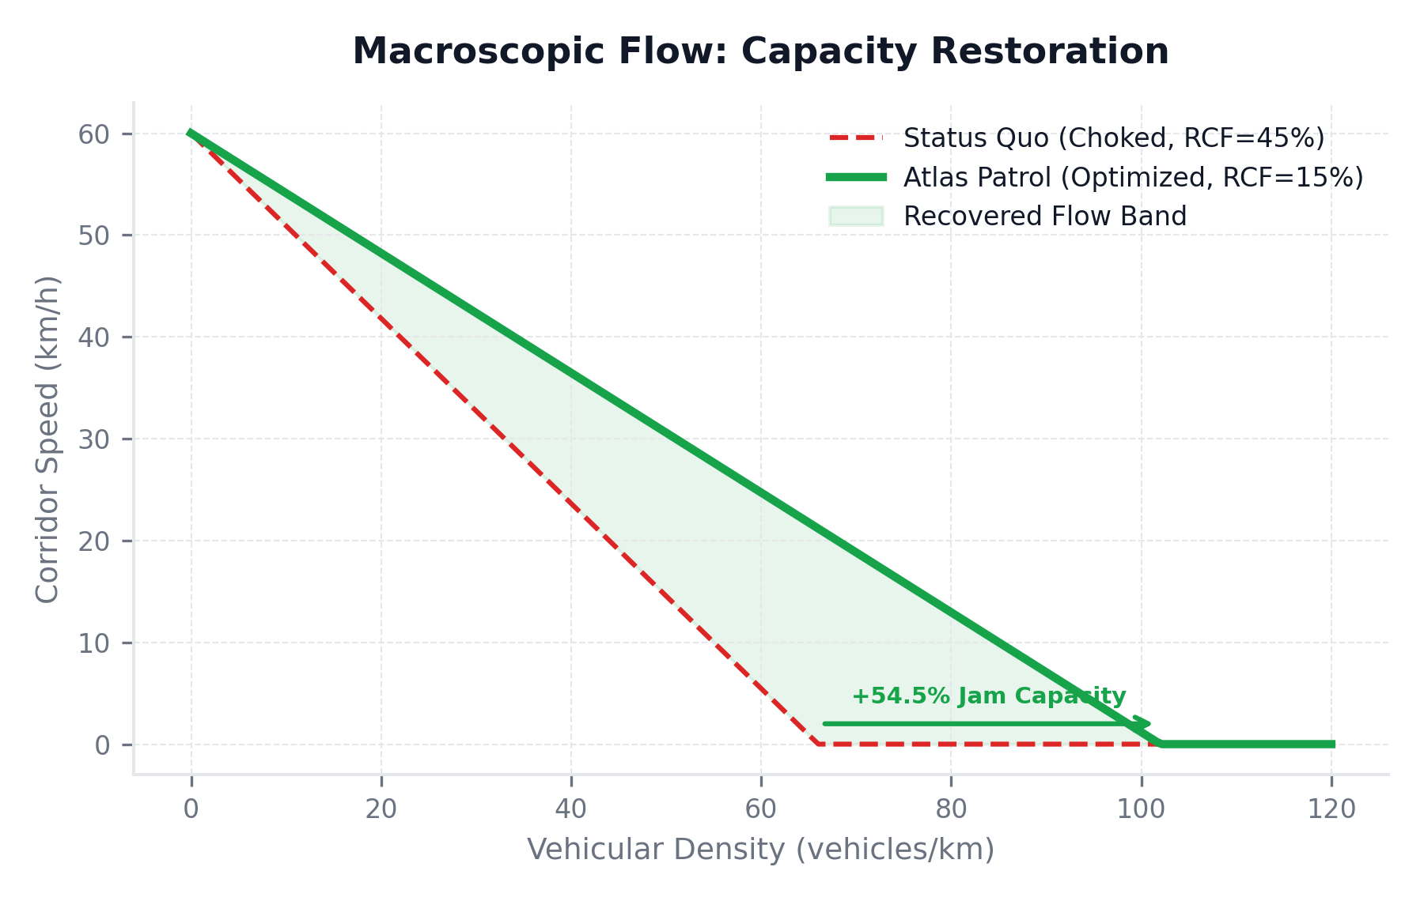
06 · PERFORMANCE & VALIDATION
Tuned ST-GATv2 Validation & Traffic Impact Metrics
01 · PREDICTION PRECISION
+13.1% MAE reduction with custom Weighted Huber Loss. High-density commercial nodes are penalized quadratically using node-specific deltas.
02 · GIS HOTSPOT COVERAGE
DBSCAN clusters cover 50.6% of city-wide violations with 68.1% station boundary alignment purity. Minimizes spatial patrol routing dispersion.
03 · SIMULATION IMPACT
~100 vehicle-hours saved per peak hour. Proactive officer presence restores congested road capacity, yielding a average ~5% capacity recovery.
BTP · CMD
07 / 11

Slide 8


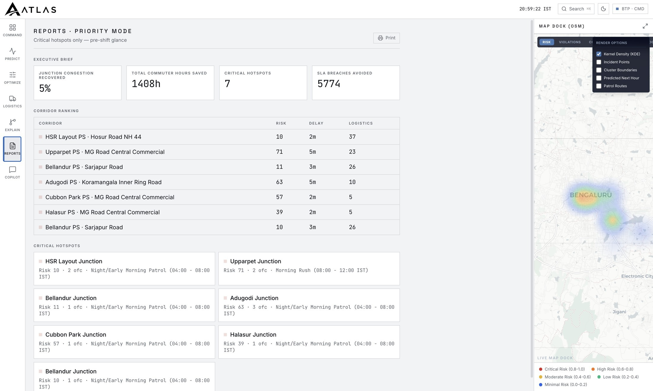



07 · IMPACT
One pre-shift brief, measured
1,408 h
7
COMMUTER TIME SAVED
CRITICAL HOTSPOTS
5,774
5 %
SLA BREACHES AVOIDED
CAPACITY RECOVERED
114,506
VIOLATIONS ANALYZED
LIVE EXECUTIVE BRIEF — BTP · CMD, REPORTS · PRIORITY MODE
BTP · CMD
08 / 11

Slide 9







08 · THE SYSTEM
Seven modules, one operating picture
COMMAND
PREDICT
OPTIMIZE
LOGISTICS
EXPLAIN
REPORTS
COPILOT
Live operating picture
ST-GATv2 forecasting
ILP officer dispatch
Freight-aware weighting
Why each call was made
Pre-shift priority brief
Ask Atlas in plain English
PIPELINE
Data → ST-GATv2 forecast → GIS clustering → ILP dispatch → operating picture
Forecast validated at ~98 R²×100 on held-out data — the rankings are measured, not guessed.
BTP · CMD
09 / 11

Slide 10


09 · DIFFERENTIATION
Atlas ≠ a dashboard
STANDARD MVP / COMPETITORS
ATLAS
Historical Data Only: Plots static violation averages without real-time predictive sequence modeling
ST-GATv2 Graph Net: Integrates learnable road topology matrices (A_adaptive) to predict next-shift risk
Manual Patrol Scheduling: Relies on manual dispatcher heuristics and static geographic bounds
SciPy MILP Dispatch Solver: Optimizes officer allocation subject to capacity and station limits
No Topographic Awareness: Ignores road elevation gradients that constrict narrow corridor capacity
Mappls Terrain Snapping: Models slope gradeability speed restrictions via cached elevation APIs
Logistics Blindspot: Treats logistics routes and Flipkart supply hubs as standard consumer traffic
Logistics Penalty Index (LPI): Prioritizes routes using snapped Flipkart hubs and logistics matrices
Reactive Dispatch Loop: Deploys officers after a bottleneck forms, cascading delays downstream
Greenshields Flow Simulation: Predicts queue shockwaves to calculate counterfactual vehicle-hour savings
Black Box Operations: Provides static data feeds without explainable reasoning or interactive copilot
AI Copilot Command Center: Explains enforcement suggestions and accepts commands in plain English
A dashboard tells you there's a problem. Atlas tells you what to do — and does it.
BTP · CMD
10 / 11

Slide 11

DEPLOY
From live console to city-wide rollout
Running today on Bengaluru data: COMMAND · PREDICT · OPTIMIZE · LOGISTICS · EXPLAIN · REPORTS · COPILOT. It runs on standard traffic-feed data cities already collect.
ON THE ROADMAP
Scenario simulator
Mappls routing
Multi-city scale
Live ANPR feeds
Atlas turns traffic enforcement from reactive to predictive — and proves it on the map.
PREDICTIVE TRAFFIC COMMAND

