Slide 1
Meiti Shangcheng Employee & Shift Management System
UML Class Diagram Design
The first DIY & hardware chain store of Jupiter Group in Zhengzhou
Group 6 · Assignment 3
Jupiter Group · Zhengzhou · 2026

Slide 2
CONTENTS
01
UML Class Diagram Overview
Five packages · 12 core classes · 3 enumeration types
02
Class Diagram Notation
Three-compartment class structure, visibility markers, and key modeling mechanisms
03
Core Classes in Detail
Design rationale, responsibilities, and encapsulation strategies, class by class
04
Class Relationship Analysis
Semantics of generalization, association, composition, and dependency

Slide 3
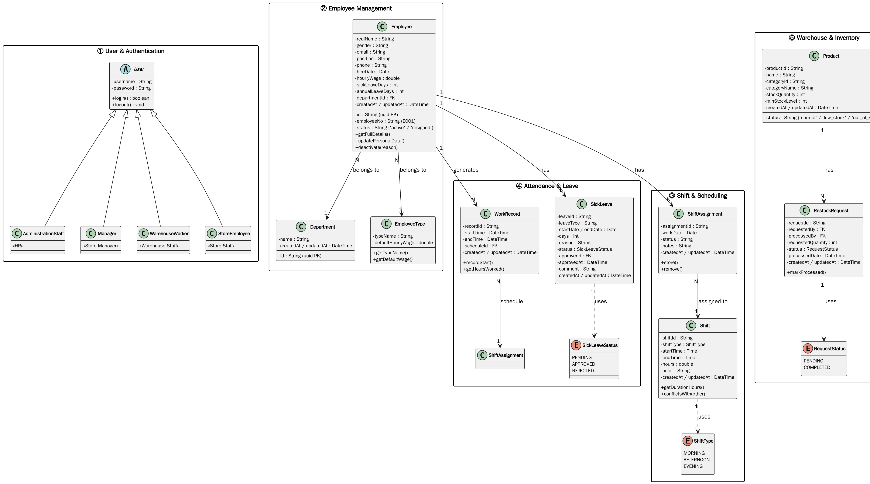
01 UML Class Diagram — Full Overview
Five-package structure · top-down layout · clean, untangled edges
Figure 1. UML class diagram of the Meiti Shangcheng employee and shift management system

Slide 4
02 Class Diagram Notation — Conventions
Graphical notation following the UML 2.x specification
Class
Three-compartment structure: name / attributes / operations
Abstract Class
«abstract» stereotype marker — User
Enumeration
Stereotyped data type with a restricted value domain
Relationship notation:
Solid + hollow triangle ▷
Generalization — specialization of the parent class User
Solid + filled diamond ◆
Composition — strong whole–part ownership (not used: see Detail ⑤, DB-Aligned)
Solid + crow's foot ↗
Association — the crow's-foot end denotes the "many" side
Dashed line ☼
Dependency — value-constraint reference to an enumeration type
+ / − prefixes
Visibility: + public; − private, reflecting encapsulation

Slide 5
02 Notation — Key Modeling Mechanisms
Core OO mechanisms adopted in this class diagram and their design intent
Generalization
Abstract Class
Behavior reuse & polymorphism
Contract definition, no instantiation
Subclasses inherit the parent's attributes and operations and append specialized responsibilities;
Honors the Liskov Substitution Principle (LSP) — role objects are referenced uniformly as User;
Runtime dynamic binding provides the polymorphic basis for permission dispatch.
«abstract» User cannot be instantiated; it defines the common contract of all system users;
No role-less "bare user" exists — every concrete user is a subclass;
Effectively prevents bypassing the role-based permission model.
Enumeration
Composition
Value-domain constraint
Lifecycle constraint
Restricts an attribute's value space to a set of predefined constants;
Eliminates illegal states at the modeling level, replacing free-text input;
More readable and maintainable than boolean flags or string conventions.
A filled diamond marks strong ownership in UML, but here ShiftAssignment—Shift
is modeled as a normal association: the DB keeps only a plain FK (schedules.shift_id),
so the composite lifecycle semantics no longer apply (DB-Aligned).

Slide 6
03 Detail ① — User Role Inheritance Hierarchy
A permission model built on generalization
«abstract» User
Design rationale: Pull Up common behavior
Abstract base class for all users
All four roles share one authentication flow, lifted into the abstract parent User;
login()/logout() are implemented once and reused by all subclasses, eliminating duplication.
- username: String
- password: String
+ login(): boolean
+ logout(): void
▼ Four concrete subclasses:
AdministrationStaff (HR)
Manager (Store Manager)
WarehouseWorker (Warehouse Staff)
StoreEmployee (Store Staff)
Responsibility assignment: role-specific operations
HR: employee records, wage setting;
Manager: statistics queries, sick-leave registration, scheduling;
WarehouseWorker: inventory view, restock-request processing;
StoreEmployee: personal roster, profile maintenance (self-service site).
Architectural benefit: Open-Closed Principle (OCP)
Open for extension — a new role (e.g., Cleaner) requires only a new subclass;
Closed for modification — existing roles and authentication logic stay untouched;
Permission isolation is achieved at the type level, without runtime checks.
Database implementation note (DB-Aligned)
The users table stores roles in a string column (single-table inheritance);
the 'manager' role value is removed from DB — shift_manager takes over its permissions
as a role value only, not as a UML subclass.

Slide 7
03 Detail ② — Employee: The Core Business Entity
Business rules mapped to attribute design
Employee
Dual identity: uuid PK + business employeeNo
Core entity associated with most classes
id (uuid) is the internal PK referenced by all foreign keys;
employeeNo (E001) is the human-readable business code.
- id: String (uuid PK)
- employeeNo: String (E001)
- realName: String
- gender / email / position
- phone: String
- hireDate: Date
- hourlyWage: double
- sickLeaveDays: int
- annualLeaveDays: int
- status: String ('active'/'resigned')
- departmentId: FK
- createdAt / updatedAt: DateTime
+ getFullDetails()
+ updatePersonalData()
+ deactivate(reason)
+ hasOngoingShift()
hourlyWage: single wage field (no dual-track flag)
The isIndividualWage boolean from the design model is not implemented in DB;
each employee has one hourly_wage column directly storing the rate.
status: soft-delete via string code
Instead of isActive: boolean, the DB uses a status string 'active' / 'resigned';
it preserves historical payroll data while hiding resigned employees from views.
Additional fields: leave balance + audit + FK
annualLeaveDays added (design only had sick leave);
departmentId FK links to the departments table (new Department class);
createdAt / updatedAt audit timestamps exist on all tables.

Slide 8
03 Detail ③ — EmployeeType: Position Pricing Entity
A normalized design that removes data redundancy
EmployeeType
Design rationale: single point of storage for rate standards
Foundational data entity
The "position type — default wage" pair is modeled as an independent entity;
The rate standard is stored exactly once, following normalization principles;
If duplicated on every Employee, a price change would require O(n) updates.
- typeName: String
- defaultHourlyWage: double
+ getTypeName()
+ getDefaultWage()
Cascading effect
Changing one type's defaultHourlyWage automatically applies to all employees
of that type without individual pricing;
DB-Aligned: the hourly_wage column directly stores the rate —
no isIndividualWage dual-track flag exists in the database.
Association semantics
Employee—EmployeeType is an N:1 association;
Every employee must belong to exactly one position type, forming the payroll default.

Slide 9
03 Detail ④ — Shift & ShiftType: Value-Domain Constraints
Enumeration constraint and interval-overlap detection
Shift + «enum» ShiftType
ShiftType: domain constraint
Shift definition entity and its value-constraint enum
Locks the shift type into three predefined constants in the UML model,
preventing dirty data from free-text input at the modeling level;
DB-Aligned: in the database this is a plain dictionary table shifts(code/name),
storing strings without a native enum constraint.
Shift:
- shiftId: String
- shiftType: ShiftType
- startTime: Time
- endTime: Time
- hours: int (DB: shifts.hours)
- color: String (DB: shifts.color)
- createdAt / updatedAt: DateTime
+ getDurationHours()
+ conflictsWith(other)
ShiftType (enum):
MORNING 08:00-12:00
AFTERNOON 12:00-16:00
EVENING 16:00-20:00
Shift: encapsulation of the time span
shiftType identifies the category; startTime/endTime define the interval boundaries;
DB-Aligned: hours is precomputed and stored (shifts.hours);
getDurationHours() remains as a convenience getter.
conflictsWith(): interval-overlap detection
Two intervals overlap iff start1 < end2 and start2 < end1;
Invoked at the scheduling entry point to enforce FR-012 (no overlapping shifts per employee);
DB-Aligned: this is application-layer logic — schedules has no unique constraint
and SQLite foreign keys are off, so the DB itself does not enforce it.

Slide 10
03 Detail ⑤ — ShiftAssignment: Associative Entity
Relational representation of a many-to-many relationship
ShiftAssignment
Design rationale: a relationship that carries attributes
Associative entity: employee × shift × date
Employee and Shift form a time-varying many-to-many relationship:
one employee takes multiple shifts on different dates; one shift is staffed by several employees;
The relationship itself carries the date attribute, hence an associative entity —
each record represents the triple (employee × shift × date).
ShiftAssignment:
- assignmentId: String
- workDate: Date (was: date)
- status: String
- notes: String
- createdAt / updatedAt: DateTime
+ store()
+ remove()
-- associated with Shift (normal association, was ◆ composition)
← associated with Employee (crow's foot)
Operation encapsulation & constraint cohesion
store() persists a record after conflict detection and weekly-shift-limit validation;
remove() revokes a record; business rules stay cohesive within entity operations,
so callers need no knowledge of the validation details.
Composition → normal association (DB-Aligned)
Assignment records reference shift definitions through a plain FK (schedules.shift_id);
in the database this is a standard child/junction table without composite lifecycle (DB-Aligned).

Slide 11
03 Detail ⑥ — WorkRecord & SickLeave
Event logging and state-machine-driven approval
WorkRecord / SickLeave
WorkRecord: the source of truth for attendance
Clock-in event record and sick-leave entity
recordStart() / recordEnd() handle the Start-Work and End-Work events;
DB-Aligned: endTime and scheduleId are now stored (attendances.end_time / schedule_id);
getHoursWorked() derives actual working hours from startTime/endTime.
WorkRecord:
- recordId: String
- startTime / endTime: DateTime (was: startTimestamp)
- scheduleId: FK
- createdAt / updatedAt: DateTime
+ recordStart()
+ recordEnd()
+ getHoursWorked()
SickLeave:
- startDate / endDate: Date
- days: int (stored, was calculateDays())
- reason: String
- status: SickLeaveStatus
- approverId: FK
- approvedAt: DateTime
- comment: String
- createdAt / updatedAt: DateTime
SickLeave: a state-machine-driven entity
status takes PENDING / APPROVED / REJECTED, forming an approval state machine;
DB-Aligned: days is stored directly (leaves.days) instead of derived;
approverId / approvedAt / comment complete the approval loop (who approved, when, note).
Cross-entity state consistency
Approval deducts Employee.sickLeaveDays;
The association keeps balance changes traceable against approval records.

Slide 12
03 Detail ⑦ — Product & RestockRequest: Inventory Domain
Stock-level alerting and restock state flow
Product / RestockRequest
Product: master data & stock state
Inventory entity and restock-request entity
Encapsulates static product info (ID, name, categoryId/categoryName) and dynamic stock state;
minStockLevel supports per-product replenishment thresholds;
DB-Aligned: status ('normal'/'low_stock'/'out_of_stock') replaces the isLowStock() boolean predicate.
Product:
- productId: String
- name: String
- categoryId / categoryName: String (was: category)
- stockQuantity: int
- minStockLevel: int (was: lowStockThreshold)
- status: String ('normal' / 'low_stock' / 'out_of_stock')
- createdAt / updatedAt: DateTime
RestockRequest:
- requestedQuantity: int
- status: RequestStatus (PENDING / COMPLETED)
- requestedBy / processedBy: FK
- createdAt / updatedAt: DateTime
+ markProcessed()
RestockRequest: a two-phase restock flow
Phase 1: stock hits the threshold → a request is created with status PENDING;
Phase 2: after restocking, markProcessed() moves it to COMPLETED (was PROCESSED)
and records processedBy, closing a traceable loop.
Scope control
This version implements read-only queries and restock marking only (Could priority);
Full inbound/outbound and procurement management is deferred (Won't);
Following YAGNI, no extra classes are pre-introduced in the class diagram.

Slide 13
04 Class Relationship Analysis
Semantics and design rationale of the four relationship kinds
Generalization
AdministrationStaff, Manager, WarehouseWorker, and StoreEmployee generalize from the abstract base class User;
Authentication is pulled up for reuse; role responsibilities are specialized downward — honoring LSP and OCP (Detail ①).
DB-Aligned: the hierarchy collapses to one users table with a roles string column;
the 'manager' role value is removed — shift_manager takes over its permissions as a role value only.
Association
Employee—EmployeeType: an N:1 ownership association forming the payroll default (Detail ③);
Employee—ShiftAssignment / WorkRecord / SickLeave: 1:N associations — one employee owns multiple business records (Details ②⑤⑥);
ShiftAssignment—Shift: normal association backed by a plain DB foreign key (DB-Aligned).
Composition
Product—RestockRequest: 1:N — one product accumulates multiple restock requests (Detail ⑦);
ShiftAssignment—Shift no longer uses composition: the DB keeps only a plain FK
FK constraints are off — no lifecycle semantics (DB-Aligned).
Dependency
Shift→ShiftType, SickLeave→SickLeaveStatus, RestockRequest→RequestStatus;
Enumerations constrain attribute value spaces — a usage-level dependency (see Modeling Mechanisms).

Slide 14

Thank You
Questions & Discussion
Meiti Shangcheng Employee & Shift Management System · Class Diagram Design

