Slide 1
Meiti Shangcheng Employee & Shift Management System
UML Class Diagram Design
The first DIY & hardware chain store of Jupiter Group in Zhengzhou
Group 6 · Assignment 3
Jupiter Group · Zhengzhou · 2026

Slide 2
CONTENTS
01
UML Class Diagram Overview
Five packages · 12 core classes · 3 enumeration types
02
Class Diagram Notation
Three-compartment class structure, visibility markers, and key modeling mechanisms
03
Core Classes in Detail
Design rationale, responsibilities, and encapsulation strategies, class by class
04
Class Relationship Analysis
Semantics of generalization, association, composition, and dependency

Slide 3
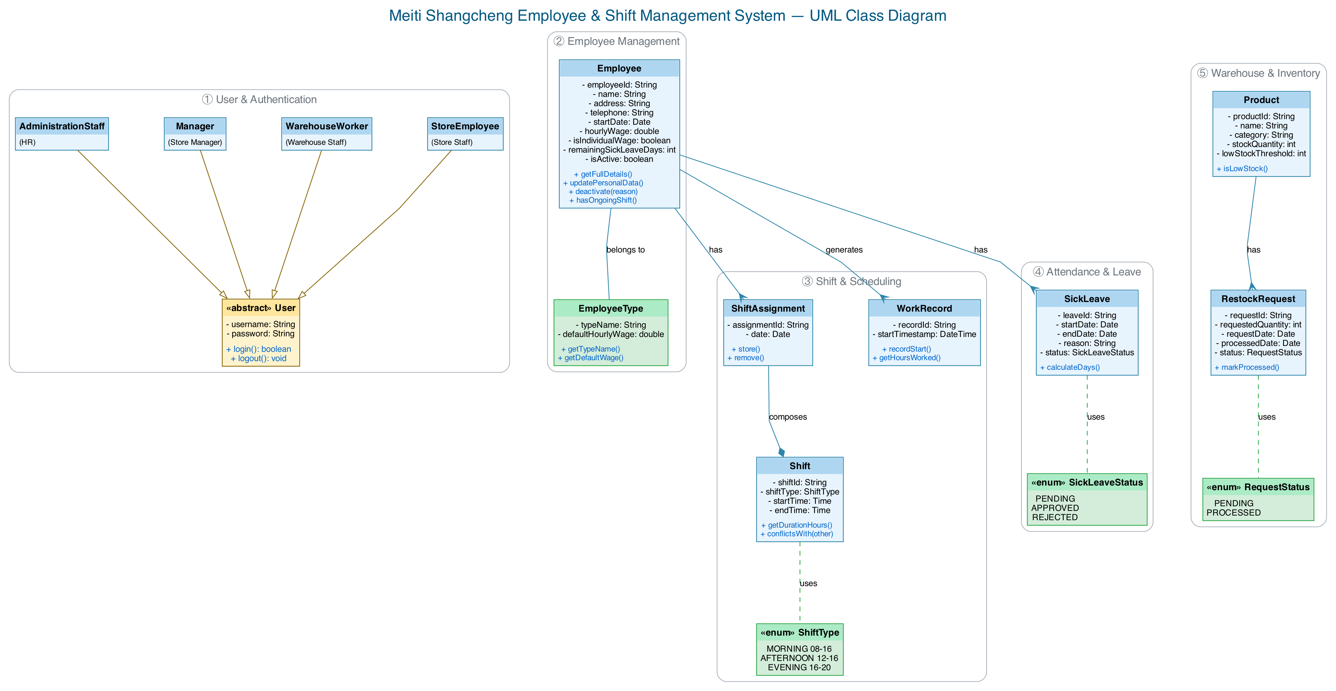
01 UML Class Diagram — Full Overview
Five-package structure · top-down layout · clean, untangled edges
Figure 1. UML class diagram of the Meiti Shangcheng employee and shift management system

Slide 4
02 Class Diagram Notation — Conventions
Graphical notation following the UML 2.x specification
Class
Three-compartment structure: name / attributes / operations
Abstract Class
«abstract» stereotype marker — User
Enumeration
Stereotyped data type with a restricted value domain
Relationship notation:
Solid + hollow triangle ▷
Generalization — specialization of the parent class User
Solid + filled diamond ◆
Composition — strong whole–part ownership
Solid + crow's foot ↗
Association — the crow's-foot end denotes the "many" side
Dashed line ☼
Dependency — value-constraint reference to an enumeration type
+ / − prefixes
Visibility: + public; − private, reflecting encapsulation

Slide 5
02 Class Diagram Notation — Key Modeling Mechanisms
Core OO mechanisms adopted in this class diagram and their design intent
Generalization
Abstract Class
Behavior reuse & polymorphism
Contract definition, no instantiation
Subclasses inherit the parent's attributes and operations and append specialized responsibilities;
Honors the Liskov Substitution Principle (LSP) — role objects are referenced uniformly as User;
Runtime dynamic binding provides the polymorphic basis for permission dispatch.
«abstract» User cannot be instantiated; it defines the common contract of all system users;
No role-less "bare user" exists — every concrete user is a subclass;
Effectively prevents bypassing the role-based permission model.
Enumeration
Composition
Value-domain constraint
Lifecycle constraint
Restricts an attribute's value space to a set of predefined constants;
Eliminates illegal states at the modeling level, replacing free-text input;
More readable and maintainable than boolean flags or string conventions.
A filled diamond marks strong ownership: the part depends on the whole;
The part loses its semantics when the whole ceases to exist — distinct from aggregation;
Used to express ShiftAssignment's definitional dependence on Shift.

Slide 6
03 Detail ① — User Role Inheritance Hierarchy
A permission model built on generalization
«abstract» User
Design rationale: Pull Up common behavior
Abstract base class: the common contract of all users
All four roles share an identical authentication flow, lifted into the abstract parent User;
login()/logout() are implemented once and reused by all subclasses, eliminating duplication.
- username: String
- password: String
+ login(): boolean
+ logout(): void
▼ Four concrete subclasses:
AdministrationStaff (HR)
Manager (Store Manager)
WarehouseWorker (Warehouse Staff)
StoreEmployee (Store Staff)
Responsibility assignment: role-specific operations
HR: employee records, wage setting;
Manager: statistics queries, sick-leave registration,scheduling;
WarehouseWorker: inventory view, restock-request processing;
StoreEmployee: personal roster, profile maintenance (self-service site).
Architectural benefit: Open-Closed Principle (OCP)
Open for extension — a new role (e.g., Cleaner) requires only a new subclass;
Closed for modification — existing roles and authentication logic stay untouched;
Permission isolation is achieved at the type level, without runtime checks.

Slide 7
03 Detail ② — Employee: The Core Business Entity
Business rules mapped to attribute design
Employee
employeeId: unique entity identifier
Core entity associated with most classes
Serves as the business primary key across scheduling, payroll, and attendance subsystems,
ensuring consistent entity references.
- employeeId: String
- name / address / telephone
- startDate: Date
- hourlyWage: double
- isIndividualWage: boolean
- remainingSickLeaveDays: int
- isActive: boolean
+ getFullDetails()
+ updatePersonalData()
+ deactivate(reason)
+ hasOngoingShift()
hourlyWage + isIndividualWage: dual-track wage policy
The wage defaults to the EmployeeType standard rate;
When isIndividualWage is set, an individual override takes precedence in payroll;
A single boolean distinguishes the pricing source, avoiding a redundant pricing-record table.
isActive: soft-delete strategy
Deactivation only sets a flag instead of physically deleting the record,
preserving referential integrity of historical shifts and payroll data;
deactivate() also checks hasOngoingShift() to block resignation with unfinished shifts.
Encapsulation guarantee
All attributes are private (−); mutation happens only through public operations (+)
under business rules — e.g., the wage cannot be assigned directly from outside.

Slide 8
03 Detail ③ — EmployeeType: Position Pricing Entity
A normalized design that removes data redundancy
EmployeeType
Design rationale: single point of storage for rate standards
Foundational data entity
The "position type — default wage" pair is modeled as an independent entity;
The rate standard is stored exactly once, following normalization principles;
If duplicated on every Employee, a price change would require O(n) updates.
- typeName: String
- defaultHourlyWage: double
+ getTypeName()
+ getDefaultWage()
Cascading effect
Changing one type's defaultHourlyWage automatically applies to all employees
of that type without individual pricing;
The isIndividualWage flag switches between the standard and individual pricing paths.
Association semantics
Employee—EmployeeType is an N:1 association;
Every employee must belong to exactly one position type, forming the payroll default.

Slide 9
03 Detail ④ — Shift & ShiftType: Value-Domain Constraints
Enumeration constraint and interval-overlap detection
Shift + «enum» ShiftType
ShiftType: domain constraint
Shift definition entity and its value-constraint enum
Locks the shift type into three predefined constants,
preventing dirty data from free-text input at both the modeling and storage level;
Type-safe and semantically explicit compared with string conventions or boolean combinations.
Shift:
- shiftId: String
- shiftType: ShiftType
- startTime: Time
- endTime: Time
+ getDurationHours()
+ conflictsWith(other)
ShiftType (enum):
MORNING 08:00-12:00
AFTERNOON 12:00-16:00
EVENING 16:00-20:00
Shift: encapsulation of the time span
shiftType identifies the category; startTime/endTime define the interval boundaries;
getDurationHours() derives the duration, avoiding redundant storage.
conflictsWith(): interval-overlap detection
Two intervals overlap iff start1 < end2 and start2 < end1;
Invoked at the scheduling entry point to enforce FR-012 (no overlapping shifts per employee);
Checking validity before data writes keeps the scheduling state consistent.

Slide 10
03 Detail ⑤ — ShiftAssignment: Associative Entity
Relational representation of a many-to-many relationship
ShiftAssignment
Design rationale: a relationship that carries attributes
Associative entity: employee × shift × date
Employee and Shift form a time-varying many-to-many relationship:
one employee takes multiple shifts on different dates; one shift is staffed by several employees;
The relationship itself carries the date attribute, hence an associative entity —
each record represents the triple (employee × shift × date).
- assignmentId: String
- date: Date
+ store()
+ remove()
◆ composes Shift (filled diamond)
← associated with Employee (crow's foot)
Operation encapsulation & constraint cohesion
store() persists a record after conflict detection and weekly-shift-limit validation;
remove() revokes a record; business rules stay cohesive within entity operations,
so callers need no knowledge of the validation details.
Composition semantics
Assignment records strongly depend on shift definitions: without a shift, a record is meaningless;
This maps to a standard junction table in later database design.

Slide 11
03 Detail ⑥ — WorkRecord & SickLeave: Attendance Domain
Event logging and state-machine-driven approval
WorkRecord / SickLeave
WorkRecord: the source of truth for attendance
Clock-in event record and sick-leave entity
recordStart() handles the Start-Work event and writes a tamper-proof timestamp;
The timestamp is system-generated, not user input — the authoritative basis for payroll and audit;
getHoursWorked() derives actual working hours from the timestamp.
WorkRecord:
- recordId: String
- startTimestamp: DateTime
+ recordStart()
+ getHoursWorked()
SickLeave:
- startDate / endDate: Date
- reason: String
- status: SickLeaveStatus
+ calculateDays()
SickLeave: a state-machine-driven entity
status takes PENDING / APPROVED / REJECTED, forming an approval state machine;
Transitions are triggered only by Manager approval operations — controlled and auditable;
calculateDays() derives the leave span from the start and end dates.
Cross-entity state consistency
Approval deducts Employee.remainingSickLeaveDays;
The association keeps balance changes traceable against approval records.

Slide 12
03 Detail ⑦ — Product & RestockRequest: Inventory Domain
Stock-level alerting and restock state flow
Product / RestockRequest
Product: master data & stock state
Inventory entity and restock-request entity
Encapsulates static product info (ID, name, category) and dynamic stock state (stockQuantity);
lowStockThreshold supports per-product replenishment thresholds;
isLowStock() encapsulates the alert predicate, polled by the warehouse view.
Product:
- productId: String
- name: String
- category: String
- stockQuantity: int
- lowStockThreshold: int
+ isLowStock()
RestockRequest:
- requestedQuantity: int
- status: RequestStatus
+ markProcessed()
RestockRequest: a two-phase restock flow
Phase 1: stock hits the threshold → a request is created with status PENDING;
Phase 2: after restocking, markProcessed() moves it to PROCESSED
and records processedDate, closing a traceable loop.
Scope control
This version implements read-only queries and restock marking only (Could priority);
Full inbound/outbound and procurement management is deferred (Won't);
Following YAGNI, no extra classes are pre-introduced in the class diagram.

Slide 13
04 Class Relationship Analysis
Semantics and design rationale of the four relationship kinds
Generalization
AdministrationStaff, Manager, WarehouseWorker, and StoreEmployee generalize from the abstract base class User;
Authentication is pulled up for reuse; role responsibilities are specialized downward — honoring LSP and OCP (Detail ①).
Association
Employee—EmployeeType: an N:1 ownership association forming the payroll default (Detail ③);
Employee—ShiftAssignment / WorkRecord / SickLeave: 1:N associations — one employee owns multiple business records (Details ②⑤⑥).
Composition
ShiftAssignment ◆— Shift: strong ownership of the associative entity over the shift definition, lifecycle-controlled (Detail ⑤);
Product—RestockRequest: 1:N, one product accumulates multiple restock requests (Detail ⑦).
Dependency
Shift→ShiftType, SickLeave→SickLeaveStatus, RestockRequest→RequestStatus;
Enumerations constrain attribute value spaces — a usage-level dependency (see Modeling Mechanisms).

Slide 14
Thank You
Questions & Discussion
Meiti Shangcheng Employee & Shift Management System · Class Diagram Design

