Slide 1
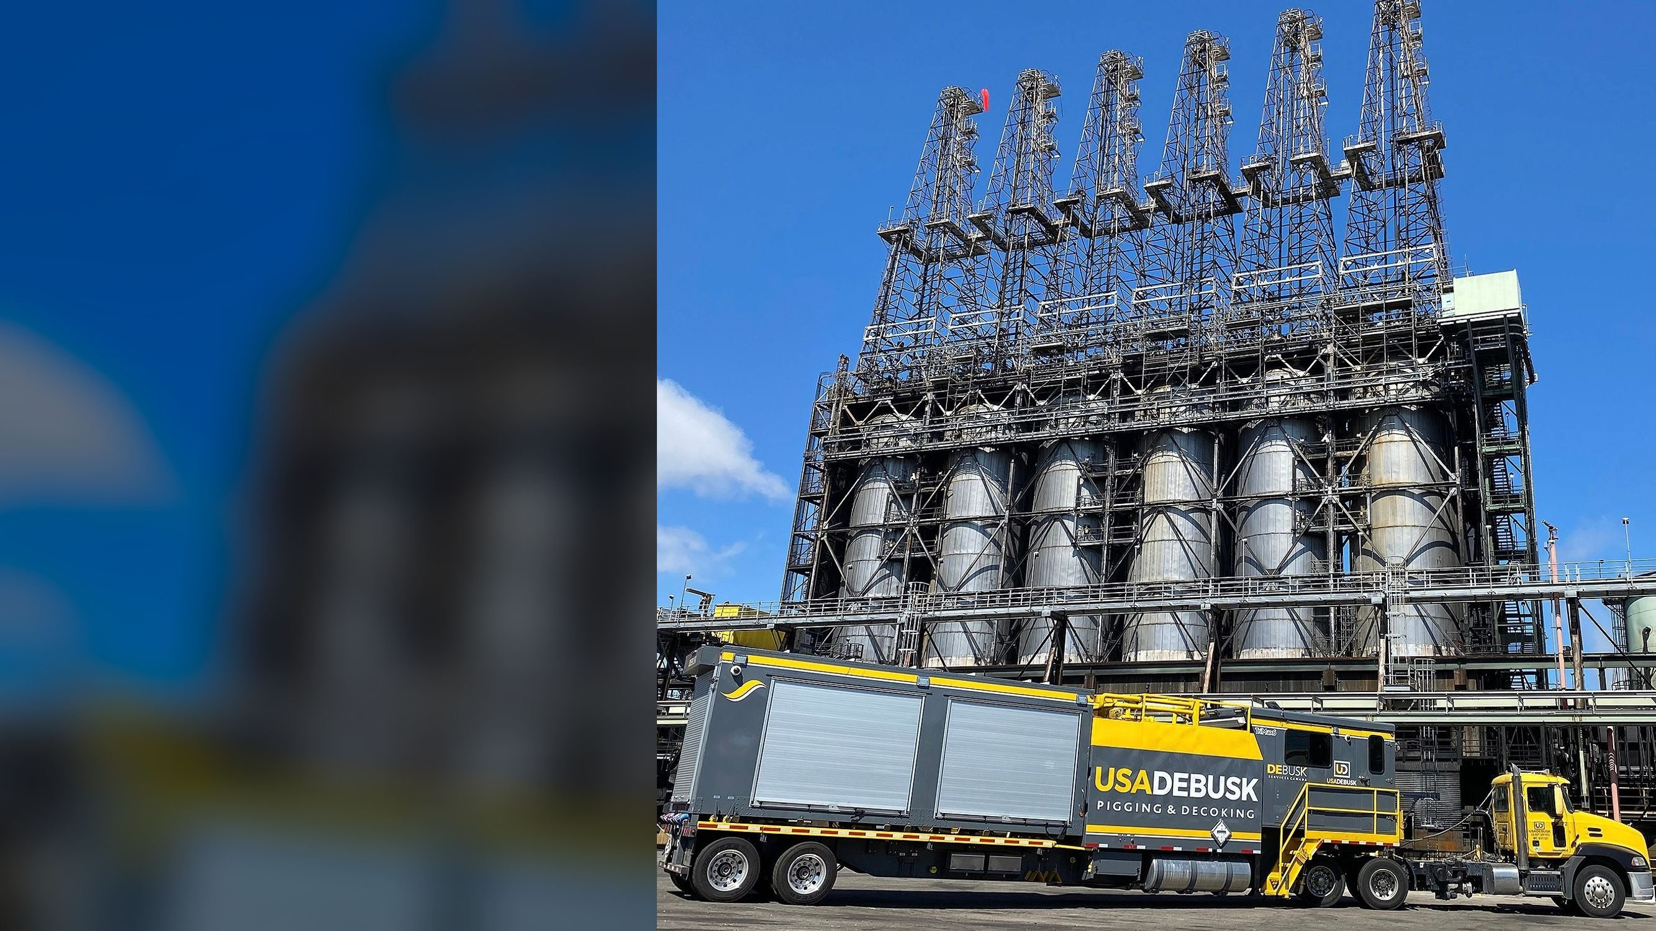


LAR Heater Pigging
& Decoking Services
Marathon Petroleum, Los Angeles Refinery
Carson Coker #1 & #2, Wilmington DCU H-101
Presented by Marshall Douglas
Director of Pigging Operations
DSP#26098 | September 2026
Notes:
[~1 min] Open: thank the evaluation team for the shortlist. Introduce yourself (Marshall Douglas, Director of Pigging Operations) and anyone attending with you.
Frame: "This deck follows your ten discussion points in your order, so you can score as we go. We'll hold about 40 minutes and leave 20 for questions."
The photo is our TriMax triple pumper on a delayed coker, the same service we're proposing for LAR.

Slide 2
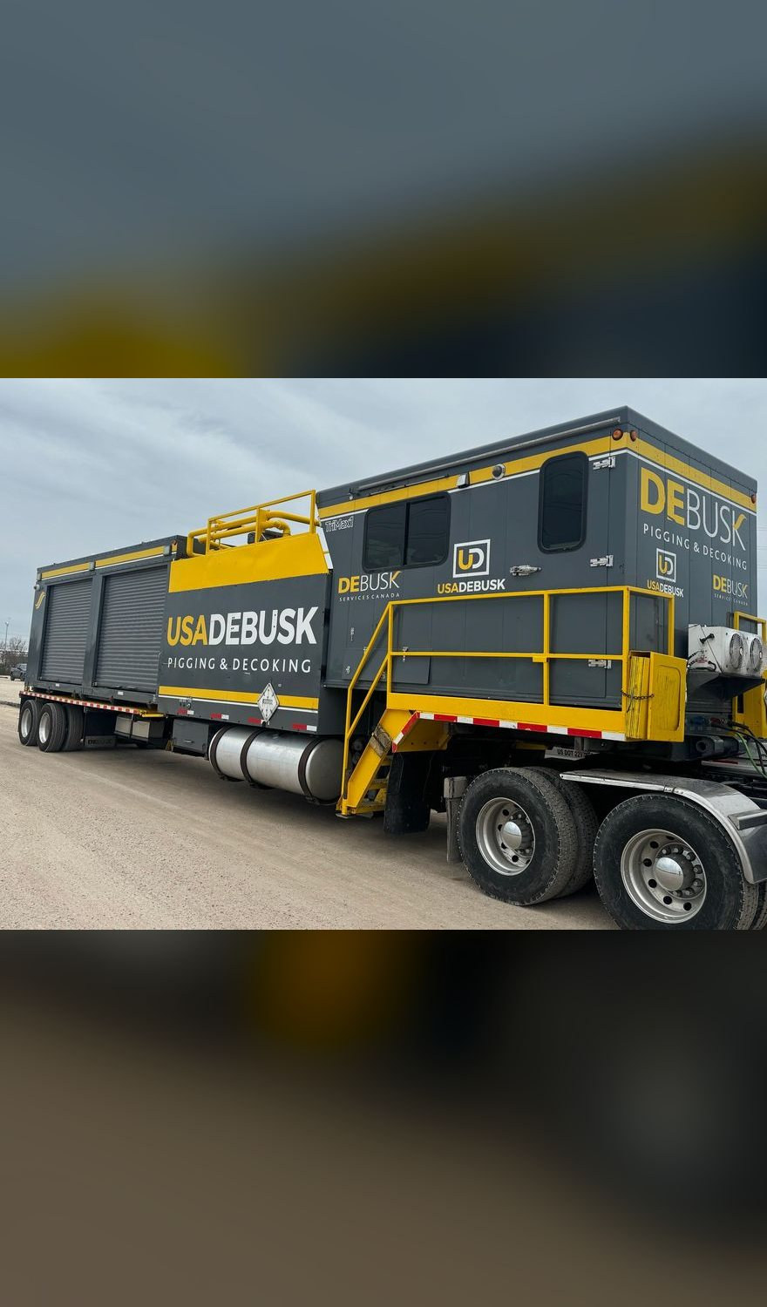
Agenda
Structured to the evaluation team's ten discussion points
01
Pigging & decoking methodology
06
Emergency response & local resources
02
Execution plan & schedule
07
Safety & risk mitigation
03
Operational readiness & resources
08
Best practices, capabilities & innovation
04
Equipment & technology
09
MPC references & case studies
05
Cleanliness verification & QA/QC
10
Why USA DeBusk
Notes:
[~1 min] Walk the agenda quickly. Point out it mirrors MPC's list 1 to 10. Item 10 "Others" is used as a closing summary.
Transition: "Let's start with what we understood the job to be."

Slide 3

SCOPE
Our understanding of the scope
Recurring mechanical pigging & decoking, lump sum per occurrence, mobilization and demobilization waived
Unit | Heater | Passes | Per year | 5 years
Carson Coker #1 | Heater #1 | 2 | 4 | 20
Carson Coker #1 | Heater #2 | 2 | 4 | 20
Carson Coker #2 | Heater #3 | 2 | 3 | 15
Wilmington DCU | H-101 | 4 | 1 | 5
Source: DSP#26098 Rev 1, scope table
4
12
60
2,790
Marathon Los Angeles Refinery
Carson delayed coker
heaters, two sites
decokes per year
decokes over 5 years
project hours, 5 years
Photo: Marathon Petroleum
USA DeBusk | LAR Heater Pigging & Decoking Services | DSP#26098
3
Notes:
[~1.5 min] Four heaters across the Carson and Wilmington sides of LAR. Coker #1 Heaters 1 and 2 four times a year each, Coker #2 Heater 3 three times, Wilmington DCU H-101 once. That is 12 decokes a year and 60 over the five-year term.
Commercial basis as submitted: lump sum per occurrence, mob/demob waived, 30-day terms. Stand-by not caused by USA DeBusk at the attached rates.
Key message: this is a program, not a one-off job, and we've planned it that way.
Point to the photo: "That's your coker at Carson, from Marathon's own site. It's the unit we'd be cleaning four times a year."

Slide 4
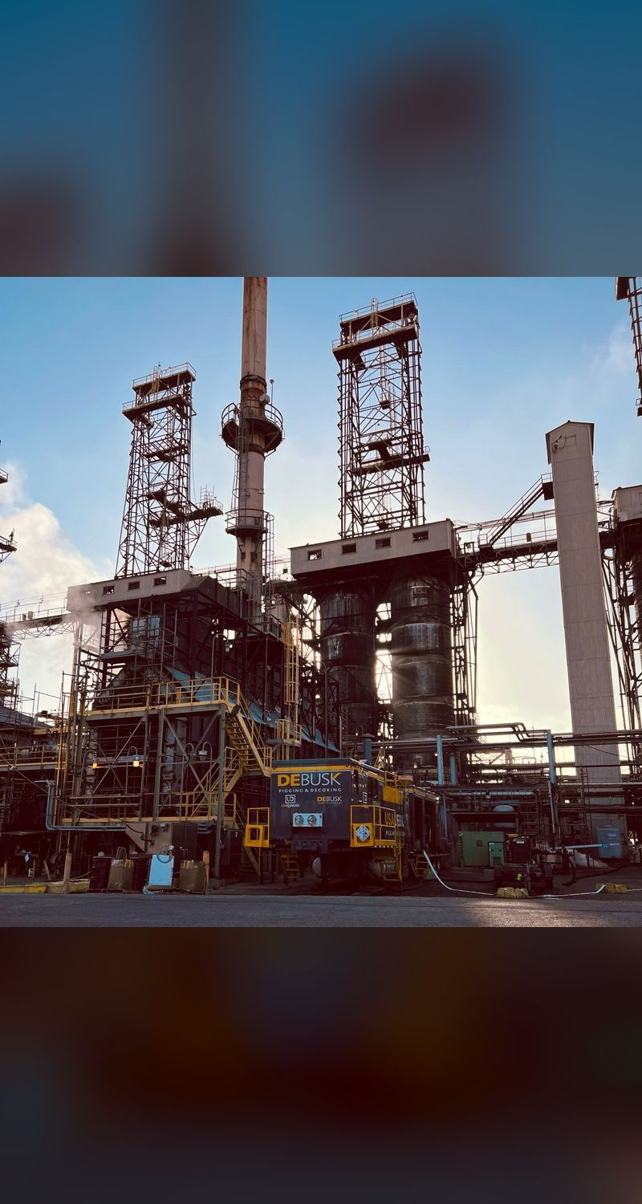
01 METHODOLOGY
Bi-directional mechanical decoking
Every pass follows the same controlled sequence
1
Rig-in & pressure test
Connect 300# launchers and receivers; fill and test before any launch
2
Baseline flow test
Record pressure at a set rate for a before-and-after comparison
3
Gauge foam run
Proves the pass is open and sets the initial pig size
4
Scraper pig progression
Carbide-studded pigs run in both directions, stepped up ⅛" per clean pass
5
Oversize polish
Up to tube ID + ¼" maximum, with real-time pressure monitoring
6
Gauge foam & sign-off
Line-size foam witnessed by Marathon, final flow test, pass signed clean
USA DeBusk | LAR Heater Pigging & Decoking Services | DSP#26098
4
Notes:
[~2.5 min] Walk the six steps. Emphasize "bi-directional": the TriMax reverses flow from the operator station without hose changes, so pigs work the coke from both sides. That is how we clear tight spots and plug headers.
Step 1: we fill and pressure-test the rig before anything launches.
Step 2: the baseline flow test gives an objective before/after comparison at the same rate and direction.
Step 4: pigs step up in 1/8" increments only after a clean pass at the current size. We never jump sizes on hard coke.
Step 5: the maximum oversize is capped at the smallest tube ID + 0.250". That protects the tube wall from grooving; over-cleaning is a real risk and we control it.
Step 6: Marathon witnesses the final gauge foam and signs off per pass (detail in topic 5).

Slide 5
01 METHODOLOGY
Pig progression plan by heater
Answers RFI item SP-2; the gauge foam run sets the starting size, the tube ID sets the ceiling
Carson Cokers, Heaters #1, #2, #3
Governing ID 3.826" (4" Sch 80)
The sizing rule
3.826"
4.076"
Max pig OD =
smallest tube ID + 0.250"
+⅛"
+⅛"
Initial
+⅛"
Gauge
foam
Run first
Set by foam
Step
Step
Step
Line size
Max
Step up ⅛" after each clean pass
Pig wear drives size & appendages
Body length set for bends & mule ears
Gauge foam sets the starting size
Line-size foam witnessed at sign-off
Wilmington DCU H-101
Tube ID 4.026" (4.5" OD × 0.237")
4.026"
4.276"
+⅛"
+⅛"
Initial
+⅛"
Gauge
foam
Run first
Set by foam
Step
Step
Step
Line size
Max
USA DeBusk | LAR Heater Pigging & Decoking Services | DSP#26098
5
Notes:
[~2.5 min] RFI item SP-2 asked for a pig progression plan per heater. This is it.
The ceiling is fixed by our sizing rule: smallest tube ID plus a quarter inch. On the Carson cokers the governing ID is 3.826" (4" Sch 80), so the maximum is 4.076". On H-101 the ID is 4.026", so the maximum is 4.276".
We don't pick a starting size in advance. The first run is a gauge foam: how it comes out of the pass tells us how much the bore is restricted, and that sets the initial pig size. From there we step up 1/8" at a time, only after a clean pass at the current size, until we reach line size and then the maximum. Wear marks on a pig show where coke remains, and we change size and appendage type from that evidence.
If asked about short-radius bends or mule ears: pig body length and flexibility are selected for the bend geometry, not just the diameter.

Slide 6
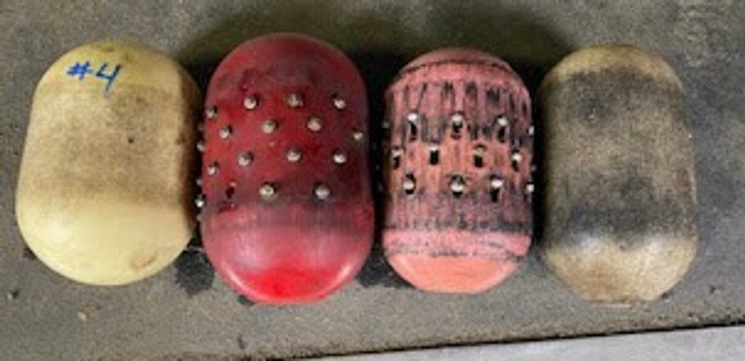


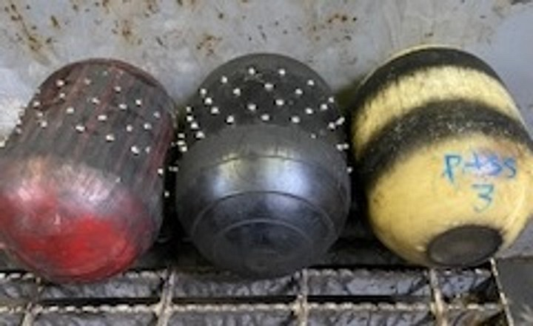


01 METHODOLOGY
Engineered decoking pigs, matched to the coke
The most diverse selection of engineered decoking pigs in the world
Urethane body, foam core
Durometer chosen per job
Flexes through return bends while flow bypasses the pig and carries debris away
Softer compounds compress through tight bends; harder compounds remove coke aggressively
Bald or studded
Heavy-coke designs
Carbide studs as standard, with alternate stud materials matched to the tube metallurgy
High-durometer, fully studded pigs brought in when pig wear shows hard, heavy coke
Foam, carbide-studded and worn pigs from USA DeBusk jobs
USA DeBusk | LAR Heater Pigging & Decoking Services | DSP#26098
6
Notes:
[~1.5 min] The pig does the work, so pig selection matters as much as the pumper.
We don't build our own pigs. We source engineered decoking pigs from specialist manufacturers, so we're never limited to one design and can match the pig to the coil and the coke.
(Presenter: this is where to talk about our supplier base and why we buy rather than build.)
Walk the four cards: urethane body over a foam core lets flow bypass the pig and carry coke away; durometer is chosen for each job, softer to get through tight bends, harder to cut hard coke; studs are carbide as standard, with other stud materials when the tube metallurgy calls for it; and when the pig wear shows hard, heavy coke, we move to high-durometer, fully studded designs.
The photos are real pigs from our jobs, including the wear marks that tell us what's left in the pass.

Slide 7



01 METHODOLOGY
Heater data & coil-specific controls
Heater | Section | Passes | Footage | Tube ID | Metallurgy
Carson Cokers | Convection | 2 | 2,268' | 3.826" | SS 321
Carson Cokers | Radiant | 2 | 4,032' | 3.826" / 4.026" | A335 P9
H-101 | Convection | 4 | 2,508' | 4.026" | A312 347H
H-101 | Radiant | 4 | 7,524' | 4.026" | A312 347H
Stainless coils
Water quality verified before fill; passivation coordinated with Marathon; no galvanized contact with tubes
Connections
600# RFWN coil flanges adapted to USA DeBusk 300# launchers and receivers
Source: DSP#26098 Rev 1, Technical Data (coil data provided by Marathon)
6,300'
10,032'
Grade
Return bends
per Carson heater
on H-101
launcher access (H-101 radiant: grade & 1st deck)
Pig length and flexibility selected for 180° returns and mule ears
USA DeBusk | LAR Heater Pigging & Decoking Services | DSP#26098
7
Notes:
[~1.5 min] Numbers here are exactly as submitted in the proposal's Technical Data page, from the coil data Marathon provided.
Per Carson heater: 1,134' per pass convection plus 2,016' per pass radiant, about 3,150' per pass and 6,300' per heater. H-101: 627' plus 1,881' per pass across 4 passes, about 10,000'.
Three coil-specific controls:
1) Stainless. The Carson convection and all of H-101 are stainless. We verify water quality before fill, coordinate with Marathon's passivation requirements, and keep galvanized hardware off the tubes.
2) Connections. The coils have 600# RFWN flanges and our launchers/receivers are 300#; Marathon supplies the inlet/outlet spools and adapters, per the proposal's provided-items list.
3) Bends. 180° returns and mule ears set pig length and flexibility, not just diameter.
Launcher connections are at grade (process control valves / radiant outlets); the H-101 radiant outlets are at grade and the 1st deck.

Slide 8
02 EXECUTION PLAN & SCHEDULE
Execution plan per occurrence
Continuous 24/7 pigging on 12-hour shifts; passes pigged in conjunction
0 h
12 h
24 h
36 h
48 h
Carson Coker #1, Heater #1
6
Pig all coils in conjunction: 34 h
6
46 h
Carson Coker #1, Heater #2
6
Pig all coils in conjunction: 34 h
6
46 h
Carson Coker #2, Heater #3
6
Pig all coils in conjunction: 34 h
6
46 h
Wilmington DCU, H-101
6
Pig coils 1 & 2: 18 h
4
Pig coils 3 & 4: 18 h
6
52 h
Per occurrence; durations are not consecutive
Rig-in / rig-out
Pigging
Rig-over
USA DeBusk | LAR Heater Pigging & Decoking Services | DSP#26098
8
Notes:
[~2.5 min] Each occurrence as quoted:
Carson heaters: 6 hours rig-in, 34 hours pigging all coils in conjunction, 6 hours rig-out: 46 hours total.
H-101: 6 rig-in, 18 hours on coils 1 and 2 together, a 4-hour rig-over to coils 3 and 4, 18 hours, 6 rig-out: 52 hours.
"In conjunction" means both Carson passes are pigged at the same time, each on its own pump and operator station, so elapsed time is one coil's time, not two. On a 2-pass heater the TriMax's third pump is a spare: if a pump goes down, the job keeps running.
We run 24/7 on 12-hour day/night shifts, so a Carson heater is back in Marathon's hands in about two days.
Durations come from footage and our historical performance. Actual hardness and thickness of deposits can move them, and the proposal covers that.

Slide 9
02 EXECUTION PLAN & SCHEDULE
Five-year program at a glance
Illustrative annual cadence: dates are set to Marathon's run-length and turnaround plan
J
F
M
A
M
J
J
A
S
O
N
D
12
decokes a year
Coker #1, Heater #1
4× / yr
Coker #1, Heater #2
4× / yr
60
decokes in 5 years
Coker #2, Heater #3
3× / yr
2,790
project hours
DCU, H-101
1× / yr
$0
mob / demob
Same crew leadership, same equipment and same procedures every visit: each decoke builds on the last one's records.
USA DeBusk | LAR Heater Pigging & Decoking Services | DSP#26098
9
Notes:
[~1 min] The dots show one year of the program; exact dates follow Marathon's run-length and turnaround plan, not ours.
12 decokes a year, 60 over the term, 2,790 project hours, and mobilization/demobilization waived because LAR is serviced as a program.
The real value of a recurring program: each decoke on the same heater builds on the last. We keep heater-specific records of pig sizes, hours and problem spots, so every visit starts smarter than the last.

Slide 10
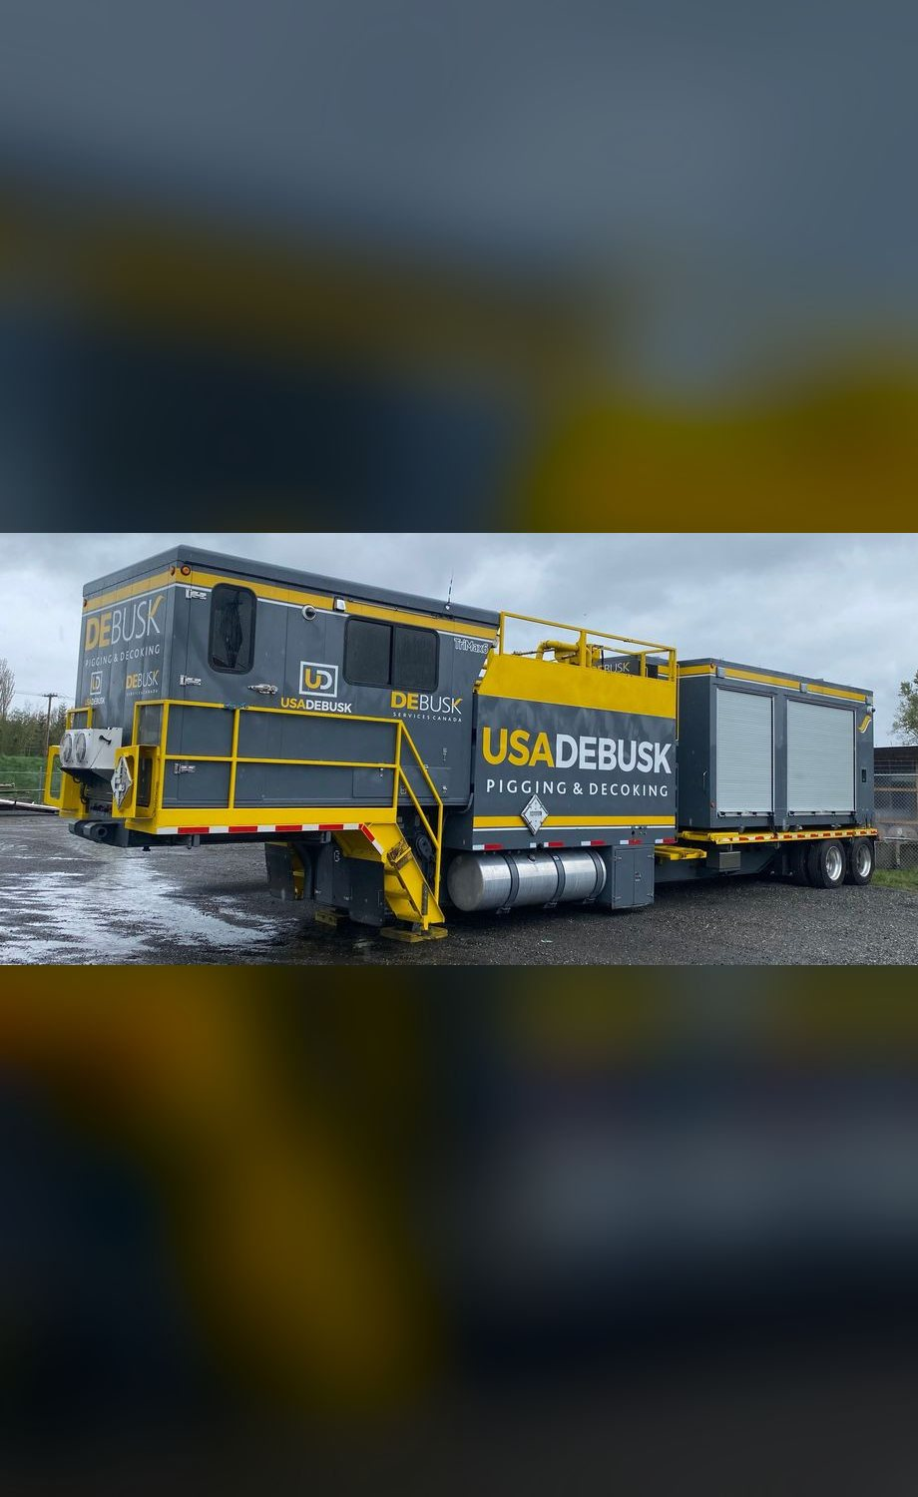


03 READINESS & RESOURCES
Crew & equipment, every occurrence
Equipment
Manpower
1
TriMax triple pumper
2
Supervisors: 1 day, 1 night
1
Support unit: fittings, tooling, spares
3
Operators: 2 day, 1 night
2
Crew trucks
1
Project manager
~5%
24/7
100%
crew turnover, last 12 months
two 12-hour shifts
training verified before mobilization
USA DeBusk | LAR Heater Pigging & Decoking Services | DSP#26098
10
Notes:
[~2 min] Every occurrence gets the same package: one TriMax, one support unit carrying fittings, tooling and spares, two crew trucks.
Crew: day shift is a supervisor and two operators; night shift is a supervisor and an operator; Travis Trenholm manages the project.
Readiness: turnover has run about 5% over the last 12 months. We hold onto people with competitive pay, ongoing training and certification, career paths, and dedicated core crews per site. For LAR that means the same faces on the same heaters.
Every technician is USA DeBusk-certified, selected by heater-type experience, with training verified before mobilization. The personnel training documents (SSHASP) were attached to the RFI.

Slide 11
03 READINESS & RESOURCES
Your LAR project team
200+
Anthony Fazio
VP Operations
years of combined pigging & decoking experience
15+
Marshall Douglas
Jason Harman
Director of Pigging Operations
Commercial Manager
years self-performing heater pigging
Travis Trenholm
Pigging Operations Manager (PM)
Day shift
Night shift
Site org chart finalized at award
1 supervisor, 2 operators
1 supervisor, 1 operator
USA DeBusk | LAR Heater Pigging & Decoking Services | DSP#26098
11
Notes:
[~1 min] Our team brings more than 200 years of combined pigging and decoking experience, and the company has self-performed heater pigging for over 15 years.
Leadership line: Anthony Fazio, VP Operations; me as Director of Pigging Operations; Travis Trenholm as the project manager on every LAR occurrence. Jason Harman is the commercial point of contact.
One point of contact manages work flow and daily updates to Marathon.
Leadership resumes were included with the RFI response; the full site org chart is issued at award.

Slide 12
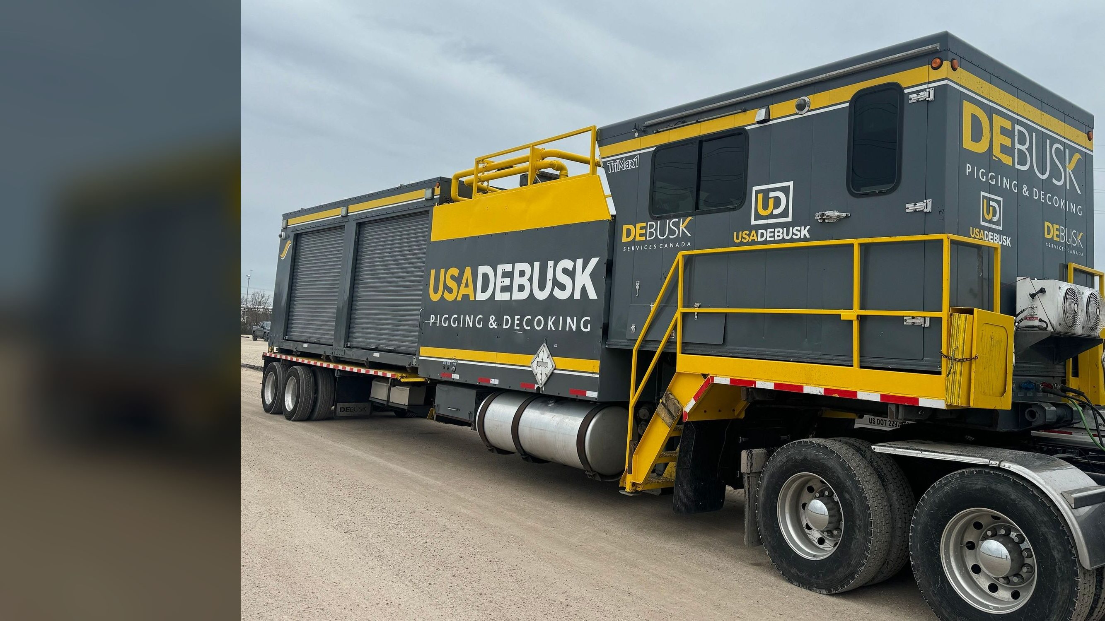





04 EQUIPMENT & TECHNOLOGY
The TriMax triple pumper
6 identical TriMax units, 18 engines: one standardized fleet
Three independent pump systems
Closed-loop, bi-directional; 50% more productive than a twin pumper
Automated HMI control
Three 17" touchscreens, automated digital pig logs
150–300 psi working pressure
Pump rated 600 psi; 500–550 psi effective after valve losses
Real-time sensor data
Coke shows as pressure spikes at the operator interface
Cummins QSL9, 333 bhp, Tier 4 Final
CARB-registered engines, California-ready
OPERATING PRESSURE, PSI
Normal pigging
Effective max
0
150
300
500
600
USA DeBusk | LAR Heater Pigging & Decoking Services | DSP#26098
12
Notes:
[~2 min] This is the core of our service, and every one of our six TriMax units is the same build: 18 identical engines, the same pumps, the same controls. Any crew can run any unit, spares fit every unit, and the procedures are the same everywhere. Three independent pump assemblies in one trailer, each with its own operator station, so three passes can run at the same time. At LAR we pig both Carson passes together and H-101 in pairs, which leaves the third pump as an on-board spare. Against a dual unit the triple raises productivity by about 50%, and on a two-pass Carson heater the third pump is 100% spare capacity: if one pump goes down, the job doesn't stop.
The spare pump can also propel a smart pig, so inspection runs don't need extra equipment.
Each operator station has a 17" automated HMI touchscreen, and pig logs are recorded digitally (next slide).
Other features built into the unit: temperature-controlled pig compartments so the pigs keep their cleaning characteristics, antifoam injection, a coke transfer chute, and guided-radar tank level indicators. On-board tankage is 3,000 gal clean and 2,000 gal return.
The bar at the bottom is our operating window: normal pigging runs 150 to 300 psi. The pump is rated to 600 psi, but after losses through our valves the realistic ceiling at the pig is 500 to 550, and above 500 the crew works an over-pressure checklist. The manufacturer's pump curves are in the appendix if anyone wants them.
Real-time sensor data feeds the operator interface, where coke shows up as a pressure spike. The technician can stop and scrub that exact spot. Flow direction reverses from the station without hose changes.
Power is a Cummins QSL9 at 333 bhp, Tier 4, CARB-registered. California compliance is two slides on, after the operator screen.

Slide 13
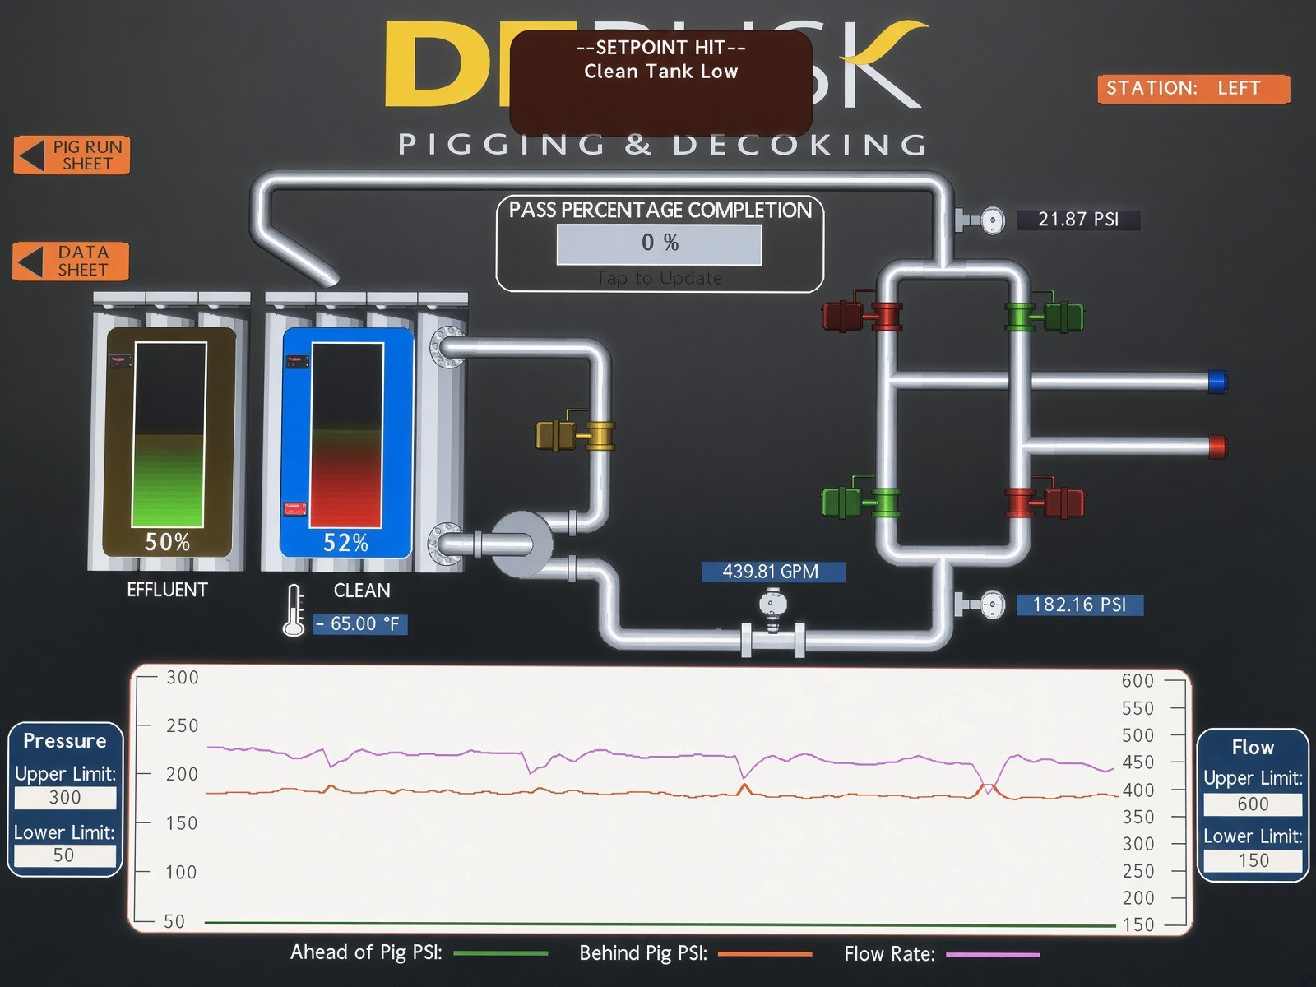
04 EQUIPMENT & TECHNOLOGY
Real-time control at every operator station
1
Live trends
4
6
Pressure ahead of and behind the pig, plus flow; coke shows as a spike
2
Flow & pressure
5
GPM and psi at the pump, updated continuously
3
3
Tank levels
Clean and effluent tanks on guided-radar indicators
4
Setpoint alarms
2
Upper and lower limits on pressure and flow trigger alerts
1
5
Digital pig logs
Pass completion, pig run sheet and data sheet recorded automatically
6
One station per pass
Left, center and right stations run independently
USA DeBusk | LAR Heater Pigging & Decoking Services | DSP#26098
13
Notes:
[~1.5 min] This is the operator screen from a TriMax station, the same software every LAR pass runs on.
Walk the numbers: (1) the trend at the bottom plots pressure ahead of the pig, pressure behind it, and flow rate. When the pig meets coke you see the spike, and that's the "sensor data" indicator in our cleanliness verification. (2) Live GPM and psi. (3) Clean and effluent tank levels from guided-radar indicators. (4) Setpoint alarms; this one shows a clean-tank-low alert. (5) Pass completion and the pig run sheet and data sheet, so the pig log builds itself. (6) Each pass has its own station: left, center, right.
The takeaway for Marathon: every decision on a pass is made from live data, and the record is automatic.

Slide 14
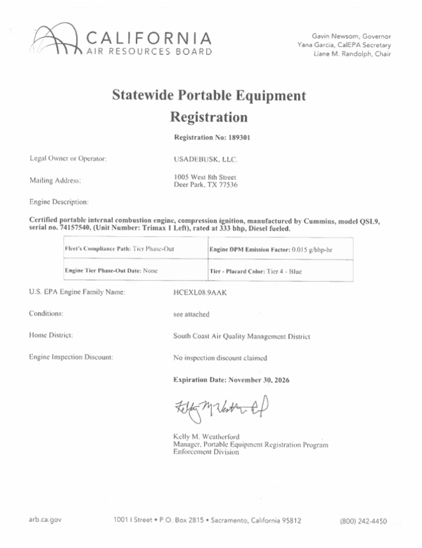
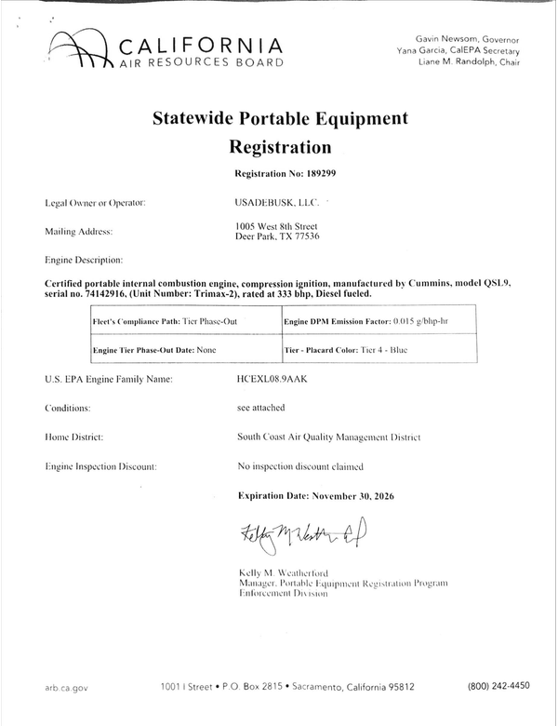
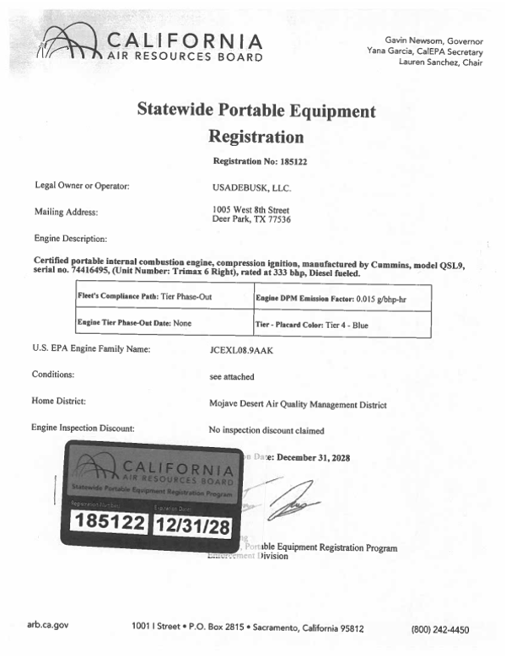




04 EQUIPMENT & TECHNOLOGY
California-ready, CARB-registered fleet
CARB Statewide Portable Equipment Registration (PERP); certificates shown
6
18
identical TriMax units, SCAQMD-ready
registered pumping engines
Tier 4
0.015
TriMax 1
TriMax 2
TriMax 6
engines (blue placard)
g/bhp-hr diesel PM emission factor
CARB PERP registration certificates
Support unit
300# launchers & receivers
Tested & certified hard and flex pipe
All pigs & foam swabs
Optional: closed-loop filtration
USA DeBusk | LAR Heater Pigging & Decoking Services | DSP#26098
14
Notes:
[~1 min] California compliance is a gate for LAR, and we've cleared it. Every TriMax engine carries a CARB Statewide Portable Equipment Registration: certified Cummins QSL9 engines, Tier 4 blue placard, a diesel particulate emission factor of 0.015 g/bhp-hr. Six triple-pass units and 18 engines are registered for SCAQMD work, so no rental or swap-in equipment is needed to work in the Basin.
Everything needed arrives with the rig: support unit, 300# launchers and receivers, tested and certified hard and flex pipe connecting our equipment, all pigs and foam swabs. Closed-loop filtration is optional at the proposal rate: it runs continuously, captures coke fines from the effluent, and recycles clean water. That can save thousands of gallons of water a shift.

Slide 15


05 CLEANLINESS VERIFICATION & QA/QC
Verifying every pass is clean
Four independent indicators, reviewed side by side with Marathon
1 Sensor data
2 Effluent returns
Coke shows as a pressure spike; the tech stops and scrubs that exact spot
"Black" in the return stream fades to nothing as the pass cleans
Joint
sign-off
per pass
3 Pig condition
4 Final gauge foam
Wear marks guide pig size and appendage choices
Soft line-size (or slightly over) foam, witnessed by the Marathon rep
Proven in the field: successful sign-offs from all of our clients, and highly effective for first-attempt smart pig data.
USA DeBusk | LAR Heater Pigging & Decoking Services | DSP#26098
15
Notes:
[~2.5 min] How do we know a pass is clean? Four independent indicators, and the pass isn't called clean until all four agree.
1) Sensor data: live pressure data at the operator interface. Coke shows as a spike, and the technician can stop the pig and scrub that exact area.
2) Effluent: the technician watches the returns. The "black" (coke fines) in the stream fades to an unnoticeable amount as the pass cleans.
3) Pig condition: bi-directional runs leave tracking marks on the pigs (the photo shows real pigs after runs, with the wear visible). Those marks drive our size and appendage changes toward 100% removal.
4) Final gauge foam: when the interface, the water and the pigs all read clean, our shift leader invites the Marathon rep to watch the final gauge foam run. It's line size or slightly over and soft enough to mark, groove or deform on any remaining coke. Marathon reviews it with us and signs the pass off.
This is also why smart pig inspections after our cleans usually get good data on the first attempt.

Slide 16



05 CLEANLINESS VERIFICATION & QA/QC
QA/QC from walkdown to job book
Governed by the USA DeBusk QA/QC manual, submitted with the RFI response
Before
During
Close-out
Pre-job walkdown with operations
Coil data checked against Marathon records
JSA, permits and isolation confirmed
Pig progression staged by heater
Daily report to one point of contact
Automated digital pig log per pass
Flow tests before and after at the same rate
JSA reviewed at every shift change
Per-pass cleanliness sign-off
Final pig size recorded per pass
Job book delivered to Marathon
Post-job review and lessons learned
USA DeBusk | LAR Heater Pigging & Decoking Services | DSP#26098
16
Notes:
[~1 min] QA/QC runs through the whole job, not just the end.
Before: walkdown, coil data check, JSA/permits/isolation, pig progression staged by heater.
During: work is documented in the job book with daily reports, pig logs and JSAs. One point of contact manages the work flow and daily updates to Marathon. Flow tests before and after at the same rate give an objective comparison.
Close-out: per-pass sign-off, final pig size recorded for each pass, the job book, and a post-job review. On a recurring program, that record is what makes the next decoke on the same heater faster.
The full QA/QC manual was attached to the RFI response.

Slide 17
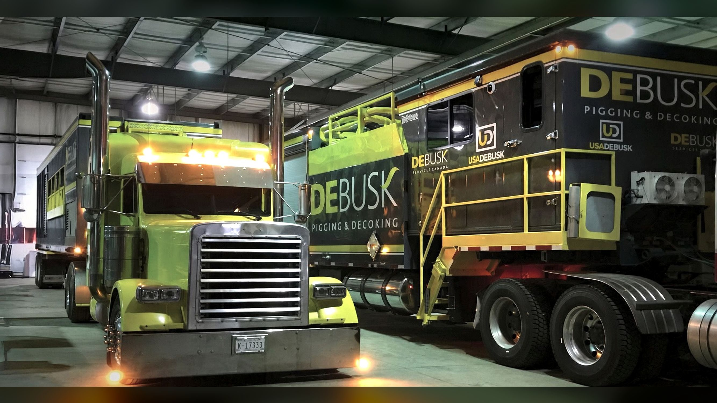

06 EMERGENCY RESPONSE & LOCAL RESOURCES
Ready when LAR needs us
Shops, equipment and crews in Southern California / LA Basin, with regional support
24/7
Dispatch and account manager, any hour
Same day
Response for local needs
< 24 hrs
Manpower & equipment anywhere else, from regional shops
USA DeBusk | LAR Heater Pigging & Decoking Services | DSP#26098
17
Notes:
[~2 min] Topic 6: emergency response and local resources.
We maintain shops, equipment and crews in the Southern California / LA Basin area with regional support. That local footprint allows same-day to next-day mobilization to LAR.
Support is 24/7: dispatch and the account manager can be reached at any hour, with on-call supervisors and crews for nights, weekends and holidays.
Response: same day for local needs, within 24 hours otherwise, with manpower and pigging/decoking equipment staged from our regional shops.
On the recurring program, the same crew that knows these heaters is the crew that answers an unplanned call.
The photo: a TriMax and its support unit staged in the shop, fueled and ready to roll.

Slide 18
07 SAFETY & RISK MITIGATION
Safety performance
Experience Modification Rate: 1.0 is the industry baseline; lower is better
A
0.48
ISNetworld safety grade
EMR, 2026
−49%
0
EMR since 2024
fatalities in 3 years
USA DeBusk | LAR Heater Pigging & Decoking Services | DSP#26098
18
Notes:
[~2 min] The numbers as submitted in the RFI: EMR 0.95 in 2024, 0.62 in 2025, 0.48 in 2026, roughly half the industry baseline and down 49% in two years. Active in ISNetworld with an A grade. No fatalities in the last three years. OSHA 300 logs for three years were provided with the RFI.
Let the trend speak: this is a sustained improvement, not a single good year.

Slide 19
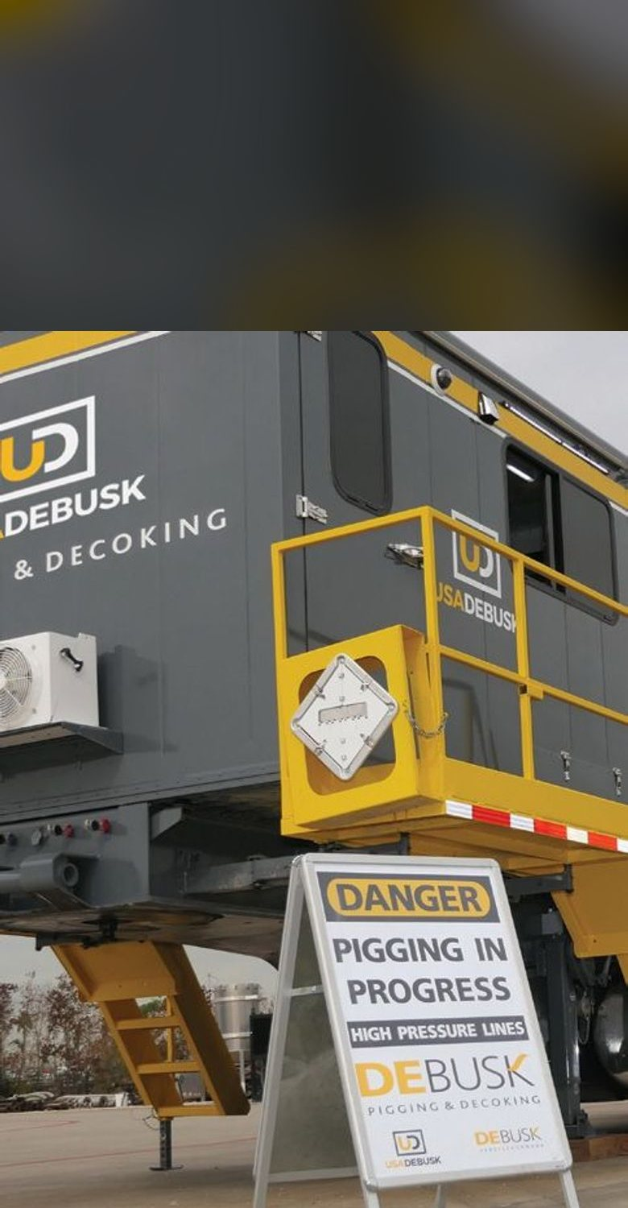





07 SAFETY & RISK MITIGATION
Risk mitigation in the field
JSA & permits
Isolation first
Job-specific JSA reviewed at every shift change; daily toolbox talks
Marathon's isolation and LOTO verified before any connection is made
Pressure control
Line of fire
Normal 150–300 psi; over-pressure checklist above 500 psi
Bleed to zero at every pig change; nobody in line with lids or hoses
Hose integrity
PPE & coil care
Tested & certified hard and flex pipe; whip checks on every connection
FRC and face shields; no galvanized metal on stainless
Engineered for safety Retractable cam-actuated stairs, composite work platform, LED lighting
USA DeBusk | LAR Heater Pigging & Decoking Services | DSP#26098
19
Notes:
[~2 min] Six practices that carry most of the risk on a decoke:
JSAs and permits: job-specific JSAs, reviewed at every shift change, with daily toolbox talks.
Isolation: we don't connect until Marathon's isolation and LOTO are verified.
Pressure: normal pigging is 150 to 300 psi; the pump is rated 600 but realistically tops out at 500 to 550 after valve losses, and above 500 psi the crew runs an over-pressure checklist.
Line of fire: every pig change bleeds to zero, and nobody stands in line with lids or hoses.
Hoses: tested and certified hard and flex pipe with whip checks on every connection.
PPE: FRC, hard hat, glasses or face shield, gloves, steel toes, hearing and respiratory protection as required. On stainless coils, no galvanized metal touches the tubes.
The pumper itself is engineered for safety too: retractable cam-actuated stairs, a composite work platform, LED lighting, and a self-contained design that prevents spills.
Full detail is in the safety manual and SSHASP submitted with the RFI.

Slide 20
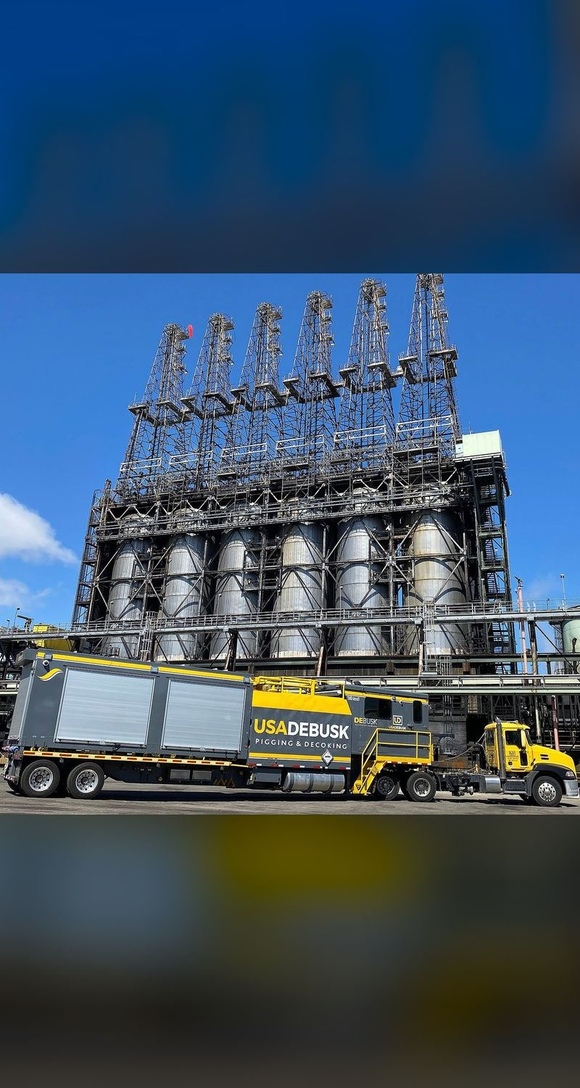



08 BEST PRACTICES, CAPABILITIES & INNOVATION
What sets USA DeBusk apart
Self-performed scope
Largest standardized fleet
Pigging, decoking and hydroblasting with our own equipment and SCAQMD rigs: one contractor, no subs
6 identical TriMax units, 18 engines, with a spare pump on board even on a 2-pass heater
Widest pig selection
Data-driven, shared
Engineered decoking pigs matched to each coil and each coke condition
Durations built from recorded actuals; lessons learned reviewed with Marathon after every job
USA DeBusk | LAR Heater Pigging & Decoking Services | DSP#26098
20
Notes:
[~2 min] Four differentiators, backed by more than 200 years of combined experience on our team.
Self-performed: pigging, decoking and hydroblasting with in-house equipment and SCAQMD rigs, so one contractor covers the full scope without subs.
Fleet: we run the largest triple-pass pigging fleet in the world, and it's standardized: six identical TriMax units, 18 engines. The TriMax runs up to three passes at once; on LAR's 2-pass heaters that third pump is an on-board spare, so a pump failure doesn't stop the job, and it can also drive a smart pig. We also offer closed-loop filtration and smart-pig support, so Marathon deals with one contractor.
Pigs: the widest selection of engineered decoking pigs, matched to the coil and the coke (slide 6).
Data-driven and shared: our durations are built from recorded actuals, every job produces pig logs and a job report, and lessons learned are reviewed with the client after each job. On a 60-decoke program that compounds, and Marathon sits in that loop.

Slide 21
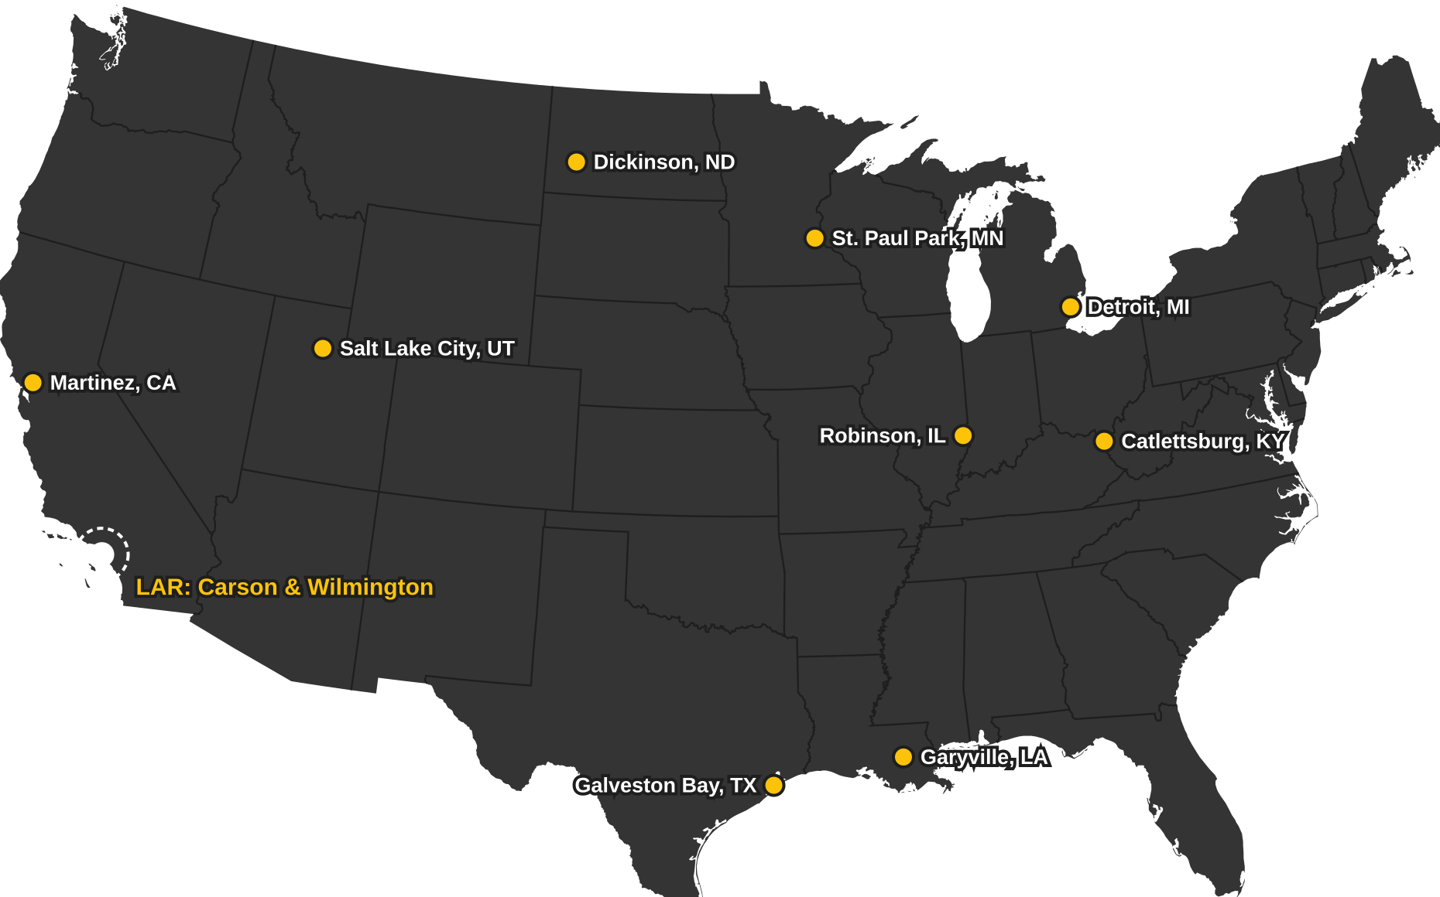
09 REFERENCES & CASE STUDIES
Trusted across the MPC system
9
Marathon refineries with USA DeBusk references
Named contacts at 8 sites (Galveston Bay on request), listed in the appendix
Includes Martinez, CA, our West Coast MPC reference
Crude, coker and vacuum heater experience
USA DeBusk | LAR Heater Pigging & Decoking Services | DSP#26098
21
Notes:
[~1.5 min] You don't have to take our word for it: nine Marathon refineries, with named contacts at eight of them; Galveston Bay's contact is available on request. Catlettsburg, Salt Lake City, Martinez, Dickinson, St. Paul Park, Robinson, Galveston Bay, Garyville and Detroit.
Martinez is the closest comparison for LAR: a California MPC facility under the same state air rules.
The contact list is in the appendix and in the leave-behind. We'd encourage the team to call any of them.

Slide 22
09 REFERENCES & CASE STUDIES
Coker heater case studies & lessons learned
Marathon Detroit, MI: 70H1 Coker
CHS McPherson, KS: Coker HF-0012
Decoked September 2024 and September 2026
6-pass coker heater, planned decoke, 2025
6
15,156'
2
12,036'
6
85 h
passes, 3 cells
coil footage
TriMax units
coil footage
passes
pigging
Scope All six passes, convection and radiant, pigged simultaneously on two TriMax units.
Challenge Hard coke held pigs in the radiant section.
Result Two decokes on the same coker, two years apart: MPC brought us back.
Lesson learned Stage heavy-duty scraper pigs for the radiant from day one, not as a mid-job change.
USA DeBusk | LAR Heater Pigging & Decoking Services | DSP#26098
22
Notes:
[~1.5 min] Two coker examples from our job records, starting with one of yours.
First: Marathon Detroit, the 70H1 coker. Six passes across three cells, about 15,000 feet of convection and radiant coil. We ran two TriMax units and pigged all six passes at once, in September 2024 and again this month, September 2026. Same coker, two years apart: Detroit brought us back. Nate Lajiness at Detroit is on our reference list.
Second: CHS McPherson, coker heater HF-0012, six passes, just over 12,000 feet of coil, 85 pigging hours on a planned decoke. The radiant held hard coke that stopped standard pigs. Lesson: on a coker, stage the heavy-duty pig set for the radiant from the start. We'll do that at LAR on every occurrence.

Slide 23

10 WHY USA DEBUSK
Why USA DeBusk for LAR
Proven experience
200+ years combined; 9 MPC references, including Detroit's coker
California-ready
CARB-registered Tier 4 fleet, Southern California footprint
Resilient execution
Triple-pass TriMax: a spare pump on every 2-pass heater
Verified clean
4-point verification and joint sign-off on every pass
Safe by the numbers
EMR 0.48, ISNetworld A, zero fatalities in 3 years
USA DeBusk | LAR Heater Pigging & Decoking Services | DSP#26098
23
Notes:
[~1 min] Close with the five reasons, then open for questions.
"We know Marathon's system, our equipment is registered and ready for California, the triple-pass rig carries its own spare pump, you sign off on every pass, and we do it safely."

Slide 24
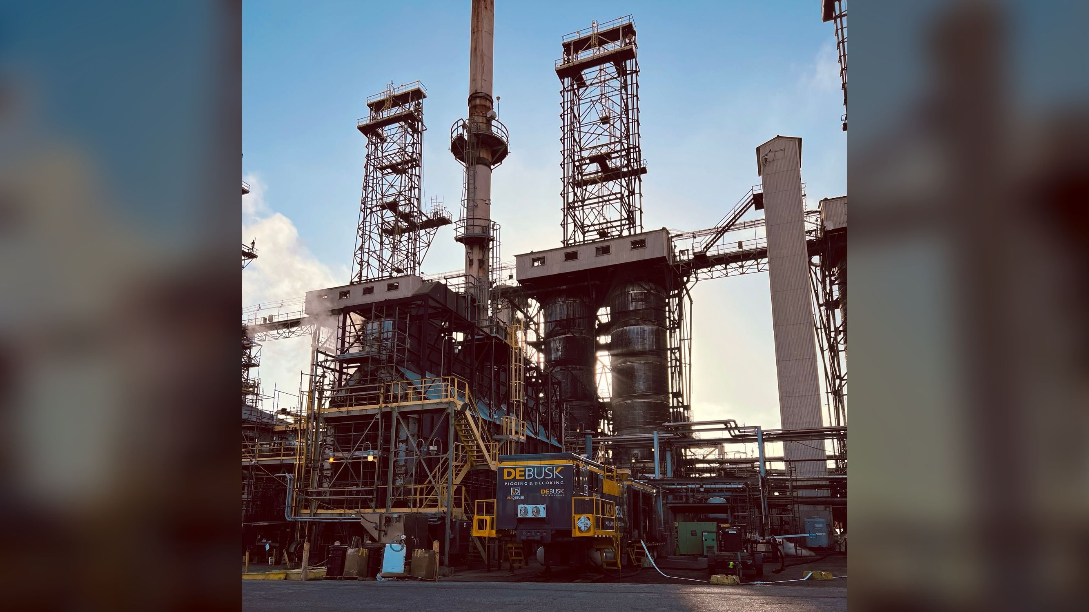
Thank you
Questions & discussion
Marshall Douglas | Director of Pigging Operations
Jason Harman | Commercial Manager | jharman@usadebusk.com | (713) 839-5961
Notes:
[20 min reserved for Q&A]
Likely questions and where the answer lives:
- "How do you handle a plugged pass?" Bi-directional flow and stepwise pig sizing (slides 4–6); pre-job walkdown (slide 16).
- "What if duration overruns?" Lump sum per occurrence. Pricing excludes additional fouling, unknown repairs and stoppages outside our control; those, plus stand-by not caused by USA DeBusk, are billed T&M at the proposal rates.
- "Local presence?" Slide 17, per RFI GD-1.
- "CARB registration?" Slide 14: every TriMax carries statewide PERP registration.
- "Filtration?" Available at $150/hr per the rate sheet.
- "Pump curves / pressure capability?" Appendix slide 26 (Waterous CMU curves). Normal 150–300 psi; rated 600, 500–550 effective after valve losses.

Slide 25
APPENDIX
MPC references
Refinery | Contact | Role | Phone | Email
Catlettsburg, KY | Eddie Slone | T/A Planner | 606-331-2585 | slone@marathonpetroleum.com
 | Ryan Rayburn | TAR / Construction Supervisor | 606-331-0180 | rdrayburn@marathonpetroleum.com
 | Ben Holbrook | Turnaround Planning | 606-369-6467 | benlholbrook@marathonpetroleum.com
Salt Lake City, UT | Aaron Wiggins | Maintenance Supervisor / Turnarounds | 801-703-6722 | ATWiggins@marathonpetroleum.com
Martinez, CA | Kyle Yates | Project Engineer | 925-316-9726 | SYates2@marathonpetroleum.com
 | Ryan Gorman |  | 952-607-6853 | RMGorman@marathonpetroleum.com
Dickinson, ND | Tyler Bauer | TA | 701-516-3456 | tbauer@marathonpetroleum.com
St. Paul Park, MN | Keith James | TA Planner | 715-441-7986 | TKJames@marathonpetroleum.com
Robinson, IL | Brian Maus | TA | 618-544-2121 | bkmaus@marathonpetroleum.com
Galveston Bay, TX | Available upon request
Garyville, LA | Shawn Kramer | TA Planner | 225-571-2689 | skramer@marathonpetroleum.com
 | Chad Childs | TA Supervisor | 281-299-6088 | cechilds@marathonpetroleum.com
Detroit, MI | Nate Lajiness | Turnaround Planner | 313-297-6166 | nlajiness@marathonpetroleum.com
USA DeBusk | LAR Heater Pigging & Decoking Services | DSP#26098
25
Notes:
Leave-behind reference list. Not presented; point to it from slide 21 (MPC map) if asked.

Slide 26
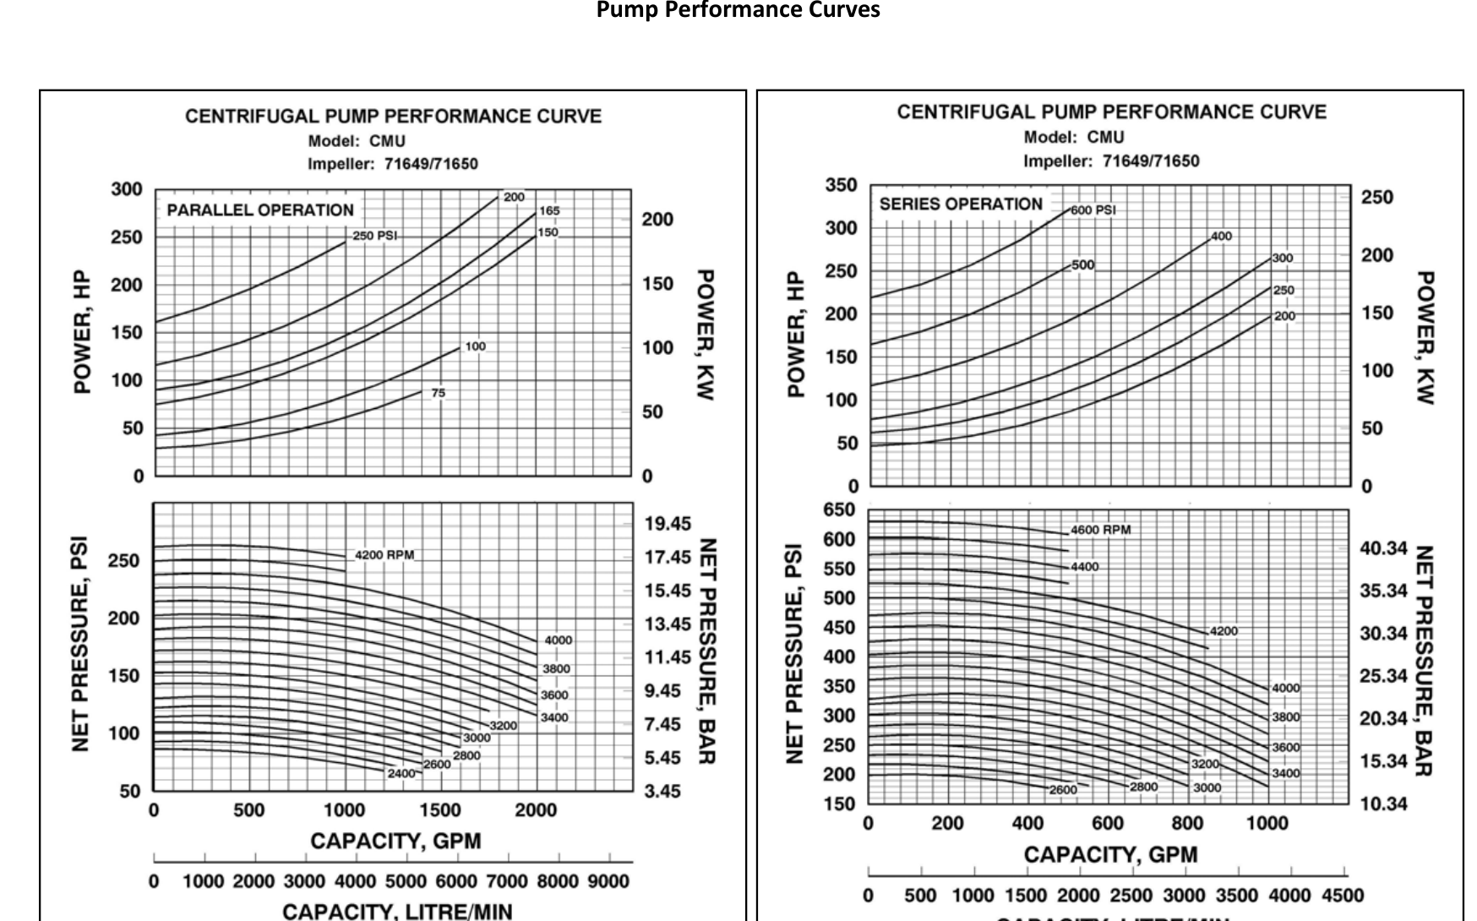
APPENDIX
TriMax pump performance
Waterous CMU two-stage pump, one per pass. Series operation is used for pigging.
150–300
psi normal pigging
500–550
psi effective max, after valve losses
600
psi rated pump maximum
Manufacturer curves: Waterous Company, form F-2692
USA DeBusk | LAR Heater Pigging & Decoking Services | DSP#26098
26
Notes:
Backup slide, not presented. Pull it up if an engineer asks about pump capability.
Series operation is how the pump runs for pigging (higher pressure, lower flow). Normal pigging runs 150 to 300 psi. The curve tops out at 600 psi; in practice we see 500 to 550 at the pig because of losses through our valves.

