Slide 1
Numerical Linear Algebra meets Machine Learning
Fabian Koffer, Simon Hanselmann, Yannick Funk,
Dennis Leon Grötzinger, Anna Ricker

Slide 2
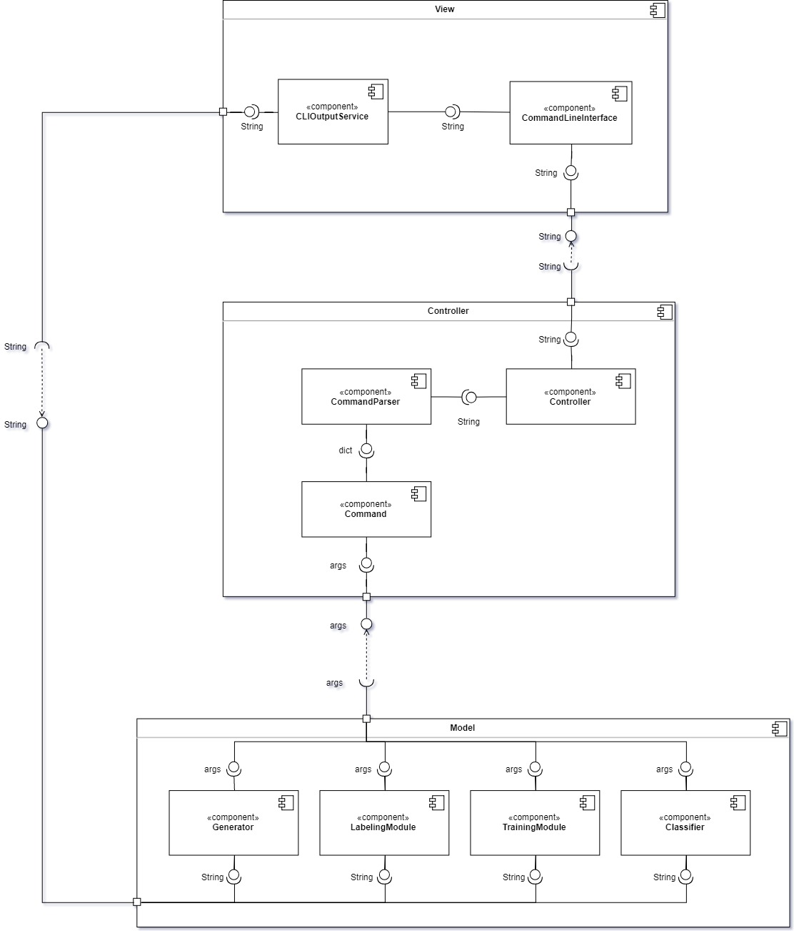
Component Diagram

Slide 3
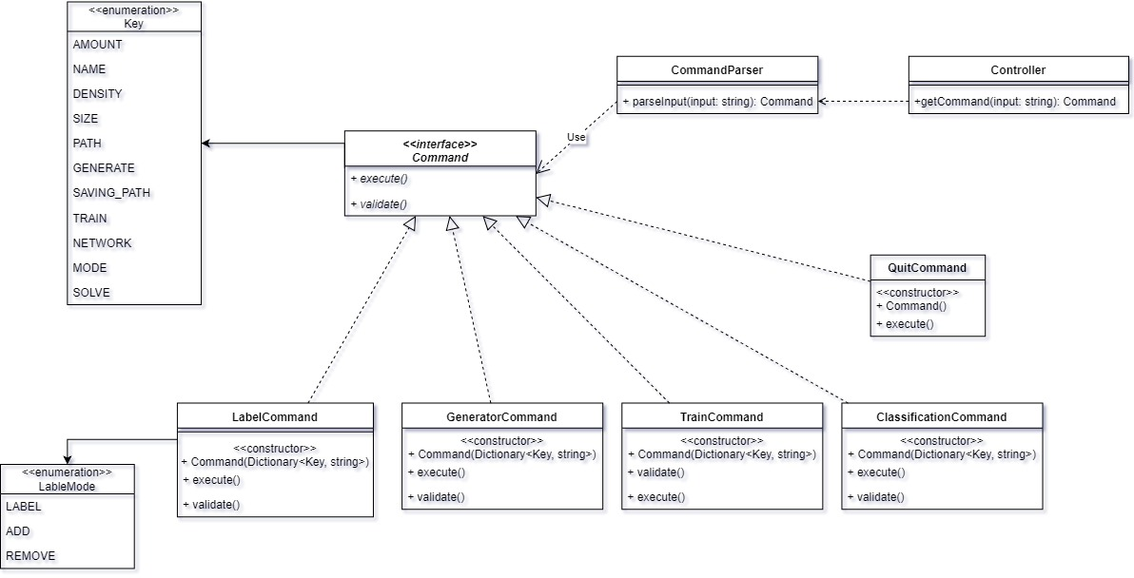
Controller Module

Slide 4
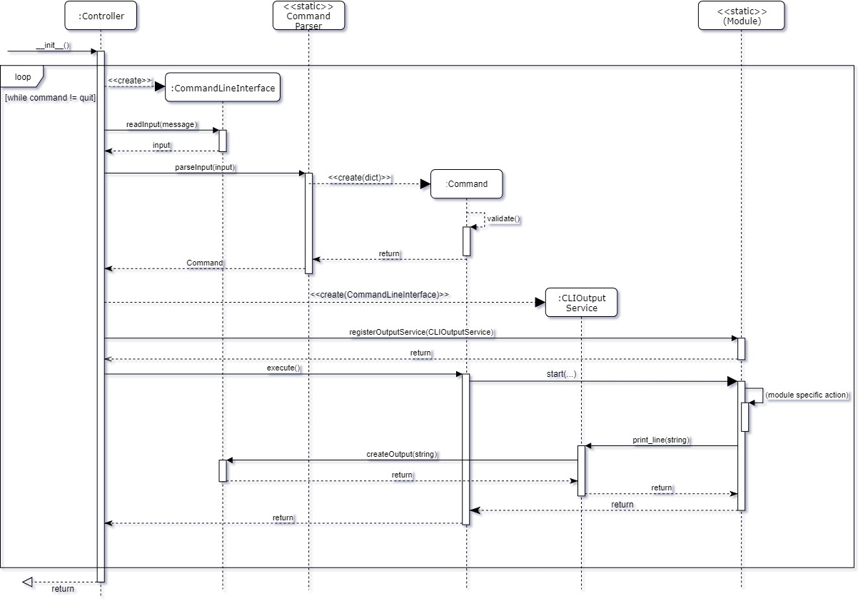

Slide 5
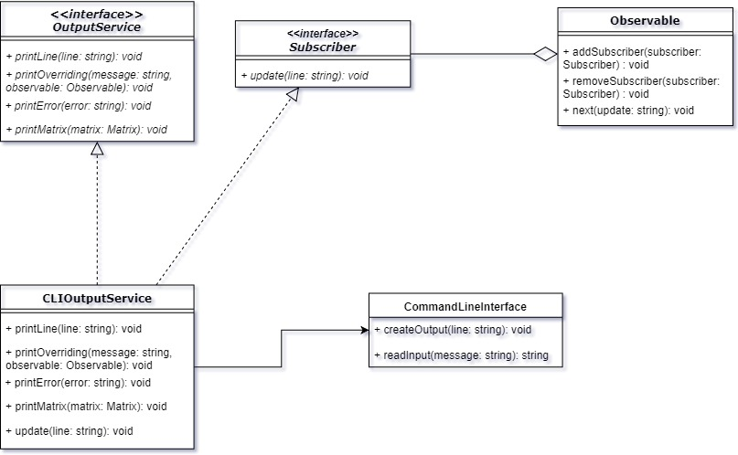
View Module

Slide 6
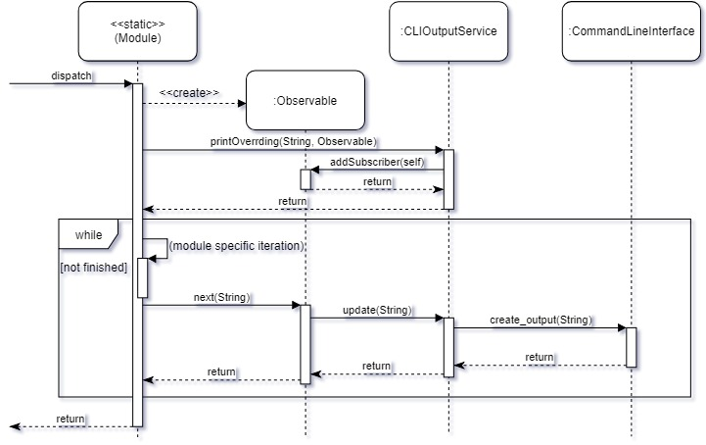

Slide 7
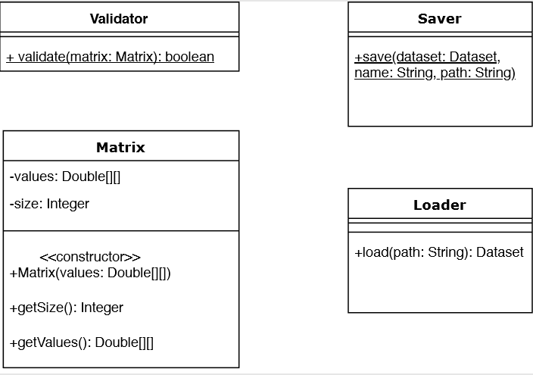
Help classes
Notes:
used by multiple modules
Saver: save dataset in hdf5 file

Slide 8
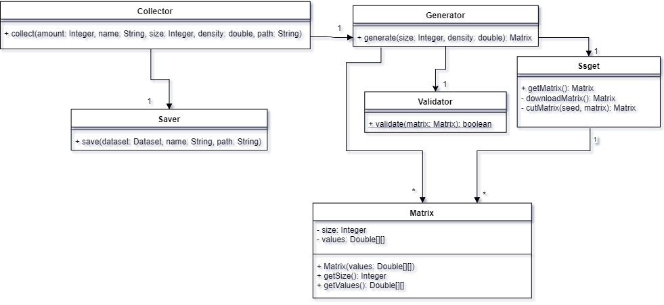
Collector Module
Notes:
Collector: aquiring, creating, collecting, saving matrices into a dataset
classes:
-collector: entry point
-ssget: fetch and cut/transform matrices from suite sparse
-generator: generating by transforming raw matrices from suite sparse and validating them

Slide 9
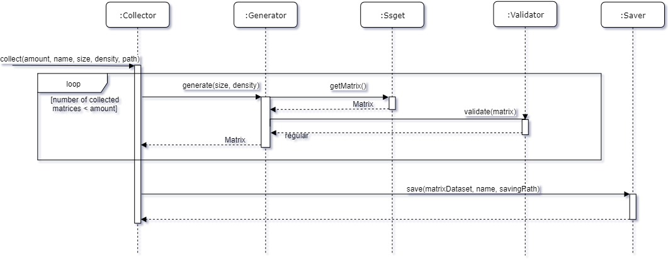

Slide 10
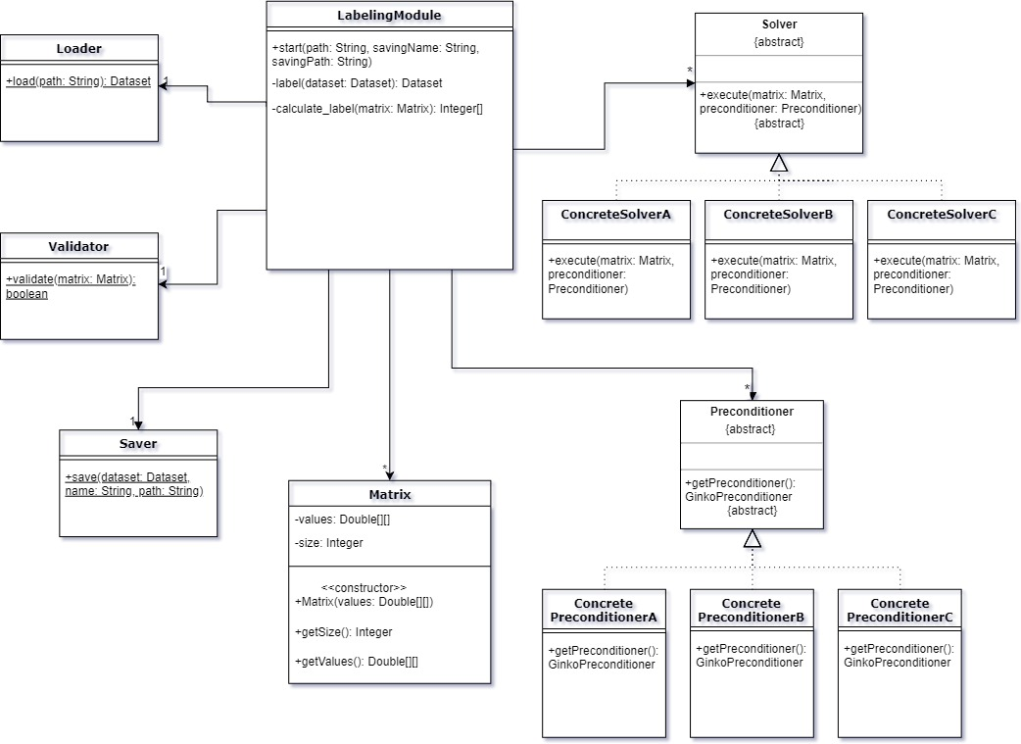
Labeling Module

Slide 11
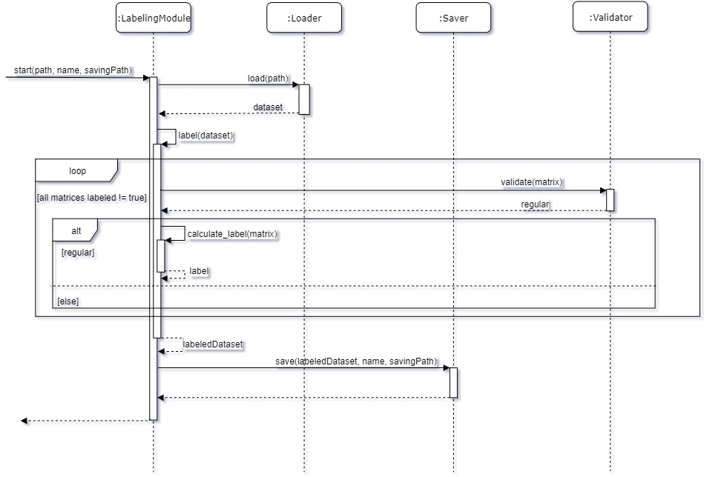

Slide 12
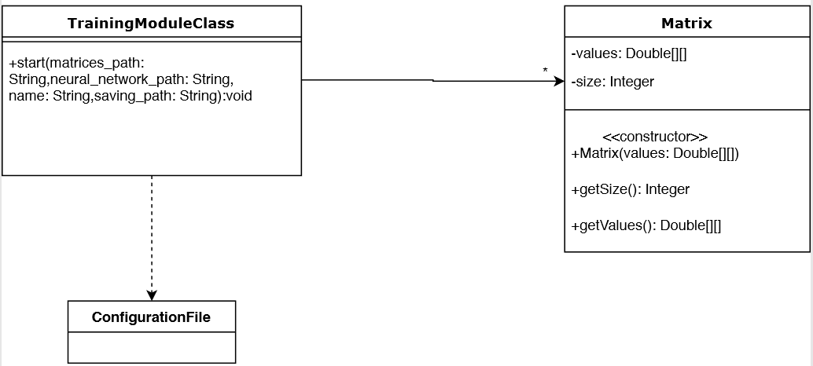
Training Module

Slide 13
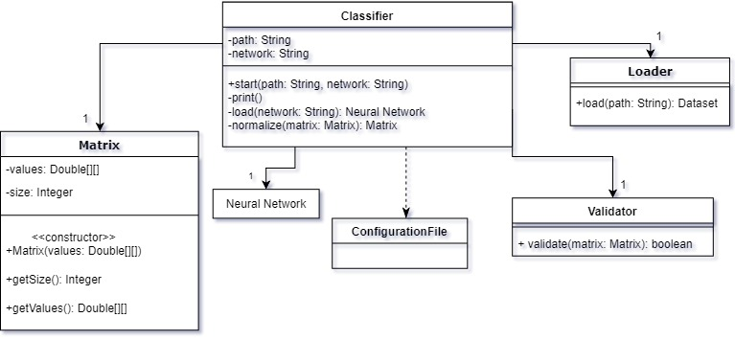
Classify Module

Slide 14
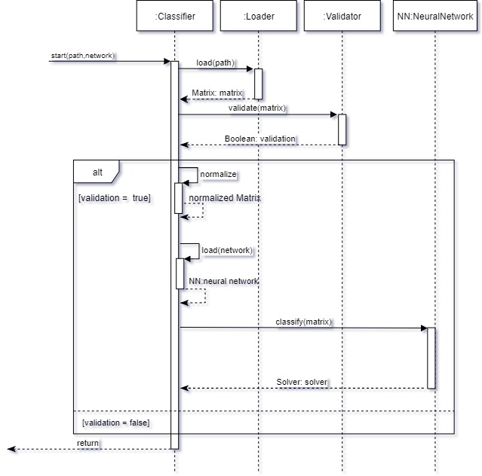

Slide 15
