Slide 1
Numerical Linear Algebra meets Machine Learning
Fabian Koffer, Simon Hanselmann, Yannick Funk,
Dennis Leon Grötzinger, Anna Ricker

Slide 2
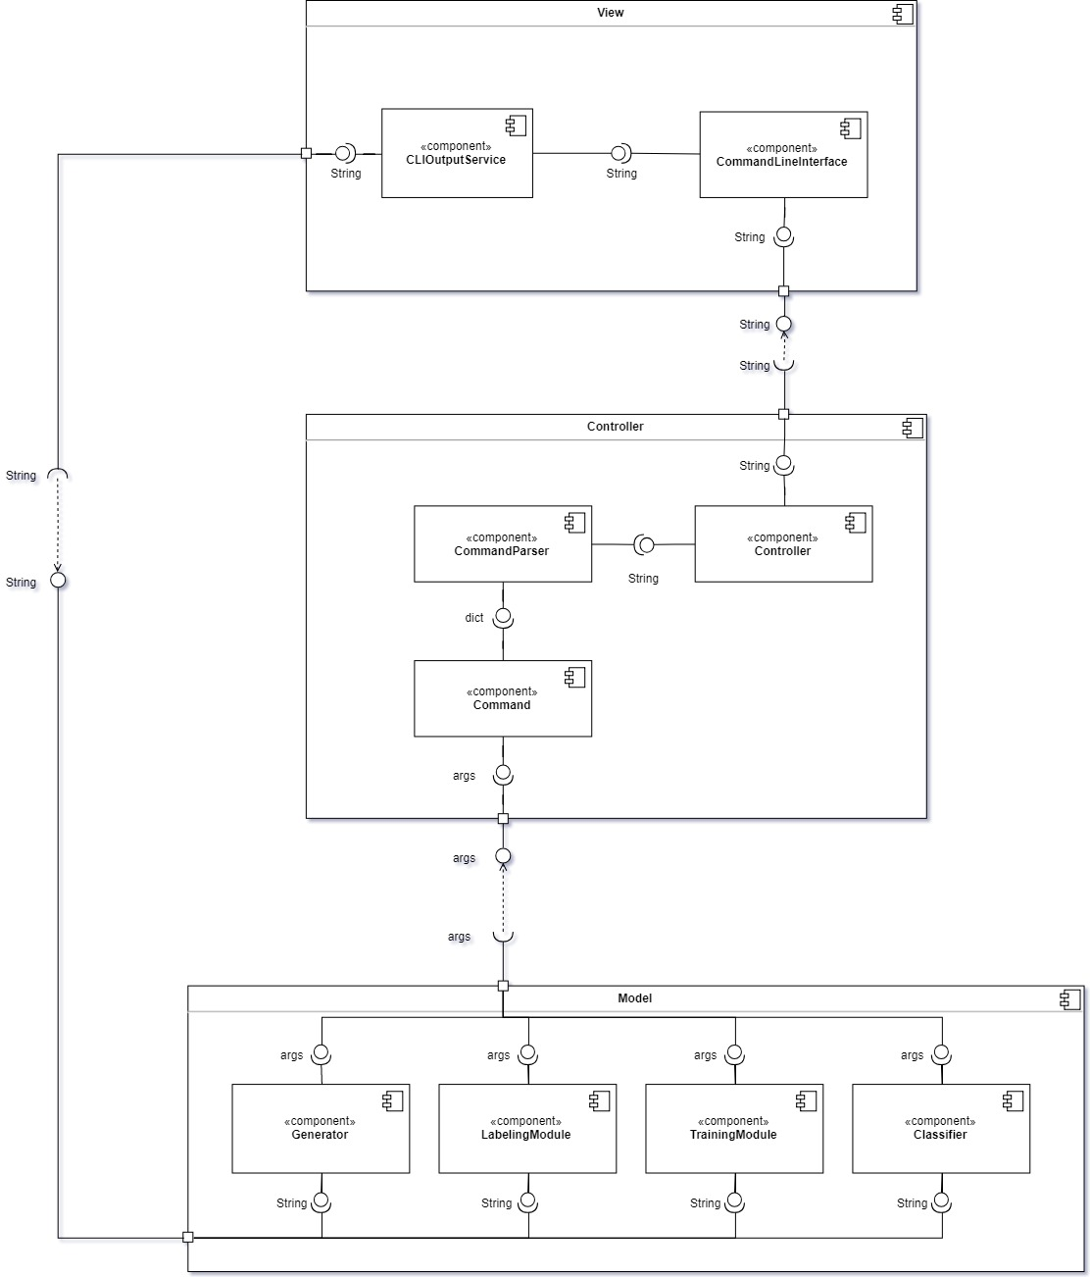
Component Diagram

Slide 3
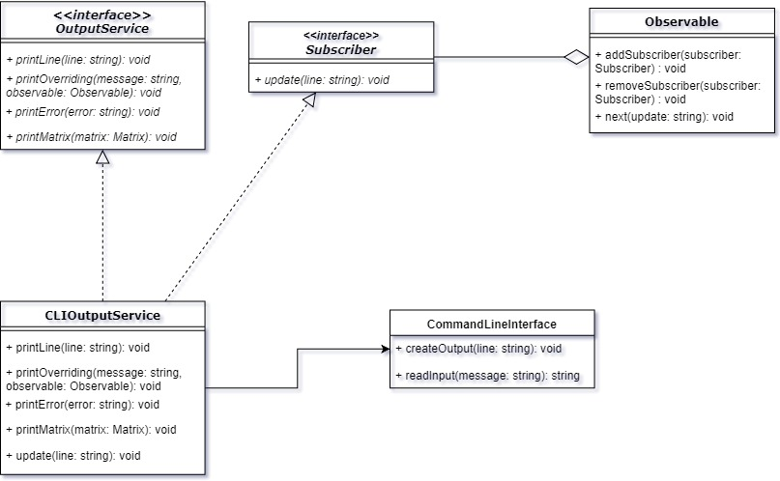
View Module

Slide 4
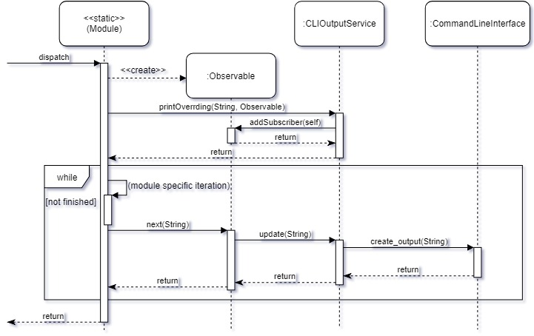

Slide 5
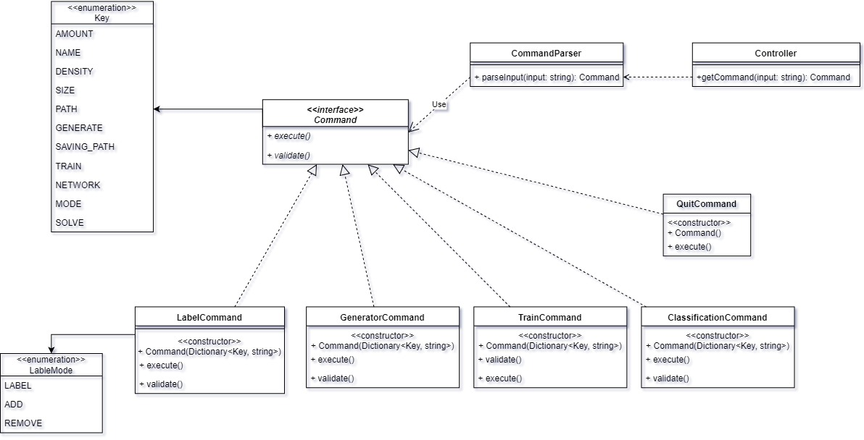
Controller Module

Slide 6
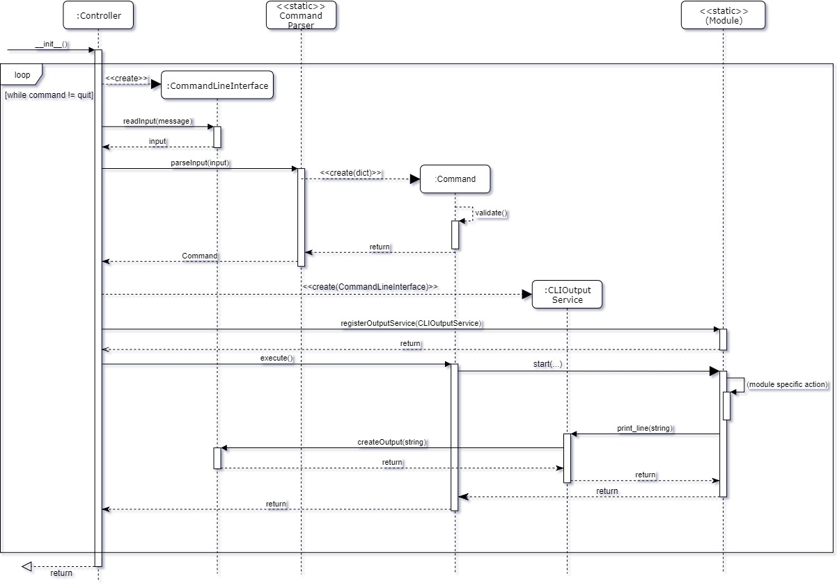

Slide 7
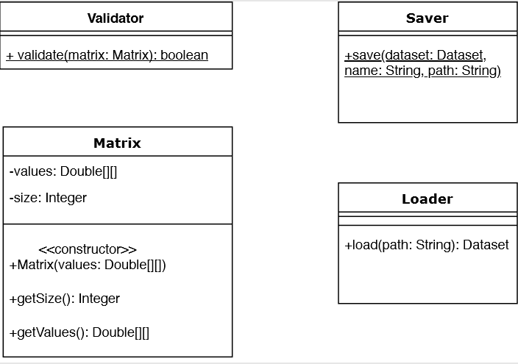
Help classes

Slide 8
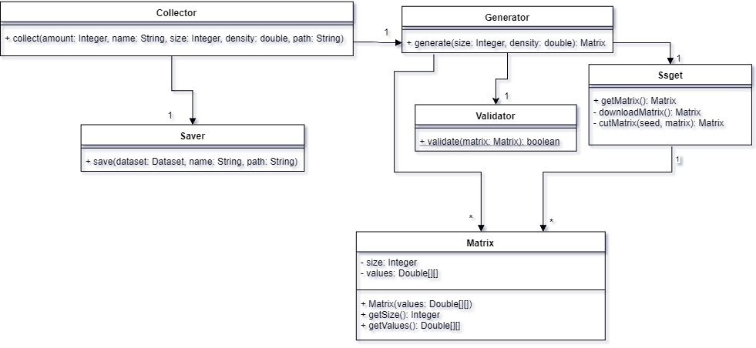
Collector Module

Slide 9
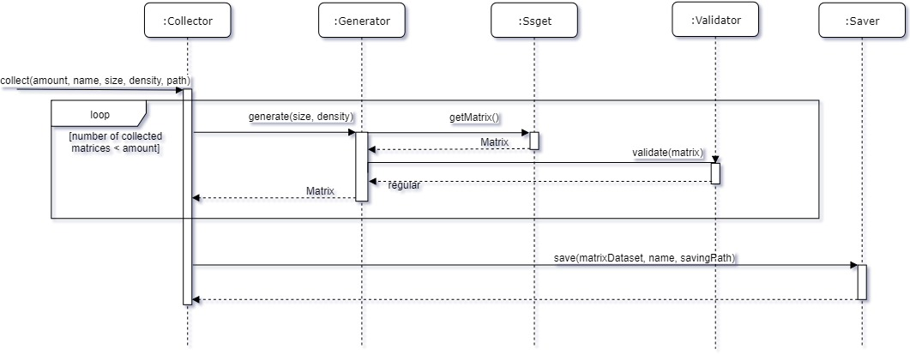

Slide 10
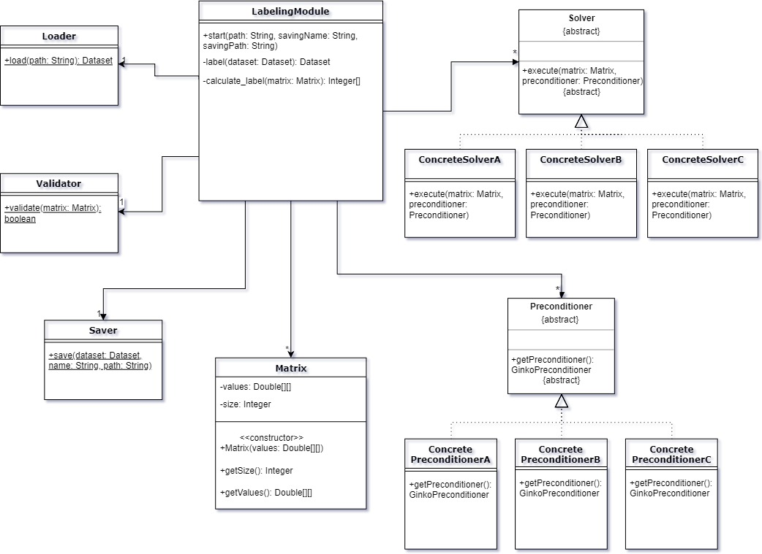
Labeling Module

Slide 11
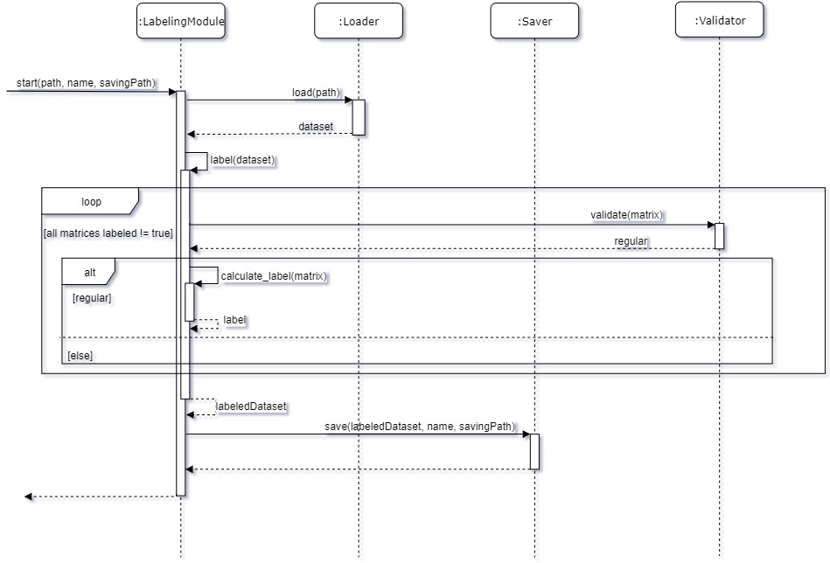

Slide 12
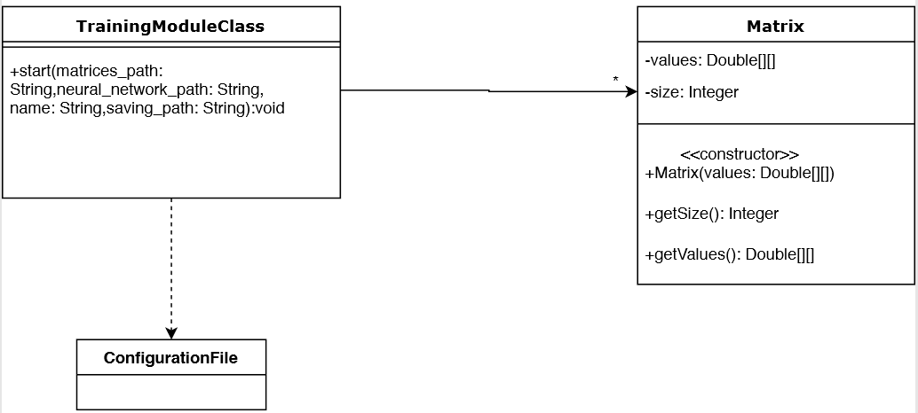
Training Module

Slide 13
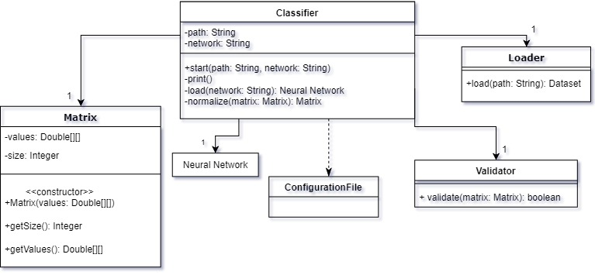
Classify Module

Slide 14
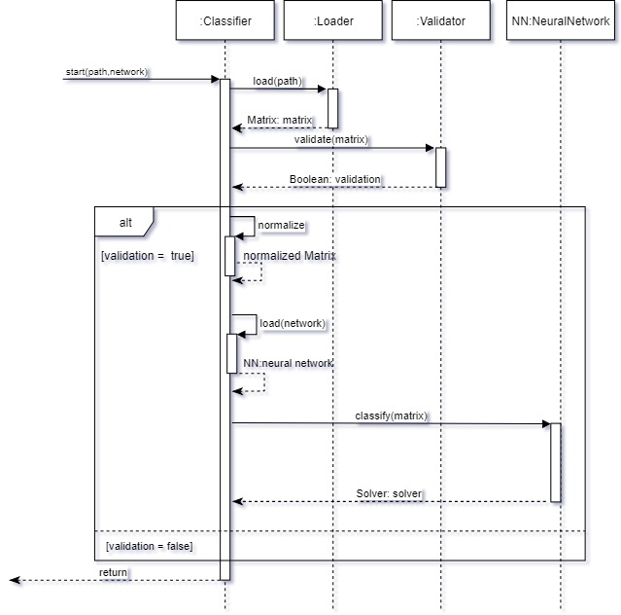

Slide 15
