Slide 1
Blinduino
Embedded Systems Architectures 2019-2020
Giacomo Menchi
Matteo Guerrini
Manuel Cretone

Slide 2
Goals
Create a system that helps blind people to move securely.
The system must:
Recognize an obstacle and communicate its presence to the user;
If the user is standing still, the object in front of him (in a certain range), is identified and described.

Slide 3
1. Obstacle Recognition
The obstacle recognition is achieved by proximity sensors, placed in three different spots:
One is placed on the fronthead/hat,
One is placed on the ankle,
One is placed on the wrist and can be moved to be used.
The three proximity sensors are coupled with three vibration actuators, which instantly communicate where the obstacles are.

Slide 4
1.1 Components list
Proximity sensor (3)
Arduino Uno (3)
Vibration actuator (3)

Slide 5
2. Object Recognition
The object that the user is looking at closely (or holding) is recognized by a camera.
This happens only if the person presses a button.
The result (phone, bottle, box, etc…) is communicated to the user vocally via the smarphone application.

Slide 6
2.1 Components list
Arduino Uno (1)
Webcam (1)
SD Card Reader (1)
Bluetooth Module (1)

Slide 7
3. Data elaboration
Arduino connects to an external device which elaborates input data (from camera) and returns output (recognized objects).

Slide 8
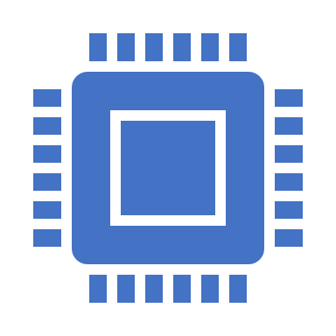
4. Definitive components list
Arduino Uno (4)
Proximity sensor (3)
Vibration actuator (3)
Webcam (1)
SD Card Reader (1)
Bluetooth Module (1)

Slide 9
Thanks for the attention

