Slide 1



ITDroid
Automated Detection of i18n Issues on Android Apps
Notes:
Hello everyone,
My name is Camilo Escobar Velásquez, I work with The Software Design Lab from Universidad de los Andes
Today I am going to present Mut A P K, a source-codeless mutant generation tool for Android Apps

Slide 2





ITDroid
TXT
JSON
Execution log
Hard-coded
Strings Location
ICC count report
Report
Notes:
So, what is ITDroid ??? … ITDroid is a tool that Works with APKs as input.
Once MutAPK is executed it generates a set of mutated APKs ready to be install in a device or emulator. Additionally, it generates 3 complementary files to enhance the result of mutant generation process. This 3 files can be processed after execution to understant the location of the injected mutations, the available locations for mutant injection and a report on execution time along with building results.

Slide 3

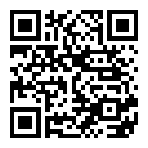


Online Appendix
GitHub Repository
Notes:
ITDroid is publicly available on github and you can find an online appendix with more detailed information following this QR code.

Slide 4














Notes:
We created ITDroid a tool for the detection and localization of internationalization failures for Android apps.

Slide 5
Detection of hardcoded strings
Detection of Non-Internationalized strings
Automated translation of strings
Automated exploration of apps and reporting of i18n issues
Notes:
Detection of hardcoded strings
Detection of Non-Internationalized strings
Automated translation of strings
Systematic Exploration of translated app
Automated detection of changes due to internationalized strings

Slide 6


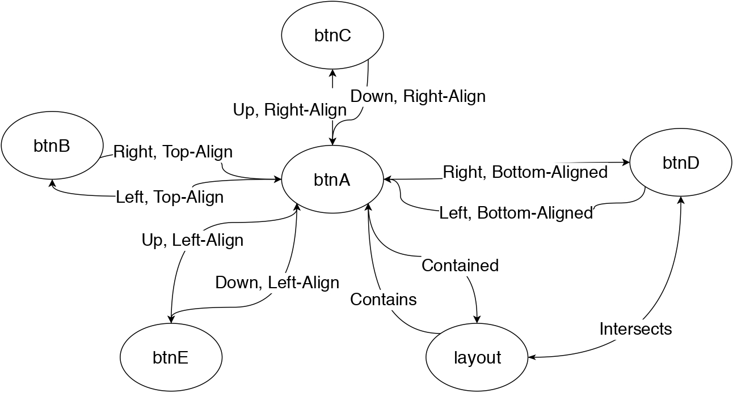
Static Analysis at APK level
Automated translation of strings
Dinamic Analysis
Layout graphs

Slide 7
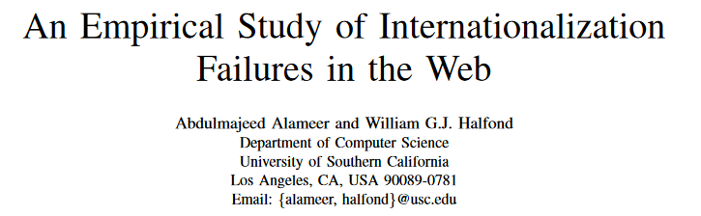
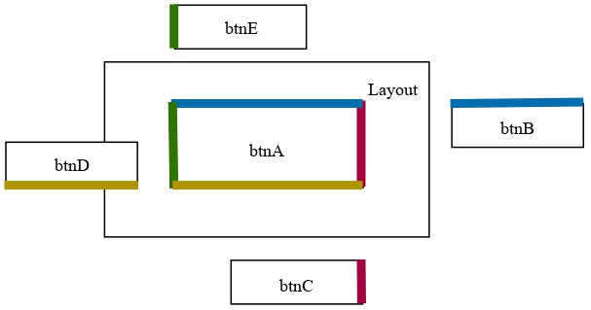

Slide 8
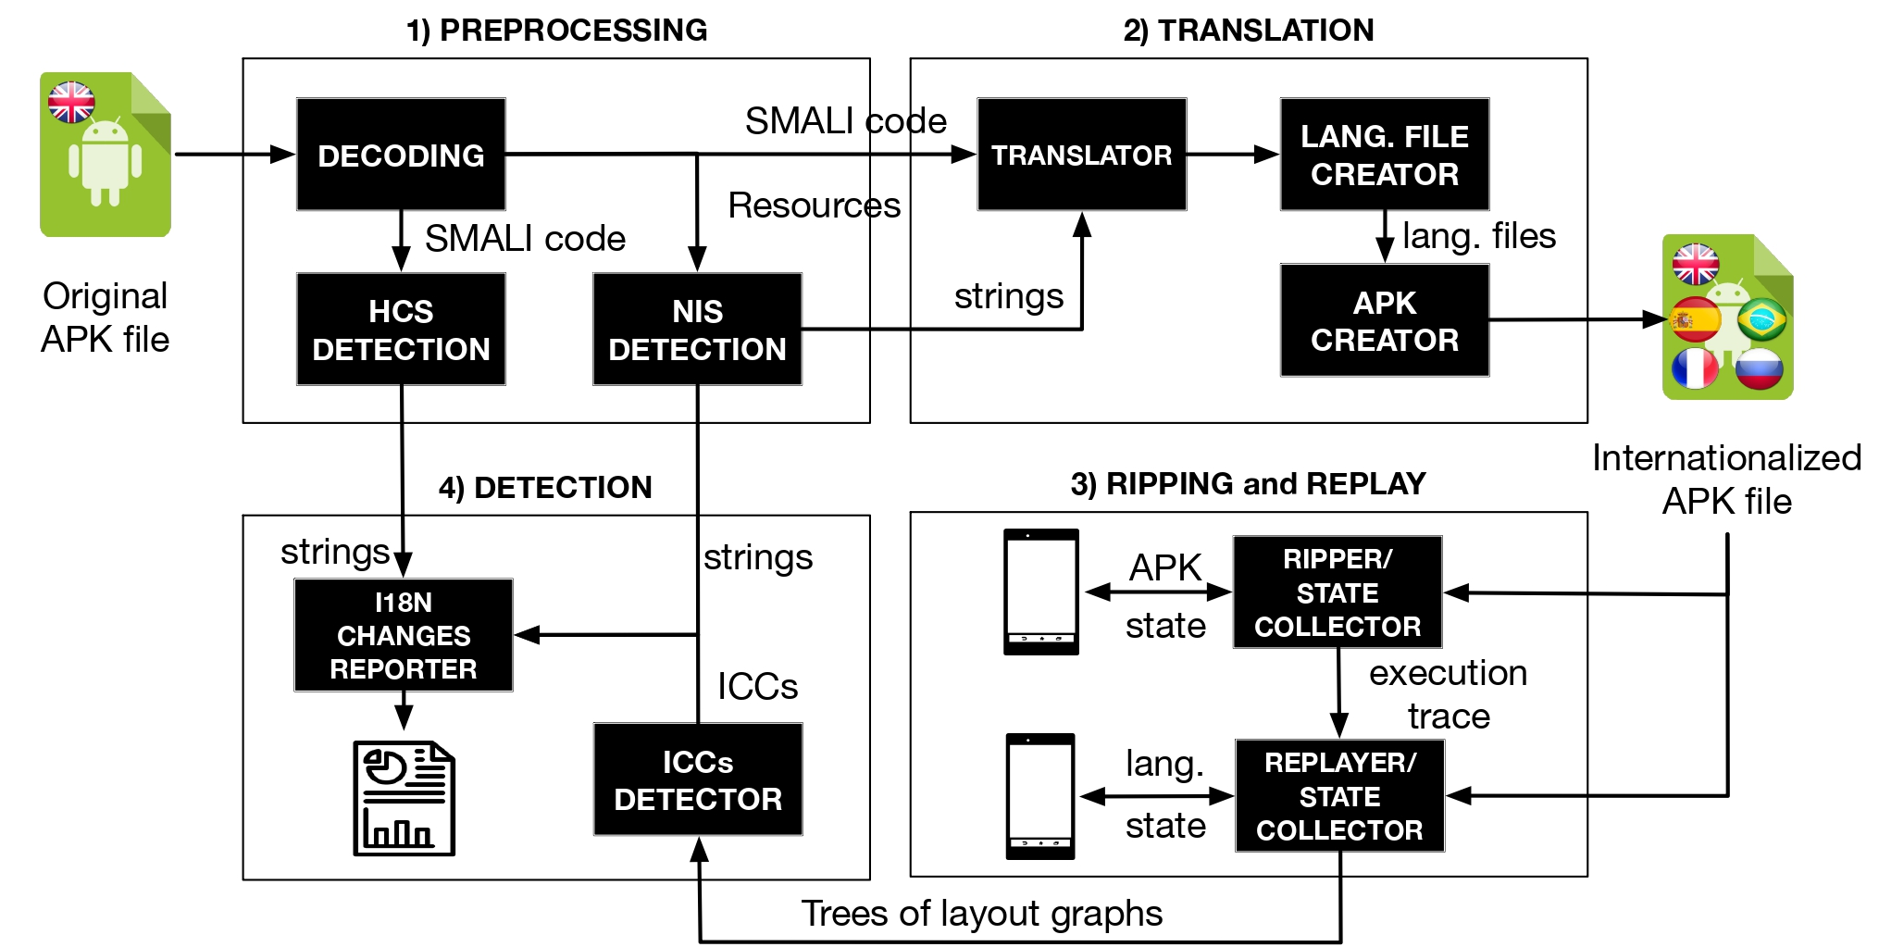

Slide 9
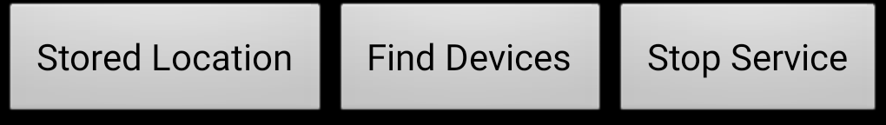
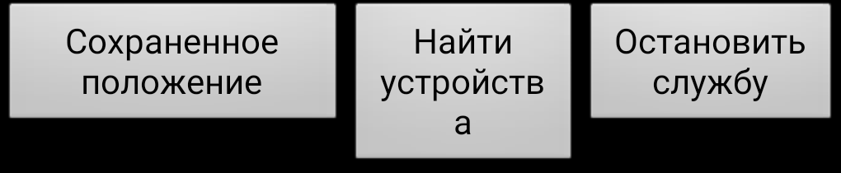

Slide 10
$ git clone https://github.com/TheSoftwareDesignLab/ITDroid.git
$ cd ITDroid/
$ mvn clean
$ mvn package
Notes:
In order to use MutAPK, user must clone the repository and build the jar file using Maven.

Slide 11
Console command:
$ java -jar ITDroid-<version>.jar <APKPath> <AppPackage> <ExtraLibsFolder> <settingsDir> <amountUntranslatable> <OutputFolder> <emulatorID>
Notes:
MutaPK has been design to work as a command line tool, to execute it user must use following command where she must provide the path to the JSON configuration file.

Slide 12
ITDroid Execution Result Files
TXT
JSON
Internationalized APK
Execution log
Hard-coded
Strings Location
ICC count report
Report
Notes:
Once the mutant generation process is executed, MutAPK generates 3 files along with the mutated apks.

Slide 13
Hardcoded Strings Locations (hcs.json)
StationsListActivity
onCreate
"stations"
"bikeNetwork"
"favStations"
"nearbyStations"
setNearbyStations
"network"
"location"
"network"
Notes:
Second, the Potential Fault profile representation, where all the potential fault locations found are details in terms of its mutation type and file location

Slide 14
ICC count report (iccs.csv)
Notes:
Third, an execution time report showing copying time mutation time and building plus signing time. Additionally, information related to mutant análisis and compilation results are shown for each mutant. In case a mutant is tagged as equivalent the sixth column would have a value of 1. In other case, the mutant is tagged as duplicate, the seventh column would have a value of 1 and the eight columna Will have the id of the mutant it was compared and identify as a duplicate. Finally, the last columna would report if the mutant was build or not.
It worth noticing that there are two entries for each mutant, since creation of app copy and mutation injection are done in different moments.

Slide 15
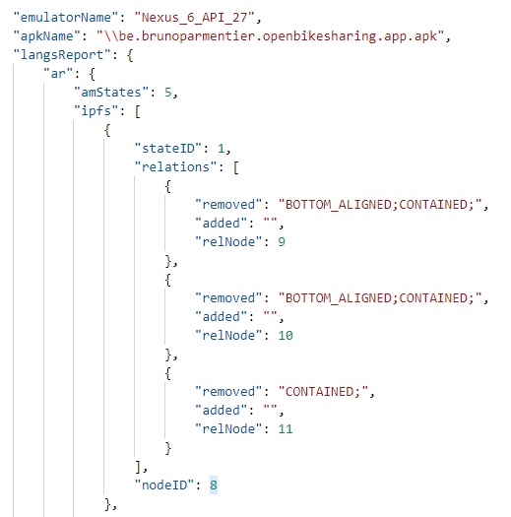
ITDroid Report
Notes:
Additioanlly, might not be able to build all the mutants due to compilation issues. In case the mutant is generated, the corresponding folder will have the mutated apk, a signed version of the mutated apk and a copy of the file the mutation was injected. In the case, the mutant is not generated, the folder will contain the complete mutated app copy for further analysis.

Slide 16
Notes:
Thank you for watching this video. Please visit out online appendix for mor information.

Slide 17
Additional slides

Slide 19
Console Output
Notes:
MutAPK console output is build as a markdown file, it is recommended for users to use console commands as tee to store the console output for further análisis.

Slide 20
Console Output (1)
Processing your APK...
Wow... that was an amazing APK to proccess!!! :D
There are 145 hardcoded strings in your app.
These strings are shown in hcs.txt
file stored in output folder.
Selected Languages: 7
Arabic
Hindi
Russian
Portuguese
Italian
French
Spanish
Notes:
First, MutAPK reports the values provided in the JSON configuration file

Slide 21
Console Output (2)
Your application is translated to the following languages:
- Arabic
- Hindi
- Russian
Your application is not translated to the following languages:
- Portuguese
- Italian
- French
- Spanish
Notes:
Second, it reports the mutant operators selected by the user via the operators.properties file

Slide 22
Console Output (3)
We are going to translate your strings...
Building mutant
Signing mutant
SUCCESS: The mutated APK has been generated.
Notes:
Third, it reports statistics from the Dead code análisis. There are 3 values reported: First, the amount of methods found that are called thorugh code but are not defined. This methods belong to libraries. Second, the amount of methods that are called and also defined. This methods are the ones used for the PFP derivation. And finally the third value is the amount of methods identified as deadcode.

Slide 23
Console Output (4)
Processing ar app version
Wiping app data
Emulator language changed to Arabic
Emulator is being restarted
waiting for emulator's idle state
Emulator now is in idle state
Going through your app
Notes:
Fourth, MutAPK reports the amount fo locations found for each mutant operator as potential mutant injection locations. MutAPK reports them grouped by mutant operator.

Slide 24
Console Output (5)
EXPLORATION FINISHED, 5 states discovered, 60 events executed, in 5 minutes
The app has been inspected
compareLayoutGraph :: English->Arabic || There was 0 states in English Graph that were not paired
compareLayoutGraph :: English->Arabic || There was 0 states in Arabic Graph that were not paired
There are 4 Internationalization Collateral Changes for Arabic app version.
Notes:
Fifth, in case a mutant selection strategy is selected, MutAPK reports the amount of mutants per mutant operator to be generared after sampling.

