Slide 1



MutAPK 2.0
Source-Codeless Mutant Generation tool for Android Apps
Notes:
Hello everyone,
My name is Camilo Escobar Velásquez, I work with The Software Design Lab from Universidad de los Andes
Today I am going to present Mut A P K, a source-codeless mutant generation tool for Android Apps

Slide 2






MutAPK 2.0
…
JSON
Execution log
PFP Representation
Execution Time Report
Notes:
So, what is Mut A P K ??? … MutAPK is a Android apps Mutant generation tool that Works with APKs as input.
Once MutAPK is executed it generates a set of mutated APKs ready to be install in a device or emulator. Additionally, it generates 3 complementary files to enhance the result of mutant generation process. This 3 files can be processed after execution to understant the location of the injected mutations, the available locations for mutant injection and a report on execution time along with building results.

Slide 3





MutAPK 2.0 Features
Mutation Operators Selection
Dead Code Omission
Mutant Selection Techniques
Equivalent and Duplicate Mutant Removal
Parallel Mutant
Creation
Notes:
MutAPK has five main features … First, it allow user to define the set of mutant operators that are used for the process. Second, it provides the capability of avoiding deadcode when computing the Potential Fault Profile. Third, it enables 2 mutant selection techniques to sample the full mutant set. Fourth, it removes equivalent and duplicate mutants and Fifth Parallel mutant generation to reduce execution time and to use availbale computational capabilities.

Slide 4
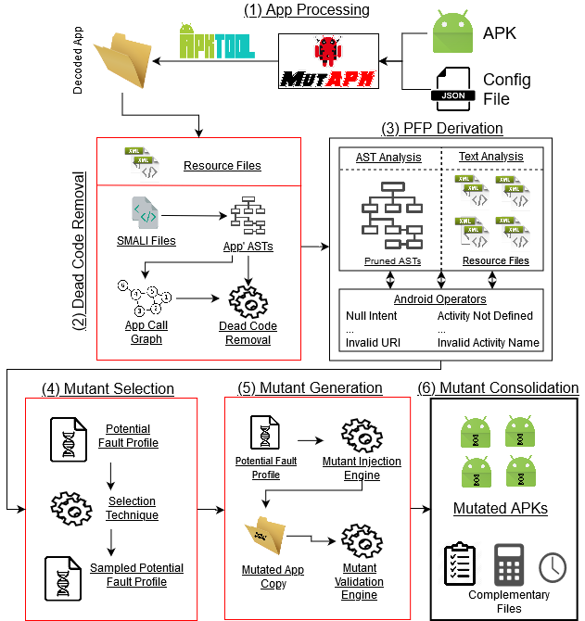
Notes:
MutAPK workflow is divided in 6 main stages: First, apk preprocesing were we use APKTool library to retrive a decoded versión of the app in a Intermediate Representation called SMALI. Second stage is the associated with the processing of the decoded app to avoid injecting mutation into dead code. For this, MutAPK generates an Abstract Syntax tree fro each SMALI File, next it generates the app’s call graph and identify the method sthat are not called through the app. Third stage consist of the Potential Fault profile derivation, where static análisis of SAMLI code is done in order to locate the posible locations where mutations can be injected. Fourth, Mutant Selection stage where depending on the selected technique, a sampling of the found locations is performed. Fifth, mutant generation stage where each mutated copy of the app is analyzed to identify if it is an equivalent or duplicate mutant. Finally, last stage is mutant consolidations where the mutants folder are clean, keeping just the mutated apks when compilation is posible and the full mutated app copy when a issue is found.

Slide 5



MutAPK 2.0
Online Appendix
GitHub Repository
Notes:
MutAPK is publicly available at github where its documentation is also host as an online appendix

Slide 6

MutAPK 2.0
$ git clone https://github.com/TheSoftwareDesignLab/MutAPK.git
$ cd MutAPK/
$ mvn clean
$ mvn package
Notes:
In order to use MutAPK, user must clone the repository and build the jar file using Maven.

Slide 7
MutAPK 2.0
Console command:
$ java –jar MutAPK-2.0.0.jar <JSONConfigFile> | tee report.md
Notes:
MutaPK has been design to work as a command line tool, to execute it user must use following command where she must provide the path to the JSON configuration file.

Slide 8
JSON Configuration File:
{
"apkPath": "./apk/com.evancharlton.mileage_3110.apk",
“appName": "com.evancharlton.mileage",
"mutantsFolder": "./mutants",
"operatorsDir": "./",
"multithreadExec": "true",
"extraPath": "./extra",
“ignoreDeadCode”: “true”,
"selectionStrategy": "all” || “amountMutants” || “representativeSubset",
"selectionParameters":
{
"amountMutants":"34",
"perOperator":"false",
"confidenceLevel":"85",
"marginError":"10"
}
}
Notes:
Aforemention configuration file has 8 main properties and 4 that must be used depending on the mutant selection technique choose for execution. First, the apkPath property defines the path to the APK to be use as base for mutation process. Second, the appName property defines de app’s main package. Third, the mutantsFolder Path, that tells MutAPK where the mutants must be generated. Fourth, operatorsDir that defines the path to hte operators.properties file. Fifth, the multithreadExec params that Enables the generation of mutants using all the threads available in the computer. Sixth, the extraPath, that defines the path to the extra folder where extensión libraries must be located. Seventh, the ignoreDeadCode property, tells MutAPK if dead code must be omitted during the PFP derivation process. Eighth, the selectionStrategy property that defines the strategy MutAPK must use to sample the full mutant set, this property has 3 posible values: “all”, “amountMutants, or “representativeSubset”. In case user selects amountMutants technique. She must provide also a value for amountMutants property under selectionParameters. In the other case, user selects “representativeSubset” it must provide values for three properties: first perOperator property to define if subset must be computed using each mutant operator set as base. Second, confidence level subset must guarantee and Third the margin error allowed for the sampling.

Slide 9
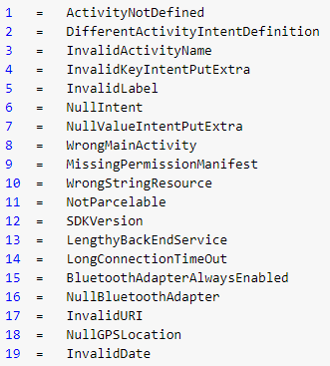
Mutation Operators Selection
operators.properties
Notes:
Regarding the selection of mutants operator, all availbale operators are listed inside the operators.properties file. In case user wanted to remove one, she can delete or comment the line within the file.

Slide 10
MutAPK 2.0
Console Output
Notes:
MutAPK console output is build as a markdown file, it is recommended for users to use console commands as tee to store the console output for further análisis.

Slide 11
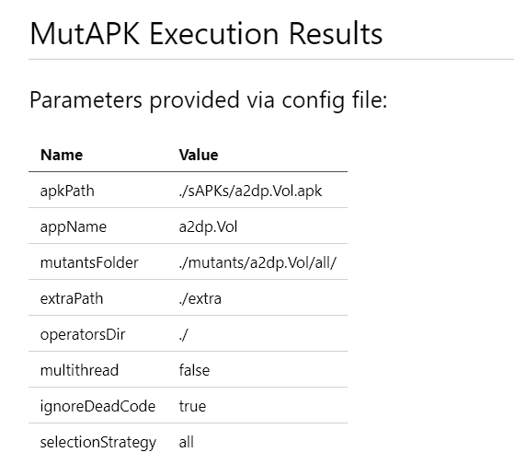
Console Output (1)
Notes:
First, MutAPK reports the values provided in the JSON configuration file

Slide 12
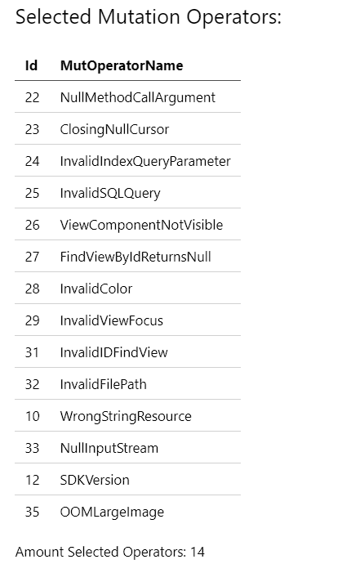
Console Output (2)
Notes:
Second, it reports the mutant operators selected by the user via the operators.properties file

Slide 13
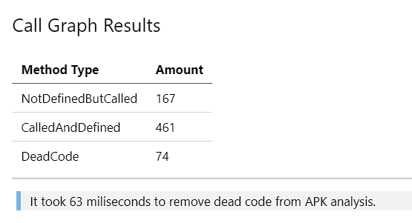
Console Output (3)
Notes:
Third, it reports statistics from the Dead code análisis. There are 3 values reported: First, the amount of methods found that are called thorugh code but are not defined. This methods belong to libraries. Second, the amount of methods that are called and also defined. This methods are the ones used for the PFP derivation. And finally the third value is the amount of methods identified as deadcode.

Slide 14
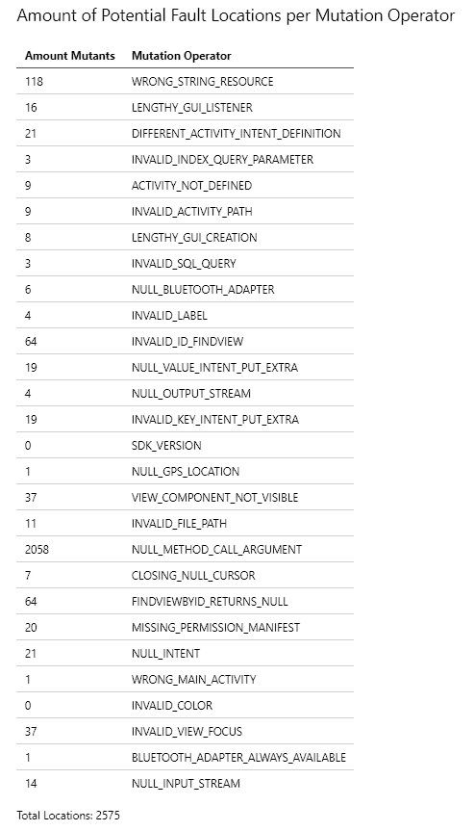
Console Output (4)
Notes:
Fourth, MutAPK reports the amount fo locations found for each mutant operator as potential mutant injection locations. MutAPK reports them grouped by mutant operator.

Slide 15
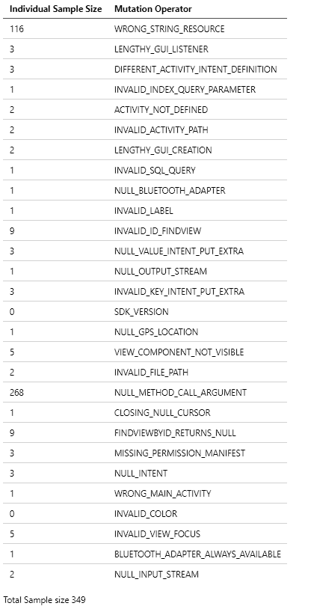
Console Output (5)
Notes:
Fifth, in case a mutant selection strategy is selected, MutAPK reports the amount of mutants per mutant operator to be generared after sampling.

Slide 16
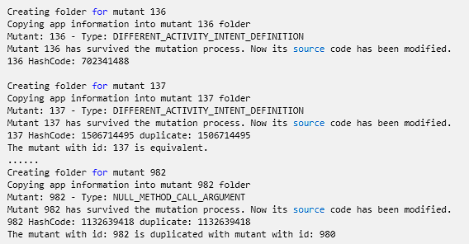
Console Output (6)
Notes:
Sixth, MutAPK presents a log of the mutation injection and building process. There are 3 posible outcomes for this process: First, if mutant is functional, all the logs related to mutation and building are reported. Second, in case the mutant is equivalent, it is reported after injecting the mutation. Finally, the third option is the mutant is tagged as duplicate, in that case MutAPK reports the id of the mutant to which it was compared and identified.

Slide 17
MutAPK Execution Result Files
JSON
PFP Representation
Execution Time Report
Mutated APKs
Execution log
Notes:
Once the mutant generation process is executed, MutAPK generates 3 files along with the mutated apks.

Slide 18
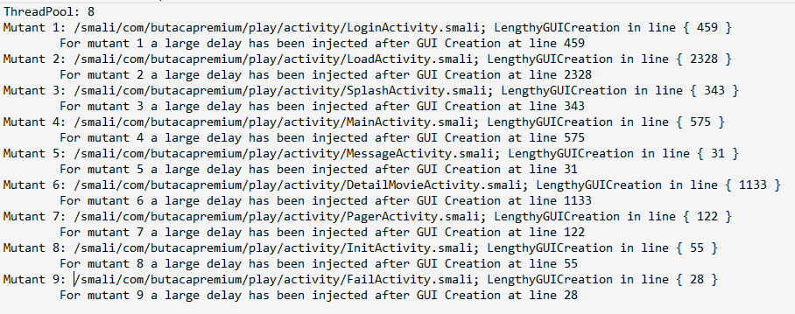
Execution log (<packageName>-mutants.log)
Notes:
First, a execution log reporting all the information related to the mutant generation, depicting the location of the mutation injection, the type of mutation, and a shot explanation of the effect of the mutation.

Slide 19
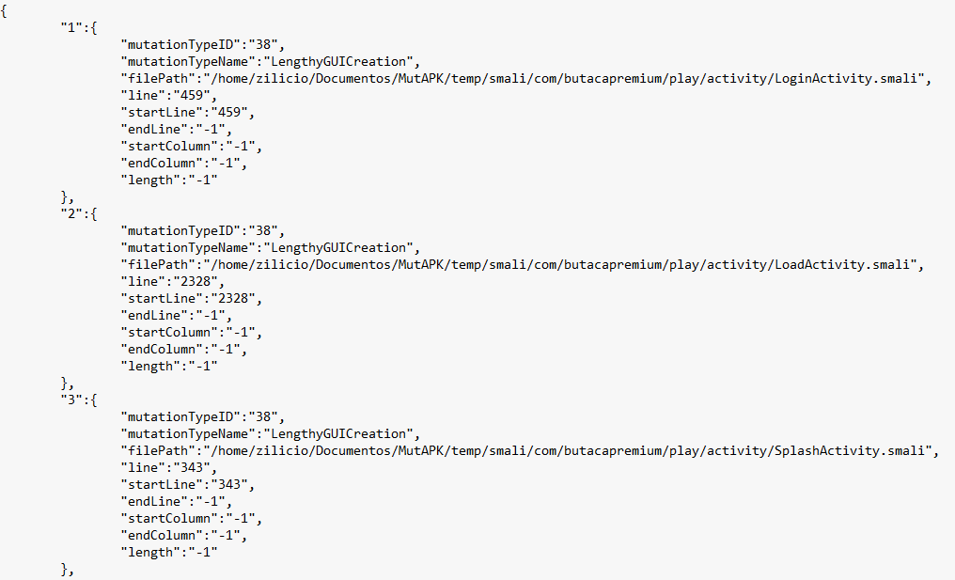
PFP Representation (<packageName>-locations.json)
Notes:
Second, the Potential Fault profile representation, where all the potential fault locations found are details in terms of its mutation type and file location

Slide 20
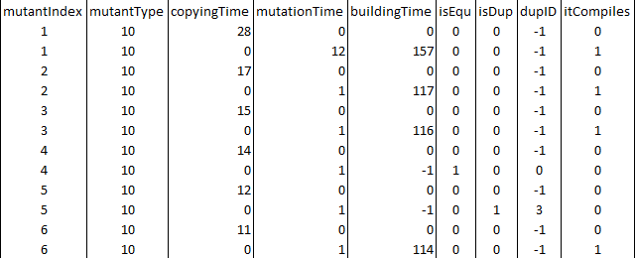
Execution Time Report (ms) (<packageName>-times.csv)
Notes:
Third, an execution time report showing copying time mutation time and building plus signing time. Additionally, information related to mutant análisis and compilation results are shown for each mutant. In case a mutant is tagged as equivalent the sixth column would have a value of 1. In other case, the mutant is tagged as duplicate, the seventh column would have a value of 1 and the eight columna Will have the id of the mutant it was compared and identify as a duplicate. Finally, the last columna would report if the mutant was build or not.
It worth noticing that there are two entries for each mutant, since creation of app copy and mutation injection are done in different moments.

Slide 21
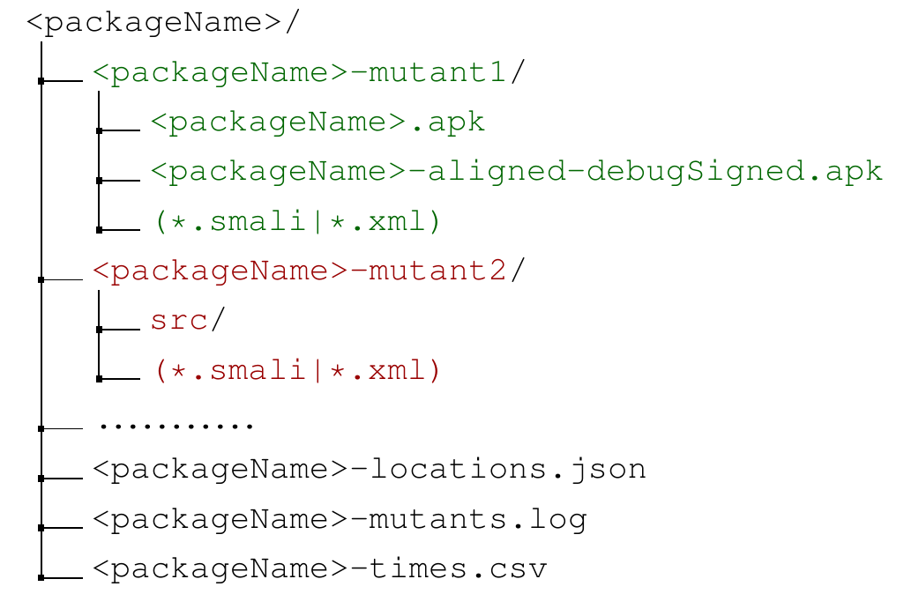
Execution Result Folder Structure
Notes:
Additioanlly, might not be able to build all the mutants due to compilation issues. In case the mutant is generated, the corresponding folder will have the mutated apk, a signed version of the mutated apk and a copy of the file the mutation was injected. In the case, the mutant is not generated, the folder will contain the complete mutated app copy for further analysis.

Slide 22
MutAPK 2.0
Notes:
Thank you for watching this video. Please visit out online appendix for mor information.

