Slide 1
Stencil computations: Shared memory, Halo cells, & Systematic indexing
ME574 Spring 2020

Slide 2
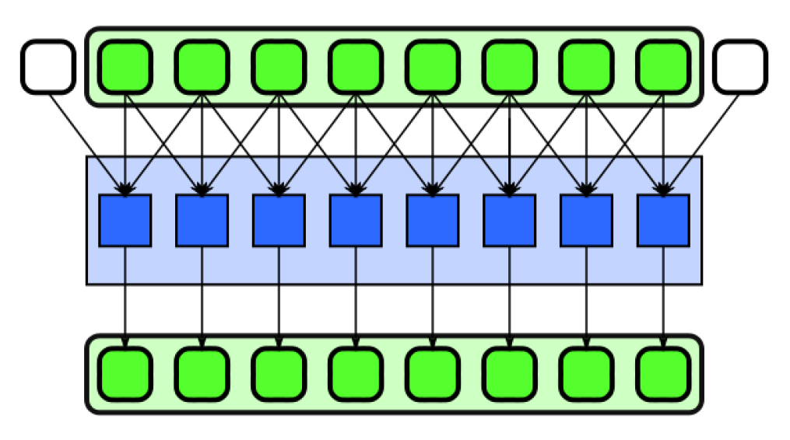
“Naive” approach
Each thread (with a given index in the grid) needs access to the corresponding entry in the input array and some neighboring values.
Each thread accesses the entries it needs from array in global memory
Lots of data access redundancy:
Typically elements are accessed (1+2*RAD)**D times
From slowest access memory on the GPU
Easiest to implement, but seriously inefficient

Slide 3
“Blocked” approach with shared array
Each thread (with a given index in the grid) needs access to the corresponding entry in the input array and some neighboring values.
Threads are organized into blocks:
Some threads (at edges of the block) need values whose indices lie outside that block ⇨ “halo” or “ghost” cells (shown below in white).
Create shared array (in the kernel)
Store the necessary portion of the input array
Provide fast access to all threads in the block
Load necessary data ONCE!
Keep track of where data is! ⇨ SYSTEMATIC INDEXING!!!

Slide 4
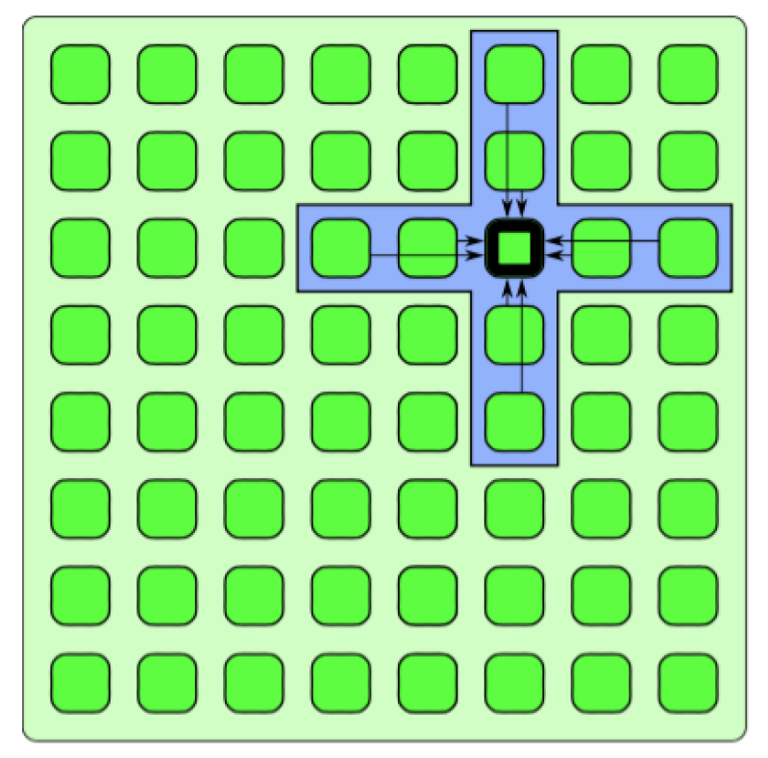
nD stencil
Redundancy becomes more severe in higher dimensions
Shared memory becomes even more useful
Loading halo requires a bit more care…

Slide 5
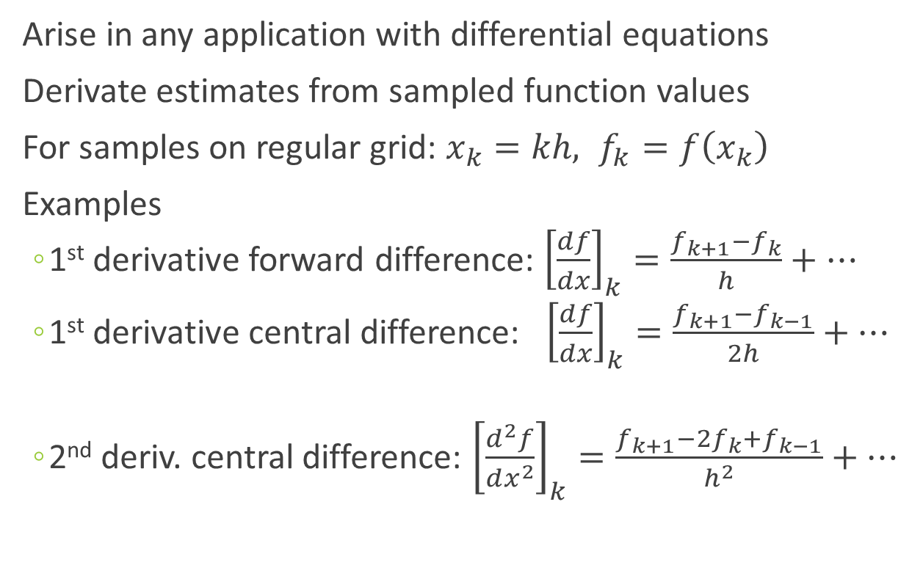
Canonical 1D example: Finite differences
Arise in any application with differential equations
Derivate estimates from sampled function values
For samples on regular grid: $x_{k}=kh, f_{k}=f\left(x_{k}\right)$
Examples
1st derivative forward difference: ${\left[\frac{df}{dx}\right]}_{k}=\frac{f_{k+1}−f_{k}}{h}+…$
1st derivative central difference: ${\left[\frac{df}{dx}\right]}_{k}=\frac{f_{k+1}−f_{k−1}}{2h}+…$
2nd deriv. central difference: ${\left[\frac{d^{2}f}{dx^{2}}\right]}_{k}=\frac{f_{k+1}−{2f}_{k}+f_{k−1}}{h^{2}}+…$

Slide 6
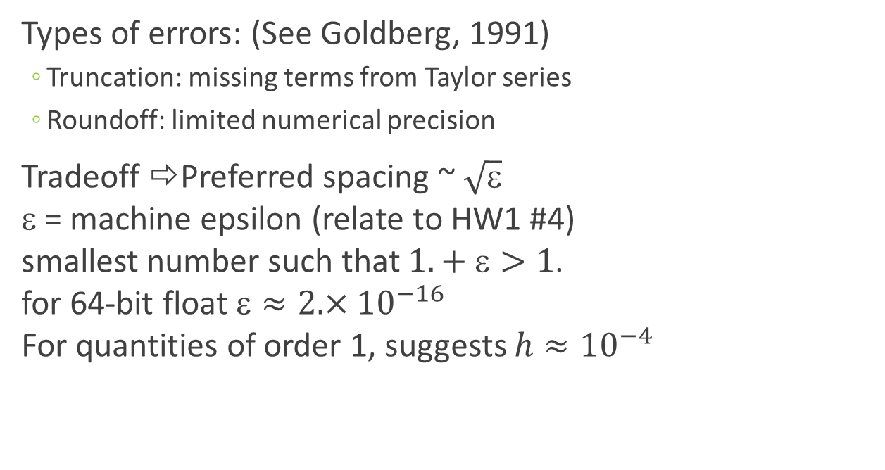
Errors and grid spacings
Types of errors: (See Goldberg, 1991)
Truncation: missing terms from Taylor series
Roundoff: limited numerical precision
Tradeoff ⇨Preferred spacing ~ $\sqrt{\text{ε}}$ ε = machine epsilon (relate to HW1 #4) smallest number such that $1.+ \text{ε}>1$. for 64-bit float$\text{}≈2. ×{10}^{−16}$ For quantities of order 1, suggests $h≈{10}^{−4}$

Slide 7
Central difference coefficients https://en.wikipedia.org/wiki/Finite_difference_coefficient
Derivative | Accuracy | −4 | −3 | −2 | −1 | 0 | 1 | 2 | 3 | 4
1 | 2 |  |  |  | −1/2 | 0 | 1/2
 | 4 |  |  | 1/12 | −2/3 | 0 | 2/3 | −1/12
 | 6 |  | −1/60 | 3/20 | −3/4 | 0 | 3/4 | −3/20 | 1/60
 | 8 | 1/280 | −4/105 | 1/5 | −4/5 | 0 | 4/5 | −1/5 | 4/105 | −1/280
2 | 2 |  |  |  | 1 | −2 | 1
 | 4 |  |  | −1/12 | 4/3 | −5/2 | 4/3 | −1/12
 | 6 |  | 1/90 | −3/20 | 3/2 | −49/18 | 3/2 | −3/20 | 1/90
 | 8 | −1/560 | 8/315 | −1/5 | 8/5 | −205/72 | 8/5 | −1/5 | 8/315 | −1/560
3 | 2 |  |  | −1/2 | 1 | 0 | −1 | 1/2
 | 4 |  | 1/8 | −1 | 13/8 | 0 | −13/8 | 1 | −1/8
 | 6 | −7/240 | 3/10 | −169/120 | 61/30 | 0 | −61/30 | 169/120 | −3/10 | 7/240
4 | 2 |  |  | 1 | −4 | 6 | −4 | 1
 | 4 |  | −1/6 | 2 | −13/2 | 28/3 | −13/2 | 2 | −1/6
 | 6 | 7/240 | −2/5 | 169/60 | −122/15 | 91/8 | −122/15 | 169/60 | −2/5 | 7/240
5 | 2 |  | −1/2 | 2 | −5/2 | 0 | 5/2 | −2 | 1/2
6 | 2 |  | 1 | −6 | 15 | −20 | 15 | −6 | 1

Slide 8
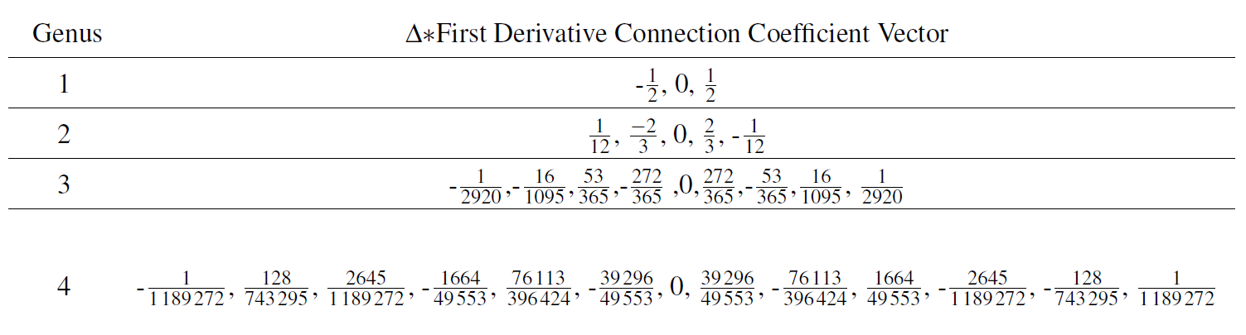
1st Derivative Wavelet Connection Coefficients

Slide 9
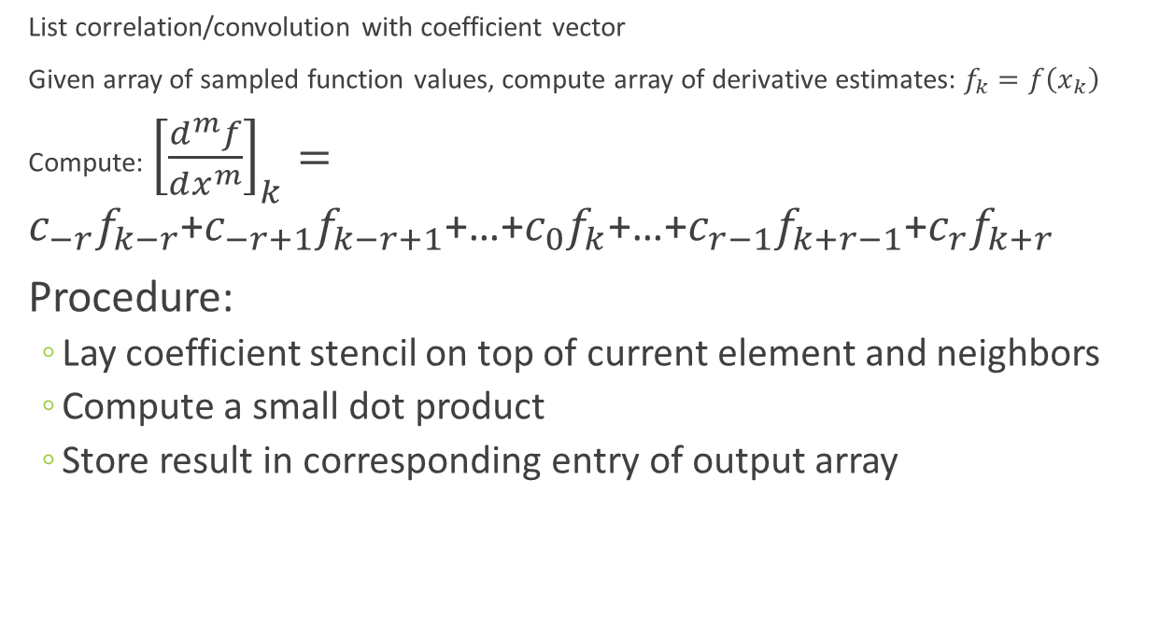
Organize as stencil computation
List correlation/convolution with coefficient vector
Given array of sampled function values, compute array of derivative estimates: $f_{k}=f\left(x_{k}\right)$
Compute: ${\left[\frac{d^{m}f}{dx^{m}}\right]}_{k}=c_{−r}f_{k−r}$+$c_{−r+1}f_{k−r+1}$+…+$c_{0}f_{k}$+…+$c_{r−1}f_{k+r−1}$+$c_{r}f_{k+r}$
Procedure:
Lay coefficient stencil on top of current element and neighbors
Compute a small dot product
Store result in corresponding entry of output array

Slide 10
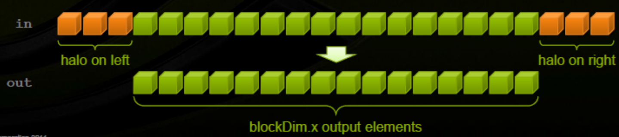
Accessing data for stencil computation from array in global memory (RAD = 3)
For each thread, accesses 2*RAD+1=7 entries from global array.

Slide 11
Transferring data for stencil computation from global memory to shared memory (RAD = 3)
Each thread requests 1 entry. Threads at edge of block load halo values.
All values gets stored in shared memory array.

Slide 12
1D stencil implementation details
Use indices to do systematic bookkeeping
Usual index i for position of thread in grid (each corresponding to an entry in global memory array)
Position in the block is indexed by thread index: tidx = cuda.threadIdx.x
Position in shared array sh_f indexed by shared index sidx = tidx + RAD and ranges from 0 to cuda.blockDim.x + 2*RAD -1
Each thread reads entry i from input arrays
First RAD threads also read halo values on either side
cuda.syncthreads() before reading values from sh_f
See example app: fdiff

Slide 13
import numpy as np
import matplotlib.pyplot as plt
from serial import pArray, nth_deriv
N = 128
RAD = 2
def main():
x = np.linspace(0, 1, N, dtype=np.float32)
f = pArray(x)
plt.plot(x, f, 'o', label='f(x) = x**2')
dfdx = nth_deriv(f, 1, RAD)
plt.plot(x, dfdx, 'o', label='First derivative')
d2fdx2 = nth_deriv(f, 2, RAD)
plt.plot(x, d2fdx2, 'o', label='Second derivative')
plt.legend()
plt.show()
if __name__ == '__main__':
main()
import numpy as np
def p(x0):
return x0**2
def pArray(x):
n = x.size
f = np.empty(n)
for i in range(n):
f[i] = p(x[i])
return f
def nth_deriv(f, order):
n = f.shape[0]
if order == 1:
stencil = np.array([-1., 0., 1.])
c = (n-1) / 2.
elif order == 2:
stencil = np.array([1., -2., 1.])
c = (n-1)*(n-1)
deriv = np.zeros(n)
for i in range(1,n-1):
deriv[i] = c * (f[i-1]*stencil[0] + f[i] * stencil[1] +
f[i+1]*stencil[2])
return deriv

Slide 14
#stencil/main.py
#SIMPLIFIED VERSION: 1ST DERIVATIVE ONLY
import numpy as np
import matplotlib.pyplot as plt
import math
N = 512
def main():
x = np.linspace(0, 1, N, dtype=np.float32)
from serial import pArray, nth_deriv
f = pArray(x)
print f
plt.plot(x, f, 'o', label='f(x) = x**2')
dfdx = nth_deriv(f, 1) #order=1
plt.plot(x, dfdx, 'o', label='First derivative')
plt.legend()
plt.show()
if __name__ == '__main__':
main()
#stencil/serial.py
import math
import numpy as np
def parab(x0):
return x0**2
def pArray(x):
n = x.shape[0]
f = np.empty(n)
for i in range(n):
f[i] = parab(x[i])
return f
def nth_deriv(f, order):
n = f.shape[0]
stencil =(n-1)/2. * np.array([-1., 0., 1.])
deriv = np.zeros(n)
for i in range(1,n-1):
deriv[i] = (f[i-1]*stencil[0]+ f[i] * stencil[1]+ f[i+1]*stencil[2])
return deriv

Slide 15
#stencil/serial.py
import math
import numpy as np
def parab(x0):
return x0**2
def pArray(x):
n = x.size
f = np.empty(n)
for i in range(n):
f[i] = parab(x[i])
return f
def nth_deriv(f, order):
n = f.shape[0]
stencil =(n-1)/2. * np.array([-1., 0., 1.])
deriv = np.zeros(n)
for i in range(1,n-1):
deriv[i] = (f[i-1]*stencil[0]+ f[i] * stencil[1]+ f[i+1]*stencil[2])
return deriv
#stencil/serial.py (alternate loop version)
import math
import numpy as np
def parab(x0):
return x0**2
def pArray(x):
n = x.shape[0]
f = np.empty(n)
for i in range(n):
f[i] = parab(x[i])
return f
# alternate version loops over the stencil
def nth_deriv(f, order):
n = f.shape[0]
stencil =(n-1)/2. * np.array([-1., 0., 1.])
deriv = np.zeros(n)
RAD = 1
for i in range(RAD,n-RAD):
for di in range(-RAD, RAD+1):
deriv[i] += f[i+di]*stencil[di+RAD]
return deriv

Slide 16
#stencil/serial.py (first part)
# populate the input matrix
import math
import numpy as np
def parab(x0):
return x0**2
def pArray(x):
n = x.size
f = np.empty(n)
for i in range(n):
f[i] = parab(x[i])
return f
#stencil/parallel.py (first part)
# adjust import in main.py to ‘from parallel…’
import numpy as np
import math
from numba import jit, cuda, float32
@cuda.jit(device = True)
def parab(x0):
return x0**2
@cuda.jit #Lazy compilation
#@cuda.jit('void(float32[:], float32[:])') #Eager
def pKernel(d_f, d_x):
i = cuda.grid(1)
n = d_x.shape[0]
if i < n:
d_f[i] = parab(d_x[i])
def pArray(x):
TPB = 32
n = x.shape[0]
d_x = cuda.to_device(x)
d_f = cuda.device_array(n, dtype = np.float32)
# include dtype for eager compilation
pKernel[(n+TPB-1)//TPB, TPB](d_f, d_x)
return d_f.copy_to_host()

Slide 17
#stencil/serial.py (second part - loop version)
# compute the derivative array
def nth_deriv(f, order):
n = f.shape[0]
stencil =(n-1)/2. * np.array([-1., 0., 1.])
deriv = np.zeros(n)
RAD = 1
for i in range(1,n-1):
for di in range(-RAD, RAD+1):
deriv[i] += f[i+di]*stencil[di+RAD]
return deriv
#stencil/parallel.py (second part)
RAD = 1
TPB = 32
@cuda.jit
def deriv_kernel(d_deriv, d_f, stencil):
i = cuda.grid(1)
n = d_f.shape[0]
d_deriv[i]=0
if i > RAD and i < n-RAD:
for di in range(-RAD, RAD+1):
deriv[i] += f[i+di]*stencil[di+RAD]
def nth_deriv(f, order):
n = f.shape[0]
stencil =(n-1)/2. * np.array([-1., 0., 1.])
d_f = cuda.to_device(f)
d_deriv = cuda.device_array(n,
dtype = np.float32)
deriv_kernel[(n+TPB-1)//TPB, TPB](d_deriv, d_f, stencil)
return d_deriv.copy_to_host()

Slide 18
#stencilo/parallel.py (second part)
TPB = 32
RAD = 1
@cuda.jit
def deriv_kernel(d_deriv, d_f, stencil):
i = cuda.grid(1)
n = d_f.shape[0]
d_deriv[i]=0
if i > RAD and i < n-RAD:
for di in range(-RAD, RAD+1):
deriv[i] += f[i+di]*stencil[di+RAD]
def nth_deriv(f, order):
n = f.shape[0]
stencil =(n-1)/2. * np.array([-1., 0., 1.])
d_f = cuda.to_device(f)
d_deriv = cuda.device_array(n,
dtype = np.float32)
derivativeKernel[(n+TPB-1)//TPB, TPB](d_deriv, d_f, stencil)
return d_deriv.copy_to_host()
#shared/shared.py (second part) “from shared…’
NSHARED = 34 #value must be TPB + 2*RAD
@cuda.jit
def deriv_kernel(d_deriv, d_f, stencil):
sh_f = cuda.shared.array(NSHARED, dtype =… )
i = cuda.grid(1)
n = d_f.shape[0]
if i>=n:
return
tIdx,bdim = cuda.threadIdx.x, cuda.blockDim.x
shIdx = tIdx + RAD #index into shared array
sh_f[shIdx] = d_f[i] #Load regular cells
if tIdx < RAD: #Halo cells- Check array bounds
if i >= RAD:
sh_f[shIdx - RAD] = d_f[i-RAD]
if i + cuda.blockDim.x < n:
sh_f[shIdx + bdim] = d_f[i + bdim]
cuda.syncthreads()
if i >= RAD and i < n-RAD: #bounds check
tmp = sh_f[shIdx] * stencil[RAD]
for d in range(1,RAD+1):
tmp += sh_f[shIdx-d]*stencil[RAD-d] +
sh_f[shIdx+d]*stencil[RAD+d]
d_deriv[i] = tmp

Slide 19
Multi-dimension version
See jacobi
2D stencil array
Be sure to load the correct halo cells (corners?)

