Slide 1
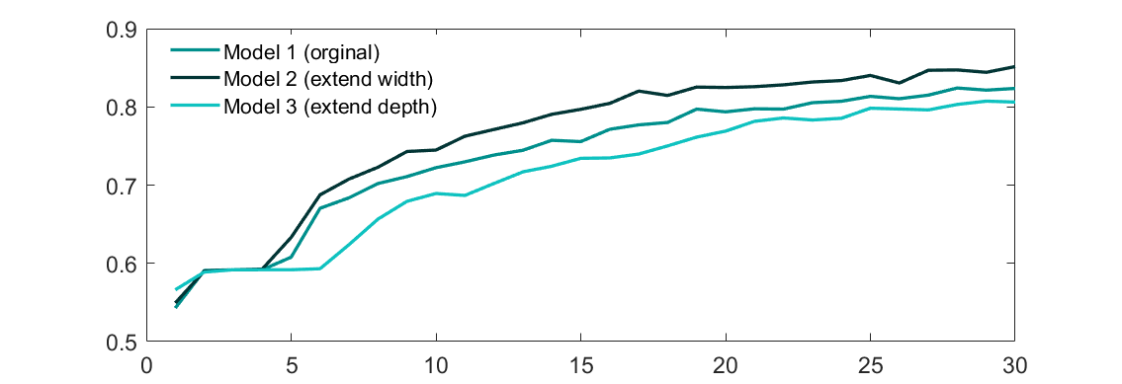
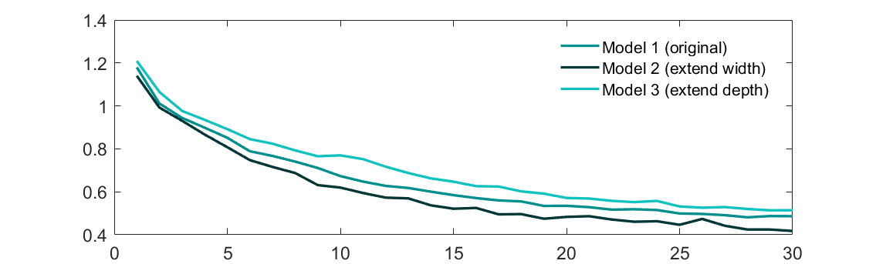
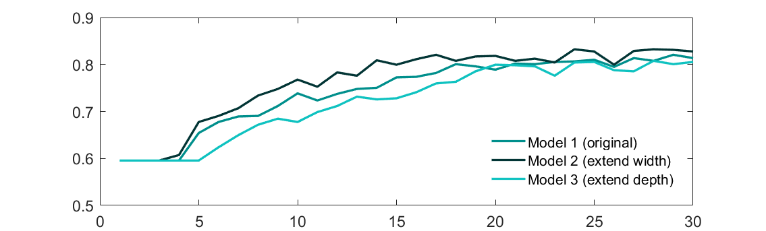
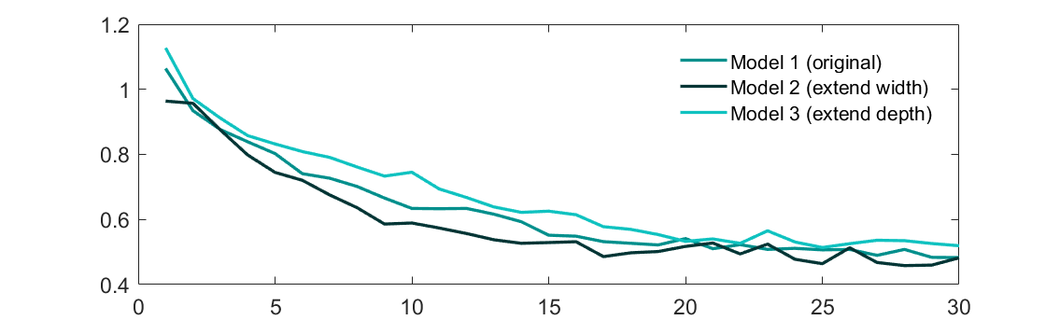
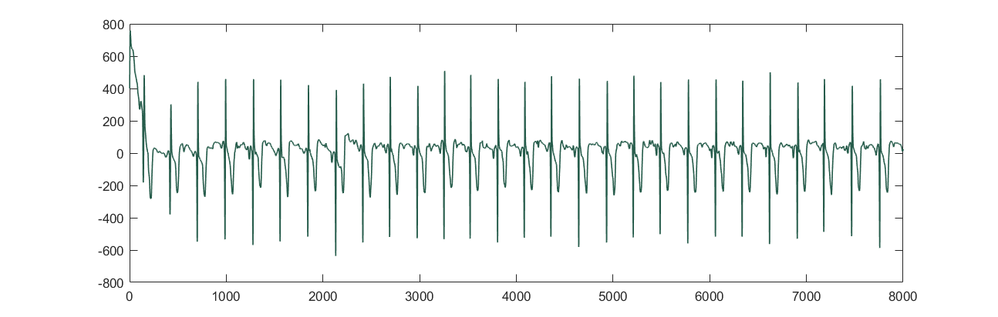
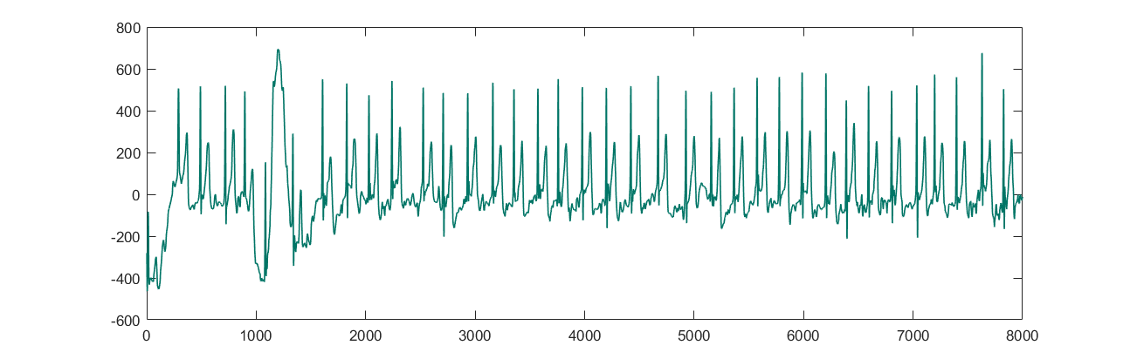
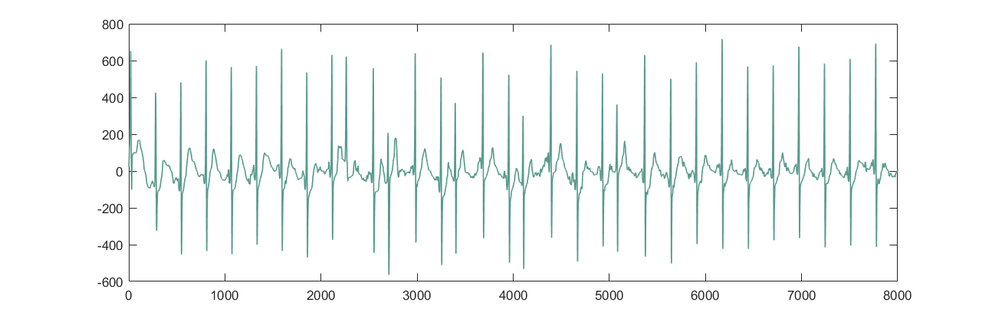
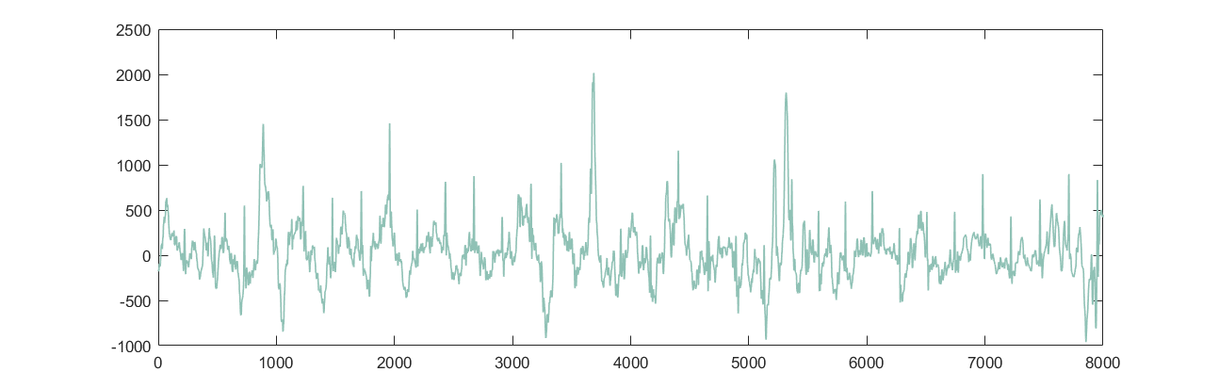
Atrial Fibrillation Diagnosis Based on One-dimensional CNN
Yizhou Bian,
Hao Huang,
Mohan Li
Results and discussion
Training result of accuracy and loss on training/validation set is present below. Model 2 with an extension of CNN layer width has the best overall performance and reached an accuracy of >80% during both training and validation. Curiously, despite a larger depth, the performance of Model 3 is the worst, giving insight of model adjustment in future works.
All models can give AF diagnosis within milliseconds after training, fulfilling the need of this work.
Background, motivation, and significance
Method and network
Atrial fibrillation (AF) is becoming one of the most important health issues around the world. Wearable ECG devices are developed recently to realize long-term cardiovascular monitoring & help AF diagnosis, but the corresponding ECG categorization algorithms for those devices are missing, establishing an urgent need of such technique.
Previous studies can be concluded as follows:
Previous deep learning results on 12-lead ECG was promising, but its transformation to single-lead ECG used in wearable devices is hard.
Wearable device data was studied but data collection before diagnosis was required for training, leading to time-costing algorithm and low data amount.
A good CNN classification model was achieved to distinguish different ECG types, but its running time is not fit for real-time diagnosis.
Other problems in this field include lack of all the other cases with respect to ECG signals and small sample size.
Here we present a new method using 1D CNN to obtain a model fit for real-time modelling while maintaining sufficient accuracy. Potentially, this study will help developing long-term ECG monitoring system and improve the quality of many patients’ lives. Results will be compared with several previous studies on classification precision and calculation speed.
20% of Dataset is divided into training set and 80% validation set. To eliminate inter-patient bias, we normalized each original ECG waveform in the database before training the network. 3 networks are trained and observed to help improve the accuracy of AF diagnosis.
Our basic network uses 4 1D-CNN layer as the main body, marked as Model 1 below. Dense layers, which are basically Fully Connected layers, also contribute to the categorization calculation. Max Pooling and Global Average Pooling layers are used to adjust the size of data.
Two modified networks are also constructed to observe the effect of hyper parameters on our network and help improve the accuracy of AF diagnosis. One of them applied extension to 1D-CNN layer width, marked as red in model 2 below. Since amount of parameter of the output of CNN layers after global averaging has reached saturation (<100), the other modified network applied an extra Dense layer to make the whole network deeper, marked as red in model 3 below.
All 3 networks are trained and validated. Accuracy and loss are calculated both for training set and validation set during the learning process.
Accuracy on training
Loss on training
Accuracy on validation
Dataset
Model 1 (Original)
Dataset used in this study comes from the 2017 PhysioNet/CinC Challenge. The dataset contains 8528 recordings in total. Respectively, 5154 recordings are normal, 771 recordings are with atrial fibrillation, 2557 of them are alternative in rhythm, and the rest 46 are too noisy to classify. Below are four samples of each to show the data waveform. Examples of waveforms are present below.
Loss on validation
Conv1D(64,55)
Conv1D(64,25)
Conv1D(64,10)
Conv1D(64,5)
Dense(256)
Dense(64)
MaxPooling(10)
MaxPooling(5)
MaxPooling(5)
GlobalAvePooling
Dense(128)
Out(4)
Normal ECG
Model 2 (Extend width)
Conclusion and future work
A 1D-CNN-based network for AF diagnosis on single-lead ECG data, which can be applied to wearable devices, is present here. Quick speed and sufficient accuracy is achieved, which may help AF applications.
One important future work is to apply our network onto real-time collected data of wearable devices. Clinical trails should also be done to further improve the significance of this work.
ECG of AF patients
Conv1D(128,55)
Conv1D(128,25)
Conv1D(128,10)
Conv1D(128,5)
Dense(256)
Dense(64)
MaxPooling(10)
MaxPooling(5)
MaxPooling(5)
GlobalAvePooling
Dense(128)
Out(4)
ECG belonging to patients with other situations
Model 3 (Extend Depth)
References
1.. Zoni-Berisso, Massimo, et al. "Epidemiology of atrial fibrillation: European perspective." Clinical epidemiology 6 (2014): 213.
2. Nemati, Ebrahim, M. Jamal Deen, and Tapas Mondal. "A wireless wearable ECG sensor for long-term applications." IEEE Communications Magazine 50.1 (2012): 36-43.
3. Andersen, Rasmus S., Abdolrahman Peimankar, and Sadasivan Puthusserypady. "A deep learning approach for real-time detection of atrial fibrillation." Expert Systems with Applications 115 (2019): 465-473.
4. Kiranyaz, Serkan, Turker Ince, and Moncef Gabbouj. "Real-time patient-specific ECG classification by 1-D convolutional neural networks." IEEE Transactions on Biomedical Engineering 63.3 (2015): 664-675.
5. Chandra, B. S., et al. "Atrial fibrillation detection using convolutional neural networks." 2017 Computing in Cardiology (CinC). IEEE, 2017
ECG that is too noisy to recognize
Conv1D(64,55)
Conv1D(64,25)
Conv1D(64,10)
Conv1D(64,5)
Dense(256)
Dense(128)
MaxPooling(10)
MaxPooling(5)
MaxPooling(5)
GlobalAvePooling
Dense(256)
Dense(64)
Out(4)

