Slide 1
Unit Overview
There are 5 unit lines and 4 of them have 4 levels.
Total of 17 units.
Infantry Line
Militia
Men at Arms
Long Sword
Champion
Archer Line
Archer
Crossbow
Arbalest
Longbow
Cavalry Line
Scout Cavalry
Light Cavalry
Knight
Paladin
Anti-Cavalry Line
Spearman
Pikeman
Halberdier
Adv Halberdier
Speacial Unit
War Elephant

Slide 2
Modules
The project is divided into 9 modules:
Object Description
Animations and Sounds
Combat and Collision Logic
Control Menu Management
Single Player AI
Multiplayer
Integration
Documentation
Testing

Slide 3
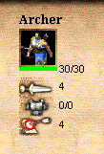
Object Description
It defines unit stats, cost and value.
Unit stats include:
HP (Hit points)
Attack
Attack Bonuses
Melee Armor
Pierce Armor
Range
Movement Speed
Unit costs include:
Cost
Cost on Death
XP on Death
Upgrade Costs

Slide 4

Animations and Sounds
Animations and sounds helps in making the game more immersive and improve the gaming experience
Key areas for unit animations :
Moving Animation
Attacking Animation
Death Animation
Key areas for sounds:
Background Music
Menu Interaction
Unit Creation
Combat Sounds
Unit Death
Win/Lose Music

Slide 5
Combat and Collision Logic
Determine relative positions of the units to one another and decide the state upon which the units engages in combat.
Logic : unit is in range , if so attack , else continue moving. Calculate the position of one unit and check whether an enemy
An arrow leaves the bow of an archer and moves in a parabolic path until it hits an object or ground.

Slide 6
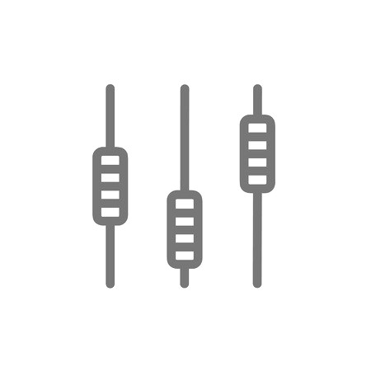
Control Menu Management
The menu is the part where the user interacts with the game.
It displays :
Unit stats
Currency
Experience(XP)
Icons
Provides interface to :
Create new units
Upgrade new units
Advance age

Slide 7

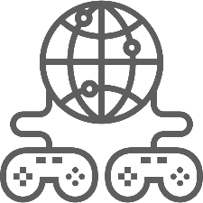
Single Player AI
Developing an AI which can create units and upgrade them intelligently to improve player’s single player gaming experience.
Multiplayer
Implementation of peer to peer connection for multiplayer. 2 players can play the same game from 2 different locations.

Slide 8



Integration
The modules are integrated to develop the whole ready to play game.
Testing
Once the game is playable, it will undergo testing process to test unit balance, game durability and consistency. Further modifications will be done in this stage itself.
Documentation
The integrated game is well documented for further reference and modification.

