Slide 1


Visual Domain Adaptation Challenge 2018:Open Set Classification
Qing Lian, Yuming Jiang, Shengju Qian, Changsheng Li, Fengmao Lv, Lixin Duan
University of Electronic Science and Technology of China, Youedata Research
Notes:
Team introduction

Slide 2
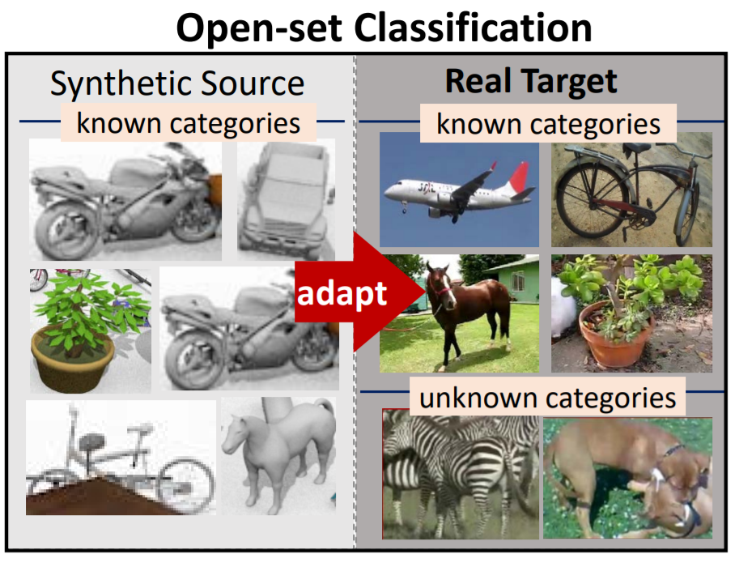
VisDA 2018 Open Set Classification
Notes:
Challenge Setting: Different from closed set domain adaptation, Open-set domain adaptation considers classification when the target domain contains categories unknown (unlabeled) in the source domain, which is more difficult than closed set domain adaptation

Slide 3
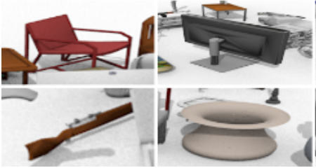
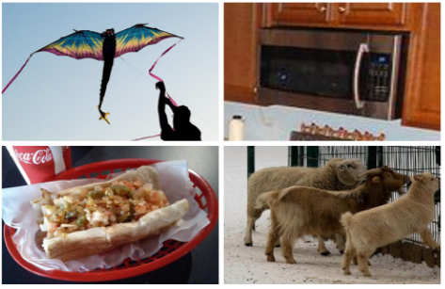
Problem on Open Set Domain Adaptation
Hard to recognize unknown class
Larger domain gap on unknown class than known class (maybe negative transfer)
Source unknown class
Target unknown class
Notes:
We think that the problem on open set domain adaptation most exist on two parts: 1) how to recognize unknown class, In domain adaptation setting, validation and testing set may represent different distribution on unknown class. So it is not a good way to treat unknown class the same as the known class. 2) As talked above, the unknown class also have larger domain gap than known class, and due to we don’t know the label on the validation set, how to do domain adaptation for the known class is also a problem. What’s more, if we don’t treat it properly, it is also easy to cause the negative transfer problem. For example, if we directly add DAN(Learning Transferable Features with Deep Adaptation Networks ) or DANN(Domain-Adversarial Training of Neural Networks) to this task, it would worse than just use adabn (Domain-Adversarial Training of Neural Networks)

Slide 4
How to solve the problem
Recognize unknown class through determine whether it has feature in known class?
Domain adaptation while avoid the interference of unknown class
Source unknown class
Target unknown class
Notes:
So, how to solve the problem we talk above? We think we can catch the feature that “unknown”. In another word, we also can treat the unknown class as other class, so we can force our model to recognize unknown class through determining whether it has featured in the known class. Such as red apple is one of known class and pear is one of unknown class, we could determine pear is unknown though it’s color is green instead of red. 2) For domain adaptation: we think we can try to do domain adaptation while avoiding the interference of unknown class, such as fake label or only do entropy reduction or dann for known class.

Slide 5
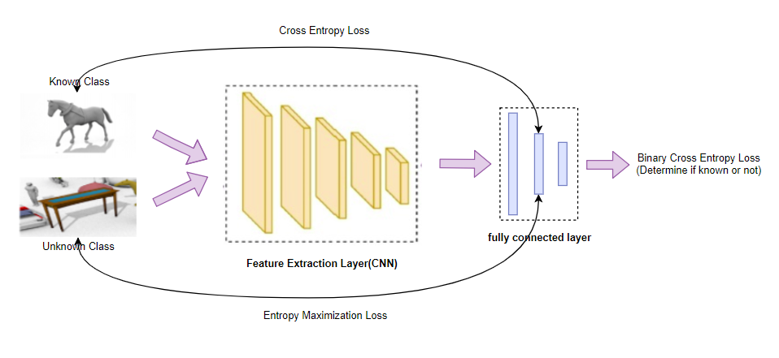
Recognize unknown class module
Notes:
So, this picture displays our recognize unknown class module. We base on resnet to extend our model.

Slide 6
Recognize unknown class module
Only implement cross entropy loss for 12 known class
Use feature extract from known class to determine whether it is known or not
Notes:
We only implement cross entropy loss for 12 known class at the second fully connected layer. And we use the feature at that layer to determine whether it is known or not with a fully connected layer. Through this operation, we force the feature extracted from the model is related to known class and use this feature to determine our model’s decision on unknown class.

Slide 7
Recognize unknown class module
Add an Entropy Maximization loss for unknown class at 12 fully connected layer
Notes:
What’s more, we add a regularize to the unknown class that: add an entropy maximization loss for the unknown class at 12 fully connected layer, hoping that our model’ prediction would not show any bias towards 12 known class for unknown class

Slide 8
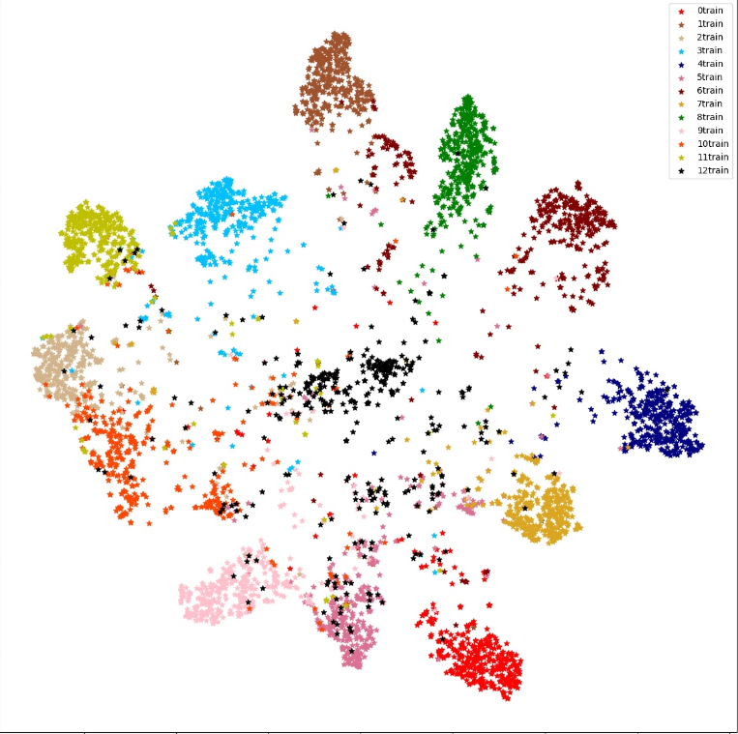
Recognize unknown class module
Add an Entropy Maximization loss for unknown class at 12 fully connected layer
Tsne result: Black represent unknown class and other is known class
Notes:
And we also implement tsne to check if our method work or not. The black circle represents unknown class and other is known class. We can see that unknown class stay in the middle of known class.

Slide 9
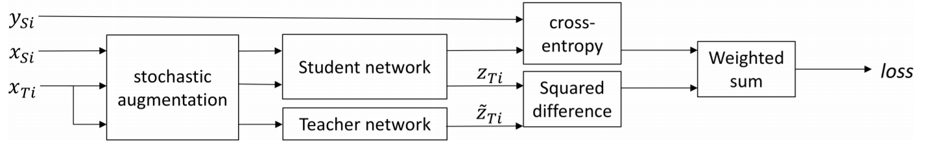
Improve Self-ensemble method
Xsi: source image, Xti: target image
Need to tune the parameter of threshold on Squared difference loss(hard to tune but important)
Notes:
And then for domain adaptation, we follow the last year’s best result used in closed-set domain adaptation. However, it gets 92%+ accuracy on closed set domain adaptation, it still has some drawback. Self-ensemble is more engineering than most of other domain adaptation method and has a few hyper-parameters to tune. We noticed that in their implementation details, they set the threshold for doing squared difference loss to 96.8%. It needs to do lots of experiments to get this result. But this hyper-parameter matter.

Slide 10

Improve Self-ensemble method
$x^{sⅈ}$: source image, $x^{tⅈ}$: target image
Why: model show different stability when they give different confidence to a image (always show positive relation)
Squared can not represent this kind of relation
Notes:
So, let us analysis why this while happen. In my opinion, self-ensemble is through doing stochastic augmentation and dropout to present a different view of an image to the model. And it hopes that the model would present the same prediction although they receive a different view of an image. It is also can be considered to measure the stability of the target domain’s class. However, they do squared difference loss to penalize model’s instability, which can be more reasonable. Because the model always shows different stability when they give different confidence to an image. For example, when an input image is a hard example, the model always give low confidence to it and show low stability when they receive a different view of this image.

Slide 11
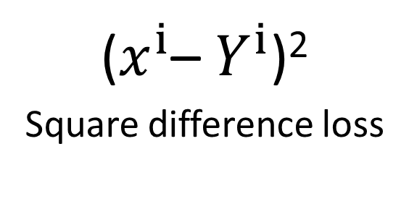

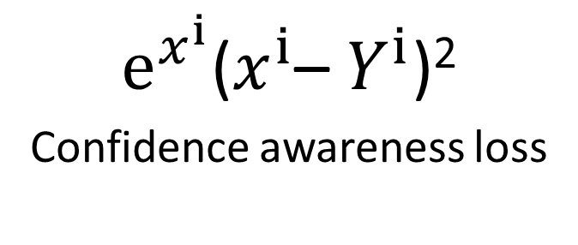
Improve Self-ensemble method
($x^{ⅈ}$– $Y^{ⅈ}$)²
^{Square difference loss}
$ⅇ^{x^{ⅈ}}$($x^{ⅈ}$– $Y^{ⅈ}$)²
^{Confidence awareness loss}
$$x^{ⅈ}$$
Notes:
As a result, we add a confidence module to the square difference loss. We let the square difference loss multiple e^xi. Through this implementation, we can penalize more when model give confidence. And after adding this loss, we can set the threshold used in square difference loss lower.

Slide 12
Domain Adaptation
Add self-ensemble module to the second fully connected layer.
Only Encourage known class to do domain adaptation(Avoid the obstacle of unknown class on domain adaptation)
Notes:
In total, we add the self-ensemble module to the second fully connected layer and noticed that this layer only predict 12 kinds of known class. So our model only shows high confidence at this layer for known class, and the unknown class will be filtered when calculating unsupervised loss. Through this operation, we only encourage the known class to do domain adaptation and avoid the obstacle of unknown class on domain adaptation.

Slide 13
Implementation detail
ImageNet pretrained ResNet:
ResNet-101_{[K. He et al.CVPR’16]}
ResNet-152_{[K. He et al.CVPR’16]}
Data Augmentation:
Random Resize, Random Crop, Random Rotation, Random Horizontal Flip
Double softmax when calculating cross entropy loss
Averaged predictions from 16 differently augmented images
Ensemble with independent training model
Notes:
Then we discuss our implementation detail. We use resnet as our base model and the weight was pretrained on ImageNet. And we only do Random Resize, Random Crop, Random Rotation, Random Horizontal Flip at Data Augmentation module. We implement a double softmax layer when calculating cross entropy loss, hoping that the known class will sperate farther. At the testing time, we applied test time augmentation (we averaged predictions from 16 differently augmented images) to achieve our competition results.

Slide 14
Evaluations
Dataset
Training Domain : synthetic renderings of 3D models from different angles and with different lighting conditions
Validation Domain : a real-image domain consisting of images cropped from the Microsoft COCO dataset
Testing Domain : a real-image domain consisting of images cropped from the Youtube Bounding Box dataset
Method | Mean Accuracy
Source only | 42
AdaBN | 58.5
Self-ensemble | 62.5
Ours(single model) | 68.4
Ours(ensemble) | 69
Notes:
.

Slide 15
Thanks !

