Slide 1
C# CMD Parser
Richard Savčinský
Lukáš Riedel

Slide 2
requirements
Allow user to do whatever he wants to, do not limit him to the features implemented by the library
Externalize storage of the parsed arguments
Convenient set-up using builders

Slide 3
Main idea
To fulfill the requirements, we use callback mechanism
The callback is called once the option is succesfully parsed
Parameters for options are strongly-typed
The library predefines parse methods for common types (string, int...)
However, parse method for user-defined type can be supplied
In both cases, callback is invoked with argument corresponding to result of the parse method

Slide 4
EXAMPLE
parserBuilder.SetupOption<string>(Short('f'), Long("format"))
.WithDescription("Description of the option")
.Callback(format => output.OutputFormat = format)
.ParameterRequired();

Slide 5
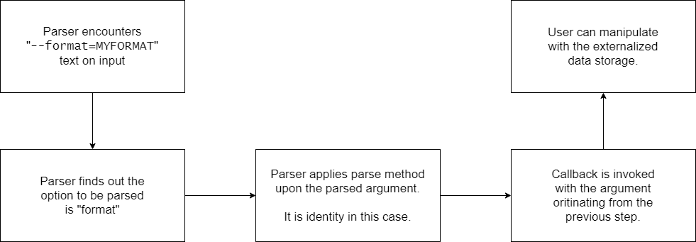
EXAMPLE

Slide 6
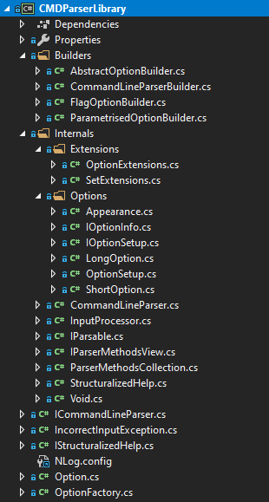
What have we done so far
We implemented PoC solution a month ago
Right now, we are just tuning some things

Slide 7
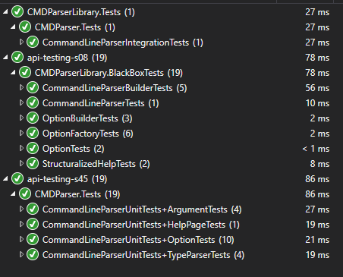
What have we done so far
We integrated provided tests
Most of them are very good
Helped us to discover problems in our PoC version

Slide 8
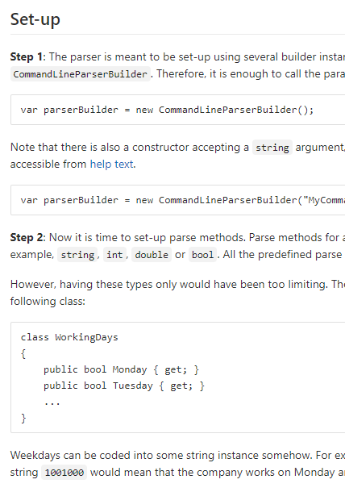
WHAT HAVE WE DONE SO FAR
We wrote a documentation
Overview
Step-by-step tutorial
Some technical details

Slide 9
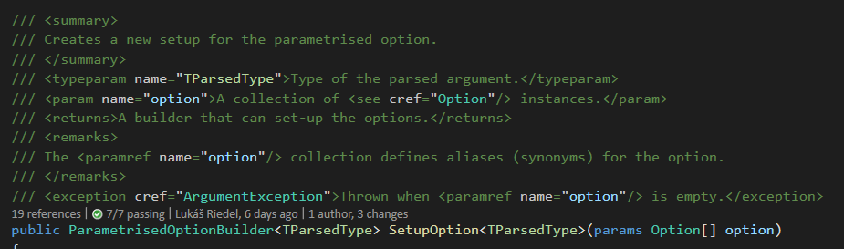
What have we done so far
We wrote API documentation

Slide 10
WHAT ARE WE GOING TO DO
Write more tests
Clean-up the code
Fix bugs that have not been discovered yet

Slide 11
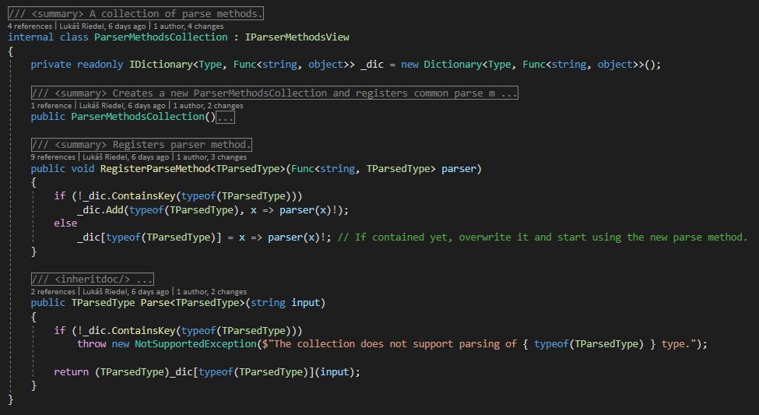
Some technical details

