Slide 1
C# CMD Parser
Richard Savčinský
Lukáš Riedel

Slide 2
requirements
Allow user to do whatever he wants to, do not limit him to the features implemented by the library
Externalize storage of the parsed arguments
Convenient set-up using builders

Slide 3
Main idea
To fulfill the requirements, we use callback mechanism
The callback is called once the option is succesfully parsed
Parameters for options are strongly-typed
The library predefines parse methods for common types (string, int...)
However, parse method for user-defined type can be supplied
In both cases, callback is invoked with argument corresponding to result of the parse method

Slide 4
EXAMPLE
parserBuilder.SetupOption<string>(Short('f'), Long("format"))
.WithDescription("Description of the option")
.Callback(format => output.OutputFormat = format)
.ParameterRequired();

Slide 5
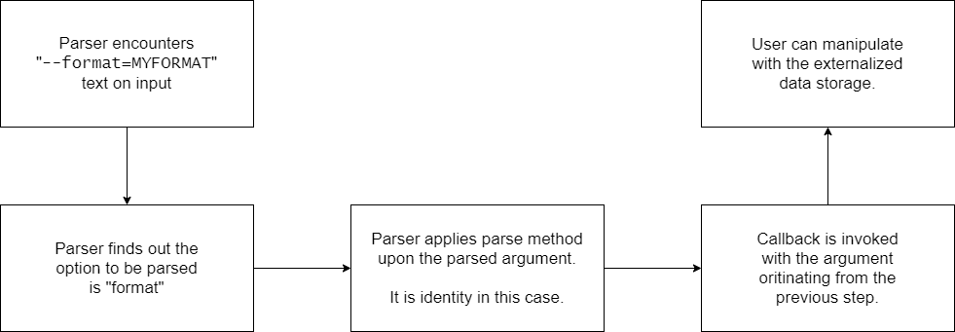
EXAMPLE

Slide 6
Main idea
We use builders to set-up the parser
Parsed arguments are returned using IReadOnlyList<string> instance
Help can be viewed for a single option, or as a structuralized text block

Slide 7
Benefits / drawbacks
Parser can be customized in any way the user wants to
Can be used even in complex workflow
Due to callback mechanism, the library might not be beginner-friendly
A lot of code needs to be implemented to set-up the parser
Even for naïve usage of the parser

Slide 8
Review comments
Basically positive, thanks for all of them
We will write a tutorial for newcomers how to use the library
Until now, the usage had to be inferred from the provided example
We will think about incorporating excluding options into the parser
That means, there should be several sets, each one allowing some options only

