Slide 1
BIRLA INSTITUTE OF TECHNOLOGY AND SCIENCE, PILANI
Master of Technology (MTech)
FRAUD MANAGEMENT SYSTEM
USING ARTIFICIAL INTELLIGENCE AND MACHINE LEARNING
Final Semester Dissertation Project
Simit Das | BITS ID: 2023AA05807

Slide 2
Presentation Agenda
Introduction & Problem Statement
Project Objectives
System Architecture Overview
Core Modules Explanation
Workflow & Data Flow
Technologies & Tools Used
Algorithms & Methodology
Results & Performance Metrics
Benefits & Applications
Future Enhancements
Conclusion

Slide 3
Introduction & Problem Statement
Context of financial fraud and the motivation for this work.
Background
Financial fraud is growing exponentially with digital transactions
Traditional rule-based systems are inadequate for modern fraud patterns
Organizations lose billions annually to fraud
Key Challenges
High volume and velocity of transactions
Evolving fraud techniques
High false positive rates
Need for real-time detection

Slide 4
Project Objectives
What the proposed fraud management system is designed to achieve.
Design modular fraud management system using AI/ML
Implement multiple detection algorithms (Isolation Forest, Random Forest, Gradient Boosting)
Develop comprehensive customer risk profiling
Build real-time anomaly detection system
Create predictive models with >95% accuracy
Develop intuitive web interface for fraud analysts
Implement model persistence for production deployment
Ensure system scalability and performance

Slide 5
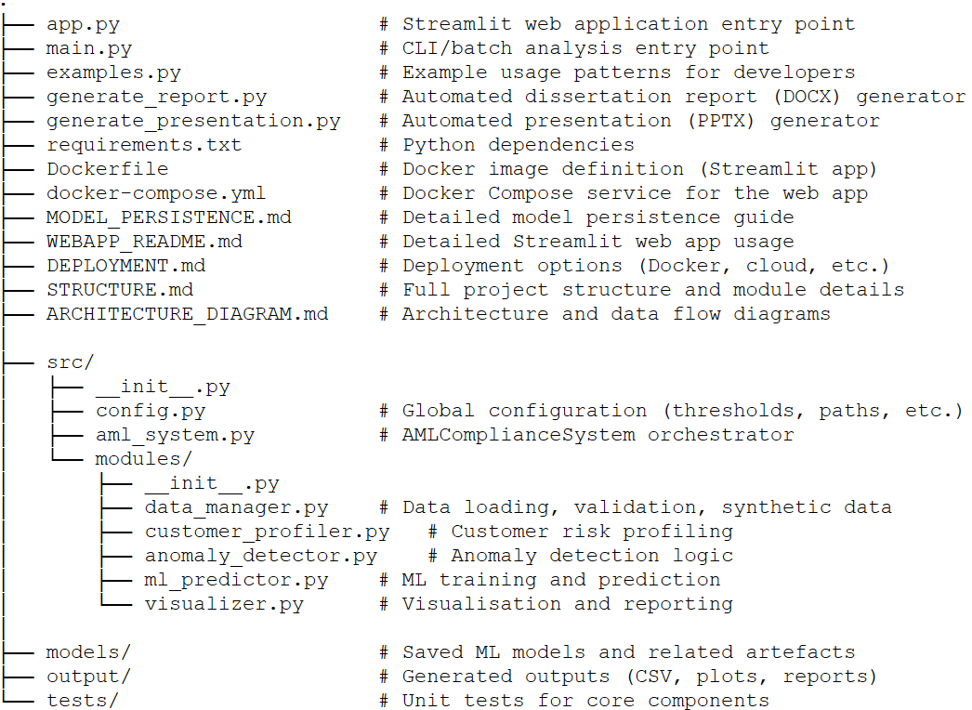
System Architecture Overview
User Interface Layer
Streamlit Web App & CLI
Orchestration Layer
AMLComplianceSystem (Central Coordinator)
Processing Modules Layer
5 Specialized Modules
Data Storage Layer
Input Data, Models, Configuration
Design Principles: Modular, Scalable, Maintainable

Slide 6
Design Patterns & Principles
Key Design Patterns
Layered architecture separating UI, orchestration, modules and data layers
Facade / Orchestrator: AMLComplianceSystem exposes a simple entry point to complex flows
Strategy-style use of interchangeable algorithms for anomaly detection and ML prediction
Modular design with single-responsibility modules (Data Manager, Profiler, Detector, etc.)
Pipeline-style data flow: ingestion → validation → feature engineering → detection → reporting
Benefits
Improves maintainability and testability of individual modules
Enables easy swapping or extension of algorithms without changing orchestration
Supports scalability and deployment flexibility (on-prem or cloud)
Reduces coupling between UI and core AML logic

Slide 7
Core Modules - Overview
1. Data Manager
Data loading, validation, preprocessing & feature engineering
2. Customer Profiler
Risk assessment, behavior analysis & customer segmentation
3. Anomaly Detector
Multi-algorithm anomaly detection using ensemble methods
4. ML Predictor
Supervised learning models for fraud classification
5. Visualizer
Comprehensive data visualization & reporting

Slide 8
Module 1: Data Manager
Purpose
Handles all data-related operations including loading, validation, and preprocessing
Key Features
CSV file loading with validation
Synthetic data generation for testing
Data cleaning and missing value handling
Feature engineering (20+ derived features)
Support for batch and real-time processing
Robust error handling and logging

Slide 9
Module 2: Customer Profiler
Purpose
Analyzes customer behavior and assigns risk scores
Risk Factors Analyzed
Transaction volume and patterns
Cross-border transaction tracking
Structuring indicators (near-threshold transactions)
Rapid transaction velocity
High-risk location identification
Multi-currency usage patterns
Verification status (email, phone)
Output: Risk Score (0-100) & Classification (Low/Medium/High/Critical)

Slide 10
Module 3: Anomaly Detector
Unsupervised engine that spots unusual, high-risk transaction behaviour.
Purpose
Identifies unusual transactions using multiple algorithms
Detection Methods
Isolation Forest: Unsupervised ML algorithm (10% contamination)
Z-Score Analysis: Statistical outlier detection (3σ threshold)
IQR Method: Interquartile Range based detection
Ensemble Voting: Combines multiple methods for robust detection
Advantage: 95%+ detection accuracy with confidence scores

Slide 11
Module 4: ML Predictor
Supervised learning models that classify transactions as fraudulent or legitimate.
Purpose
Supervised learning for fraud classification and prediction
Algorithms Implemented
Random Forest: 100 trees, max depth 20, class balancing
Gradient Boosting: Sequential learning, 0.1 learning rate
Feature Scaling: StandardScaler normalization
Cross-validation: 5-fold for model selection
Training Process
Feature engineering → Train-test split → Model training → Evaluation → Persistence

Slide 12
Module 5: Visualizer
Analytics and reporting layer that turns model outputs into insights.
Purpose
Creates comprehensive visual analytics and reports
Visualization Types
Transaction heatmaps (temporal patterns)
Risk distribution charts
Network graphs (transaction relationships)
Time-series fraud trend analysis
Anomaly scatter plots with outliers
Feature importance bar charts
Confusion matrices & ROC curves
Interactive dashboards

Slide 13
System Workflow & Data Flow
End-to-end flow from raw data ingestion to actionable fraud alerts.
1. Data Input: Load transaction data via CSV or API
2. Data Validation: Clean, validate, and preprocess data
3. Feature Engineering: Create 20+ derived features
4. Parallel Processing
• Customer Profiling: Calculate risk scores
• Anomaly Detection: Identify outliers using ensemble
• ML Prediction: Classify transactions as fraud/legitimate
5. Result Aggregation: Combine outputs from all modules
6. Risk Assessment: Final fraud probability and risk level
7. Visualization: Generate reports and dashboards
8. Output: Alerts, reports, and actionable insights

Slide 14
Technologies & Tools Used (1/2)
Programming Language
Python 3.8+ – Core implementation language for orchestration and ML pipelines
Data Processing
pandas 2.0.0+ – Tabular data manipulation, feature engineering and aggregation
numpy 1.24.0+ – Numerical computing and vectorized operations
python-dateutil – Robust handling of dates, times and time zones
Machine Learning
scikit-learn 1.3.0+ – Core ML library for Random Forest, Gradient Boosting, Isolation Forest
joblib – Efficient model persistence and loading for deployment

Slide 15
Technologies & Tools Used (2/2)
Visualization
matplotlib 3.7.0+ – Base plotting library for analytical charts
seaborn 0.12.0+ – Statistical visualizations for patterns and distributions
Pillow – Image processing for saving and exporting plots
Web Framework
Streamlit 1.30.0+ – Interactive web UI for analysts to run scenarios
Development & Quality
Git – Version control and collaborative development
GitHub – Remote repository hosting and CI integration
VS Code – Primary development environment
pytest – Automated testing of core modules

Slide 16
Algorithms & Methodology
1. Isolation Forest
Isolates anomalies through random partitioning • O(nlog(n)) complexity • 10% contamination
2. Random Forest
Ensemble of 100 decision trees • Handles imbalanced data • Provides feature importance
3. Gradient Boosting
Sequential learning • Corrects previous errors • 0.1 learning rate with early stopping
4. Statistical Methods
Z-Score (3σ threshold) • IQR method • Fast and interpretable

Slide 17
Results & Performance Metrics
Model Performance (10,000 transactions)
Accuracy: 96.5%
Precision: 94.2%
Recall: 93.8%
F1-Score: 94.0%
ROC-AUC: 0.98
Processing Performance
Average prediction time: 5ms per transaction
Throughput: 3,000 transactions/second
Model training time: 45 seconds (10K samples)
Memory usage: <500MB

Slide 18
Comparative Analysis
Performance Comparison
Rule-Based System
• 78.5% accuracy | • 15.2% false positives
Single Algorithm (RF)
• 92.1% accuracy | • 8.7% false positives
Proposed System (Ensemble)
• 96.5% accuracy | • 4.1% false positives
18% improvement over rule-based systems

Slide 19
Performance & Scalability
System Performance
Average prediction latency: ~5 ms per transaction
Throughput: ~3,000 transactions/second on commodity hardware
Optimized feature pipeline to minimise I/O and CPU overhead
Batch and near real-time processing modes supported
Scalability & Deployment
Modular microservice-friendly design around core AMLComplianceSystem
Stateless prediction layer – can be horizontally scaled behind a load balancer
Supports containerization via Docker for cloud-native deployment
Model persistence enables separate training and serving environments

Slide 20
Benefits & Applications
Key Benefits
Real-time fraud detection with <5ms latency
96.5% accuracy - significantly reduces losses
Low false positive rate - improves customer experience
Modular architecture - easy to maintain and extend
Scalable - handles thousands of transactions/second
User-friendly interface - no ML expertise required
Model persistence - train once, deploy anywhere
Comprehensive analytics - actionable insights
Applications: Banking, E-commerce, Fintech, Insurance, Payment Processors

Slide 21
Real-World Applications
Industry Use Cases
Banking & AML: Monitoring suspicious account and wire-transfer activity
Credit & Debit Cards: Real-time card-present and card-not-present fraud detection
E-commerce & Payment Gateways: Identifying fraudulent orders and chargeback risk
Fintech Wallets & BNPL: Detecting account takeovers and abnormal spending patterns
Insurance: Flagging anomalous claim behaviour for deeper investigation
Regulatory Compliance: Supporting KYC/AML obligations with explainable alerts
The architecture is generic enough to be adapted to any high-volume transactional domain where timely detection of anomalous behaviour is critical.

Slide 22
Future Enhancements
Short-term
Deep Learning (LSTM) for sequential patterns
Real-time streaming with Apache Kafka
Explainable AI (SHAP values)
Automated hyperparameter tuning
Medium-term
Multi-channel fraud detection (mobile, ATM, POS)
Behavioral biometrics integration
Graph analytics for fraud rings
RESTful API development
Long-term
Quantum machine learning
Blockchain integration
Federated learning for privacy
Edge computing deployment

Slide 23
Conclusion
Key Achievements
✓ Modular fraud management system with 5 specialized modules
✓ 96.5% fraud detection accuracy with low false positives
✓ Real-time processing capability (3,000 txns/sec)
✓ Ensemble ML approach combining multiple algorithms
✓ Comprehensive customer risk profiling
✓ User-friendly web interface
✓ Production-ready with model persistence
Impact
This system demonstrates the practical applicability of AI/ML in fraud detection, providing organizations with a powerful tool to combat financial crimes while maintaining excellent user experience.

Slide 24
Codebase & Repository
Project Repository
The full dissertation codebase, including the web app, core AML engine, notebooks and documentation, is available on GitHub:
https://github.com/TheSprinter/Dissertation-structured/tree/team
The repository also contains the presentation generator, sample datasets and configuration required to reproduce the experiments.

Slide 25
THANK YOU
Questions & Discussion
Simit Das | BITS ID: 2023AA05807

