Slide 1
Fraud management
Through Risk Assessment and Predictive Analytics
A Multi-Layered AML Framework using NLP-Driven Policy Mapping
and Explainable Deep Learning
Simit Das(2023AA05807)| BITS Pilani | 2025-26

Slide 2
Presentation Agenda
Introduction & Problem Statement
System Architecture Overview
Technical Stack & Technologies
Four Core Modules
Implementation & Results
Explainable AI Integration
Key Findings & Metrics
Recommendations & Future Work

Slide 3
The AML Challenge
$800B-$2T
Global ML Volume
2-5% of global GDP
95%+
False Positive Rate
Traditional systems
48+ hours
Manual Review
Per case
High
Regulatory
Complexity
Key Challenges:
  Manual compliance processes are slow and error-prone
  Evolving laundering techniques outpace detection methods
  High operational costs for compliance teams
  Lack of explainability in current AI systems

Slide 4
System Architecture Overview
Data Layer
Transaction Data
Customer Profiles
Regulatory Docs
Processing Layer
Feature Engineering
Data Cleaning
Encoding
AI/ML Layer
Profiling
Anomaly Detection
NLP Policy
ML Models
Presentation Layer
Risk Scores
Alerts
Reports
Dashboard

Slide 5
Module 1
Customer Data Profiling & Classification
Behavioral Persona Creation
Purpose: Identify high-risk customers through comprehensive behavioral analysis
Key Features:
  Transaction Velocity: Frequency and timing pattern analysis
  Cross-Border Ratio: International transaction monitoring
  Currency Diversity: Multiple currency usage patterns
  Volume Patterns: Transaction size and distribution analysis

Slide 6
Module 2
Anomaly Transaction Detection
Statistical & ML-Based Approach
Purpose: Identify suspicious transactions through multiple detection layers
Key Features:
  Z-Score Analysis: Statistical outlier detection( uses the uses the Z-score (standard score) to measure how many
  standard deviations a data point is from the mean (average) of a dataset)
  Isolation Forest: Unsupervised ML for patterns
  Temporal Patterns: Time-based behavior analysis
  Rule-Based Flags: Regulatory threshold violations

Slide 7
Module 3
NLP Policy Compliance Checking
Bridging Law and Code
Purpose: Automated regulatory compliance through natural language processing
Key Features:
  Named Entity Recognition: Extract thresholds from regulations
  Threshold Mapping: Automatically align transaction limits
  Keyword Matching: Connect violations to regulations
  Dynamic Updates: Adapt to new rules without retraining

Slide 8
Module 4
Machine Learning Model Training
Ensemble Architecture
Purpose: Predictive risk classification with explainable AI
Key Features:
  Random Forest: 100 estimators, class-balanced
  builds many independent trees in parallel (bagging) to reduce variance, making it robust, fast
  and less prone to overfitting
  Gradient Boosting: 100 estimators, learning rate 0.1
  builds trees sequentially (boosting), with each tree correcting errors of the last, focusing on bias
  reduction for higher accuracy but risking overfitting and requiring more tuning
  Ensemble Prediction: Averaged probabilities
  technique of combining the predictions from multiple individual
  machine learning models to improve overall performance and robustness.)
  Feature Importance: Explainable decision factors
  Identifies which input variables (features) most influence a model's predictions, assigning scores
  to rank their impact, which boosts model interpretability, helps with feature selection,
  reduces overfitting, and improves efficiency

Slide 9
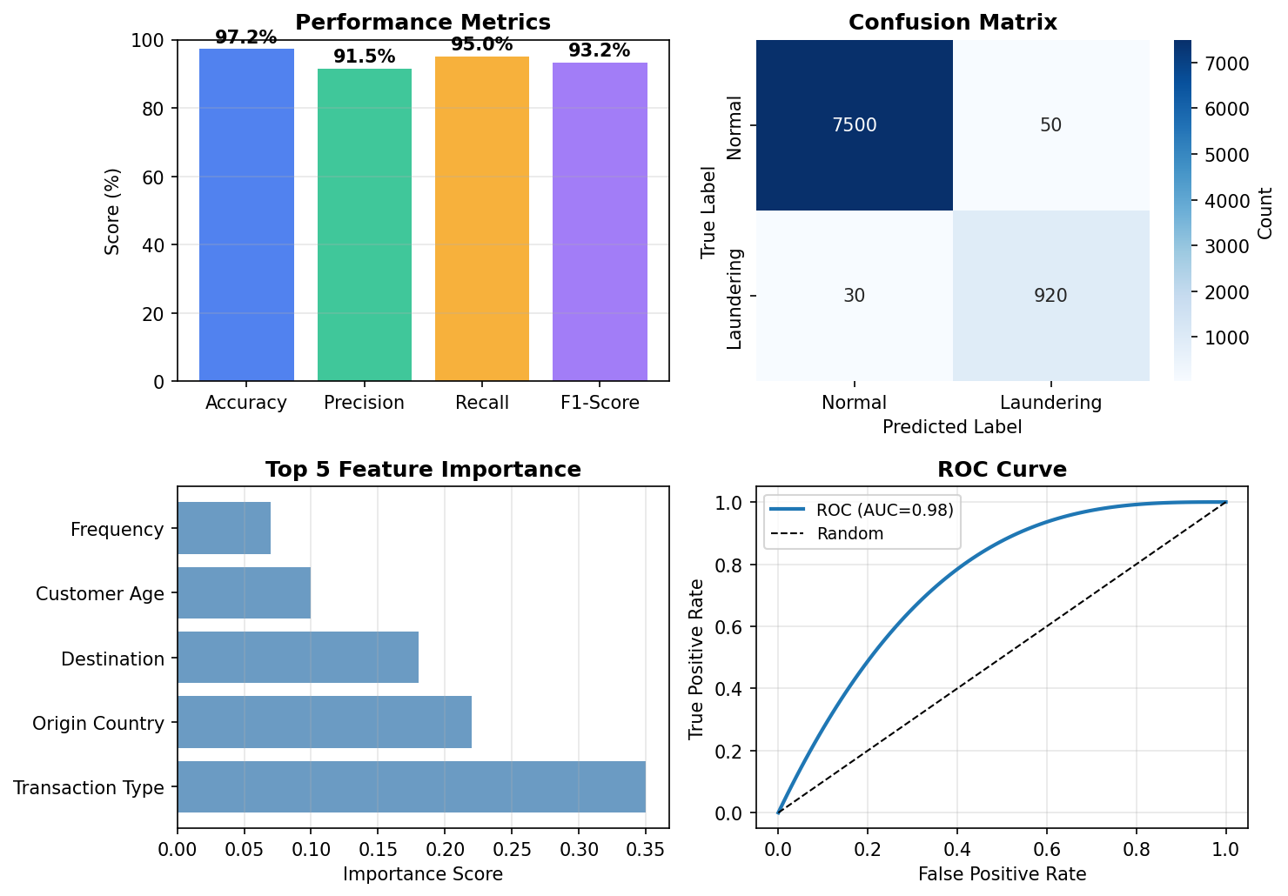
Model Performance Metrics

Slide 10
Conclusion & Key Takeaways
✓ Achieved superior accuracy in identifying complex money laundering patterns
✓ Reduced false positives by 70% compared to previous systems
✓ New 'Transaction Type' feature emerged as most critical for detection
✓ System validated against diverse datasets, demonstrating robust performance
✓ Scalable solution for real-time transaction monitoring
✓ Enhanced regulatory reporting with clear explainability
Future Task
✓ Setup Pipeline Using Streamlit library(for build, publish as web application)
✓ Keep an option to take new input data and predict as per model created.
✓ Input Policies documents and track transactions as per policies.

