Slide 1

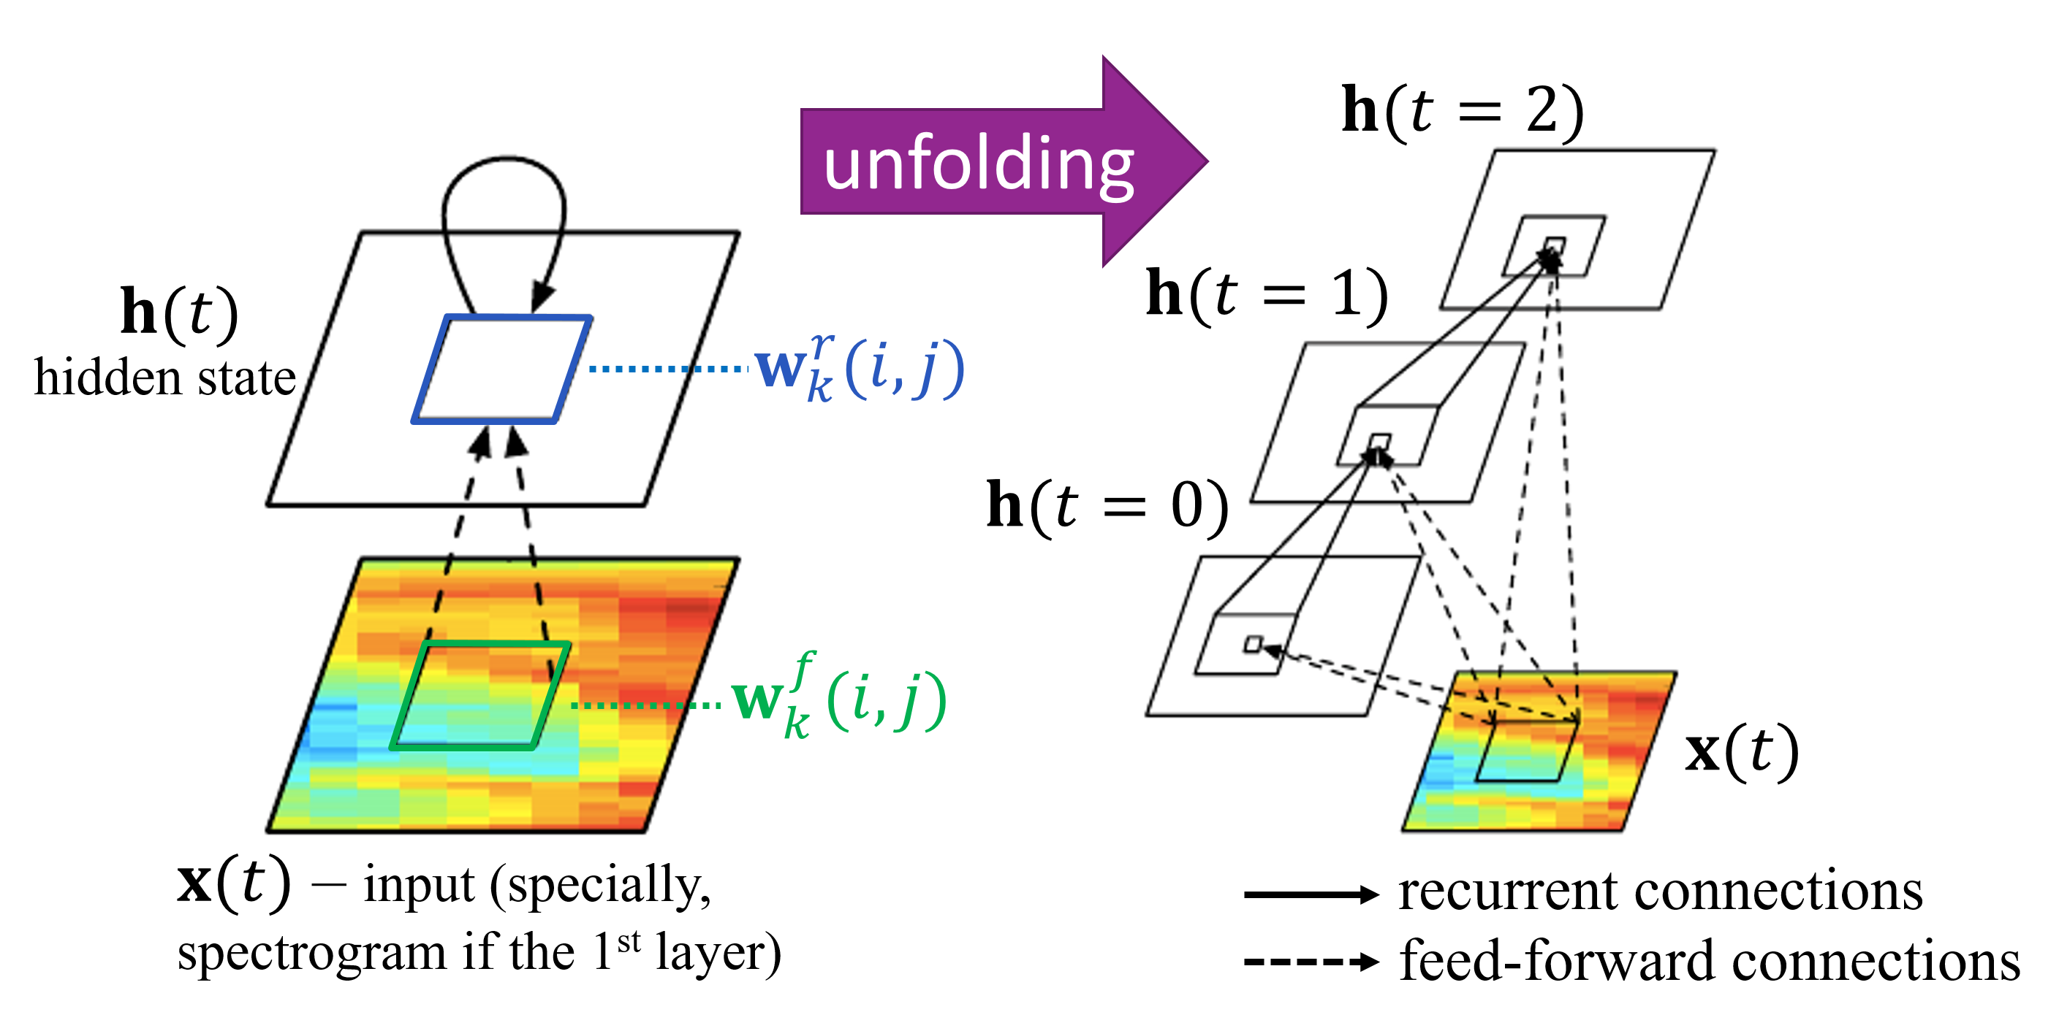
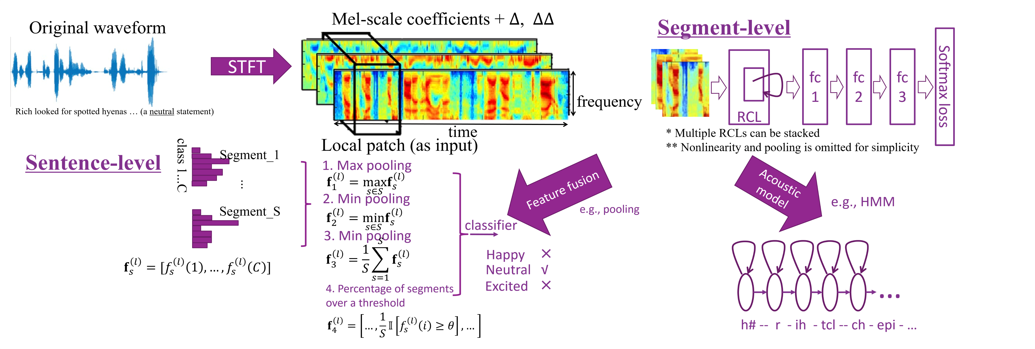
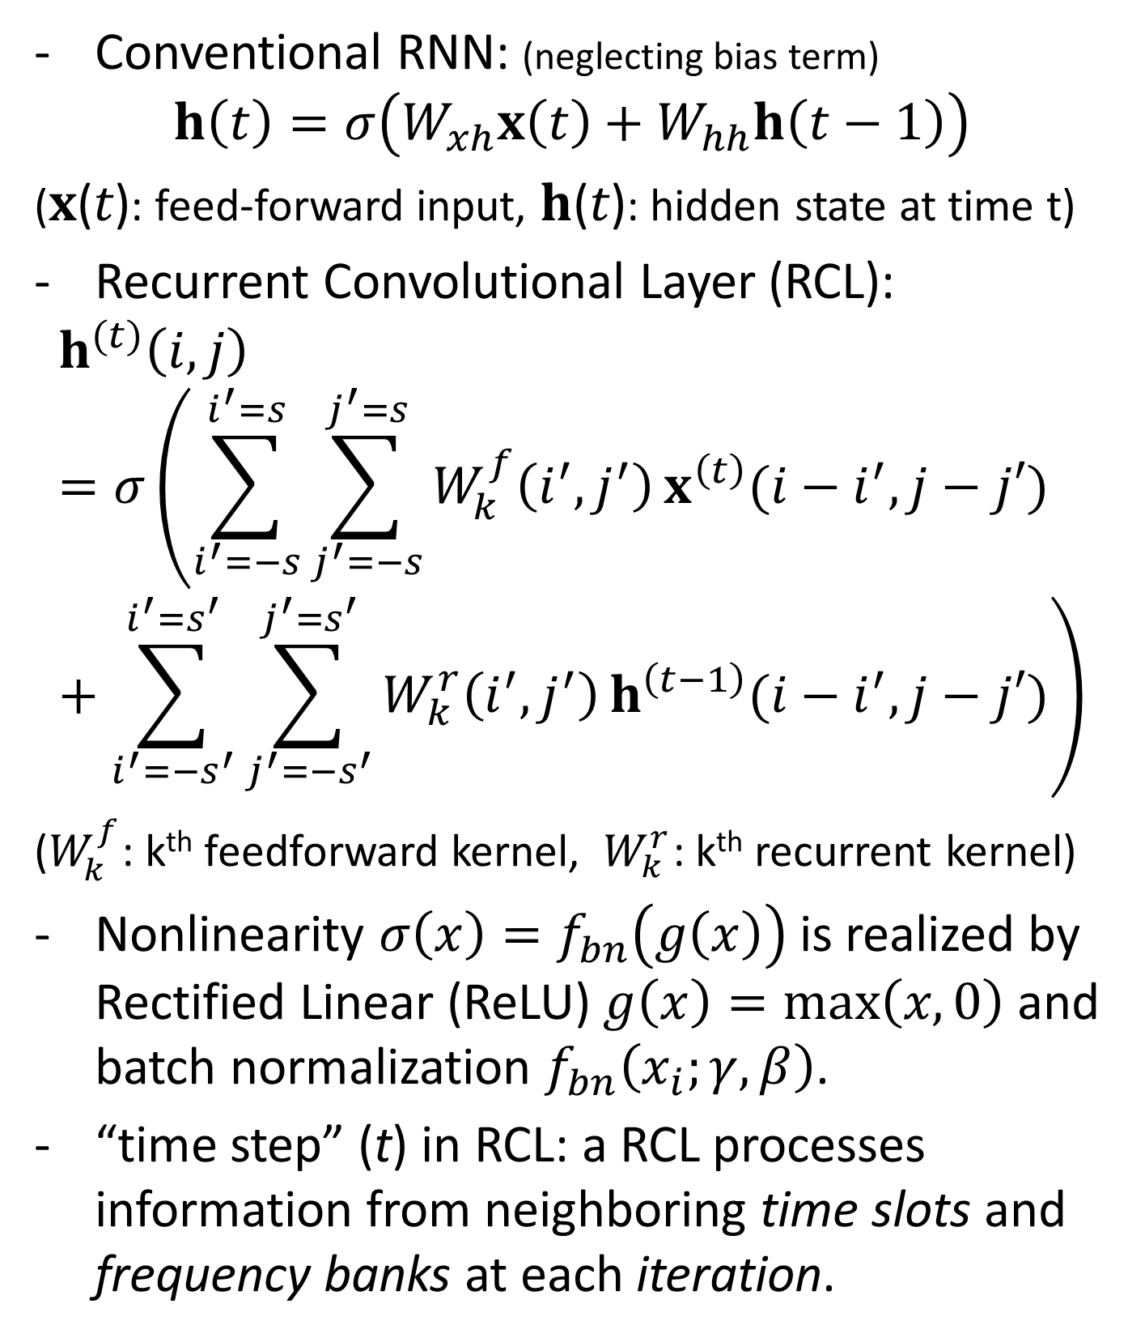
RECURRENT CONVOLUTIONAL NEURAL NETWORKS FOR SPEECH PROCESSING
Yue Zhao, Xingyu Jin
Xiaolin Hu
Department of Electronic Engineering, TNList,
Tsinghua University, Beijing, 100084, China
Department of Computer Science and Technology,
TNList, Tsinghua University, Beijing, 100084, China
MOTIVATION
ILLUSTRATION
RESULTS
RESULTS
Existing CNN and RNN have specific disadvantages.
CNN has not exhibited significant improvement in speech processing.
RNN is expected to function well in modeling sequential data, but is harder to train efficiently.
A new architecture of Recurrent Convolutional Neural Network (RCNN) [1, 2] works well in object recognition and scene labeling.
In view of the embedded RNN structure, RCNN is expected to function well in modeling speech, a typical temporally sequential data.
Illustration of a single RCL and its unfolded version with T=3.
Phoneme recognition on TIMIT
Unfolding more times yields lower PER but there is a limit.
Outperform most ANN-HMM models. Competitive to existing methods. (More in paper)
The speed of RCNN is faster than LSTM module, in both training and testing.
Emotion recognition on IEMOCAP
Spectral features, relatively lower-level feature than MFCC, can achieve competitive, even better results.
 | PER (dev set) | PER (core test set)
4-layer MLP | 19.9% | 22.0%
CL + pooling + 3-layer MLP | 18.4% | 20.0%
CL1 + CL2 + pooling + 3-layer MLP | 19.2% | 20.5%
RCL (T=1) + pooling + 3-layer MLP | 18.3% | 20.3%
RCL (T=2) + pooling + 3-layer MLP | 17.3% | 19.2%
RCL (T=2) + CL + 3-layer MLP | 17.0% | 18.0%
3-layer LSTM + HMM [3]* | 17.7% | 18.8%
 | Framewise accuracy | Weighted accuracy | Unweighted accuracy
3-layer MLP | 41.4% | 48.5% | 39.9%
CL+2-layer MLP | 43.1% | 53.4% | 41.6%
RCL+2-layer MLP | 43.5% | 53.6% | 42.8%
(MFCC+pitch) MLP+SVM [4] | - | ~50% | ~45%
Log Spec(+PCA whitening)+CNN [5] | - | - | 35.98% (40.02%)
 | training | testing
RCNN | 2012 samples per second | 1.721 utterances per second
LSTM | 275 samples per second | 0.944 utterances per second
FORMULATION
CONCLUSIONS
Conventional RNN: (neglecting bias term)
$$h\left(t\right)=σ\left(W_{xh}x\left(t\right)+W_{hh}h\left(t−1\right)\right)$$
(𝐱(𝑡): feed-forward input, 𝐡(𝑡): hidden state at time t)
Recurrent Convolutional Layer (RCL):
$$h^{(t)}\left(i,j\right)=σ\left(\sum_{i^{′}=−s}^{i^{′}=s}{\sum_{j^{′}=−s}^{j^{′}=s}{W_{k}^{f}\left(i^{′},j^{′}\right)}x^{\left(t\right)}(i−i^{′},j−j′) }+\sum_{i^{′}=−s^{′}}^{i^{′}=s^{′}}{\sum_{j^{′}=−s^{′}}^{j^{′}=s^{′}}{W_{k}^{r}\left(i^{′},j^{′}\right)}h^{\left(t−1\right)}(i−i^{′},j−j′)}\right)$$
($W_{k}^{f}$: k^{th} feedforward kernel, $W_{k}^{r}$: k^{th} recurrent kernel)
Nonlinearity $σ\left(x\right)=f_{bn}\left(g\left(x\right)\right)$is realized by Rectified Linear (ReLU) $g\left(x\right)=max\left(x, 0\right)$ and batch normalization $f_{bn}\left(x_{i};γ,β\right)$.
“time step” (t) in RCL: a RCL processes information from neighboring time slots and frequency banks at each iteration.
* Paper [3] works on another dataset. We borrow the structure for comparison of speed. Parameters may not be perfectly tuned.
Propose to use RCNN originally from computer vision to speech processing.
RCNN achieves competitive results with existing models. Also, it runs faster than LSTM networks.
Inspire more generic and efficient cross-modal deep learning models in the future.
PIPELINE
REFERENCES
[1] M. Liang and X. Hu. Recurrent convolutional neural network for object recognition. CVPR 2015.
[2] M. Liang, X. Hu, and B. Zhang. Convolutional neural networks with intra-layer recurrent connections for scene labeling. NIPS 2015.
[3] Y. Zhang, G. Chen, D. Yu, K. Yaco, S. Khudanpur, and J. Glass. Highway long short-term memory RNNs for distant speech recognition. ICASSP 2016.
[4] K. Han, D. Yu, and I. Tashev. Speech emotion recognition using deep neural network and extreme learning machine. INTERSPEECH 2014.
[5] W. Zheng, J. Yu, and Y. Zou. An experimental study of speech emotion recognition based on deep convolutional neural networks. In International Conference on Affective Computing and Intelligent Interaction (ACII), pages 827–831. IEEE, 2015
SOURCE CODES
The source codes can be downloaded at: https://github.com/zhaoyue-zephyrus/RecurrentConvNet-for-Speech
Contact: Yue Zhao, thuzhaoyue@gmail.com

