Slide 1
amazon product DATA analysis - recommendation System CISC7201 INTRODUCTION TO DATA SCIENCE PROGRAMMING
Group K
Wong Kit Kan - mb95513
Chio Chon Hou - mb95540
Notes:
Halo, This is kim, is is dennis.. Today we are going to talk abou t

Slide 2
What we have done
☐ Collect the data
☑ Clean the data
☑ Process the data
☑ Analyze / recommend / forecast / visualize data
☑ Simple recommendation system
Notes:
In this project, what we have done, after we got the data, we do the data cleaning; and we do the data pre-process before we analyze the data;
After tahat, we analyze the charactestic of the data, and vaulizeize the data
Finally, we iimplement a simple recommendation system to present the result

Slide 3
Data source
From: Amazon China’s product data
Data overview: (846 MB)
20,000 products
1,100 categories
1.42 million users
7.2 million reviews / rating data
Source: https://github.com/SophonPlus/ChineseNlpCorpus/blob/master/datasets/yf_amazon/intro.ipynb
Notes:
About the data source, we original dataset is comf from amazon china. The data set is amost 1GB; there is four dimention about the data: prodect, categories, users and rating

Slide 4
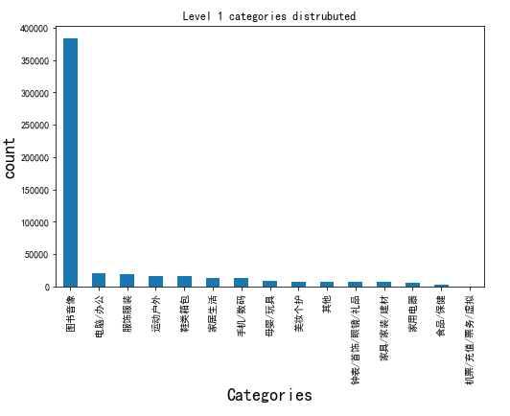
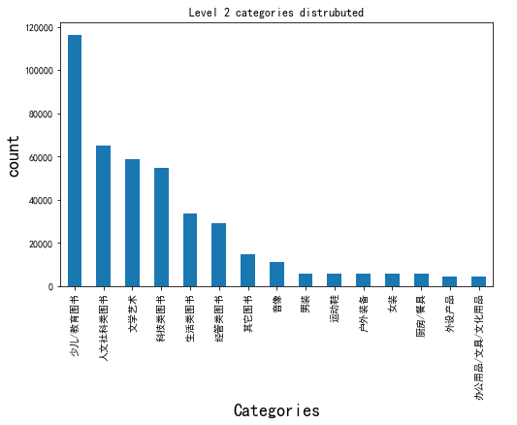
Data overview
Notes:
First we take a look about the daata disturbistion. The most products are books, accounting for 80% about the total in the book product , The largest number of books are educational books and children book.

Slide 5
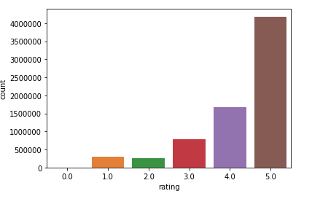
Data overview – cont.
Notes:
In the rating records, there is 1 to 5 score for user to rate. We found that user open rate 5 score more that else.

Slide 6
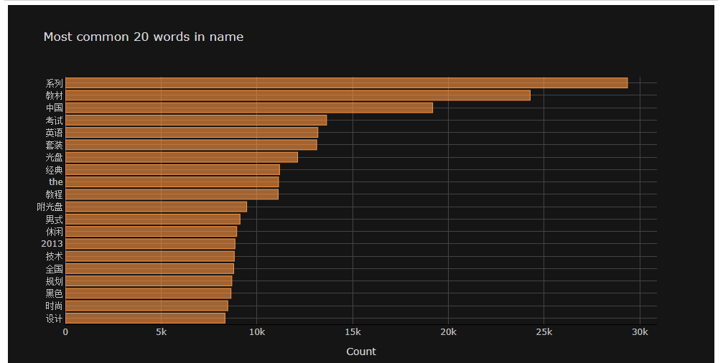
Data overview – cont.
Notes:
We perform a word segmentation analysis on all product names, we find that the post Popular key word is the 系列 and 中國. But we found that this is some stop word just like “the”, so this key word list is not totally correct.
So we use baduo stop word list the filter out all the stop word, and here is the final result

Slide 7
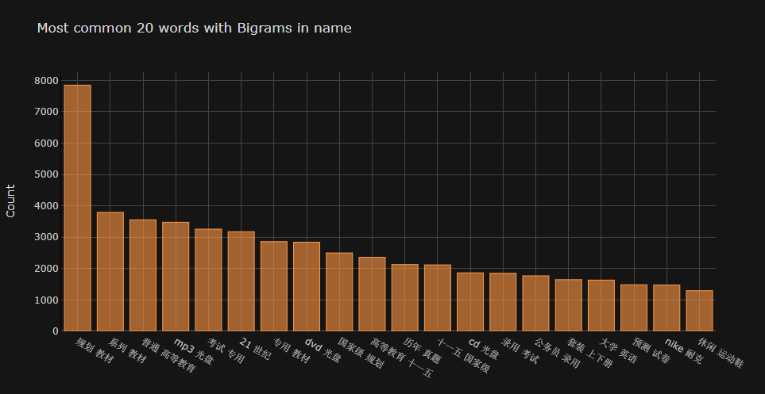
Data overview – cont.

Slide 8
Simple recommendation system

Slide 9
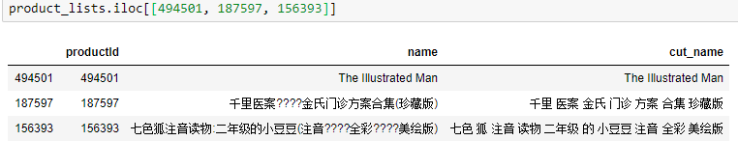
Data cleaning
Drop useless column
Remove NaN product name/user id/rating data
Remove punctuation(%$?) in product name
Remove Extreme data (rating)
Drop duplicate rating records
Notes:
We have drop and remove the meaningless record,
And remove punctuation in the product name

Slide 10
Data processing
Categories split
Split the word (jieba)
Join table (join csv)
Build user-items matrix
Export the processed dataset (speed up)
Notes:
In the data processing part we done a lot.
But I want to talk about the split word part.

Slide 11
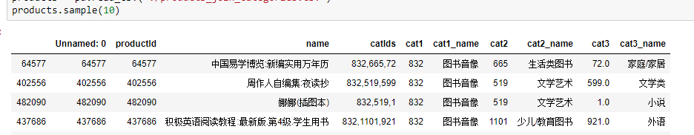
Data processing
Categories split
Split the word (jieba)
Join table (join csv)
Build user-items matrix
Export the processed dataset (speed up)

Slide 12
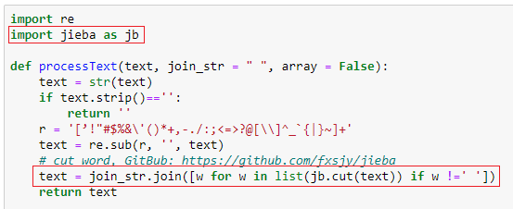
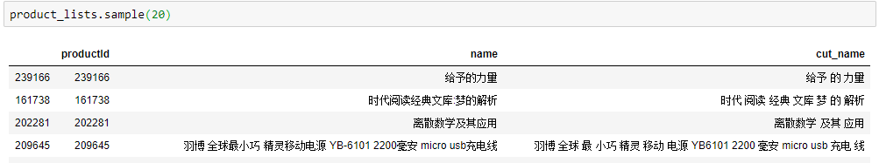
Data processing
Categories split
Split the word (jieba)
Join table (join csv)
Build user-items matrix
Export the processed dataset (speed up)
Notes:
In split word part, we are using jieba library.
This library we help us make the sentence split to lots of terms.

Slide 13
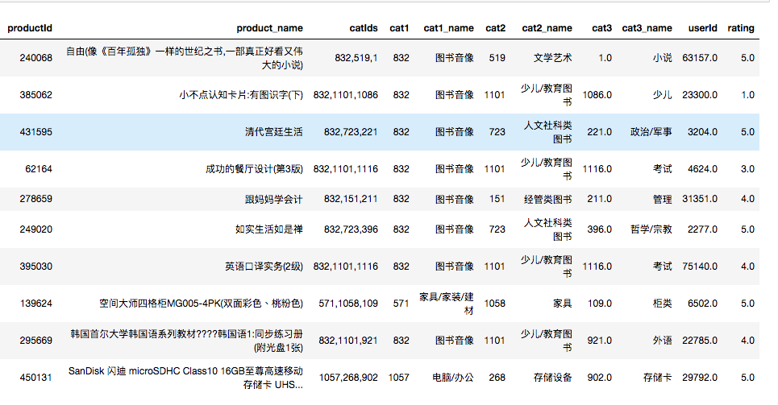
Data processing
Categories split
Split the word (jieba)
Join table (join csv)
Build user-items matrix
Export the processed dataset (speed up)

Slide 14
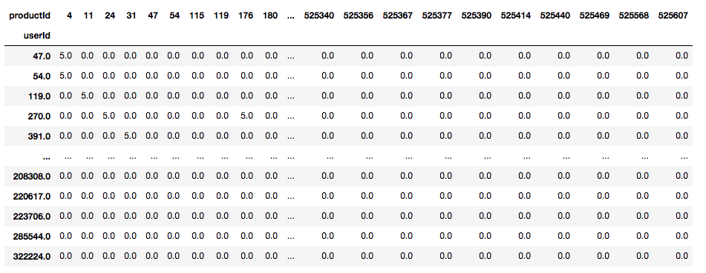
Data processing
Categories split
Split the word (jieba)
Join table (join csv)
Build user-items matrix
Export the processed dataset (speed up)

Slide 15
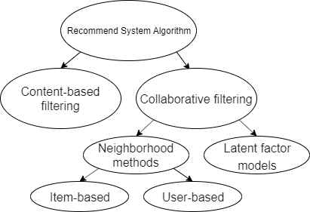
Data Analyze / recommend
Find top categories
Find top words (n-gram)
Item based recommendation
content-based filtering
Item/User based recommendation
Neighborhood methods
Notes:
And the virtualization part we have already show in the demo.
Last talk about the implementation.
I think latent factor model everyone are know well.
So we implement the content-based filtering and neighborhood methods.

Slide 16
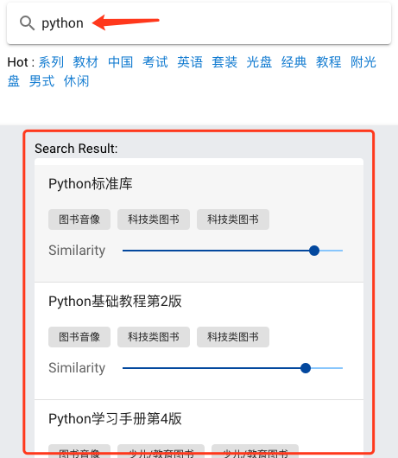


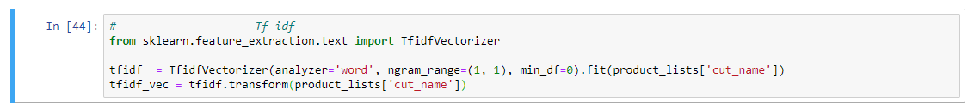

Content-based filtering - tfidf
TF-IDF
TF: Term frequency
the raw count of a term in a document
IDF: Inverse document frequency
the documents that contain the word
Notes:
TF means the term frequency in a document, the frequency more high means the term is more important But the term is less important if it appear in lots of document. So it need to inverse weight. That is IDF
TF-IDF means TF multiy IDF.
And there is our using library.

Slide 17
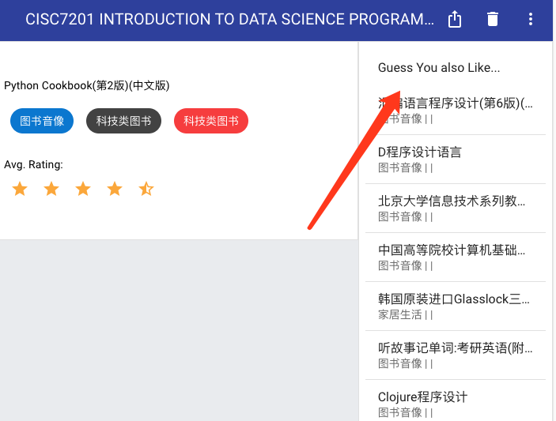
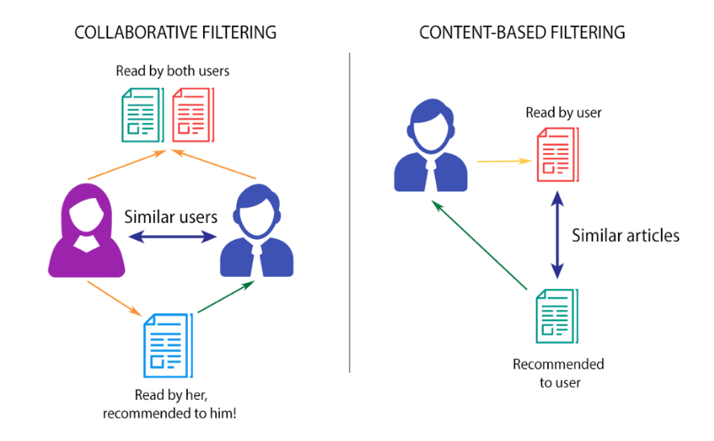
ITEM / User based recommendation Neighborhood methods
Notes:
And the recommendation, there are user-based and item-based. In user-based recommendation, first it find the similar user based on their rating comment.

Slide 18
Data Analyze / recommend
Find top categories
Find top words (n-gram)
Item based recommendation
content-based filtering
Item/User based recommendation
Neighborhood methods
(sklearn library)
Notes:
We are using the sklearn library to find the user similarity base on the matrix.

Slide 19
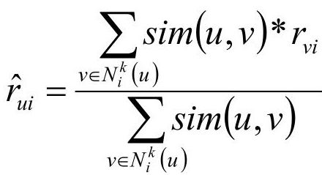
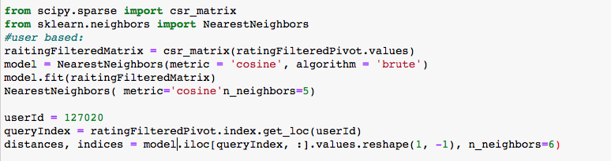
Data Analyze / recommend
Find top categories
Find top words (n-gram)
Item based recommendation
content-based filtering
Item/User based recommendation
Neighborhood methods
Simple Weighted average method
Notes:
Last, we calculate the weighted average of similar user’s rating product to recommend product list to the user.

Slide 20
Thank you
Questions?

