Slide 1
recommendation System of amazon product data CISC7201 INTRODUCTION TO DATA SCIENCE PROGRAMMING
Group K
Wong Kit Kan - mb95513
Chio Chon Hou - mb95540

Slide 2
What we have done
☐ Collect the data
☑ Clean the data
☑ Process the data
☑ Analyze / recommend / forecast / visualize data
☑ Simple recommendation system

Slide 3
Data source
From: Amazon China’s product data
Data overview: (846 MB)
20,000 products
1,100 categories
1.42 million users
7.2 million reviews / rating data
Source: https://github.com/SophonPlus/ChineseNlpCorpus/blob/master/datasets/yf_amazon/intro.ipynb

Slide 4
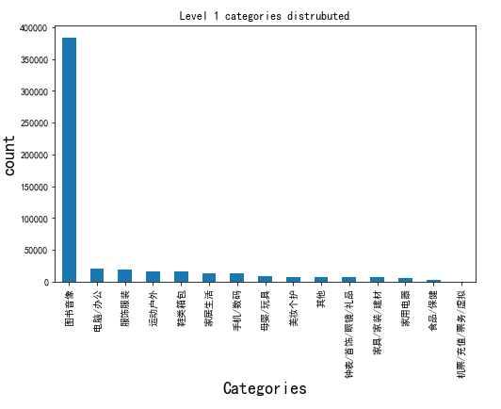
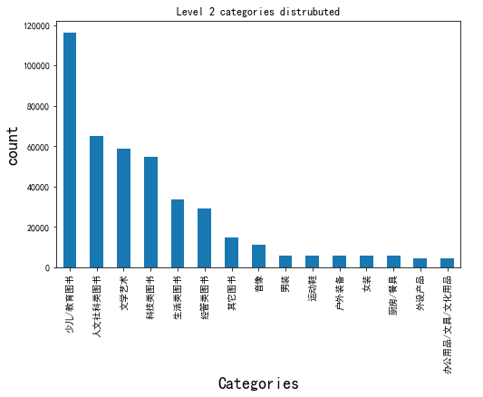
Data overview

Slide 5
Data overview – cont.

Slide 6
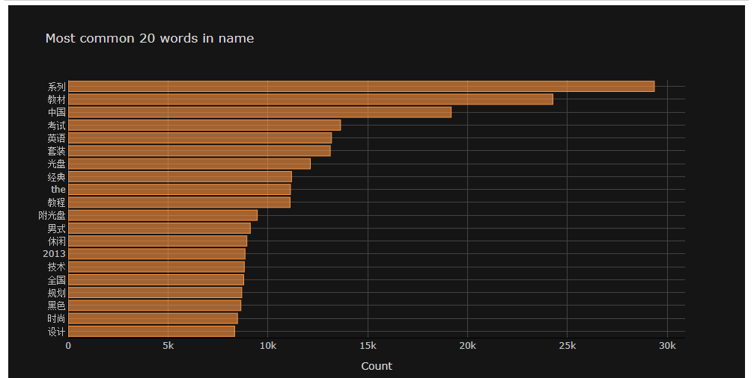
Data overview – cont.

Slide 7
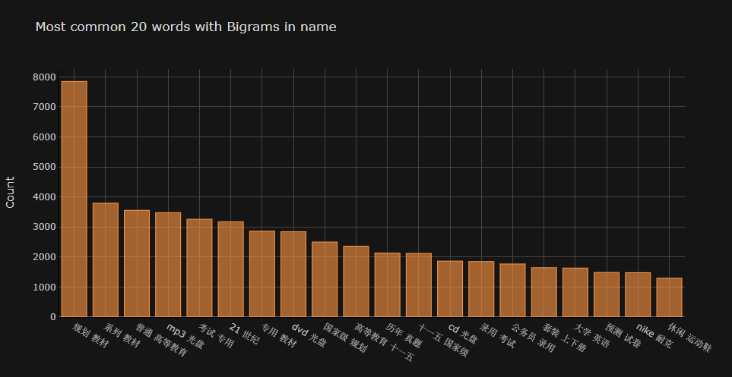
Data overview – cont.

Slide 8
Simple recommendation system

Slide 9
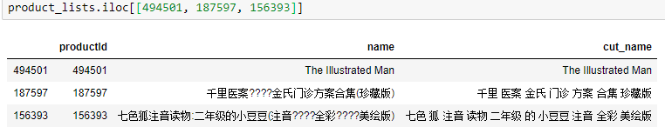
Data cleaning
Drop useless column
Remove NaN product name/user id/rating data
Remove punctuation(%$?) in product name
Remove Extreme data (rating)
Drop duplicate rating records

Slide 10
Data processing
Categories split
Split the word (jieba)
Join table (join csv)
Build user-items matrix
Export the processed dataset (speed up)

Slide 11
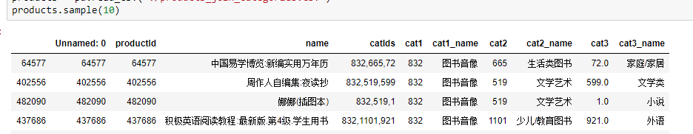
Data processing
Categories split
Split the word (jieba)
Join table (join csv)
Build user-items matrix
Export the processed dataset (speed up)

Slide 12
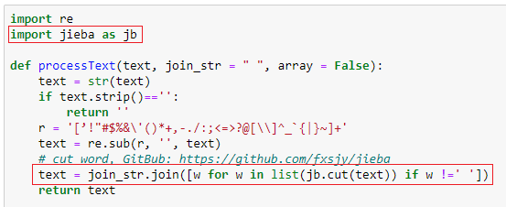
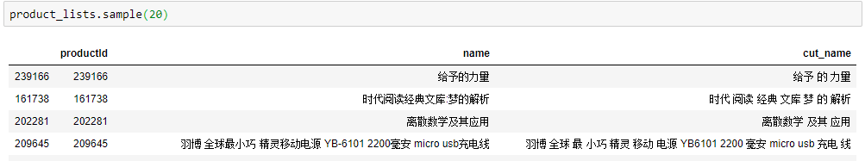
Data processing
Categories split
Split the word (jieba)
Join table (join csv)
Build user-items matrix
Export the processed dataset (speed up)

Slide 13
Data processing
Categories split
Split the word (jieba)
Join table (join csv)
Build user-items matrix
Export the processed dataset (speed up)

Slide 14
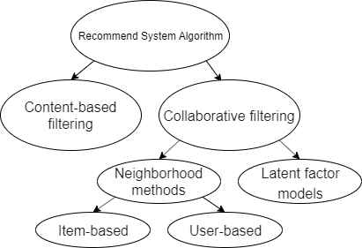
Data Analyze / recommend
Find top categories
Find top words (n-gram)
Item based recommendation
content-based filtering
Item/User based recommendation
Neighborhood methods

Slide 15


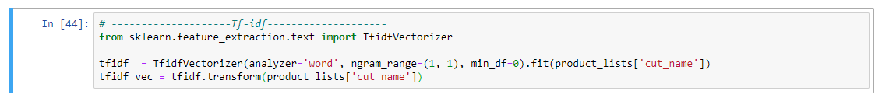

Data Analyze / recommend
Find top categories
Find top words (n-gram)
Item based recommendation
content-based filtering
Item/User based recommendation
Neighborhood methods
TF-IDF
TF: Term frequency
the raw count of a term in a document
IDF: Inverse document frequency
the documents that contain the word

Slide 16
Data Analyze / recommend
Find top categories
Find top words (n-gram)
Item based recommendation
content-based filtering
Item/User based recommendation
Neighborhood methods

Slide 17
Thank you
Questions?

