Slide 1
amazon product DATA analysis - recommendation System CISC7201 INTRODUCTION TO DATA SCIENCE PROGRAMMING
Group K
Wong Kit Kan - mb95513
Chio Chon Hou - mb95540
Notes:
Halo, This is Kim, this is Dennis.. Today we are going to talk about the amazon product data analysis

Slide 2
What we have done
☐ Collect the data
☑ Clean the data
☑ Process the data
☑ Analyze / recommend / forecast / visualize data
☑ Simple recommendation system
Notes:
In this project, after we got the data. We do the data clean and preprocess;
After that, we analyze the charactestic of the data, and vaulizeize the result.
Finally, we implement a simple recommendation system to present what we are doing.

Slide 3
Data source
From: Amazon China’s product data
Data overview: (846 MB)
20,000 products
1,100 categories
1.42 million users
7.2 million reviews / rating data
Source: https://github.com/SophonPlus/ChineseNlpCorpus/blob/master/datasets/yf_amazon/intro.ipynb
Notes:
The original dataset is come from amazon china. The data set is almost 1GB;
There is four dimension about the data: product, categories, users and rating

Slide 4
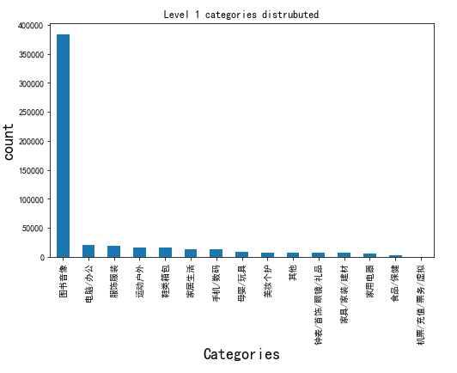
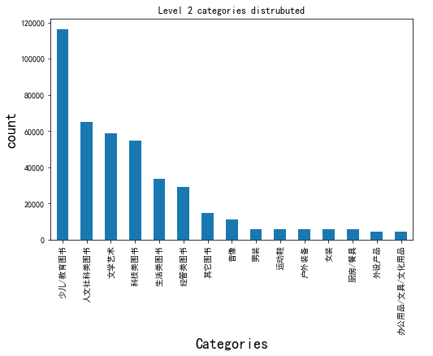
Data overview
Notes:
First we take a look about the data distribution. The most products is books categories 80% of the total.
---NO ----In the book categories, The largest number of books are educational books and child book.

Slide 5
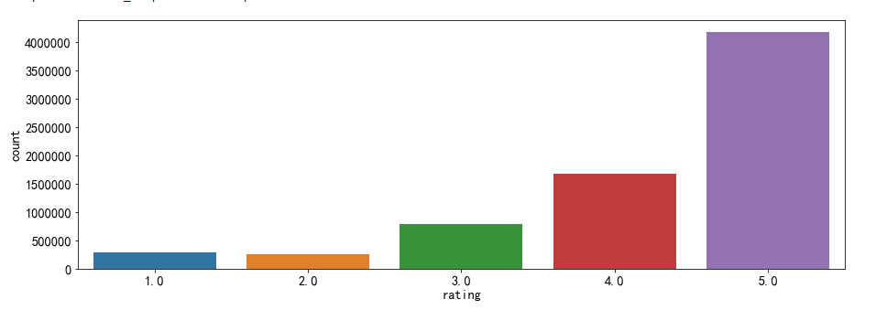
Data overview – cont.
Notes:
In the rating score, there is 1 to 5 point for user to rate. We found that user often rate 5 point more that else.

Slide 6
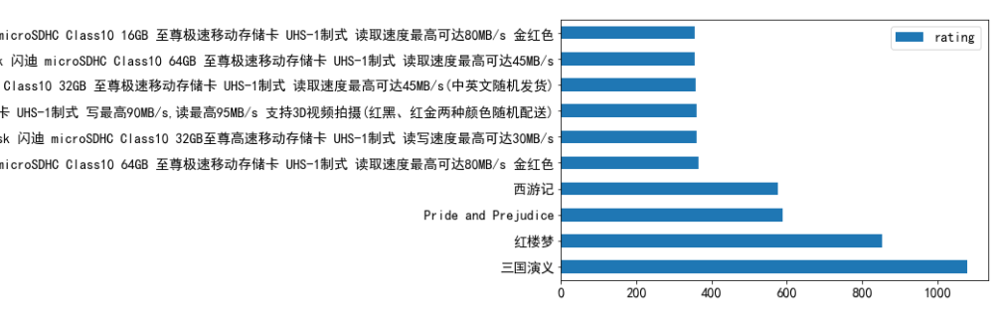
Data overview – cont.
Notes:
And next, we can do same simple analysis about the product, we find that 三國演義and紅樓夢have the most rating count, we can conclude that they are the most poplula.

Slide 7
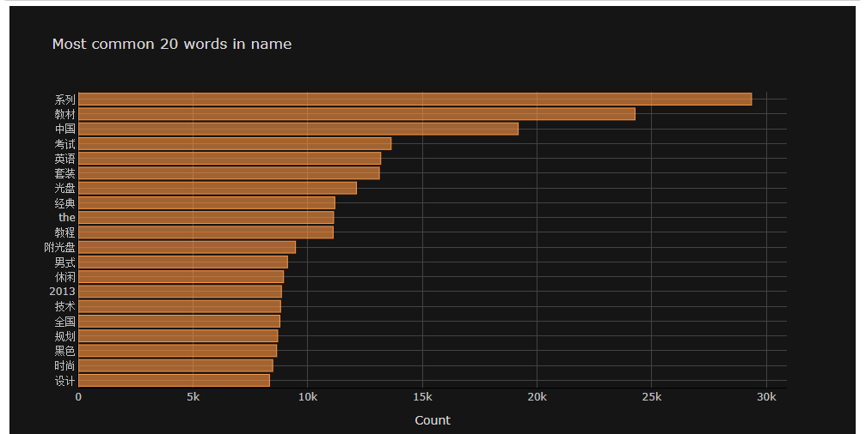
Data overview – cont.
Notes:
We perform a word segmentation analysis on all product names, we find that the most Popular key word is the 系列 and 中國. But we found that this is some stop word just like “the”, so this key word list is not totally correct.
So we use baduo stop word list the filter out all the stop word, and here is the final result

Slide 8
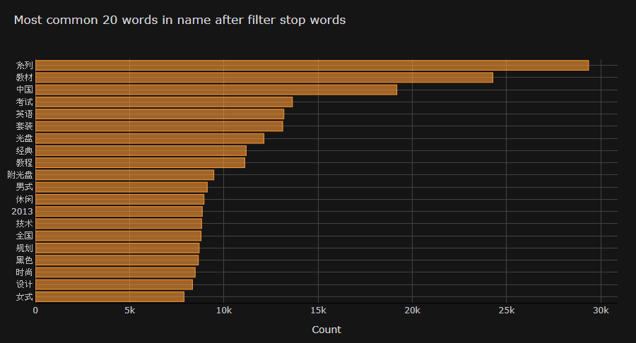
Data overview – cont.
Notes:
We perform a word segmentation analysis on all product names, we find that the most Popular key word is the 系列 and 中國. But we found that this is some stop word just like “the”, so this key word list is not totally correct.
So we use baduo stop word list the filter out all the stop word, and here is the final result

Slide 9
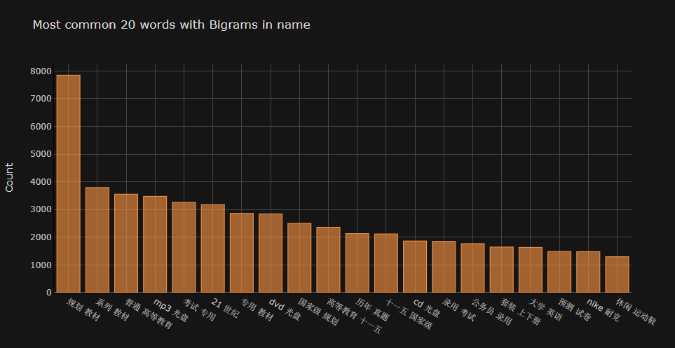
Data overview – cont.
Notes:
On the other hand, we find the most Popular word combination is 規划and 教財, also here we find a funny combination is 預測and試卷

Slide 10
Simple recommendation system

Slide 11
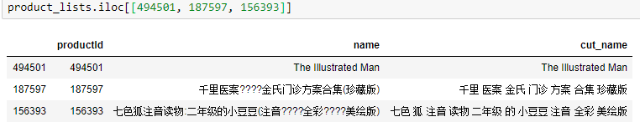
Data cleaning
Drop useless column
Remove NaN product name/user id/rating data
Remove punctuation(%$?) in product name
Remove Extreme data (rating)
Drop duplicate rating records
Notes:
We have drop and remove the meaningless record,
And remove punctuation in the product name

Slide 12
Data processing
Categories split
Split the word (jieba)
Join table (join csv)
Build user-items matrix
Export the processed dataset (speed up)
Notes:
In the data processing part we done a lot.
But I want to talk about the split word part.

Slide 13
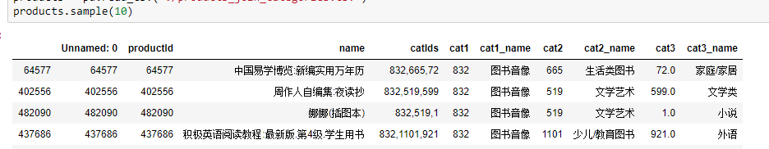
Data processing
Categories split
Split the word (jieba)
Join table (join csv)
Build user-items matrix
Export the processed dataset (speed up)

Slide 14
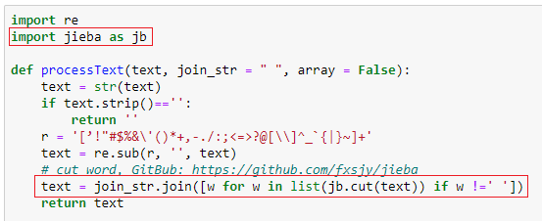
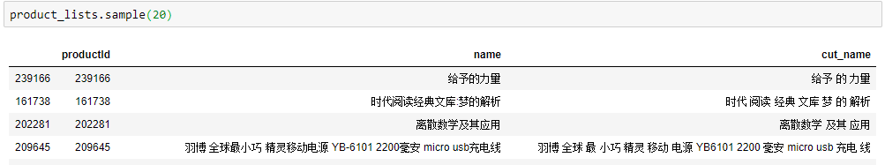
Data processing
Categories split
Split the word (jieba)
Join table (join csv)
Build user-items matrix
Export the processed dataset (speed up)
Notes:
In split word part, we are using jieba library.
This library we help us make the sentence split to lots of terms.

Slide 15
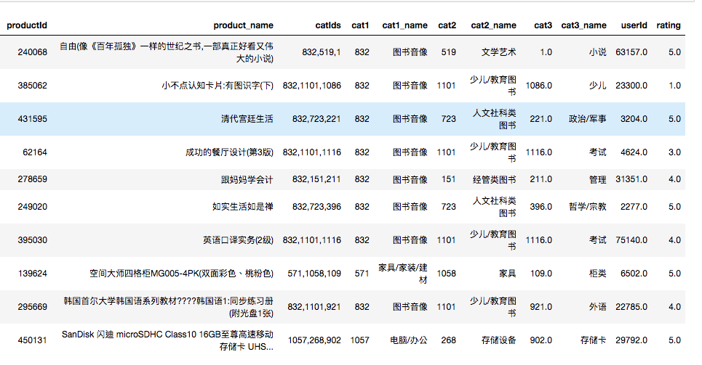
Data processing
Categories split
Split the word (jieba)
Join table (join csv)
Build user-items matrix
Export the processed dataset (speed up)

Slide 16
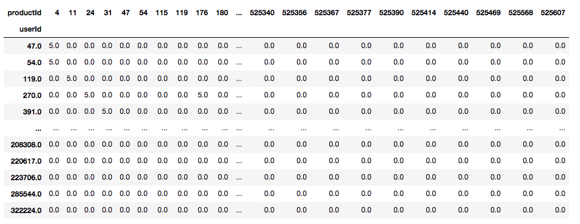
Data processing
Categories split
Split the word (jieba)
Join table (join csv)
Build user-items matrix
Export the processed dataset (speed up)

Slide 17
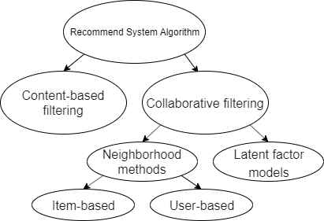
Data Analyze / recommend
Find top categories
Find top words (n-gram)
Item based recommendation
content-based filtering
Item/User based recommendation
Neighborhood methods
Notes:
And the virtualization part we have already show in the demo.
Last talk about the implementation.
I think latent factor model everyone are know well.
So we implement the content-based filtering and neighborhood methods.

Slide 18
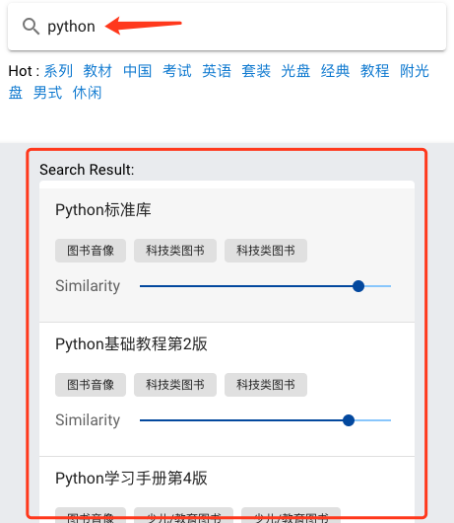


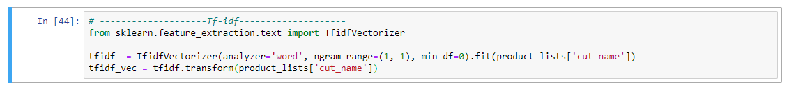

Content-based filtering - tfidf
TF-IDF
TF: Term frequency
the raw count of a term in a document
IDF: Inverse document frequency
the documents that contain the word
Notes:
TF means the term frequency in a document, the frequency more high means the term is more important But the term is less important if it appear in lots of document. So it need to inverse weight. That is IDF
TF-IDF means TF multiy IDF.
And there is our using library.

Slide 19
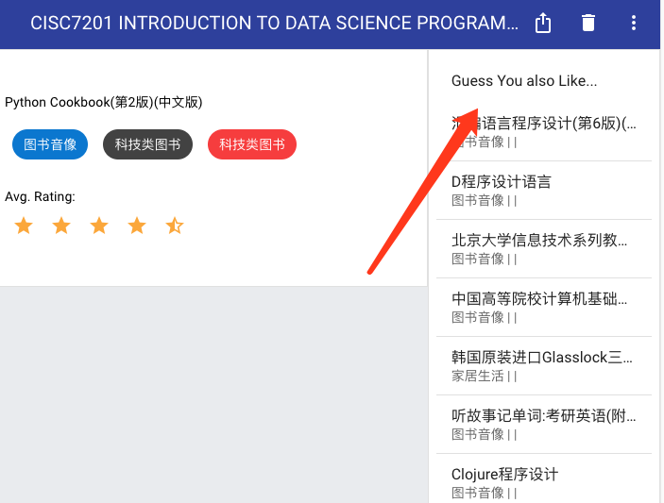
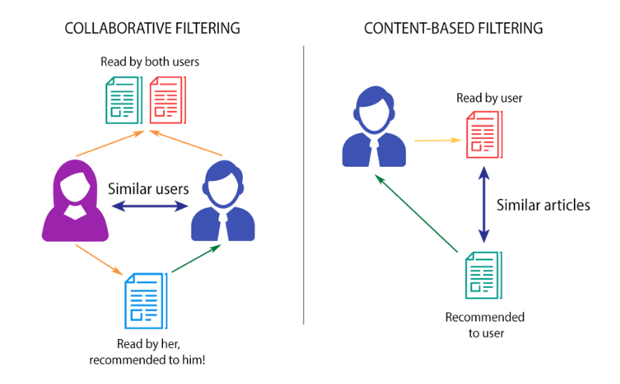
ITEM / User based recommendation Neighborhood methods
Notes:
And the recommendation, there are user-based and item-based. In user-based recommendation, first it find the similar user based on their rating comment.

Slide 20
Data Analyze / recommend
Find top categories
Find top words (n-gram)
Item based recommendation
content-based filtering
Item/User based recommendation
Neighborhood methods
(sklearn library)
Notes:
We are using the sklearn library to find the user similarity base on the matrix.

Slide 21
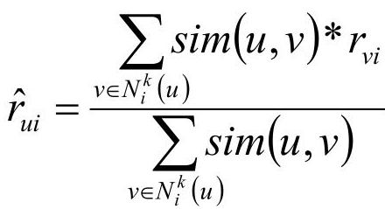
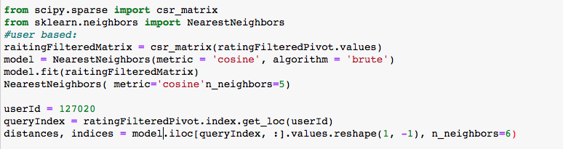
Data Analyze / recommend
Find top categories
Find top words (n-gram)
Item based recommendation
content-based filtering
Item/User based recommendation
Neighborhood methods
Simple Weighted average method
Notes:
Last, we calculate the weighted average of similar user’s rating product to recommend product list to the user.

Slide 22
Thank you
Questions?

Slide 25
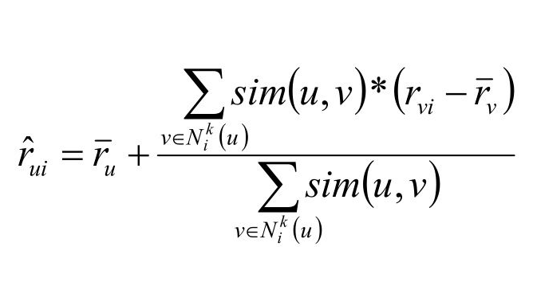
[Backup Slide]
[UserCF]Improvement: The principle of the algorithm is that the user's rating of the item should be near the average of the user's rating of all items

Slide 26
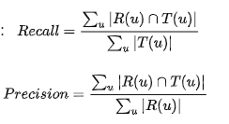
[Backup Slide]
[UserCF] Evaluation
K | precision | recall
10 | 15.25% | 8%
20 | 22.5% | 10.03%
50 | 20.25% | 10.01%
75 | 20.45% | 9.92%

Slide 27
[Backup Slide]
pip install jieba => Chinese text segmentation: built to be the best Python Chinese word segmentation module.
pip install sklearn => scikit-learn: machine learning in Python
pip install cufflinks
pip install flask => webserver
pip install json_tricks => json
pip install flask-cors

Slide 28
[Backup Slide]
Environment:
Python3.6 & flask (back-end api)
VueJs (front-end)
Jupyter notebook

