Slide 1
recommendation System of amazon product data CISC7201 INTRODUCTION TO DATA SCIENCE PROGRAMMING
Group K
Wong Kit Kan - mb95513
Chio Chon Hou - mb95540

Slide 2
What we have done
☐ Collect the data
☑ Clean the data
☑ Process the data
☑ Analyze / recommend / forecast / visualize data
☑ Simple recommendation system

Slide 3
Data source
From: Amazon China’s product data
Data overview: (846 MB)
20,000 products
1,100 categories
1.42 million users
7.2 million reviews / rating data
Source: https://github.com/SophonPlus/ChineseNlpCorpus/blob/master/datasets/yf_amazon/intro.ipynb

Slide 4
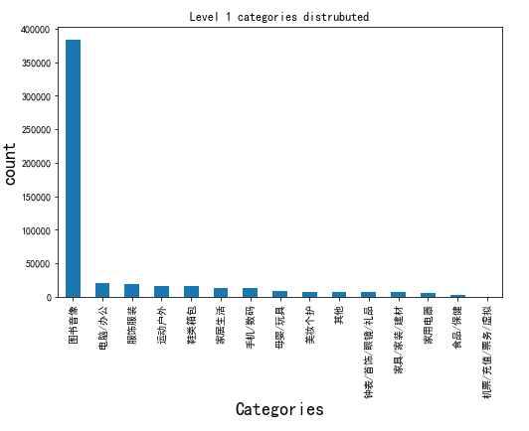
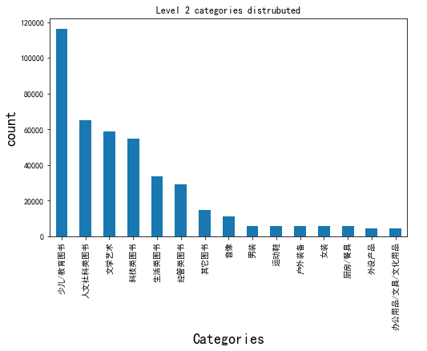
Data overview

Slide 5
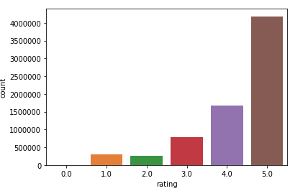
Data overview – cont.

Slide 6
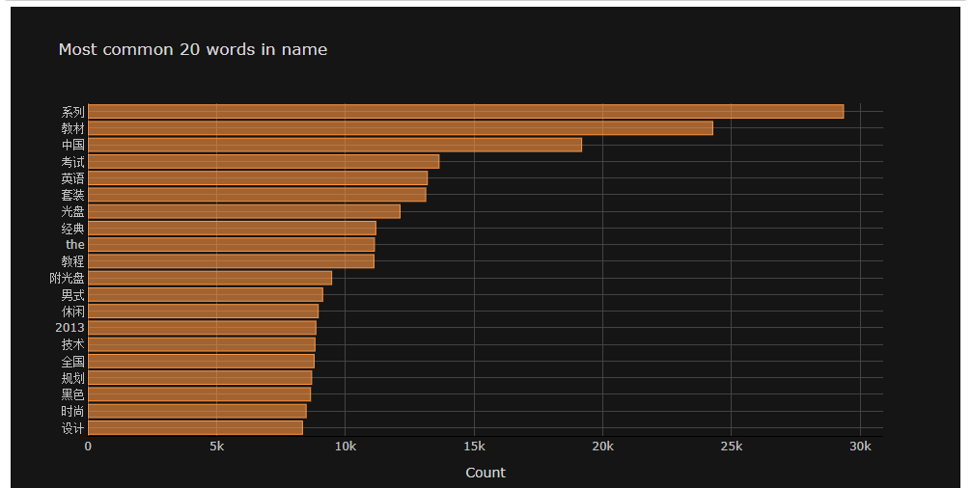
Data overview – cont.

Slide 7
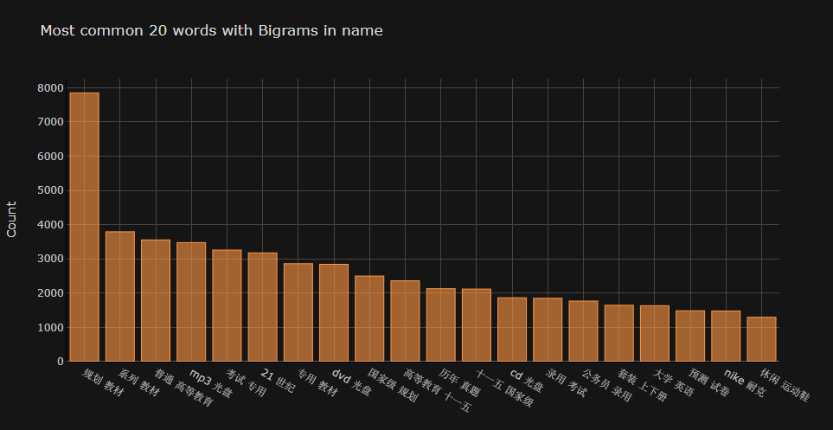
Data overview – cont.

Slide 8
Simple recommendation system

Slide 9
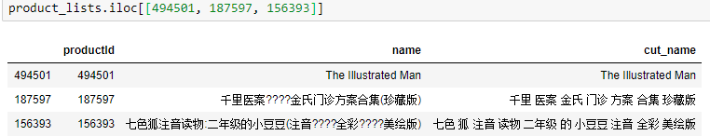
Data cleaning
Drop useless column
Remove NaN product name/user id/rating data
Remove punctuation(%$?) in product name
Remove Extreme data (rating)
Drop duplicate rating records
Notes:
We have drop and remove the meaningless record,
And remove punctuation in the product name

Slide 10
Data processing
Categories split
Split the word (jieba)
Join table (join csv)
Build user-items matrix
Export the processed dataset (speed up)
Notes:
In the data processing part we done a lot.
But I want to talk about the split word part.

Slide 11
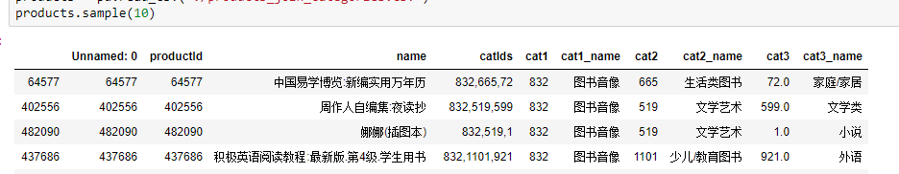
Data processing
Categories split
Split the word (jieba)
Join table (join csv)
Build user-items matrix
Export the processed dataset (speed up)

Slide 12
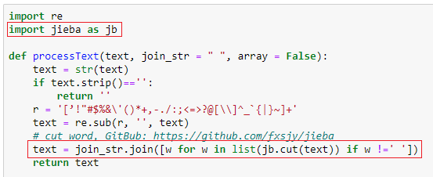
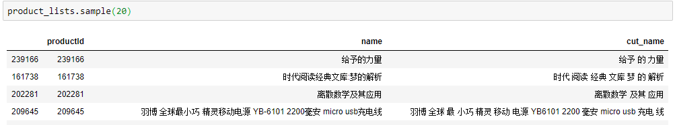
Data processing
Categories split
Split the word (jieba)
Join table (join csv)
Build user-items matrix
Export the processed dataset (speed up)
Notes:
In split word part, we are using jieba library.
This library we help us make the sentence split to lots of terms.

Slide 13
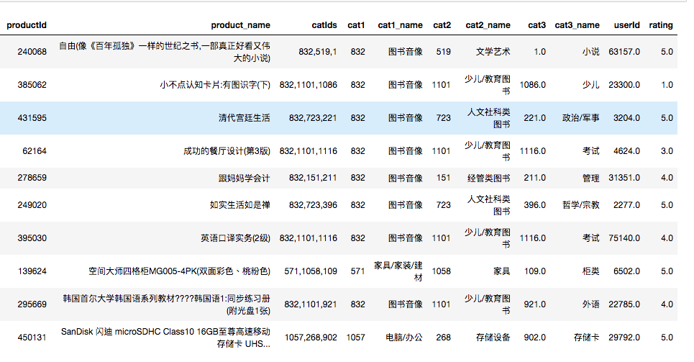
Data processing
Categories split
Split the word (jieba)
Join table (join csv)
Build user-items matrix
Export the processed dataset (speed up)

Slide 14
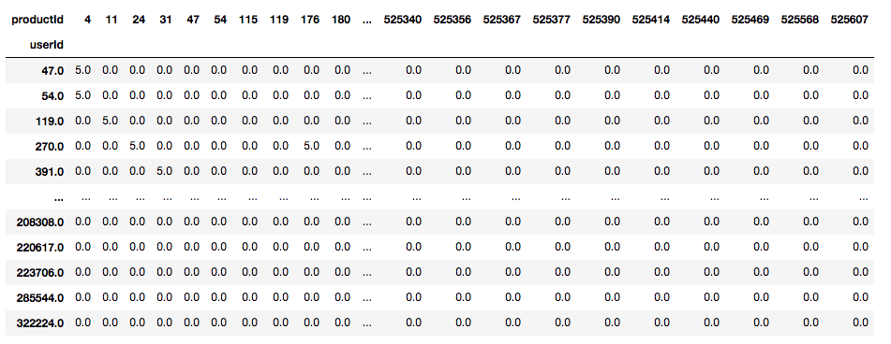
Data processing
Categories split
Split the word (jieba)
Join table (join csv)
Build user-items matrix
Export the processed dataset (speed up)

Slide 15
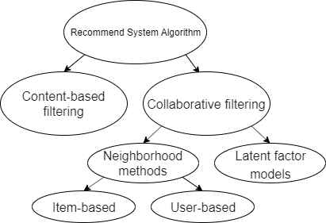
Data Analyze / recommend
Find top categories
Find top words (n-gram)
Item based recommendation
content-based filtering
Item/User based recommendation
Neighborhood methods
Notes:
And the virtualization part we have already show in the demo.
Last talk about the implementation.
I think latent factor model everyone are know well.
So we implement the content-based filtering and neighborhood methods.

Slide 16
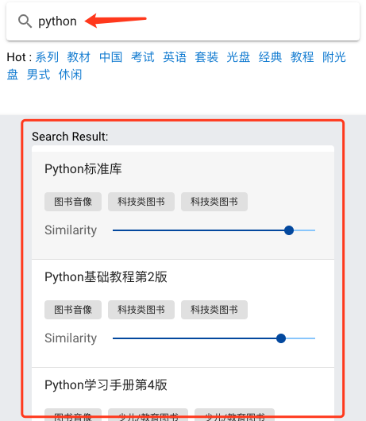


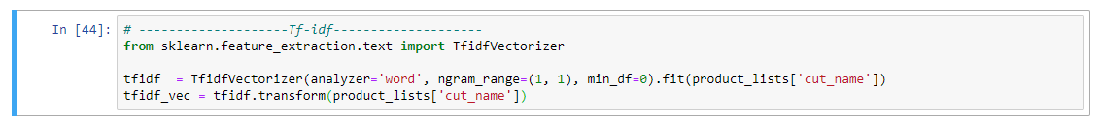

Content-based filtering - tfidf
TF-IDF
TF: Term frequency
the raw count of a term in a document
IDF: Inverse document frequency
the documents that contain the word
Notes:
TF means the term frequency in a document, the frequency more high means the term is more important But the term is less important if it appear in lots of document. So it need to inverse weight. That is IDF
TF-IDF means TF multiy IDF.
And there is our using library.

Slide 17
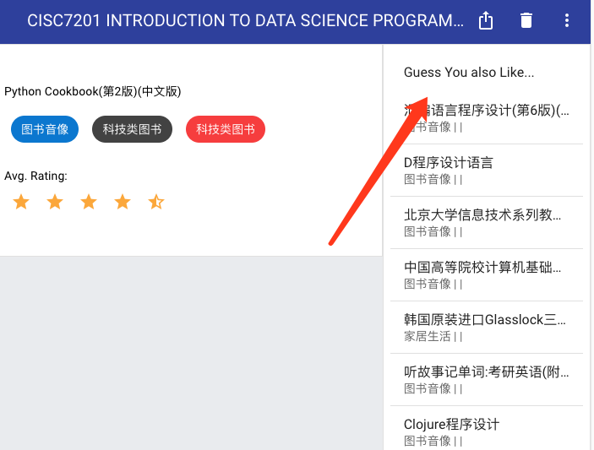
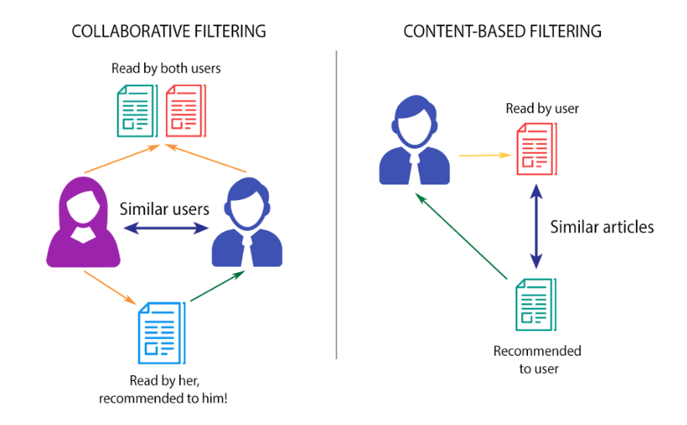
ITEM / User based recommendation Neighborhood methods
Notes:
And the recommendation, there are user-based and item-based. In user-based recommendation, first it find the similar user based on their rating comment.

Slide 18
Data Analyze / recommend
Find top categories
Find top words (n-gram)
Item based recommendation
content-based filtering
Item/User based recommendation
Neighborhood methods
(sklearn library)
Notes:
We are using the sklearn library to find the user similarity base on the matrix.

Slide 19
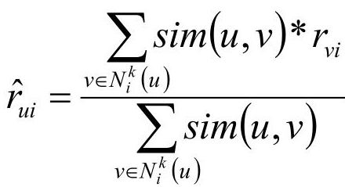
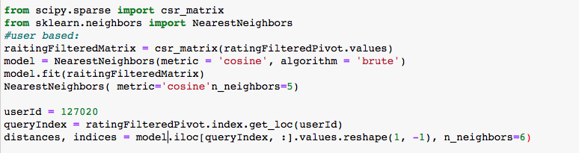
Data Analyze / recommend
Find top categories
Find top words (n-gram)
Item based recommendation
content-based filtering
Item/User based recommendation
Neighborhood methods
Simple Weighted average method
Notes:
Last, we calculate the weighted average of similar user’s rating product to recommend product list to the user.

Slide 20
Thank you
Questions?

