Slide 1

Introductions / Administrative Stuff
Paul Goldman – this is what I look like without a mask, you might decide the mask is preferable. Contact Information - Mobile: 585.737.8654 – call/text between 9AM and 7PM Eastern Time, Monday thru Friday: if I don’t answer the phone, leave a voicemail, with your name & number please, and I will get back to you shortly. After 7PM, leave a voicemail and I will get back to you the next day: let me know if there is a “best time” to call you. When texting please include your name in the text, if you don’t, I won’t know who you are. You can also send me an email, and I will get back to you as soon as possible. Office hours - I will be holding office hours using “Zoom.” The sessions will be “one on one” and will allow us to discuss any issues you may be having as well as share screens to review issues with code, etc. I will be available on Monday and Wednesday between 10AM and 5PM. Please call, text or send an email to make an appointment.
Client Programming ISTE.340
Lecture 1 - PLG

Slide 2
Introductions / Administrative Stuff
Textbooks
Standard: JavaScript The Definitive Guide, 7th Ed. Flanagan, O'Reilly & Associates, ISBN: 1491952024 This textbook is “encyclopedic,” it is an excellent reference book for JavaScript. The book was just updated this past Spring to include the latest versions of JavaScript. I highly recommend obtaining a copy. Unless you’re into weightlifting you should buy the eBook version from Amazon, Barnes & Noble, O’Reilly…etc.
Recommended: Secrets of the JavaScript Ninja 2nd Edition, John Resig, Bear Birbeault, Josip Maras, Manning Publications An excellent book. Highly recommended. Available from “Manning Publications” “Manning Publications” is one of the better publishers of software engineering books. Check out their website – all books are available in both hardcover and eBook formats, no DRM. They quite often have good sales.
Also Recommended: JavaScript Alongé, the “Six” Edition – Programming from Functions to Classes in ECMA Script 2015 – this is an interesting approach to JavaScript by a coffee loving technologist. It is available free or there is a pay what you want option. It is worth looking at and probably worth paying the author.
Additionally, I will be providing links to free textbooks, articles of interest and “YouTube” and other videos for the lectures.
Client Programming ISTE.340
Lecture 1 - PLG

Slide 3
Introductions / Administrative Stuff
Recommended Websites
MDN Web Docs – this website is a great reference for anyone doing web development work. It is always kept up to date with the latest standards and offers comprehensive examples for anything you might want to know. Click on the “MDN Web Docs” hyperlink that is showing and explore the website. On the menu along the top of the “home page,” click on “Technologies” to see a list of what is covered, e.g. “JavaScript.” Also, click on “References & Guides” see the available resources. This will become your “go to” website when you need to research something quickly.
LinkedInLearning – this is an excellent resource for online courses in all sort of things which RIT has made. It used to be known as “Lynda.com.” If you explore it, you will find an area entitled “Technology” and within it courses that will probably be helpful in most of your course work. In particular they have a collection of JavaScript courses.
W3schools – a great reference website. Well organized and very clearly written. If you click on the hyperlink, you will be taken to the home page. Look at the left-hand menu.
Stack Overflow – if you do searches on the web, e.g. Google, you will almost always be directed to Stack Overflow. It is generally an excellent source of information, I use it quite often myself, but use judgement in evaluating the info you find there. Some posted answers don’t have many positive votes, some even have negative, so just be aware that while many answers are genuinely authoritative mixed in there will always be a few that should be avoided.
I’ll post other websites as they occur to me.
Client Programming ISTE.340
Lecture 1 - PLG

Slide 4
Introductions / Administrative Stuff
Please read the course Syllabus, the link is on the course home page. Most of what is there is in this presentation, but it does have additional information, e.g. course drop dates. You are responsible for its contents.
There is a midterm, final and two programming projects
The midterm will be given both in class and online for those taking the course remotely the day of the exam.
If you are going to be late with either of the two programming projects, please let me know at least a week before the actual due date. Normally the grade for a late submission is reduced by one full grade for each day it is late. However, if you communicate issues you are running into, we can work on them together and I can give you extra time if it’s warranted. If you “stay in touch” with me, we can always work something out. If you don’t stay in touch when you have issues with the course material or due dates, I can’t help you.
Normally there is a third programming project in this course, however because of the “unusual” nature of this semester I am expanding the scope of the third project and it will take the place of the final exam.
Grading:
Projects 1, and 2: 20% of final grade each – total 40% of final grade
Midterm: 25% of final grade
Final (third project): 35% of final grade
Client Programming ISTE.340
Lecture 1 - PLG

Slide 5
Syllabus – Topics We Will Cover
JavaScript can be divided into two areas of study:¹
Core JavaScript: the base part of the JavaScript language that is supported on both the client and server side.
Client-side JavaScript: contains the Core JavaScript elements and has several additional objects, properties and methods that are supported by (web) browsers.
Our textbook “JavaScript: The Definitive Guide” treats “Core JavaScript” in part 1, of the book and “Client-side JavaScript” in part 2. We will combine the two areas, learning the constructs of the JavaScript language while we study the features of and learn to write client-side code.
Web based HTTP clients – creating a web client
JavaScript Libraries - they provide pre-written JavaScript code which makes common or complex tasks easy to do. JavaScript libraries often target specific tasks such as DOM, Document Object Model, manipulation, framework setup and AJAX handling.² We will study two of these libraries:
jQuery / jQuery AJAX: while not used as widely they were a few years ago these libraries are still in use in about 73% of the 10, million most popular websites. jQuery / jQuery AJAX is a traditional part of the course.
React.js: this is a relatively new JavaScript library which provides JavaScript code for highly efficient manipulation of the DOM. I am introducing this library into the course for the first time to keep the subject matter “up to date.” We will only spend a short amount of time on the library. You will not be tested on it and you will not be required to use it for any of the projects – of course if you want to try to use it, I encourage you to do so.
“Dottoto Web Reference,” http://help.dottoro.com/ljjfxqdr.php#:~:text=Core%20JavaScript%20is%20the%20base,that%20are%20supported%20by%20browsers
https://webplatform.github.io/docs/concepts/programming/javascript/libraries/
Client Programming ISTE.340
Lecture 1 - PLG

Slide 6
Syllabus – Topics We Will Cover (cont’d)
Microsoft .NET Core / ASP.NET Core:
.NET Core is an open-source, general-purpose development platform to develop applications for MS Windows, macOS and LINUX.
ASP.NET Core is an open-source version of ASP.NET, Microsoft’s “older” web-development framework for building web apps, which builds web apps that run on MS Windows, macOS and LINUX.
This topic was introduced with great success last semester to replace what was formerly the MS Windows client topic.
We will build multi-platform applications using these technologies
Client Programming ISTE.340
Lecture 1 - PLG

Slide 7
Some Initial Thoughts About JavaScript
“The strength of JavaScript is that you can do anything. The weakness is that you will”
Reginald Braithwaite
JavaScript Allongé
http://raganwald.com/
“People often feel that if they know C# or Java, they already have a pretty solid understanding of how JavaScript works. But it’s a trap! When compared to other mainstream languages, JavaScript is more functionally oriented. Some JavaScript concepts differ fundamentally from those of most other languages.
Secrets of the JavaScript Ninja – Second Edition
John Resig
Bear Bibeault
Josip Maras
Client Programming ISTE.340
Lecture 1 - PLG

Slide 8
A Little History: The many names of JavaScript — LiveScript, JScript, ECMAScript, ES6 and not still Java
1995 – Brendan Eich recruited by Netscape to make a language that could be run in the browser. He wrote it in 10, days. Originally had the code name Mocha but was launched as LiveScript, then renamed to JavaScript because everyone thought Java was the most awesome thing in the world and no one wanted to use a thing called LiveScript.
1996 — Microsoft decided to release their own version of JavaScript called JScript and was supported in Internet Explorer 3.0. JScript has since been supported by the company through Internet Explorer up until 2011 with Internet Explorer 9.
1997 — To prevent a scripts war, Netscape went to the European Computer Manufacturers Association, aka ECMA and asked them to standardize JavaScript. They agreed on one condition — the language has to use their name. At first Netscape wasn’t too keen on the name because it sounded too much like a skin disease. A compromise was made by adding Script to the end of the name, resulting in ECMAScript — shorted to ES to avoid pronouncing ECMA. The first edition came out in in June. JavaScript, as a result, becomes subset to ECMAScript and uses the standard as its governing and principle design.
Client Programming ISTE.340
Lecture 1 - PLG

Slide 9
A Little History: The many names of JavaScript — LiveScript, JScript, ECMAScript, ES6 and not still Java
1998 — Macromedia Inc (now part of Adobe Systems) created something similar called ActionScript. The last stable release was in 2006. No one talks about ActionScript anymore since the death of Flash and is considered a dialect of ECMAScript.
ES1 (June 1997), ES2 (June 1998), ES3 (Dec 1999), ES4 (Abandoned)— are the first 4 editions of ECMAScript. We don’t really need to know the details of these because programming seems to age in dog years and these versions can now be considered ancient.
ES 5 (December 2009) — ten years after politics resulted in the abandonment of ES4, ES5 was released.
ES6 / ES2015 (June 2015) — ES6 was the name popularized before release but came out under the name ES2015 to reflect the year it was released. This means that ES6 and ES2015 are the same thing. Officially it’s called ES2015 but most people know it as ES6.
Client Programming ISTE.340
Lecture 1 - PLG

Slide 10
A Little History: The many names of JavaScript — LiveScript, JScript, ECMAScript, ES6 and not still Java
ES2016 (ES7 / June 2016), ES2017 (ES8 / June 2017), ES2018 (ES9 / June 2018) — New versions of ECMAScript has now moved to yearly revisions and releases. Don’t worry, everything is backward compatible and new features such as asynchronous iteration and generators, regular expression features and rest/spread parameters have been added to make life easier.
Above “history” from an article by Aphinya Dechalert:
https://medium.com/@PurpleGreenLemon/the-many-names-of-javascript-livescript-jscript-ecmascript-es6-and-not-still-java-568b584a91b5
Also, for an interesting history of the “Browser Wars” of the mid-1990s, see:
https://thehistoryoftheweb.com/browser-wars/
Client Programming ISTE.340
Lecture 1 - PLG

Slide 11
Recommended Software
Learning How To Write JavaScript Code – before attempting to write browser-based client-side applications with JavaScript we first need to learn the basics of the JavaScript language, i.e. “Core JavaScript”
The best approach to this is the use of a “REPL” environment – “Read, Evaluate, Print, and Loop.” The environment reads the JavaScript that you type into it, evaluates the code, prints out the result of executing what you typed and then “loops” back to the first step
There are several “REPL” environments available for this. For our work I recommend the following two, please download and install them if you don’t already have them on your development machine:
Google “Chrome” browser – the browser offers “Developers Tools” which will open a comprehensive set of tools for debugging your web apps. The “Console” window in “Developers Tools” can be used as a JavaScript REPL.
Note – any of the modern web browsers available offer “Developers Tools.” I am using “Chrome” since it has become a de facto standard.
Node.js
For creating and running “HTML” web pages we will use Microsoft “Visual Studio Code”
Visual Studio Code is also useful for writing and debugging “Core JavaScript” programs using the “Node.js” runtime, we will demonstrate that as part of this lecture.
Client Programming ISTE.340
Lecture 1 - PLG

Slide 12
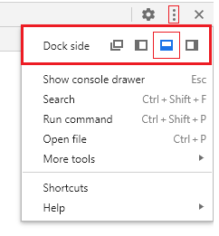
Using the “REPL” in Chrome
Open “Chrome” and type “Ctrl + Shift + I”
Note – if the “debugging” console is not at the bottom of the screen, click on the three vertical dots in the upper right-hand corner of the console window and on the top line entitled “Dock side” select the window icon with the heavy black line along the bottom; it shows as blue in the screen shot because I had it already selected.
Client Programming ISTE.340
Lecture 1 - PLG

Slide 13
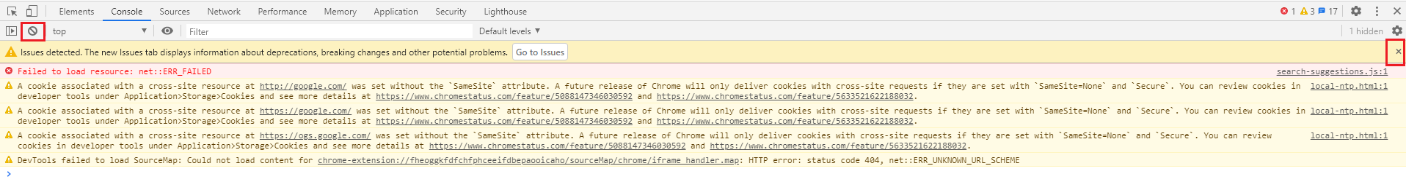
Using the “REPL” in Chrome (cont’d)
If you see a collection of error messages when the “Developers Tools” console opens, you can clear the console by clicking on the icon on the console tool bar or if you see a line in the console which has a at the end, click on it, see screen shots below
BEFORE: Click on the and the to clear all the error messages
AFTER: all error messages cleared
Client Programming ISTE.340
Lecture 1 - PLG

Slide 14
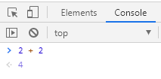
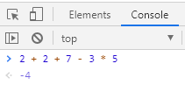
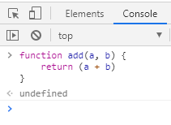
Using the “REPL” in Chrome (cont’d)
Now that we have the Console cleared, let’s try typing in some JavaScript
First, something simple: Notice that as soon as I type ‘2+ 2’ the expected result ‘4’ appears. Now continue adding to the calculation: notice that each time you add a new term to the calculation the new result is displayed. If the result ‘-4’ surprises you, take a moment to think about what happens when we add the multiplication ‘*5’ Before going any further, hit the enter key so we once more have the ‘ > ‘ prompt.
Now let’s try creating a JavaScript function and executing it:
I have created a function named ‘add’ which adds the two arguments passed to it and returns the result After creating the function I hit “Enter” and ‘undefined’ is displayed. This is because the function definition itself does not return a value, the way, for example, the simple calculation we performed above does. (continued on next slide)
Client Programming ISTE.340
Lecture 1 - PLG

Slide 15
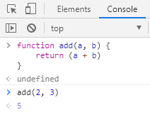
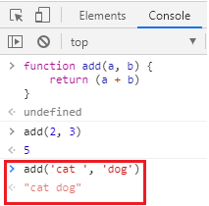
Using the “REPL” in Chrome (cont’d)
Now let’s try creating a JavaScript function and executing it (continued):
Now let’s call the ‘add’ function passing it the arguments ‘2’ and ‘3’ : As before, as soon as I finish typing ‘add(2, 3)’ the result of calling the ‘add’ function is displayed. Hit ‘Enter’ to return to the ‘ > ‘ prompt.
Let’s call the ‘add’ function again but this time pass different arguments: This time instead of two integers I passed two strings: ‘cat ‘ and ‘dog’; I placed a space after the ‘t’ in ‘cat’ Our add function didn’t care that it received strings instead of integers: for integers, the ‘+’ represented addition, for strings, the ‘+’ represented concatenation. This is one of the interesting properties of JavaScript, it will try to match up values and operators as best it can – this is called “coercion.” We’ll study it more in the next lecture. We’ll call the ‘add’ function once more. (next slide)
Client Programming ISTE.340
Lecture 1 - PLG

Slide 16
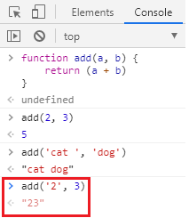
Using the “REPL” in Chrome (cont’d)
Now let’s try creating a JavaScript function and executing it (continued):
Now I’m calling the ‘add’ function passing it the character ‘2’ and the integer 3. Notice that the ‘add’ function returns the string ’23’ The first thing that the ‘add’ function sees is the character ‘2’ followed by a ‘+’ sign. So it figures I’m going to do a concatenation of two characters. However, the second argument is an integer so in order to complete the concatenation operation JavaScript converts the integer 3 to the character ‘3’ and returns the string ’23’ This is an example of ‘coercion’ JavaScript coerces the integer 3 into becoming the character ‘3’ so it can complete the requested operation. JavaScript is a “weakly typed” or “untyped language.” It will figure out what type of data you have and make the necessary adjustments. This can be a good thing or a bad thing.
Client Programming ISTE.340
Lecture 1 - PLG

Slide 17
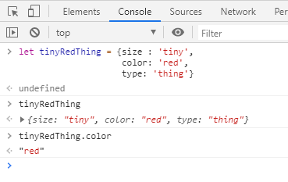
Using the “REPL” in Chrome (cont’d)
One more exercise. We’ll define a JavaScript ‘Object’ We’ll get into this topic in much greater detail later but for now we’ll just look at one.
I have defined a JavaScript Object named ‘tinyRedThing’ in the console.
After creating the definition I hit enter and its properties are displayed.
I can also select a particular property and have it displayed, ‘color.’
Continued on next slide.
Client Programming ISTE.340
Lecture 1 - PLG

Slide 18
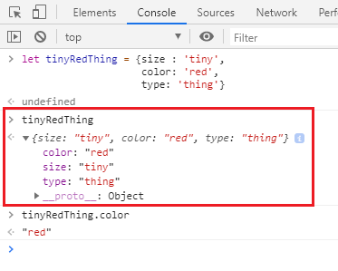
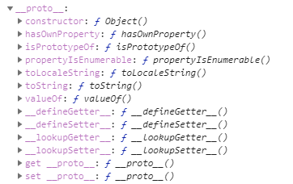
Using the “REPL” in Chrome (cont’d)
Notice what happens when the mouse is clicked on the ‘arrowhead’ to the left of ‘tinyRedThing’ properties The properties are listed on individual lines followed by the line If you click on the above arrowhead you will see the following: The is the listing of the prototypes of the ‘tinyRedThing’ object. We’ll explore the topic of JavaScript object ‘prototypes.’ The takeaway here is that JavaScript objects are not like the objects you are used to from languages like Java or C#. When it comes to inheritance, JavaScript only has one construct: objects. Each object has a private property which holds a link to another object called its prototype. That prototype object has a prototype of its own, and son on until an object is reached with null as its prototype. By definition, null has no prototype, and acts as the final link in this prototype chain. Inheritance and the prototype chain, MDN web docs
Client Programming ISTE.340
Lecture 1 - PLG

Slide 19
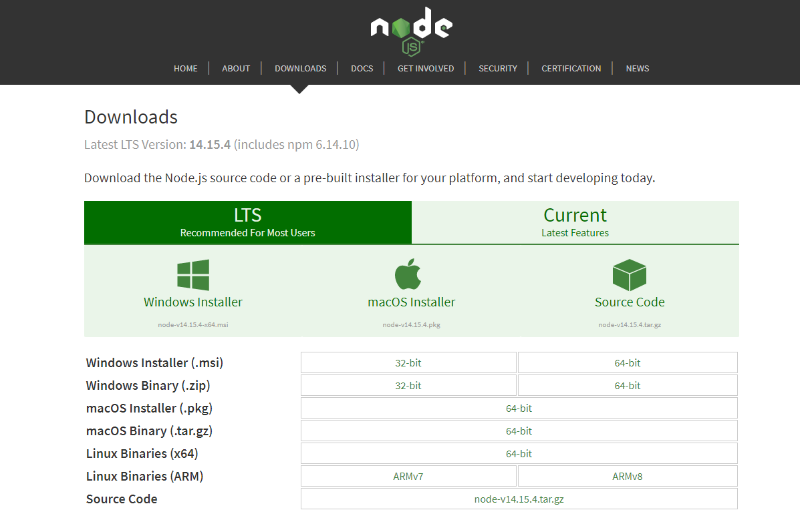
Node.js
Simply stated, Node.js is a JavaScript runtime built on Chrome’s V8 JavaScript engine – we’ll explore this in more detail later in the course. Node.js can be downloaded from: https://nodejs.org/en/download/ Download and install the version appropriate to your development machine.
Client Programming ISTE.340
Lecture 1 - PLG

Slide 20
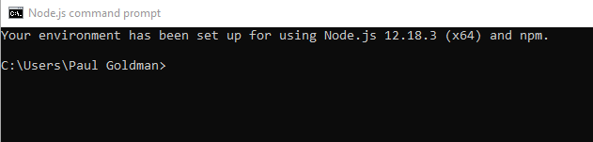
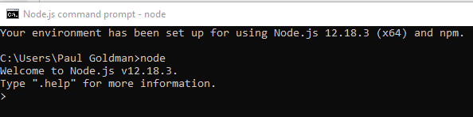
Node.js
After you finish installing Node.js open the “Node.js command prompt.” You should see something like the following (I’m running MS Windows 10):
If you type “node” following the command prompt, you will find yourself in the JavaScript “REPL” environment where you can do the same sorts of things you did with the “Chrome” “Developers Tools“ console.
As an exercise I would like you to reproduce in the Node.js REPL all the exercises I showed you in the Chrome REPL
Client Programming ISTE.340
Lecture 1 - PLG

Slide 21
MS Visual Studio Code
MS Visual Studio code is a an excellent “Interactive Development Environment,” “IDE,” from Microsoft. Microsoft states: “Visual Studio Code is a lightweight but powerful source code editor which runs on your desktop and is available for Windows, macOS and Linux. It comes with built-in support for JavaScript, TypeScript and Node.js and has a rich ecosystem of extensions for other languages (such as C++, C#, Java, Python, PHP, Go) and runtimes (such as .NET and Unity).” We will use it extensively for creating our “HTML” web pages
Client Programming ISTE.340
Lecture 1 - PLG

Slide 22
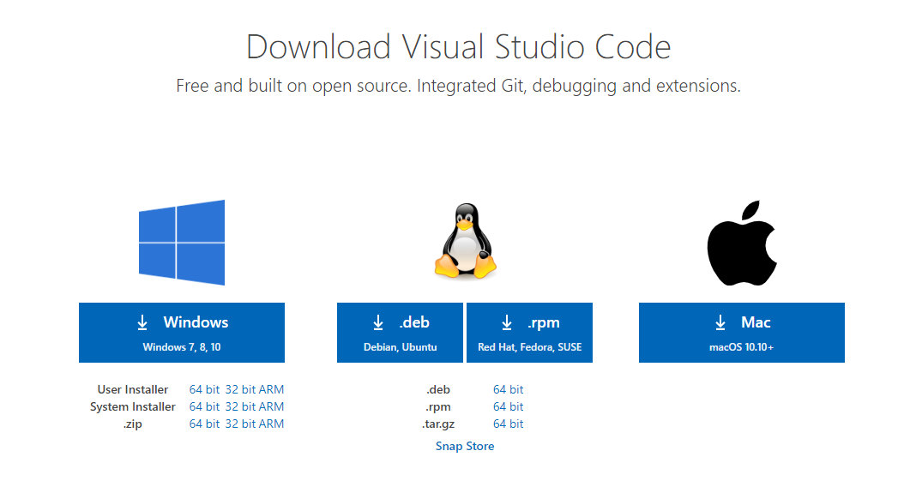
MS Visual Studio Code
Download and install Visual Studio Code, it’s free, from: https://code.visualstudio.com/Download Install the version appropriate to your development machine.
Client Programming ISTE.340
Lecture 1 - PLG

Slide 23
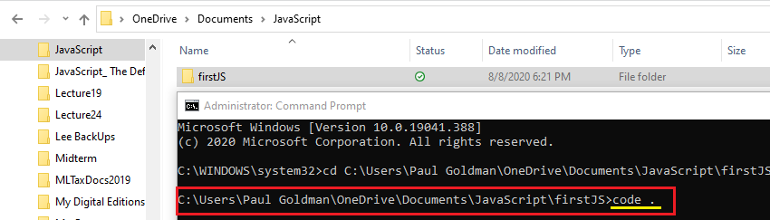
Using Visual Studio Code For JavaScript
I am going to show you how to use ‘Visual Studio Code’ to write and debug ‘Core JavaScript’ programs. The following work was performed in MS Windows 10.
For the work that follows it is suggested that you create a folder named ‘JavaScript’ in your ‘Documents’ directory, or another directory of your choice, on your development machine.
Open a command prompt and change the working directory to the ‘JavaScript’ folder you created.
Enter the command: ‘mkdir firstJS’ this will create a directory for our first JavaScript application in the ‘JavaScript’ folder.
Change the working directory to ‘firstJS’ and at the prompt type ‘code .’ and hit “Enter”
Continued on next slide
Client Programming ISTE.340
Lecture 1 - PLG

Slide 24
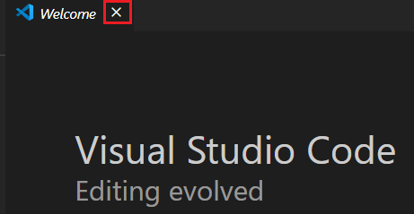
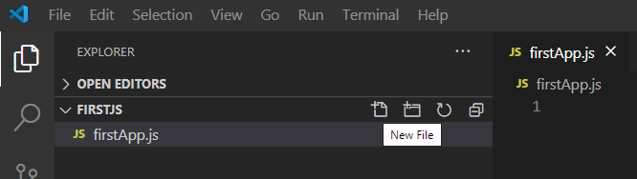
Using Visual Studio Code For JavaScript
This will open Visual Studio Code. If when it opens, you have the “Welcome’ panel showing, click the ‘x’ to close it:
On the left you will see the ‘EXPLORER’ window and under it you will see the ‘FIRSTJS’ folder we created; VS Code displays everything in upper case. If you move your mouse over ‘FIRSTJS,’ you will see it displayed as ‘firstJS.’ You will also see some folder type icons displayed to the right of ‘FIRSTJS.’ Move your mouse over each of the icons and click on the one that displays ‘New File.’
When you click on it, you will be prompted to enter a file name. Type ‘firstApp.js’ and ‘Enter’ This tells VS Code to create a JavaScript file ‘firstApp.js’ which will be our JavaScript program. You will see ‘JS’ in front of the file name and at the bottom right hand side of the screen you will see ‘JavaScript’ displayed. (go to next slide)
Client Programming ISTE.340
Lecture 1 - PLG

Slide 25
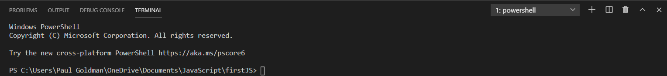
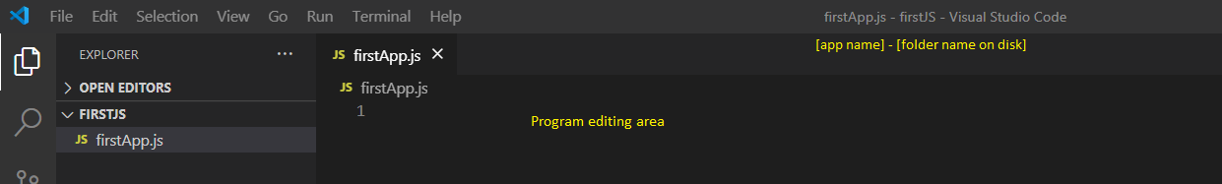
Using Visual Studio Code For JavaScript
Now find the ‘Terminal’ dropdown menu at the top of the screen, click on it and select ‘New Terminal,’ topmost menu item.
At the bottom of the screen, you will find a new ‘powershell’ window.
In the upper part of the screen, we are now ready to type some code:
Continued on next slide
Client Programming ISTE.340
Lecture 1 - PLG

Slide 26
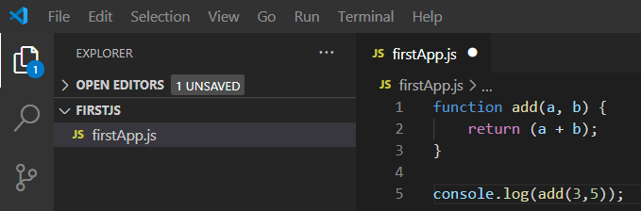
Using Visual Studio Code For JavaScript (cont’d)
Let’s enter the code for our “add” function and then call it. Some things to notice here: - the ‘return’ statement in the function definition and the call to “add” are both terminated by a ‘;’ This is proper JavaScript syntax when writing programs. - we now have line numbers for each statement, these will come in handy, especially for debugging. - in the upper left-hand corner over the “folders” icon there is a blue circle with the number 1, in it. This indicates that some changes were made to the ‘firstApp.js’ file. Before proceeding click on the ‘File’ menu at the top and then click on ‘Save’ towards the middle of the dropdown menu. Until the program is saved, we will not be able to execute the version of it displayed in the ‘firstApp.js’ editing window. - the ‘console.log(…’ statement on line 5, is a very handy JavaScript function for displaying results to the ‘console’ while debugging.
Click your mouse next to the ‘…firstJS>’ prompt in the ‘PowerShell window at the bottom of the screen and type: ‘node firstApp.js’ This tells ‘node.js’ run time to execute the ‘firstApp.js’ program. You will see the result of calling the add function as displayed by ‘console.log(…’ (see next slide)
Client Programming ISTE.340
Lecture 1 - PLG

Slide 27
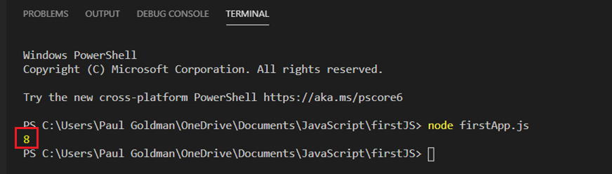
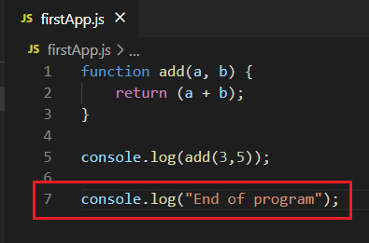
Using Visual Studio Code For JavaScript (cont’d)
Results of ‘node firstApp.js’
Let’s add another .console.log(…’ statement at the end of the program. (see next slide)
Client Programming ISTE.340
Lecture 1 - PLG

Slide 28
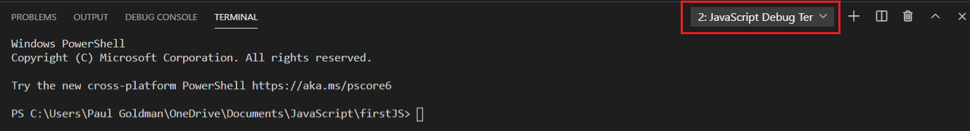

Using Visual Studio Code For JavaScript (cont’d)
Now go back down to the “TERMINAL” window at the bottom of the screen and on the right-hand side click on the dropdown menu that displays “1:powershell.” From the dropdown menu select ‘Create JavaScript Debug Terminal’ The ‘TERMINAL’ window should now appear as follows:
Go back up to the listing of ‘firstApp.js’ and move your mouse over the number 7, of line 7. A red dot will appear to the left of the 7. Move your mouse to the left and click directly on the red dot. You have just set a ‘break point” in the program. If a light bulb appears above line 7, ignore it.
Now go back to the ‘…\firstJS> prompt in the ‘TERMINAL’ window and again type: ‘node firstApp.js’ and hit enter. (next slide)
Client Programming ISTE.340
Lecture 1 - PLG

Slide 29
Using Visual Studio Code For JavaScript (cont’d)
We have stopped execution of the program at the breakpoint which allows us to look at all sorts of things that have happened up to that point in the execution.
Before the breakpoint was hit the call to the ‘add’ function completed so you will see the output value of 8. on the last line of the ‘TERMINAL’ window.
Line 7, at which the breakpoint was set is highlighted to show execution is paused there. Line 7, has not yet executed.
In the left-hand panel of the screen is a collection of information about the state of the program, values of variables, etc. at the current point in execution.
Under ‘VARIABLES,’ the topmost section in the left-hand panel, you can find the current value of all variables associated with the program. I have clicked on the ‘arrowhead’ to the left of the ‘add’ function in this section to show what it contains. What I want to show here is that functions like JavaScript object also have ‘prototypes.’ As we shall learn, everything in JavaScript is an Object. Again we’ll study this as we move through the course. See the next slide for the screen shot of what is happening when the break point is hit.
Client Programming ISTE.340
Lecture 1 - PLG

Slide 30
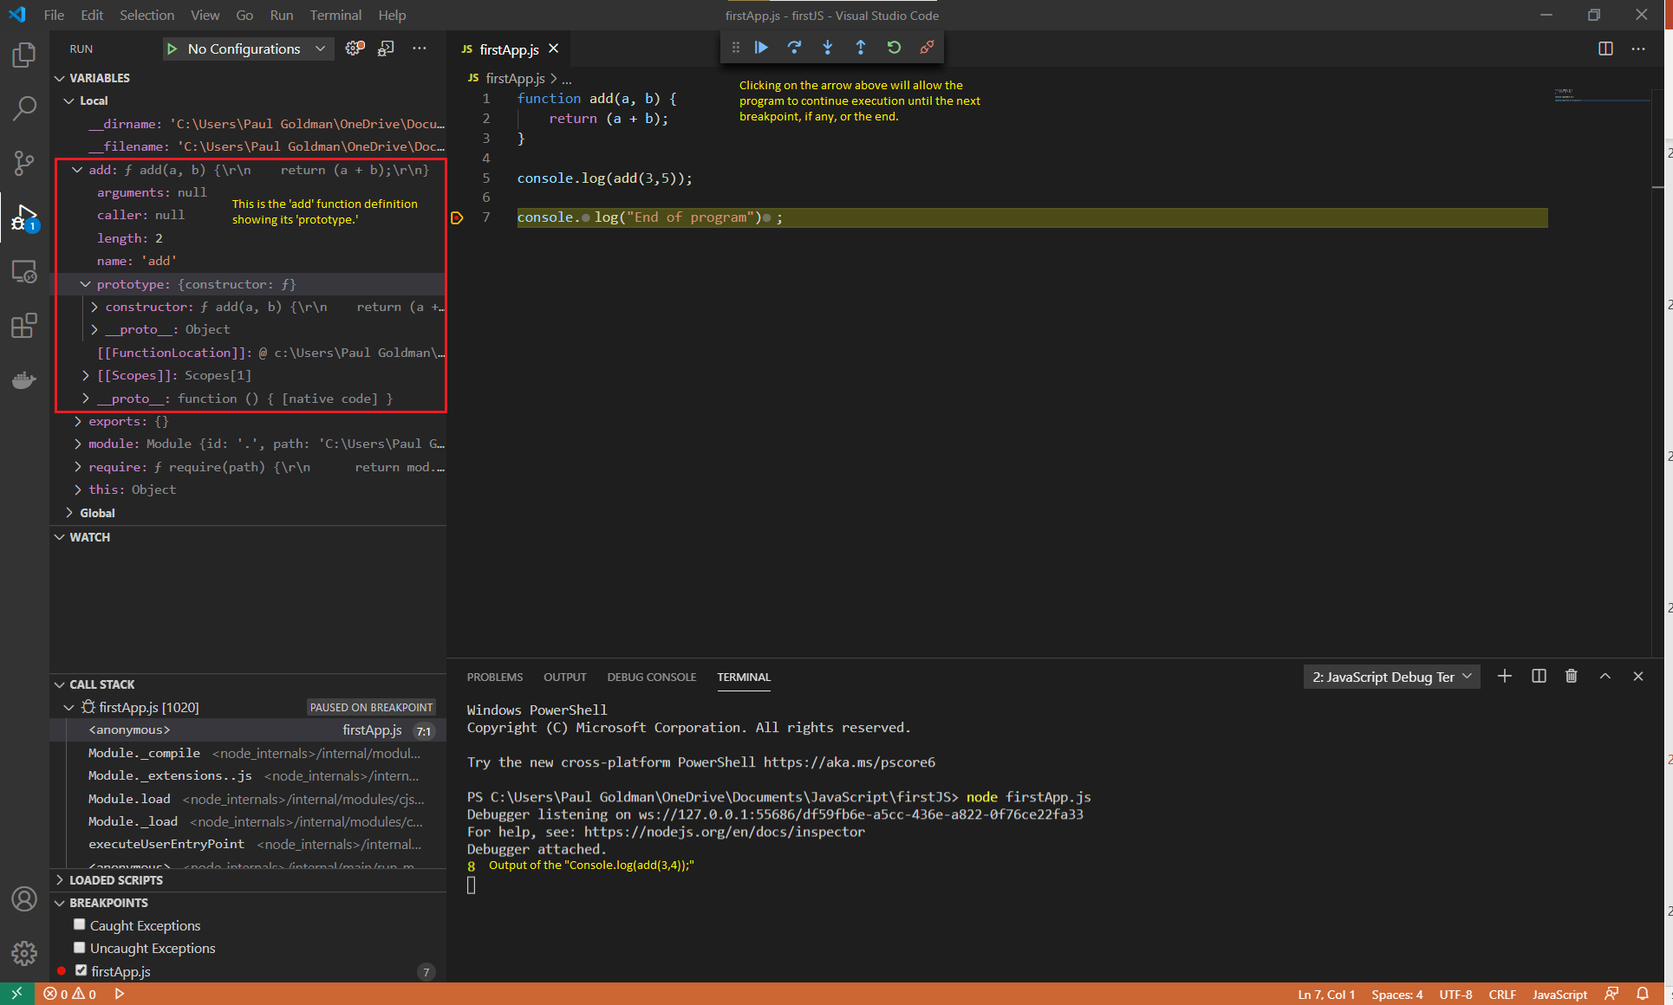
Client Programming ISTE.340
Lecture 1 - PLG

