Slide 1
UI/UX DESIGN DOCUMENT
Zeno CRM
Customer Relationship Management Platform
SRS · User Stories · Live UI Walkthrough · Future Roadmap
Sumit B. · Sagar B. · Prit T. · Devendrasinh G.
February 21, 2026

Slide 2
WHAT IS ZENO CRM?
Zeno CRM is a cloud-based Customer Relationship Management platform that unifies customer data, streamlines sales workflows, and gives teams real-time visibility across the full sales cycle.
6
CRUD
Core Modules
Operations
Modules Covered:
Home Dashboard
Accounts
Teams
Cloud
Contacts
Leads
Role-based Access
Native Platform
Opportunities
Meetings
Tasks
User Management

Slide 3
SOFTWARE REQUIREMENTS SPECIFICATION
Functional Requirements
Non-Functional Requirements
FR-01 User login, authentication & role-based access
FR-02 Account management — create, view, edit, delete
FR-03 Contact management with full profile & history
FR-04 Lead tracking with status labels & assignment
FR-05 Opportunity pipeline — Kanban & list views
FR-06 Meetings scheduler with attendees & timeline
FR-07 Task management with priority & due dates
FR-08 User & team administration panel
Performance
Page load < 2s, API < 500ms
Scalability
10,000+ concurrent users
Security
AES-256, role-based permissions
Availability
99.9% uptime with failover
Usability
WCAG 2.1 AA accessibility
Compatibility
Chrome, Firefox, Safari + Mobile

Slide 4
USER STORIES & PERSONAS
Sales Rep
Sales Manager
Admin / Ops
SR
SM
AD
🎯 Log calls & close deals faster
🎯 Forecast revenue & coach the team
🎯 Configure accounts & control access
⚠️ Too much manual data entry
⚠️ No pipeline visibility across reps
⚠️ Complex role setup slows onboarding
User Stories:
User Stories:
User Stories:
As a Sales Rep, I want to view all my open opportunities on a Kanban board so I can prioritise my day.
As a Sales Rep, I want to create a contact in one form so I can capture leads quickly.
As a Sales Rep, I want task reminders so I never miss a follow-up.
As a Manager, I want to see all leads & their status so I can reallocate assignments.
As a Manager, I want meeting logs so I can review rep activity.
As a Manager, I want to create and manage user accounts for my team.
As an Admin, I want to create users and assign roles so access is secure.
As an Admin, I want to set team membership so data is properly scoped.
As an Admin, I want to view user profiles and last-access info for auditing.

Slide 5
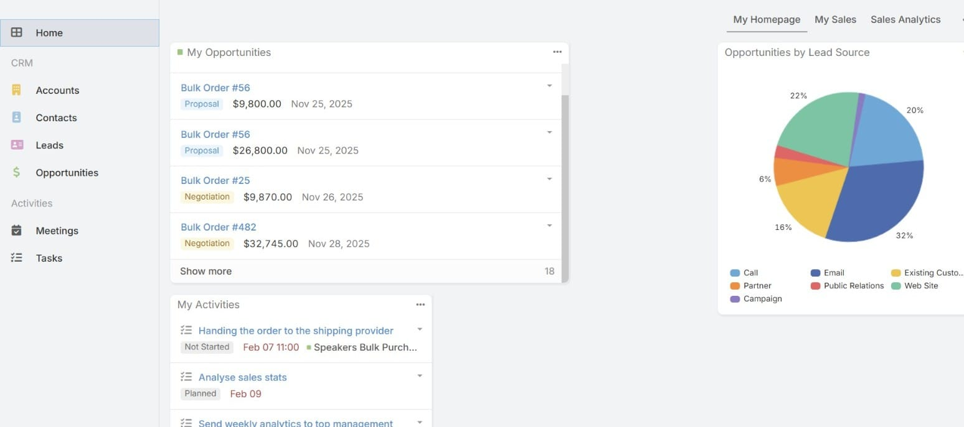
UI WALKTHROUGH · HOME DASHBOARD
Home Page — My Homepage
Key UI Elements:
My Opportunities
Live deal list with stage & value
Opportunities by Source
Pie chart: Call, Email, Web, etc.
My Activities
Upcoming tasks & meeting reminders
Navigation Sidebar
Home, Accounts, Contacts, Leads, Opportunities, Meetings, Tasks

Slide 6
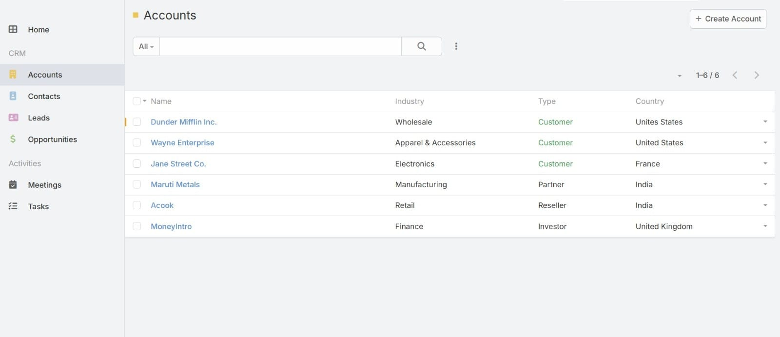
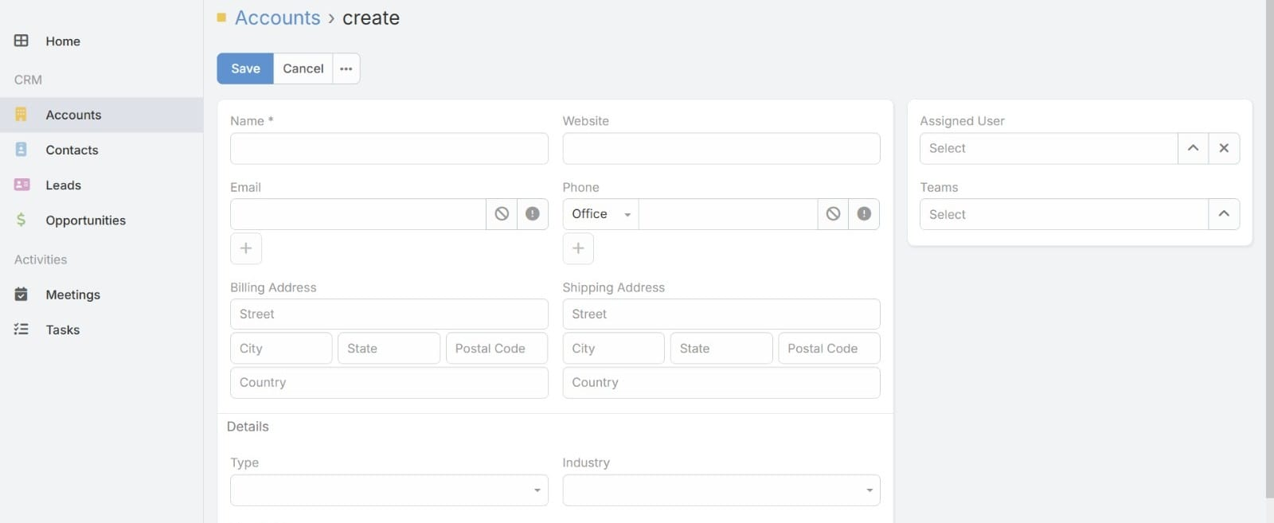
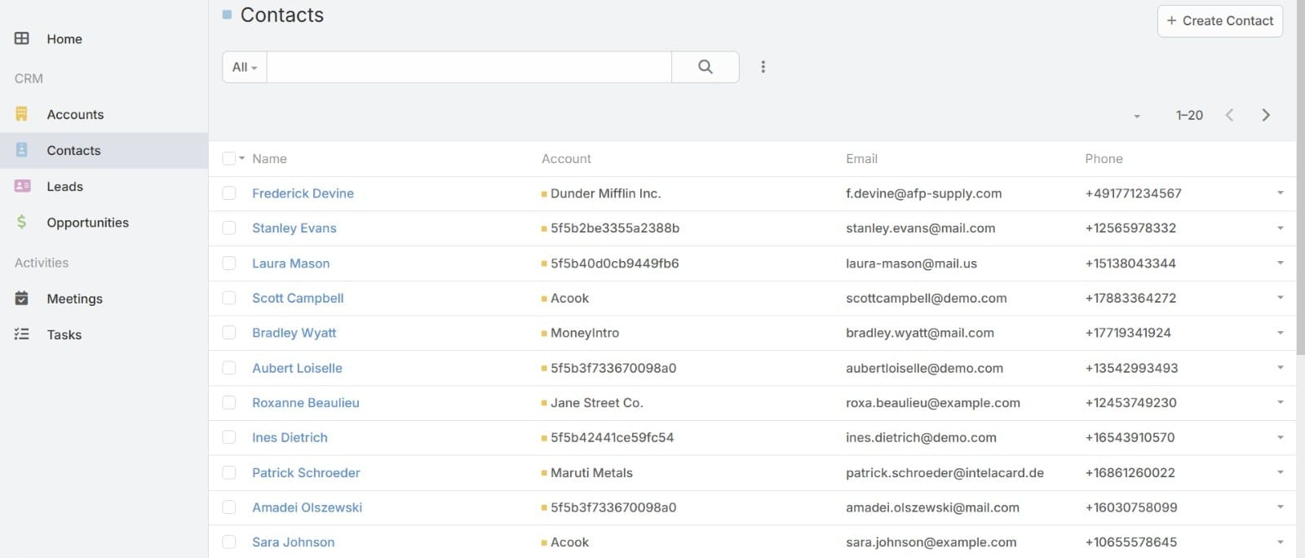
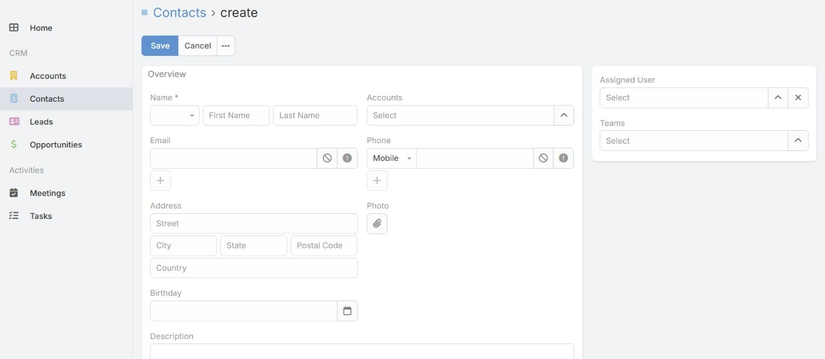
UI WALKTHROUGH · ACCOUNTS & CONTACTS
Accounts — List View
Accounts — Create Form
View all accounts filtered by industry, type & country
Enter name, email, phone, billing/shipping addresses
Contacts — List View
Contacts — Create Form
All contacts with linked accounts, email & phone
Full contact form: name, accounts, address, birthday

Slide 7
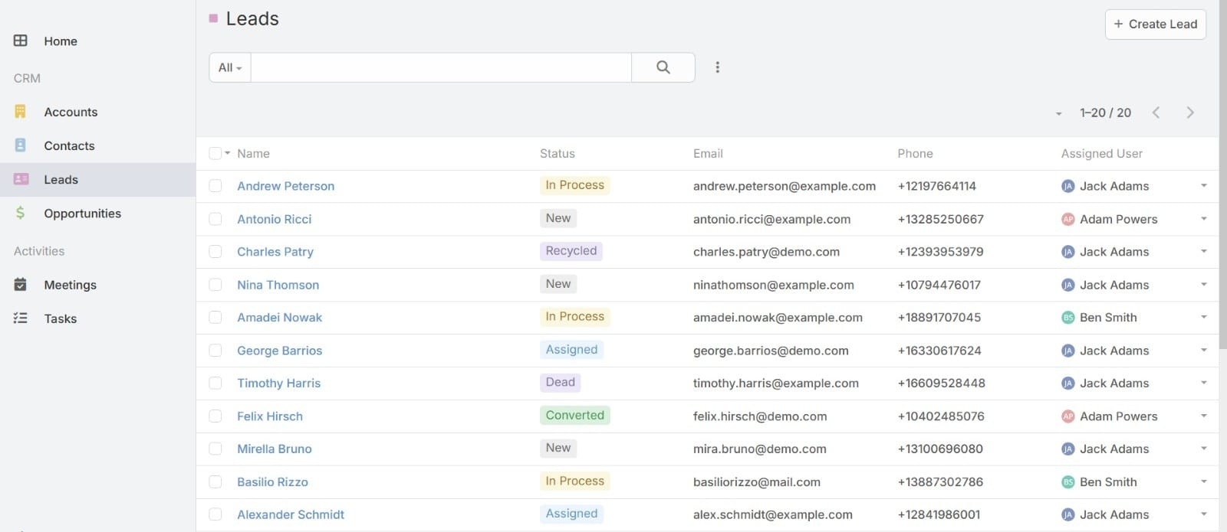
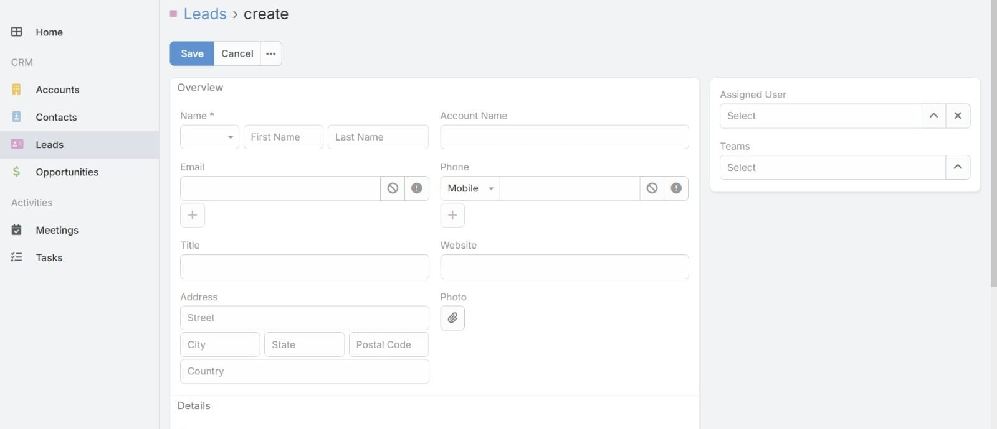
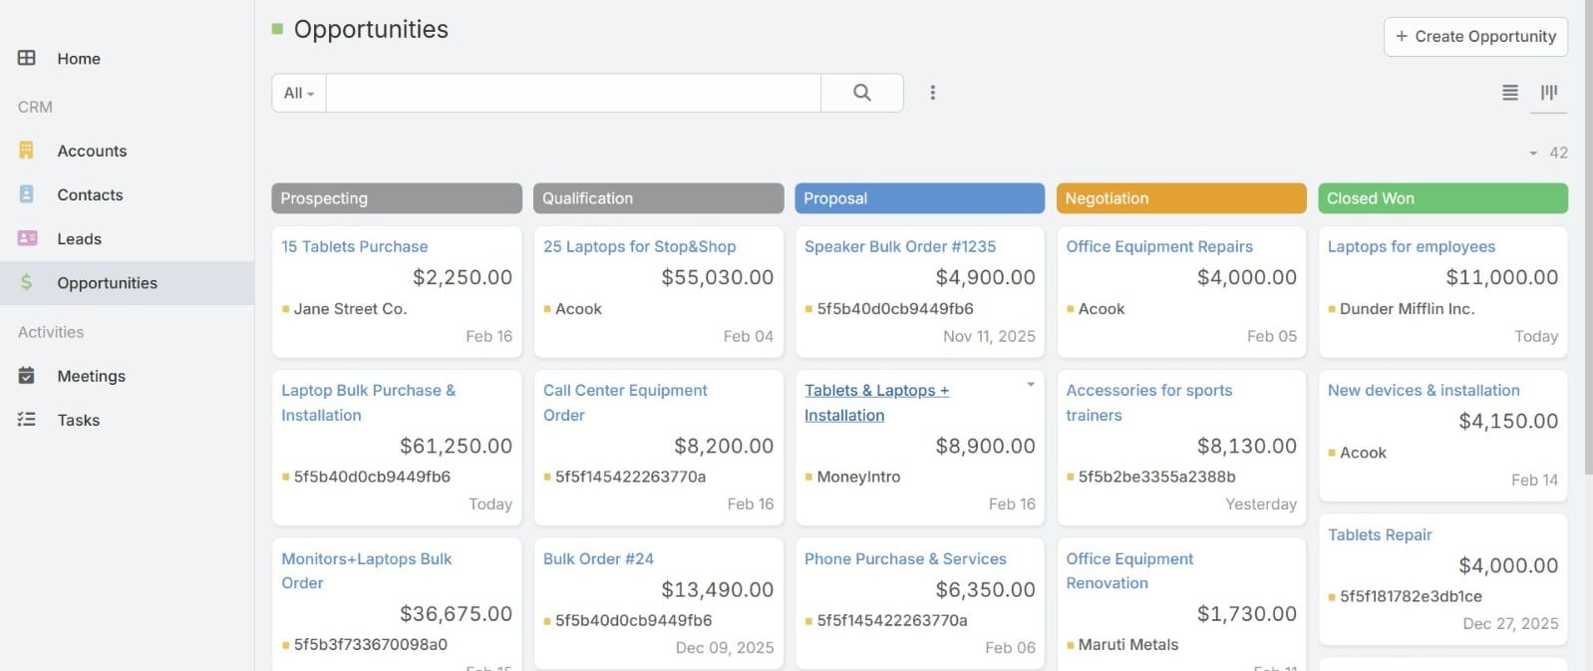
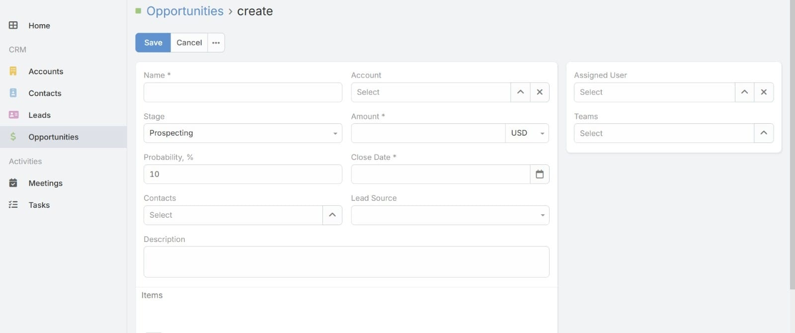
UI WALKTHROUGH · LEADS & OPPORTUNITIES
Leads — List View (Status: New · In Process · Assigned · Recycled · Converted · Dead)
Leads — Create Form
Opportunities — Kanban Board
Opportunities — Create Form
Name, email, account, title, address
Prospecting → Qualification → Proposal → Negotiation → Closed Won
Stage, amount, probability, close date, lead source

Slide 8
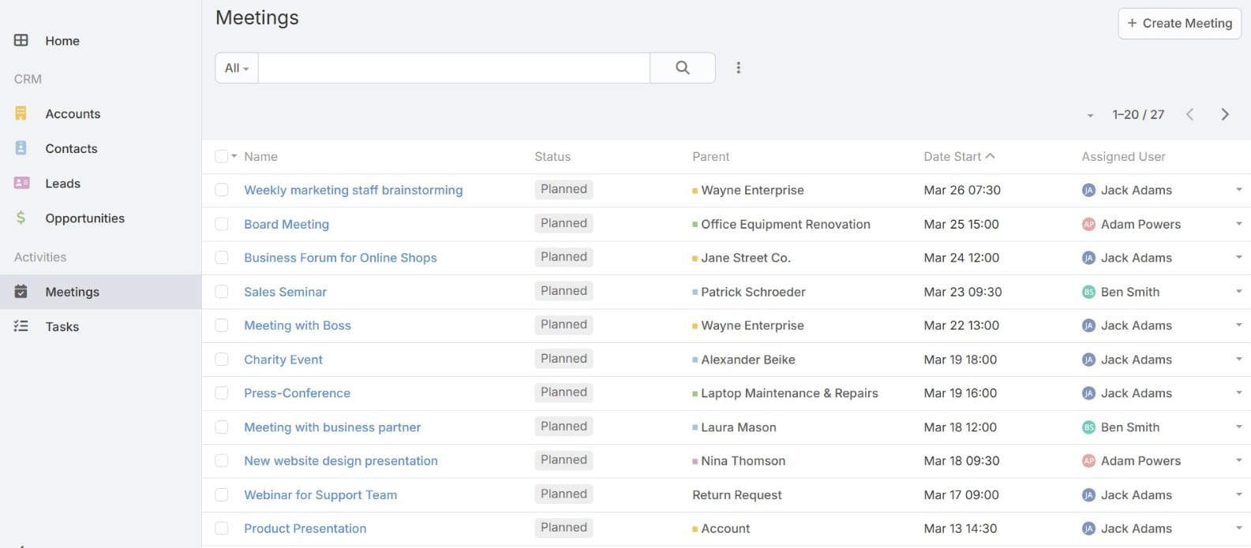
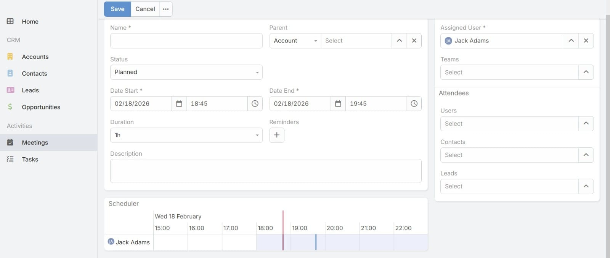
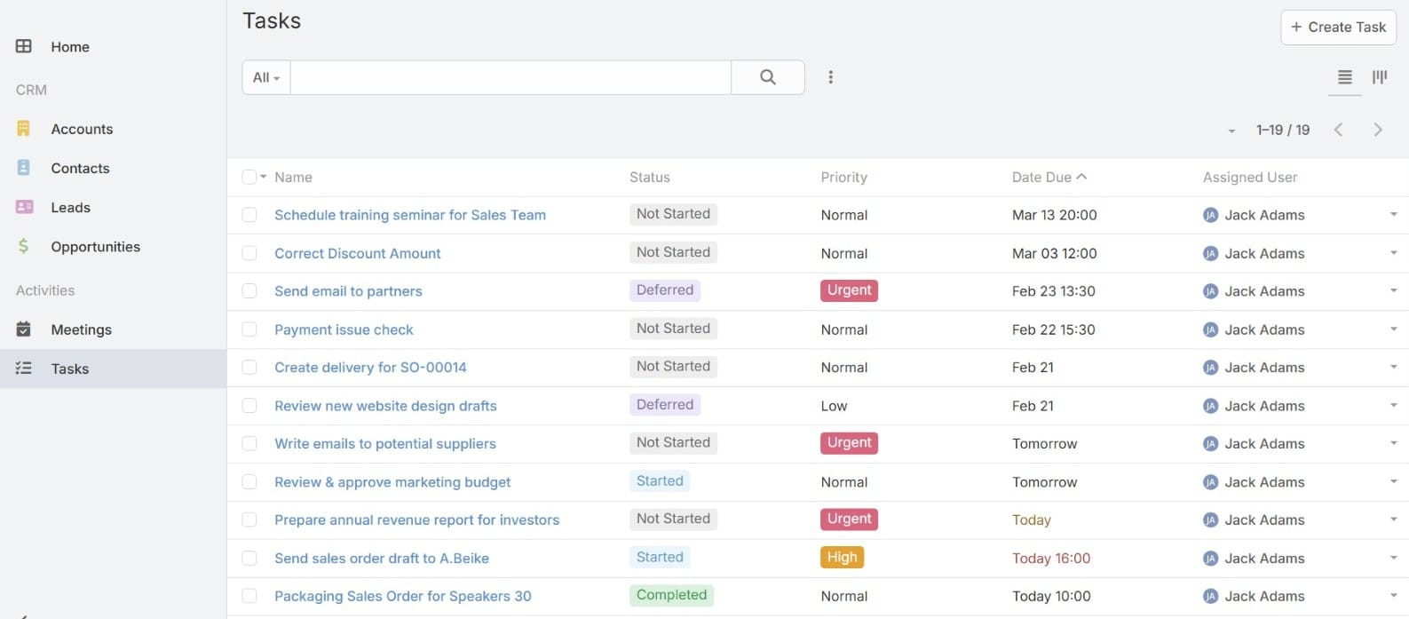
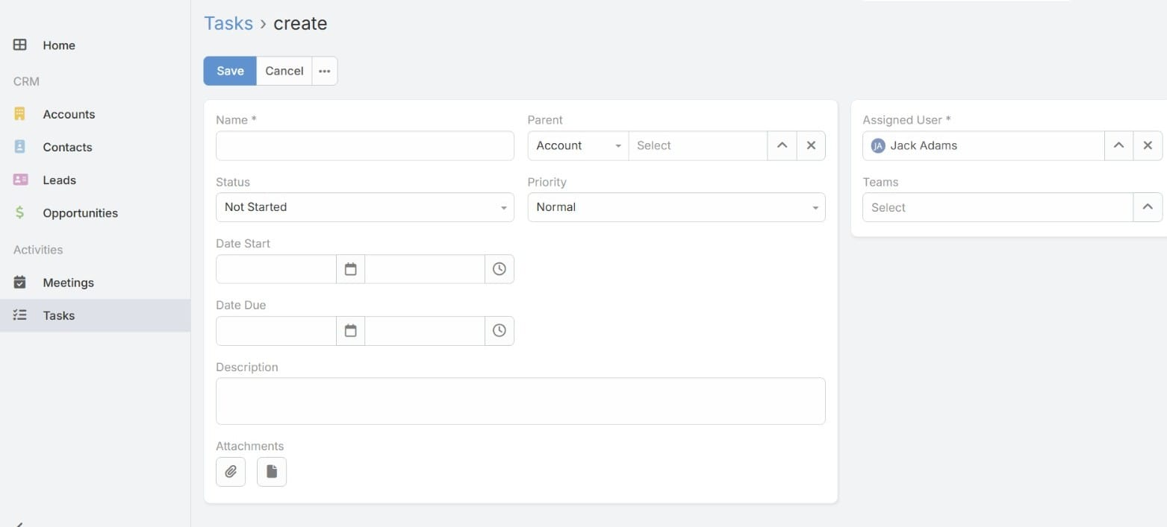
UI WALKTHROUGH · MEETINGS & TASKS
Meetings — List View
Meetings — Create Form
All meetings with status, parent record, date & assigned user
Name, parent, date/time, duration, reminders, attendees, scheduler timeline
Tasks — List View
Tasks — Create Form
Tasks with status (Not Started / Started / Deferred / Completed), priority & due date
Name, status, priority, start/due dates, attachments

Slide 9
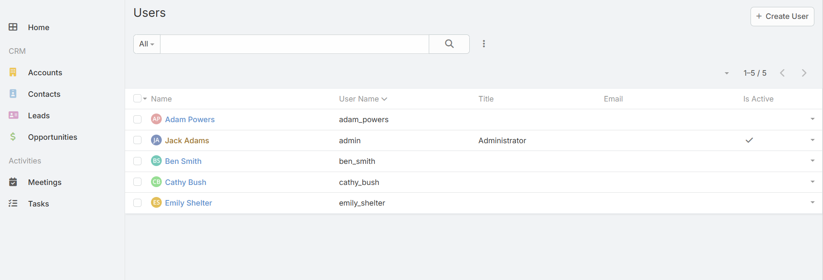
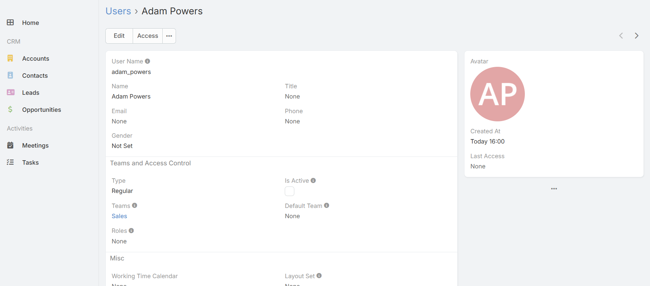
UI WALKTHROUGH · USER MANAGEMENT
Users — List View
User Detail — Adam Powers
Admin Features:
Role-based Access
Team Assignment
Active Status
Audit Trail
Regular / Admin types
Sales, Support, etc.
Enable / disable users
Last access timestamp

Slide 10
FUTURE IMPLICATIONS & ROADMAP
Q3 2025
Q4 2025
Q1 2026
Q2 2026
AI Sales Assistant
Deep Integrations
Mobile-First App
Enterprise & Scale
Deal scoring (ML model)
Suggested next best action
Auto-draft email replies
Meeting summary AI
Slack & Teams native bot
HubSpot migration tool
WhatsApp Business API
Bi-directional ERP sync
Offline mode for mobile
Voice-to-note on field
Push notification engine
Apple Watch quick log
Multi-org territory mgmt
Advanced audit & compliance
Custom AI model training
White-label option
$145B CRM Market by 2029
29% Revenue lift with AI CRM
91% Enterprises use CRM

Slide 11
PROJECT TIMELINE & ROADMAP
9-Week MVP Development Sprint · Zeno CRM
PHASE
W1
W2
W3
W4
W5
W6
W7
W8
W9
Req. Analysis & Planning
Design
Backend Development
Frontend Development
Testing
DevOps & Deployment
MVP Launch
Active Phase
Launch Milestone

Slide 12
Thank You
Zeno CRM — Built for Modern Sales Teams
SRS
User Stories
UI Screens
Roadmap
8 Functional + 6 Non-Functional Requirements
3 Personas · 9 Stories · Acceptance Criteria
15 live screens across 6 modules
AI, Mobile, Integrations & Enterprise Scale
Sumit B. · Sagar B. · Prit T. · Devendrasinh G. | Feb 2026

