Slide 1

ALPACA AI TRADING AGENTS HACKATHON
alpha
ca
Autonomous options trading with deterministic risk control
Gemini reads the market and selects an approved structure. Code controls every leg, size, limit, and exit.
PAPER TRADING
Nine ETFs across three independently managed paper accounts
SEP 2026
Notes:
Project sources: README.md, engine/config.py, and dashboard/public/snapshot*.json. This project uses Alpaca paper accounts only.

Slide 2
PROBLEM
Models can read markets. Limits need code.
A useful trading agent must reason under uncertainty without gaining authority over the account's safety boundaries.
AI IS GOOD AT
CODE MUST OWN
Reading regime and volatility
Position sizing and maximum loss
Interpreting news and catalysts
Liquidity and event constraints
Comparing strategy tradeoffs
Orders, exits, and kill switches
Alphaca separates judgment from authority.
02
Notes:
Design rationale and system thesis are documented in README.md and docs/WRITEUP.md.

Slide 3
ARCHITECTURE
Six roles turn market data into a managed position
01
Scout
Measures trend, realized volatility, implied volatility, and their spread
02
Analyst
Uses Gemini with search grounding to capture news and scheduled catalysts
03
Strategist
Compares approved structures and returns a proposal reference
04
Risk officer
Applies deterministic gates and computes a safe quantity
05
Executor
Places reproducible multi-leg orders through the Alpaca CLI
06
Manager
Monitors fills, profit targets, stops, and expiration safety
03
Notes:
Architecture source: README.md. Model routing source: engine/llm.py. Execution and management source: engine/executor.py and engine/manager.py.

Slide 4
CONTROL MODEL
The strategist chooses from trades that already passed risk review
The model never emits a strike, quantity, price, or option leg.
1. CANDIDATE FACTORY
2. RISK VERDICT
3. SELECTION
Deterministic code builds defined-risk structures from the live chain.
Each proposal receives a named approval or rejection before the model sees it.
Gemini returns an approved proposal ID or declines to trade.
A confused model can choose a worse safe trade. It cannot create an unsafe one.
04
Notes:
The strategist's tool loop and bounded output are described in README.md and docs/WRITEUP.md. Candidate construction and gate evaluation live in engine/structures.py and engine/risk.py.

Slide 5
RISK SYSTEM
Eight checks stand between an idea and an order
Current barbell preset. Limits are explicit, tested, and journalled by name.
G1
Kill switches
G2
Trade budget
4% day loss, 10% total drawdown
7 new trades, 10 open structures
G3
Defined risk
G4
Liquidity
Every short leg requires matching cover
Rejects wide or unusable quotes
G5
Pricing
G6
Event blackout
18% credit floor, 45% debit cap
Blocks premium selling across catalysts
G7
Position sizing
G8
Portfolio limits
1% tactical, 1.25% carry per trade
8% open risk with sleeve and symbol caps
Naked short options are structurally impossible. No configuration flag disables the coverage rule.
05
Notes:
Current limits verified from engine/config.py on 4 September 2026. Gate implementation source: engine/risk.py. All values refer to Alpaca paper trading.

Slide 6
STRATEGY EXPERIMENT
Three accounts test different sources of return on the same tape
BARBELL
CONVEX TILT
INCOME ONLY
Balanced
Asymmetric
Control
Core income, convex trades, and financed carry
More budget for debit spreads and long gamma
Defined-risk premium selling without convexity
Best for changing volatility regimes
Benefits from large directional moves
Tests whether volatility risk premium alone works
Strategy set: credit spreads, debit spreads, iron condors, and financed risk reversals
Universe: SPY, QQQ, IWM, DIA, XLK, XLF, SMH, GLD, and TLT
06
Notes:
Profiles and strategy variants are documented in README.md. Universe and sleeve configuration source: engine/config.py.

Slide 7
PAPER RESULTS
The balanced account leads the live three-account test
Broker equity return as shown on 4 September 2026. The sample covers fewer than five sessions.
MAIN ACCOUNT EQUITY
$101,451.99
+$1,451.99 from $100,000
PEAK EQUITY
$101,965.56
+1.97% intraday peak
MAXIMUM DRAWDOWN
0.69%
Observed on the main account
Paper results are experimental. They do not establish a durable edge.
07
Notes:
Main values come from the live dashboard screenshot captured at 10:18 ET on 4 September 2026. Test2 and test3 returns come from dashboard/public/snapshot-test2.json and snapshot-test3.json. Percent figures are displayed as percentage points, not decimal fractions. Paper trading results are not live trading results.

Slide 8
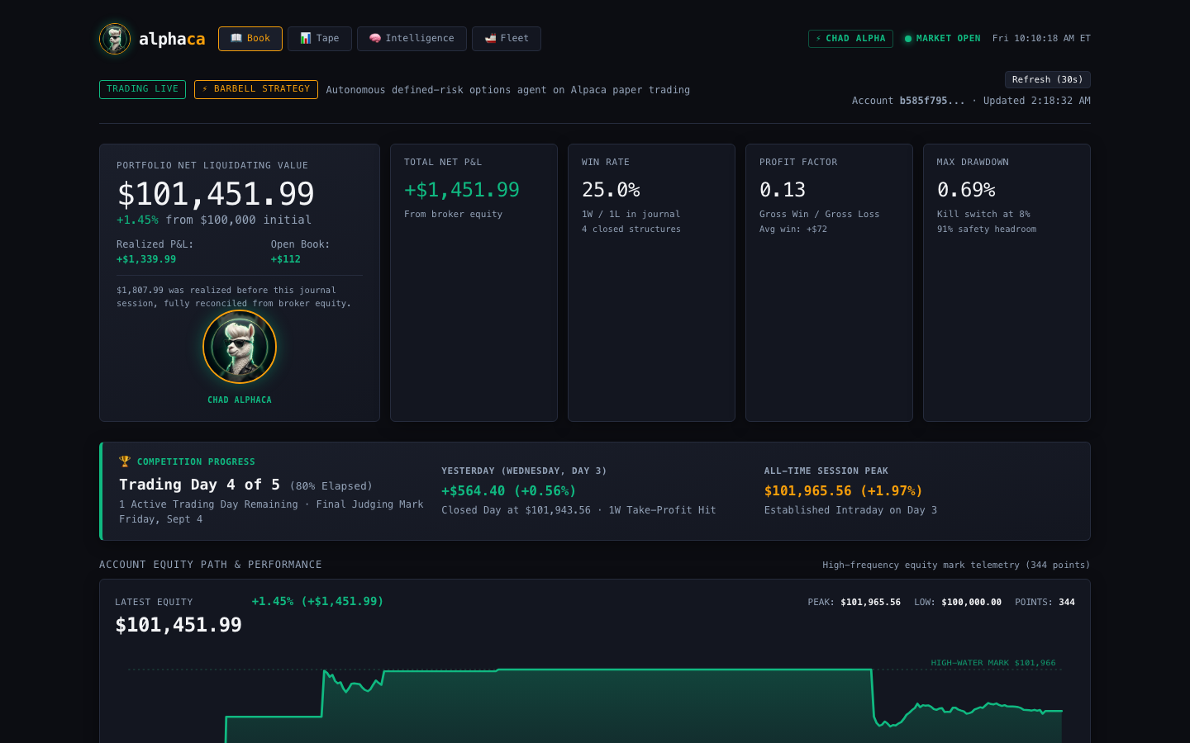
AUDITABILITY
Every fill, refusal, and risk decision is visible
PUBLIC DASHBOARD
Live broker equity
Portfolio Greeks and payoff curves
Open and closed structures
Named rejection reasons
Stress tests and session plans
Public link on the closing slide
08
Notes:
Dashboard screenshot captured from the locally served current build on 4 September 2026. Public mirror: https://thesupermanish.github.io/superio-trading-agent/

Slide 9
CONCLUSION
Autonomy without unchecked financial authority
Alphaca shows how an AI trading agent can act independently while deterministic software keeps control of account risk.
MARKET COVERAGE
PORTFOLIO EXPERIMENT
OPEN RISK CEILING
9 ETFs
3 accounts
8%
Liquid equity, sector, commodity, and bond proxies
Balanced, convex tilt, and income control
Defined risk with a 10% drawdown stand-down
Repository
Live demo
github.com/TheSupermanish/superio-trading-agent
thesupermanish.github.io/superio-trading-agent
Built on Alpaca paper trading with Gemini, Vertex AI, Python, and Next.js
09
Notes:
Repository: https://github.com/TheSupermanish/superio-trading-agent. Public demo: https://thesupermanish.github.io/superio-trading-agent/. All performance shown in this deck comes from paper accounts over a short hackathon window.

