Slide 1
Summer Training Project
B/B+Trees for indexing in Database for optimised query execution
Submitted By:
Name: Yash Saxena
Roll no.: 10214803118
Batch: 5I6(I.T.) 2018-2022

Slide 2
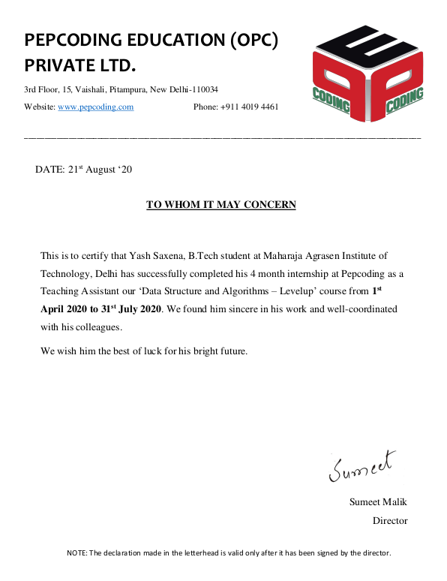
Certificate

Slide 3
Problem Description
Given a collection of data records, we want to create a B/B+tree index on some key field.
One approach is to insert each record into an empty tree. It is less expensive as compared to the indexing of that key field because each entry in the B/B+ tree requires us to start from the root and go down to the appropriate leaf page.
An efficient alternative to indexing is to use B/B+ tree. Hence, we want to implement a B/B+ tree and compare its performance with normal indexing, with different inputs and document the results.

Slide 4
What is a B/B+Tree?
A type of tree which is similar to AVL trees but more generalized
Internal nodes contain only search keys (no data).
Leaf nodes contain pointers to data records.
Data records are in sorted order by the search key.
All leaves are at the same depth.

Slide 5
What are B/B+Trees used for?
When we store data in a table in a DataBase we want
  Fast lookup by primary key
    Just this – hash-table O(c)
  Ability to add/remove records on the fly
    Some kind of dynamic tree on disk
  Sequential access to records (physically sorted by primary key on disk)
    Tree structured keys (hierarchical index for searching)
    Records all at leaves in sorted order

Slide 6
Definition of a B+Tree
A B+ tree is a balanced tree in which every path from the root of the tree to a leaf is of the same length, and each non-leaf node of the tree has between [M/2] and [M] children, where n is fixed for a particular tree.

Slide 7
Example:
B+ Tree with M = 4
Often, leaf nodes linked together
10
40
3
15
20
30
50
1
2
10
11
12
20
25
26
40
42
3
5
6
9
15
17
30
32
33
36
50
60
70

Slide 8
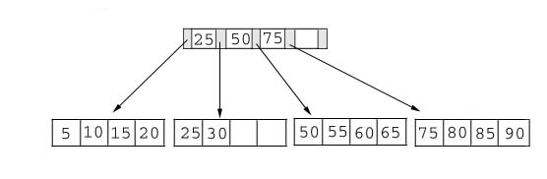
Searching
Just compare the key value with the data in the tree, then return the result.
For example: find the value 45, and 15 in below tree.

Slide 9
Insertion
Inserting a value into a B+ tree may unbalance the tree, so rearrangement of the tree might be needed needed.
Example #1: insert 28 into the below tree.
25 28 30
Fits inside the leaf

Slide 10
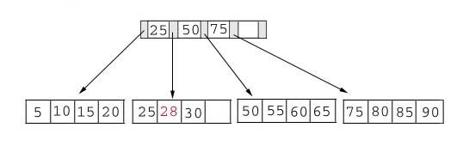
Insertion
Example #2: insert 70 into below tree

Slide 11
Insertion
Process: split the leaf and propagate middle key up the tree
50 55 60 65 70
Does not fit inside the leaf
50 55
60 65 70

Slide 12
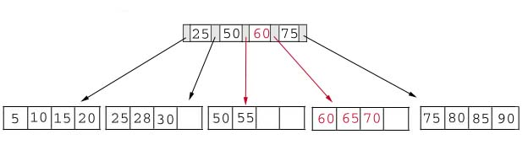
Insertion
Result: chose the middle key 60, and place it in the index page between 50 and 75.

Slide 13
Insertion
Exercise: add a key value 95 to the below tree.
75 80 85 90 95
75 80
85 90 95
25 50 60 75 85

Slide 14
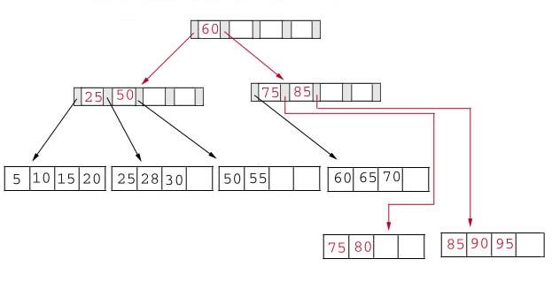
Insertion
Result: again put the middle key 60 to the index page and rearrange the tree.

Slide 15
Searching
Result:
For the value of 45, not found.
For the value of 15, return the position where the pointer located.

Slide 16
B-Trees and DBMS
Used to index primary keys
Can access records in O(log M/2) traversals (height of the tree).
Interior nodes contain Keys only.
Set node sizes so that the M-1 keys and M pointers fits inside a single block on disk.
E.g., block size 4096B, keys 10B, pointers 8 bytes
(8+ (10+8)*M-1) = 4096.
M = 228; 2.7 billion nodes in 4 levels.
One block read per node visited.

Slide 17
Advantages of B-tree usage for databases
Keeps keys in sorted order for sequential traversing
Uses a hierarchical index to minimize the number of disk reads
Uses partially full blocks to speed insertions and deletions
Keeps the index balanced with a recursive algorithm
In addition, a B-tree minimizes waste by making sure the interior nodes are at least half full. A B-tree can handle an arbitrary number of insertions and deletions.

Slide 18
Conclusion
For a B-Tree:
It is “easy” to maintain its balance
  Insert/Deletion complexity O(log M/2)
The searching time is shorter than most of other types of trees because branching factor is high.

Slide 19
Reference
Database System Concepts taught in class and text
reference textbook by Abraham Silberschatz, Henry F. Korth, and S. Sudarshan
Bulk loading in ​ https://en.wikipedia.org/wiki/B
B/B+Tree in ​ https://en.wikipedia.org/wiki/B%2B_tree
Dynamic Programming: https://en.wikipedia.org/wiki/Dynamic_programming
Introduction to Algorithms by Thomas H. Cormen
MIT opencourseware

Slide 20
Thank You
For
Listening

