Slide 1
Compressing Images with Singular Value Decomposition
MFAD MINI PROJECT · APPLIED LINEAR ALGEBRA
262,144
numbers in one 512 × 512 grayscale image
786,432
Bandwidth vs. storage: how much of an image can we throw away and still see it clearly?
numbers in the same size image in colour (R, G, B)
The question
Keep only the k most important layers of the image matrix. How small can k be before the picture falls apart, and what do we really save?
The cameraman image's 40 largest singular values (log scale): a few layers carry most of the picture
Team: add member names and USNs here
Notes:
Images are a large share of everything sent over the web, so every byte saved matters for bandwidth, page-load time and storage. A single 512 by 512 grayscale image is already over 2.6 lakh numbers, and in colour it is about 7.9 lakh. Our idea is to treat the image as a matrix and ask which parts of it carry the most information. The Singular Value Decomposition answers that exactly, and ranks the parts from most to least important — the bars on the left are those importance values for our test image, falling off very quickly. We test this on two standard 512 by 512 images, one grayscale and one colour, and measure what we save and what we lose.

Slide 2
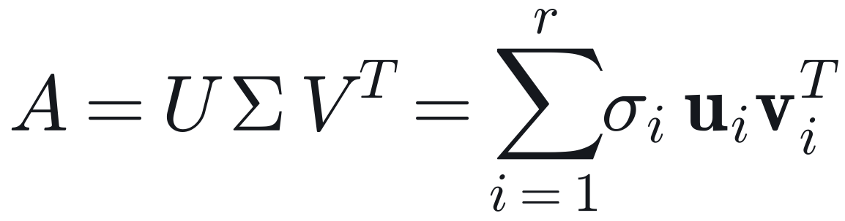
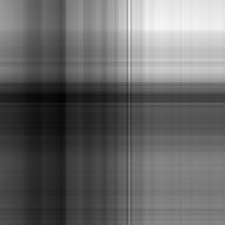
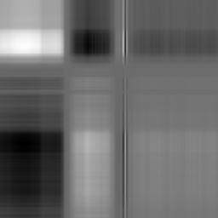
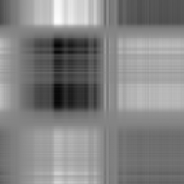
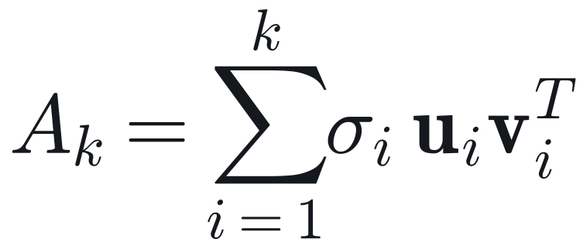
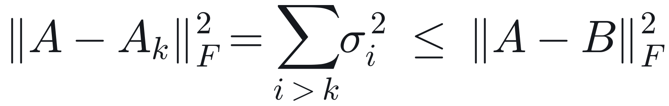
SVD writes an image as a sum of rank-1 layers, best first
SVD FOUNDATIONS · TRUNCATED RANK-k APPROXIMATION
1
Decompose: U, V orthogonal, σ₁ ≥ σ₂ ≥ … ≥ 0
The first three layers of the cameraman image
+
+
+ …
2
Truncate: keep only the first k layers
σ₁u₁v₁ᵀ
σ₁/σ₁ = 1.00
σ₂u₂v₂ᵀ
σ₂/σ₁ = 0.24
σ₃u₃v₃ᵀ
σ₃/σ₁ = 0.19
Each layer is one column pattern times one row pattern, so it can only draw horizontal and vertical streaks.
σ₁ alone holds 87% of the energy; it is mostly the average brightness.
The error of A_k is exactly the energy of the dropped σᵢ². Our code checks this to within 10⁻¹⁷.
3
Eckart–Young–Mirsky: no rank-k matrix B is closer
Notes:
Any matrix A factors as U Sigma V-transpose. U and V are orthogonal, so their columns are clean row and column patterns, and Sigma holds the singular values in decreasing order. Equivalently, A is a weighted sum of rank-one layers, sigma-i times u-i times v-i transpose. On the right are the first three layers of our cameraman image: each is one column pattern times one row pattern, which is why they look like streaks. If we stop after k layers we get A-k, and it needs only k times (M plus N plus 1) numbers instead of M times N. The Eckart–Young–Mirsky theorem says this truncation is the best possible rank-k approximation in the Frobenius norm, and the squared error is exactly the sum of the squared singular values we dropped. So we can predict the error before reconstructing anything — our program verifies this identity on every run, to about 10 to the minus 17.

Slide 3
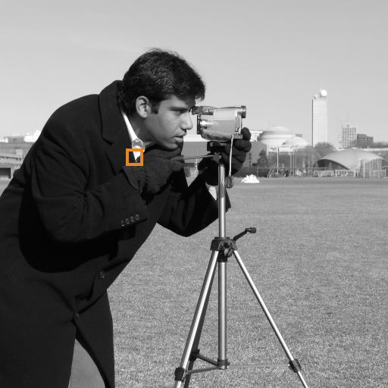
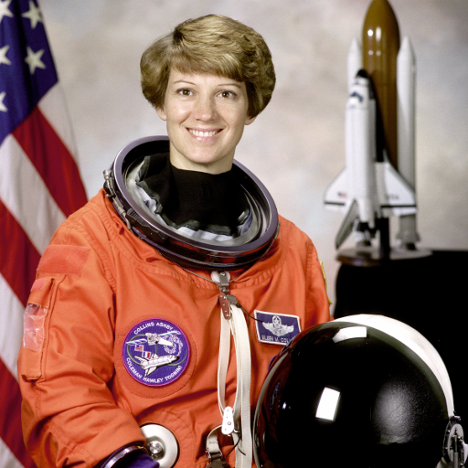
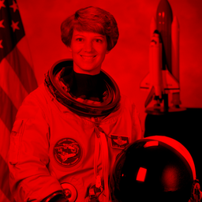
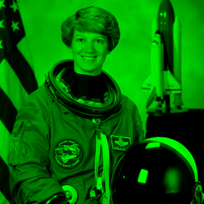
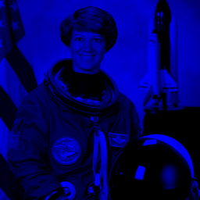
A grayscale image is one matrix; a colour image is three
IMAGE AS A MATRIX · GRAYSCALE VS. MULTI-CHANNEL RGB
Grayscale → one 512 × 512 matrix, one SVD
RGB → three 512 × 512 matrices, three SVDs
39 | 45 | 100 | 246 | 239 | 249
38 | 42 | 62 | 223 | 254 | 254
37 | 40 | 51 | 189 | 254 | 249
35 | 39 | 45 | 141 | 253 | 250
32 | 34 | 41 | 81 | 240 | 247
32 | 32 | 38 | 55 | 226 | 236
=
X_R
X_G
X_B
The orange box, zoomed: a 6 × 6 block of the matrix. Each entry is a brightness from 0 (black) to 255 (white).
Storage triples: 3k(M+N+1) values.
Channels are truncated independently, so at low k they disagree and create false colours.
!
Break-even: truncation saves space only while k < MN / (M+N+1) ≈ 256 for a 512 × 512 image.
Notes:
On the left is the grayscale case. The orange box on the cameraman is zoomed into the grid: those are the actual pixel values, a 6 by 6 piece of the 512 by 512 matrix, where 0 is black and 255 is white. One SVD of that matrix gives us everything. Storing rank k costs k times (M plus N plus 1) numbers, versus M times N for the raw pixels. On the right is colour. Matrix SVD needs two dimensions, so we split the 512 by 512 by 3 image into its red, green and blue planes, and decompose each one on its own. That triples storage and ignores the strong correlation between channels — at low rank the three channels lose different detail and stop agreeing, which shows up as false colours. Finally, the break-even: once k passes about 256, the truncated factors are no smaller than the image itself.

Slide 4
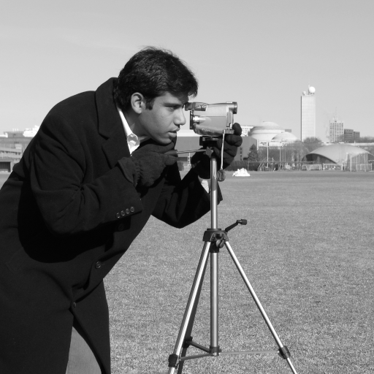
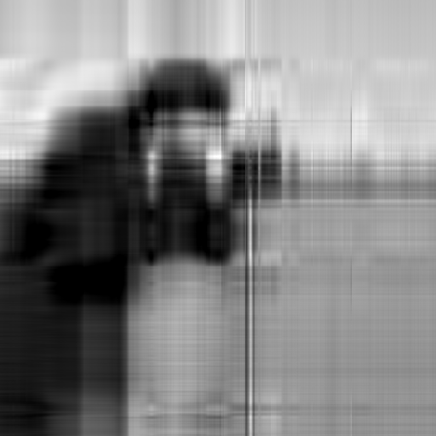



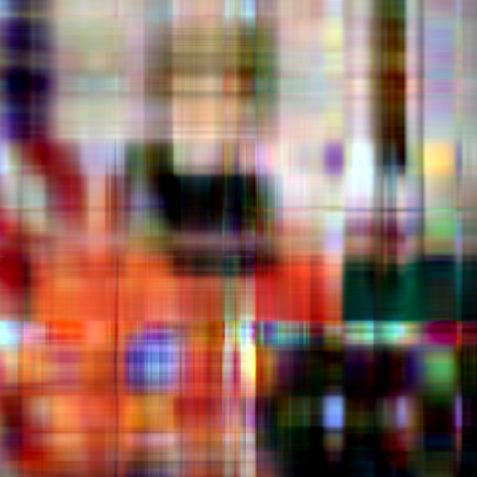
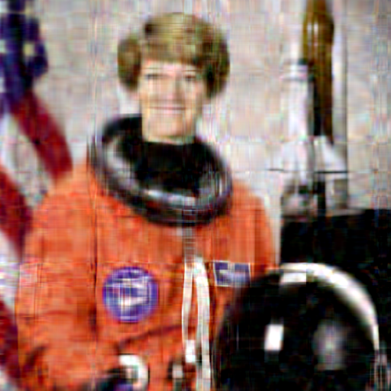


By k = 50 the image is usable; k = 100 is close to the original
EMPIRICAL RESULTS · VISUAL COMPARISON ACROSS RANKS
Original
k = 5
k = 20
k = 50
k = 100
full rank (512)
silhouette, streaks
soft, edge ringing
good at thumbnail size
near-original
Grayscale · cameraman
20.0 dB · 98.0% saved
24.6 dB · 92.2% saved
28.6 dB · 80.4% saved
32.8 dB · 60.9% saved
Colour · astronaut
16.2 dB · 98.0% saved
22.2 dB · 92.2% saved
27.4 dB · 80.4% saved
32.9 dB · 60.9% saved
Notes:
Read the grid from left to right; the top row is grayscale and the bottom row is colour. Under each picture is its quality in decibels and how many stored numbers we saved. With 5 layers we get only a silhouette made of horizontal and vertical bands — exactly the streaky layers from the previous slide — and in colour the channels disagree, giving the plaid of false colours. By 20 layers the subject is recognisable, but edges ring and the grass texture turns into noise. At 50 layers, which still saves 80 percent of the numbers, the image looks good at thumbnail size, with mild blur and ripples in the flat sky. At 100 layers it is hard to tell apart from the original on screen. [LIVE DEMO CUE] This is a good point to switch to the terminal and run: python svd_image_compression.py --gray photo.jpg --rgb photo.jpg --size 512 --out my_results, then open the new comparison figure.

Slide 5
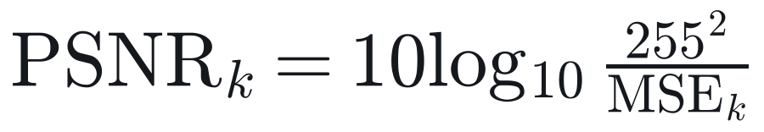
PSNR keeps rising, but each extra decibel costs more storage
QUANTITATIVE TRADE-OFFS · PSNR, MSE AND STORAGE REDUCTION
Grayscale, cameraman 512 × 512 (262,144 values raw)
k | Values stored | Saved | MSE | PSNR | Energy
5 | 5,125 | 98.0% | 649.5 | 20.0 dB | 97.0%
20 | 20,500 | 92.2% | 224.6 | 24.6 dB | 99.0%
50 | 51,250 | 80.4% | 89.0 | 28.6 dB | 99.6%
100 | 102,500 | 60.9% | 34.1 | 32.8 dB | 99.8%
97%
of the energy is kept at k = 5, yet PSNR is only 20 dB. Energy is a poor guide to how the image looks.
0.08 dB
gained per 1,000 extra values from k = 50 to 100, down from 0.30 dB from k = 5 to 20: diminishing returns.
Notes:
The chart shows quality against the number of layers kept, for both images, with the dashed line at 30 decibels — roughly where an image looks good on screen. Quality never stops improving, but the curve bends: the first few layers buy a lot, later layers buy less and less. The table makes this concrete for the grayscale image. Two numbers to remember. First, energy is misleading: at k equal to 5 we keep 97 percent of the energy, yet the picture is unrecognisable at 20 decibels, because the first singular value is mostly just the average brightness. Second, the return per stored number collapses: from 0.30 decibels per thousand extra values early on, down to 0.08 between k of 50 and 100. MSE falls from about 650 to 34 over the same range; PSNR is just MSE on a log scale, 10 log base 10 of 255 squared over MSE.

Slide 6

Use k ≈ 50 for previews, but JPEG still wins on bytes
CONCLUSION · OPTIMAL RANK FOR PRODUCTION AND WEB USE
Recommended rank
k ≈ 50
about 10% of full rank
80.4% fewer values to store
27.4–28.6 dB: good at preview size
the knee of the quality curve
Full-size images
Pick the smallest k that meets a quality target, not a fixed fraction. For 30 dB: k = 64 (grayscale), k = 72 (colour).
JPEG reaches the same PSNR in 9–24× fewer bytes at every rank we tested.
Where SVD shines: progressive loading (send layers in order), denoising, and as the idea behind transform codecs.
Notes:
Our recommendation: for previews and thumbnails, use k around 50 — about 10 percent of full rank. It stores 80 percent fewer numbers, gives roughly 27 to 29 decibels, and sits at the knee of the quality curve. For full-size viewing, pick the smallest k that meets a quality target such as 30 decibels; for our images that is k equal to 64 for grayscale and 72 for colour, which still saves over 70 percent of the stored numbers. But we also have to be honest about real bytes. Each SVD number is a real number, not a one-byte pixel. Stored as 32-bit floats, rank 100 is actually bigger than the original image; even 16-bit floats only save about 22 percent. JPEG reaches the same quality in 9 to 24 times fewer bytes, because it adds quantisation and entropy coding that plain SVD does not have. So SVD is the mathematically optimal low-rank image, and the theory predicted every error we measured — but it is not a competitive web format on its own. Where it shines is progressive loading, denoising, and as the idea behind real transform codecs. Thank you — we are happy to take questions.

