Slide 1
Maximizing Motor Power at Constant Voltage
Principles of Engineering
© 2012 Project Lead The Way, Inc.

Slide 2
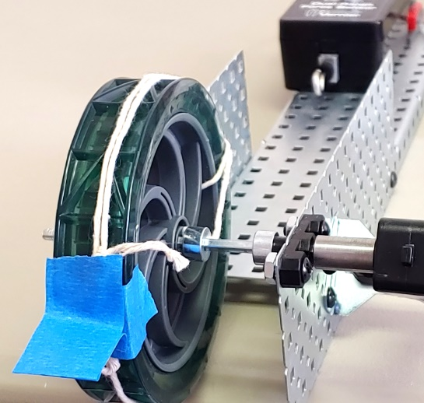
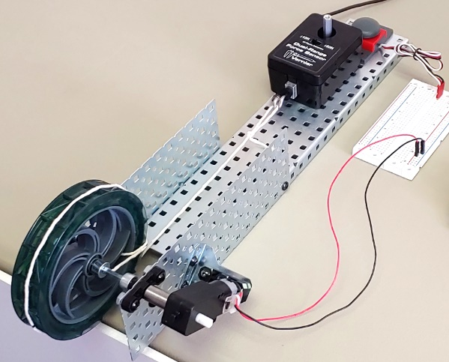
Speed Depends on Load Torque
When a motor is loaded with no torque, it spins at no-load speed, ω_{0 .}
ω₀ = no-load speed
When a motor is loaded with the stall torque τ_{stall} or more, the motor will stop.
τ_{stall} = stall torque
Notes:
The lower-case Greek letter omega is the symbol used for angular speed. Angular speed is measured in units of angle measure per time, like rotations per minute, revolutions per second, degrees per second, or radians per second. Radians per second is the SI unit for angular speed.
The lower-case Greek letter tau is the symbol used for torque. Torque is measured in units of distance times a force, like pound-inches, or newton-meters. Newton-meters is the SI unit for torque. Because the distance and force are in perpendicular directions, it cannot be simplified to units of energy; newton-meters is joules, however, when the force and distance are in the same direction.

Slide 3
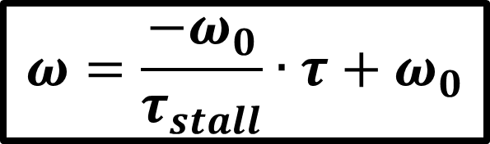
Speed vs. Torque is Linear
No-load speed
ω₀
Speed ω
Half speed
Stall
τ_{stall}
$$ω=\frac{−ω_{0}}{τ_{stall}}∙τ+ω_{0}$$
Torque τ
Notes:
What does it mean that speed “is linear” with torque? The fact that speed has a linear dependence on torque means the graph of speed vs. torque is a line. Is this graph a line?
Can you apply what you learned in algebra to figure out the speed if you know the torque? The main point of this PowerPoint is to show that maximum power is at half the stall torque. You don’t have to be able to prove it to use it. But if you want to see why algebra is useful…
y = mx+b
y = speed, omega
x = torque, tau
m = slope = rise/run = - no-load speed/stall torque
b = no-load speed
speed = (- no-load speed/stall torque)(torque) + no-load speed
…as shown in equation on the slide.

Slide 4
Optional slide for the genius: Speed vs. Torque Depends on Voltage
Speed ω
5 V
7 V
motor speed 120
3 V
motor speed 90
motor speed 60
Torque τ
Notes:
This slide shows how speed and torque depend on voltage. For now we’ll skip it and come back to it in Lesson 3.1 when we look at how the VEX®/fischertechnik controllers set the motor speed.
When you’re ready to dive in:
The graph in the previous slide describes the motor’s behavior at one specific voltage. This figure shows three different speed-versus-torque graphs, one for each of three different voltages.
At a lower voltage, the no-load speed and the stall torque are both smaller. At every voltage, the motor will go slower if loaded with more torque; every speed-versus-torque line has a negative slope. At every voltage, the motor will go half of its no-load speed at half of its stall torque.
The VEX® Cortex controls the motor by reducing the motor voltage. Every Cortex motor setting produces a specific voltage from -7.2V to 7.2 V.
Small voltages (and small Cortex motor speeds) do not produce motion even at no-load, because there is friction inside the motor that creates some internal torque.

Slide 5
Power
Power = Torque x Angular Speed
P = τ • ω
Notes:
Power is measured in units of energy per time, like joules per second, or Btu per hour. There are also many common units of power that do not explicitly show an energy per time, like horsepower, but they are still energy per time. The SI unit for power is the watt, equal to a joule per second, which—in agreement with the formula above—is equal to newton-meters x radians/second.
Extra information for the expert:
Torque and angular speed are vectors. Power is the dot product or scalar product. This formula, written without vector notation, makes the assumption that the torque and the angular rotation are around the same axes.

Slide 6
Power = Torque x Speed
No power. Why?
ω₀
Speed ω
No power. Why?
τ_{stall}
Torque τ
Notes:
Since power = torque x speed,
power is zero at zero torque (no load speed), and
power is zero at zero speed (stall torque).

Slide 7
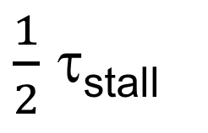
Maximum Power at Half Stall Torque
ω₀
Speed ω
Maximum power. Why?
$\frac{1}{2}$ τ_{stall}
τ_{stall}
$$ω=\frac{−ω_{0}}{τ_{stall}}∙τ+ω_{0}$$
Torque τ
Notes:
You’ll get the most power out of your motor if it has to exert half its stall torque. Why? Again, you can understand the main point of this presentation without the algebra, you just won’t know where it came from. If you want to know why…
Speed is linear with torque, with a negative slope.
speed = (- no-load speed/stall torque)(torque) + no-load speed
If you multiply speed by torque, you get a quadratic equation with a negative quadratic coefficient. The next two slides explains why this means that maximum power is at half the stall torque.

Slide 8
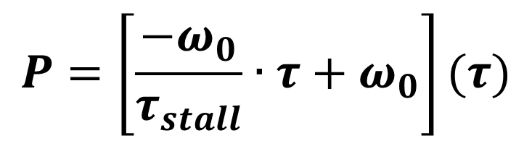
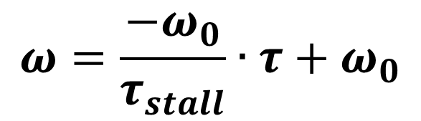
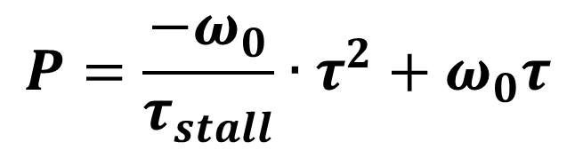
Why half stall torque?
Linear equation from last slide.
$$ω=\frac{−ω_{0}}{τ_{stall}}∙τ+ω_{0}$$
Multiply both sides by torque, product on left is power.
$$P=\left[\frac{−ω_{0}}{τ_{stall}}∙τ+ω_{0}\right](τ)$$
$$P=\frac{−ω_{0}}{τ_{stall}}∙τ^{2}+ω_{0}τ$$
Down-facing parabola.

Slide 9
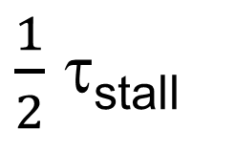
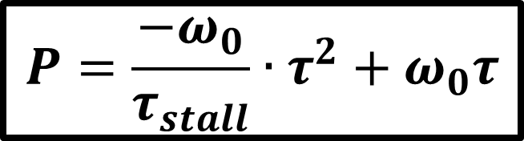
Maximum Power at Half Stall Torque
$$P=\frac{−ω_{0}}{τ_{stall}}∙τ^{2}+ω_{0}τ$$
Maximum power
Power P
$\frac{1}{2}$ τ_{stall}
No load
Stall
Torque τ
Notes:
You’ll get the most power out of your motor if it has to exert half its stall torque. Why?
Speed is linear with torque, with a negative slope.
speed = -(no-load speed/stall torque)(torque) + no-load speed
If you multiply speed by torque to get power, you find that power is a quadratic function of torque. You get a quadratic equation with a negative quadratic coefficient. That’s a parabola that opens downward. We already know that power is zero (therefore x-intercepts in the power-versus-torque graph) at zero torque and at stall torque. Since parabolas are symmetric around their vertical axis, its vertex, maximum power, must be a half the stall torque!
Power = -(no-load speed/stall torque)(torque)^2 + (no-load speed)(torque)

Slide 10
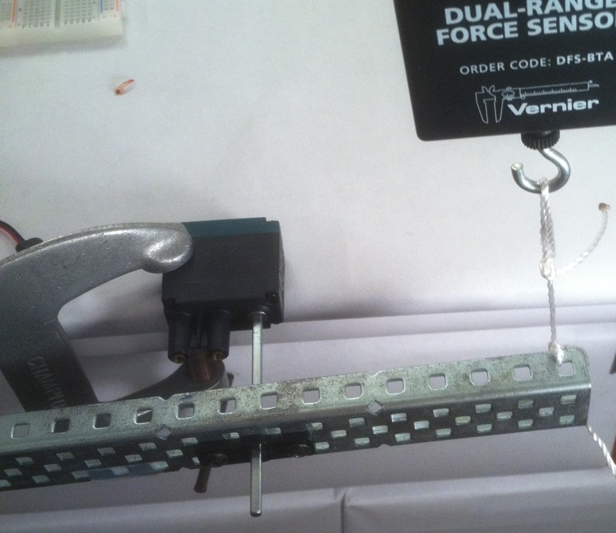
VEX® Application: Pick a Gear Ratio
Step 1. This motor is stalled. What is the stall torque?
τ_{stall} = d x F┴
= (3 in.)(1.4 lb)
= 4.2 lb·in.
F = 1.4 lb
VEX motor
d = 3 in.
Step 2. At what torque will the motor deliver maximum power?
τ_{maxPower} = ½ τ_{stall}
= ½ (4.2 lb·in.) = 2.1 lb·in.
Notes:
This VEX motor is stalled at a torque of torque = distance x perpendicular force
= 3 in. x 1.4 lb
=4.2 lb-in.
The motor will deliver maximum power when it delivers 2.1 lb-in.

Slide 11
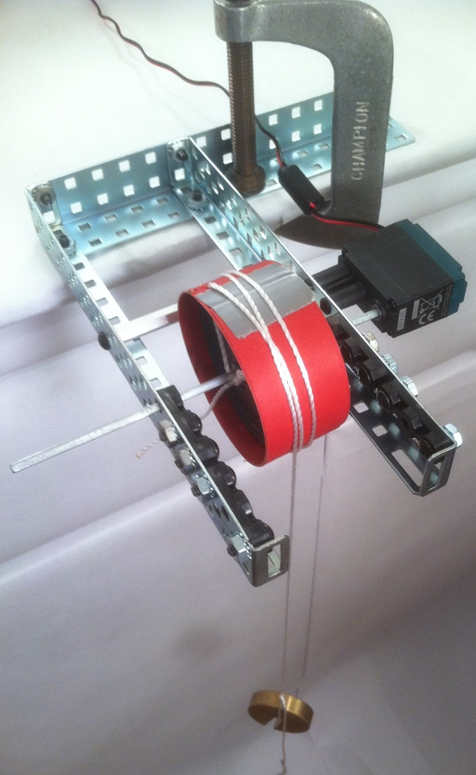
VEX Application: Pick a Gear Ratio
Step 3. The same motor as in the last slide is being used to power a winch with a drum of radius 2 in. lifting 0.2 lb. What torque is the motor applying?
τ_{out} = d x F┴
= (2 in.)(0.2 lb)
= 0.4 lb·in.
d = 2 in.
F = 0.2 lbs
Notes:
If you want to get maximum power from that VEX motor for this winch, you need it to exert 2.1 lb-in. But as designed here, with a direct drive, the motor is only exerting a torque of 0.4 lb-in. to lift this 0.2 lb weight. (Notice the symbol d is being used for the distance off-axis; that’s a radius, maybe confusing because d here stands for distance off-axis, even though d also sometimes stands for diameter.

Slide 12
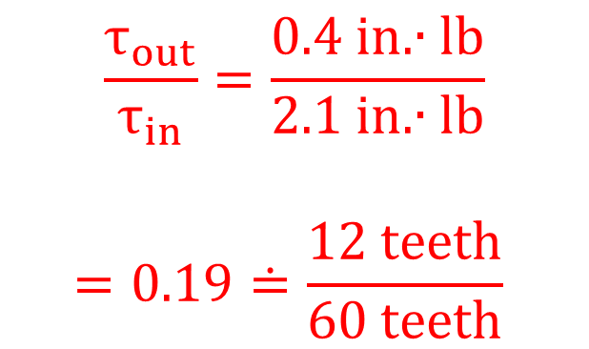
VEX Application: Pick a Gear Ratio
Step 4. Instead of direct drive, what gear ratio would make the motor deliver maximum power?
$$\frac{τ_{out}}{τ_{in}}=\frac{0.4 in.∙lb}{2.1 in.∙lb}$$
$$=0.19≐\frac{12 teeth}{60 teeth}$$
GR =
d = 2 in.
F = 0.2 lbs
Notes:
We want the motor to exert a torque of 2.1 in.-lb, going into a geartrain. The output of the geartrain will then have to exert 0.4 in.-lb. What sort of gear train will do this? We calculate the gear ratio, and then find two gears that have about that ratio.

Slide 13
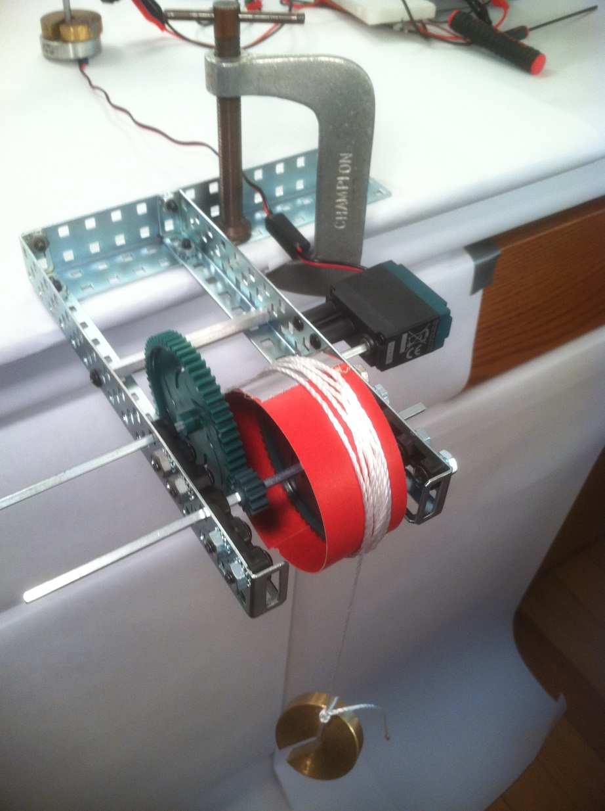
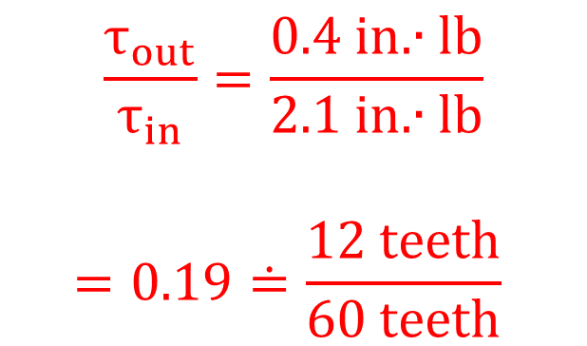
VEX Application: Pick a Gear Ratio
Now the winch is geared so that the motor is delivering half its stall torque, for maximum power.
$$\frac{τ_{out}}{τ_{in}}=\frac{0.4 in.∙lb}{2.1 in.∙lb}$$
$$=0.19≐\frac{12 teeth}{60 teeth}$$
GR =
GR =
Notes:
The motor is connected to a 60-tooth gear, which is driving a 12-tooth gear that shares a drive shaft with the drum. The output torque of 0.4 lb-in. is driven by an input torque of 2.0 lb-in., very close to half of the motor’s stall torque.
If the winch were lifting a different weight, a different gear ratio would be needed for the motor to deliver its maximum power.
The motor will deliver maximum power when it delivers 2.1 lb-in.

Slide 14
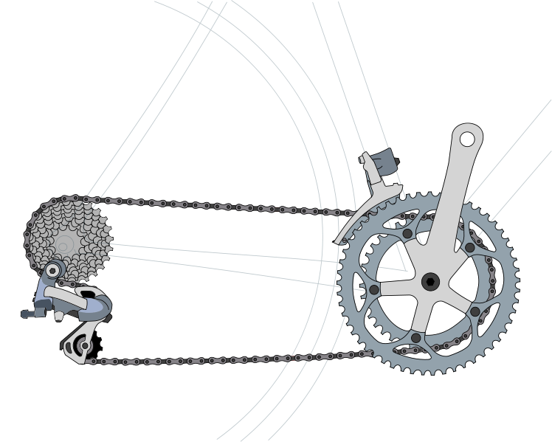
Human Application: Bicycle “gears”
Can you explain why changing “gears” on a bike helps a person win a race that goes up and down hills?
Notes:
Like a motor, the elliptical motions made by a person’s leg go faster when less force is required. When no force is exerted, the motion is at its fastest: a no-load speed with no power delivered. When the force is so large that the leg muscles cannot overcome it, the speed is zero and no power is delivered. Somewhere in-between, there is a force at which the legs can deliver maximum power. By shifting “gears” (they are actually sprockets), the bike rider is able change the gear ratio between the bottom bracket (where the pedal crank arms are mounted) and the rear axle (where the rear wheel is mounted). The rider can use the same force with leg muscles when going uphill as when going downhill by using a larger gear ratio for uphill.
Even for flat surfaces, sprockets with a variety of gear ratios help a rider reach top speeds. On a bike with only one gear ratio, the rider is unable to provide any power beyond her no-load speed. By shifting to sprockets with a low gear ratio, the rider can provide power at a lower of rotations per minute at the pedals compared to the rear wheel.
Image is by Wikipedia-author Keithonearth (2009). Retrieved from http://en.wikipedia.org/wiki/File:Derailleur_Bicycle_Drivetrain.svg and licensed under the Creative Commons Attribution-Share Alike 3.0 License.

Slide 15
References
Micromo (n.d.). DC Motors Tutorials. Retrieved from http://www.micromo.com/dc-motor-tutorials.aspx
MIT Center for Innovation in Product Development (1999). Designing with DC Motors. Retrieved from http://lancet.mit.edu/motors/index.html
Wikipedia (2009). Derailleur Bicycle Drivetrain. Retrieved from http://en.wikipedia.org/wiki/File:Derailleur_Bicycle_Drivetrain.svg

