Slide 1













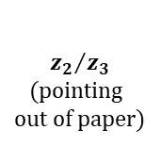











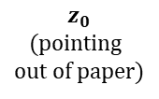

Left
Right
For an arbitrary SRA segment
$$z_{0}$$
(pointing
out of paper)
$$L_{i}$$
$$\frac{π}{2}−\frac{θ_{L1}}{2}$$
$$x_{1}$$
$$d_{2}$$
$$y_{3}$$
=
$$z_{1}$$
$$r_{L2}$$
$${z_{2}}/{z_{3}}$$
(pointing
out of paper)
$$θ_{L2}$$
=
$$r_{L2}$$
$$x_{3}$$
$$x_{2}$$

Slide 2
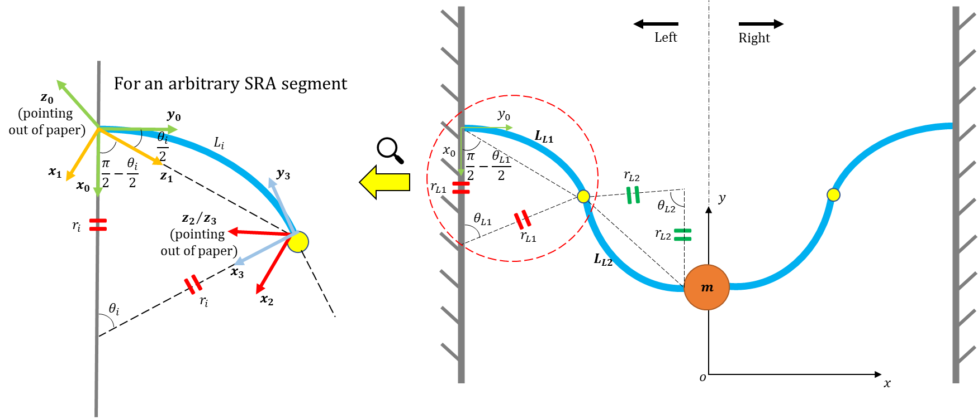

Slide 3
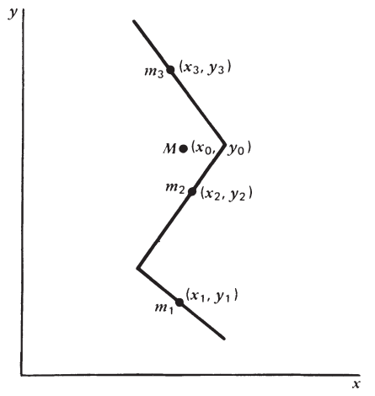
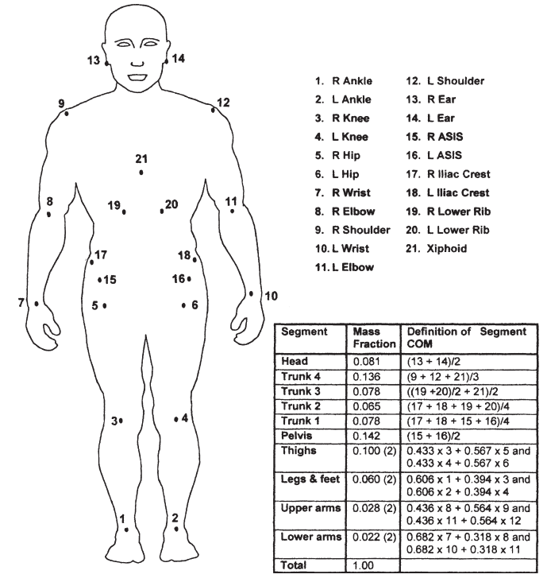









$$θ_{3}$$
$$θ_{i}$$
$$L_{i}$$
$$O$$
$$C$$
$$G$$
$$r_{i}$$
$$θ_{2}$$
$$θ_{1}$$

Slide 4





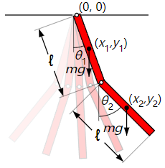






(pointing into paper)
$$z_{0}$$
$$x_{1}$$
$$x_{0}$$
$$z_{1}$$
$$y_{0}$$
$$x_{3}$$
$$z_{2}$$
$$x_{2}$$
$$z_{3}$$
$$x_{4}$$
$$z_{4}$$

Slide 5
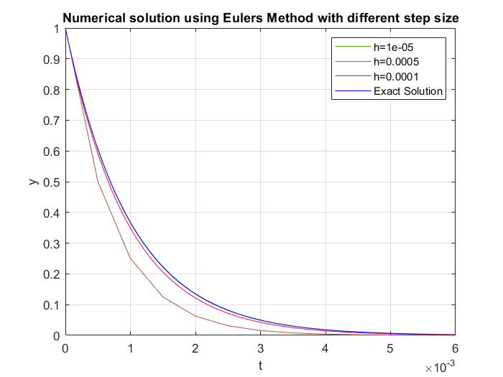
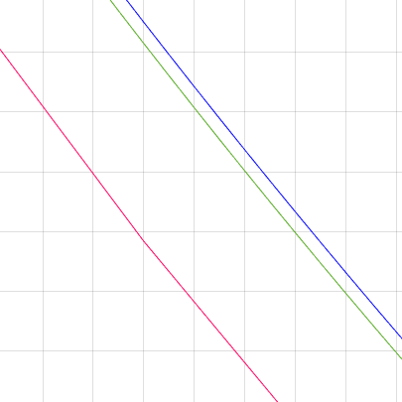

Slide 6
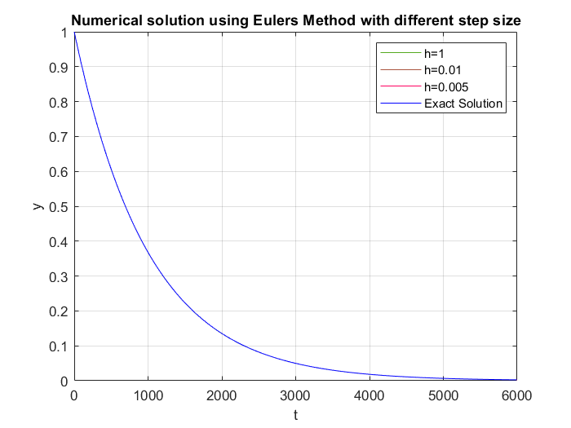
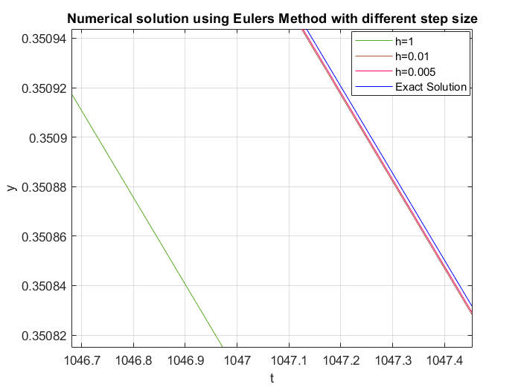
(a)
(b)

Slide 7
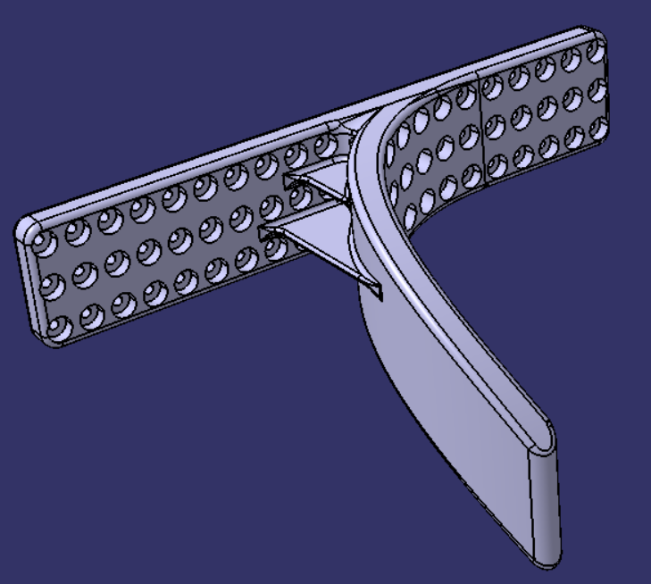
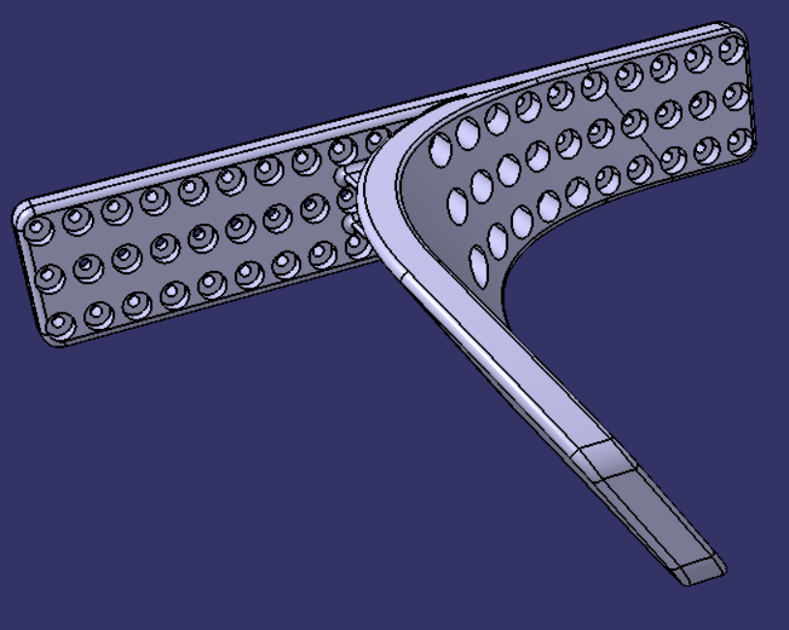
①
②
V002
V003

Slide 8
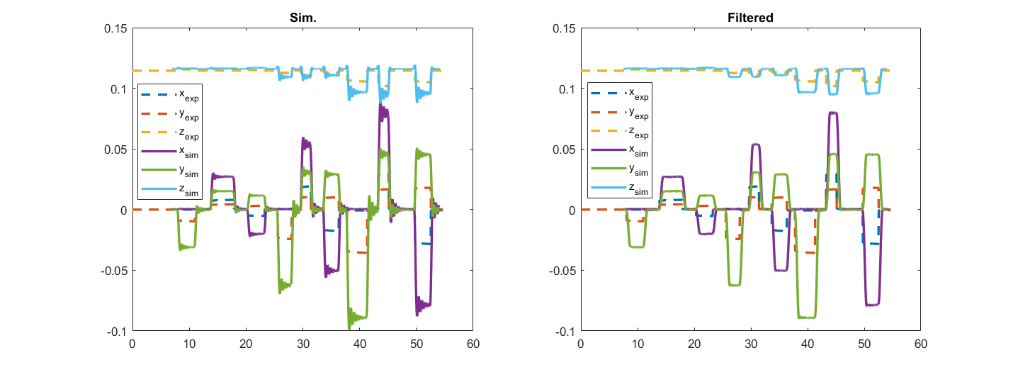
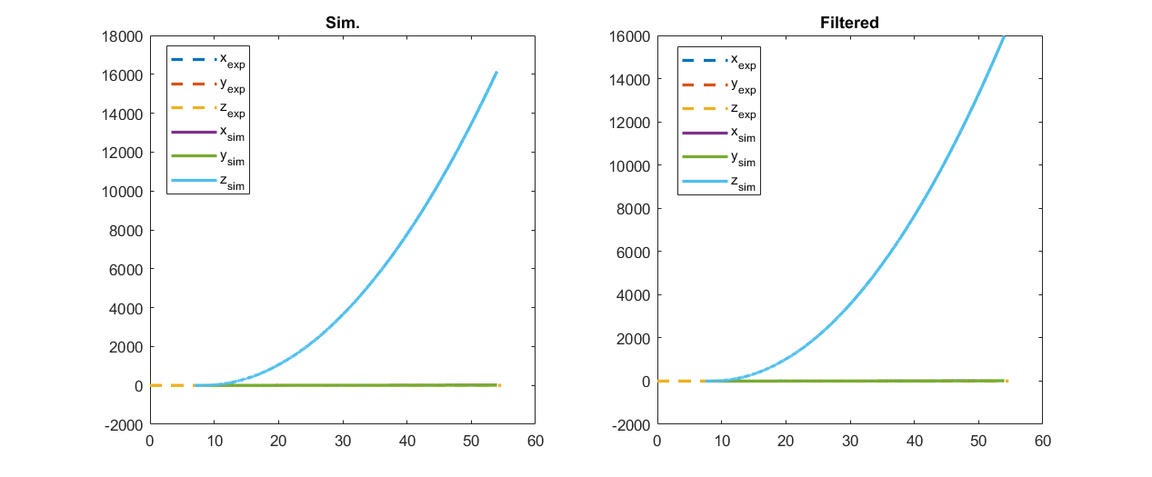
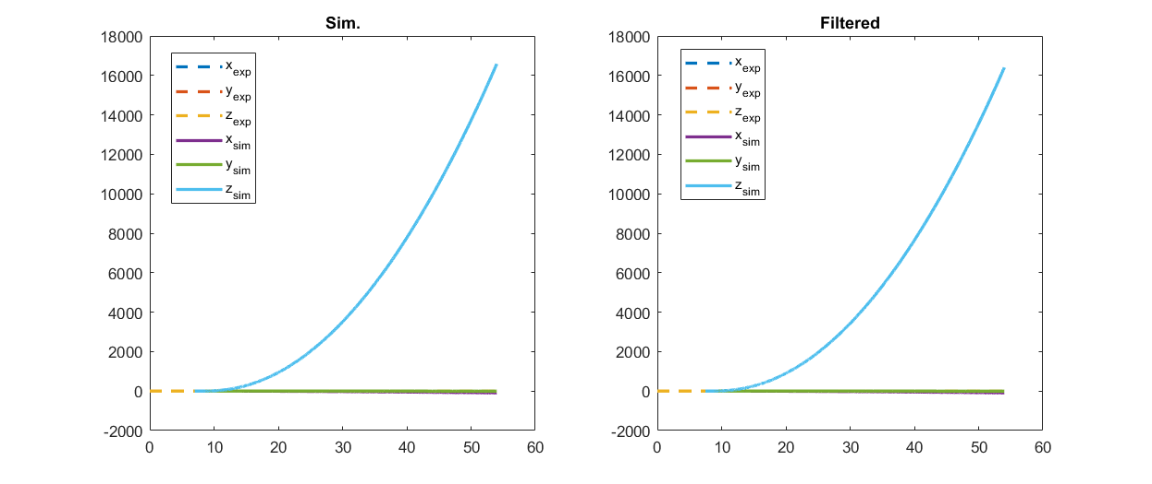
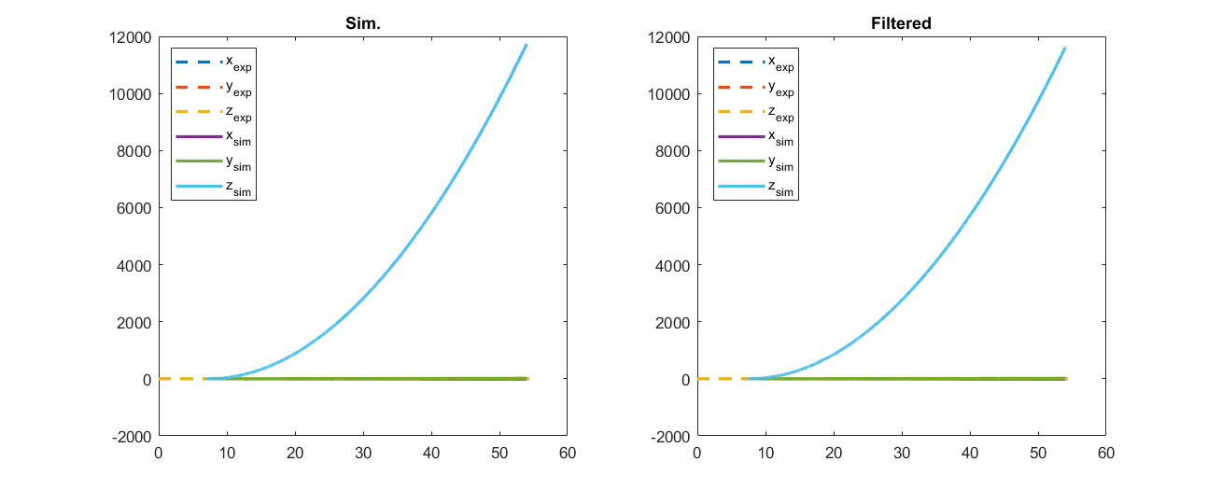
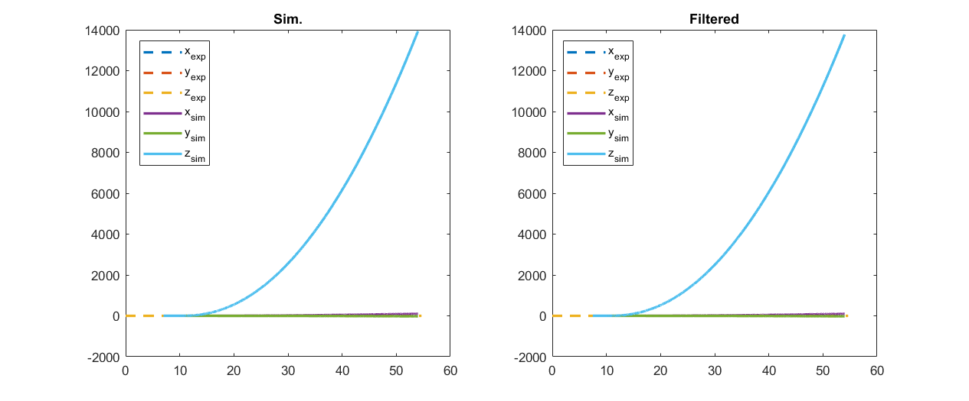
(a)
(d)
(b)
(e)
(c)
(f)

Slide 9
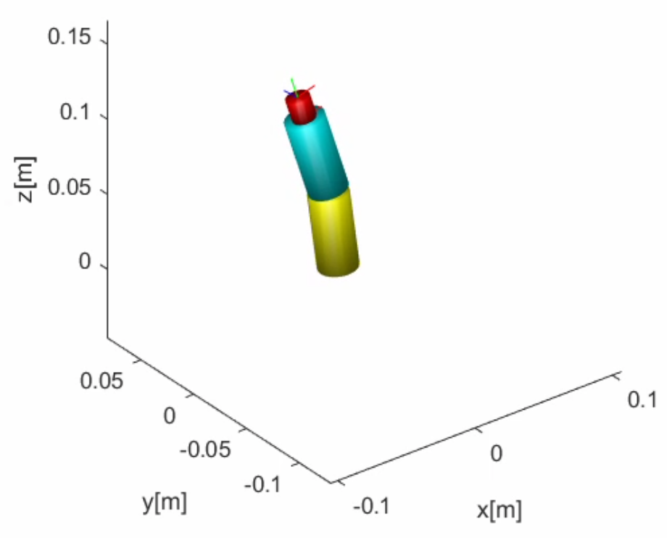
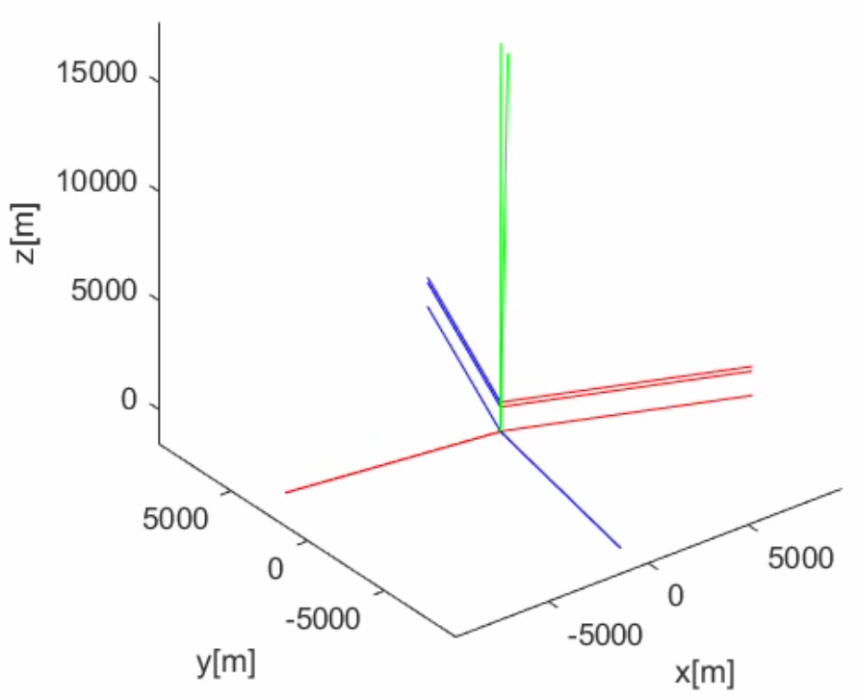
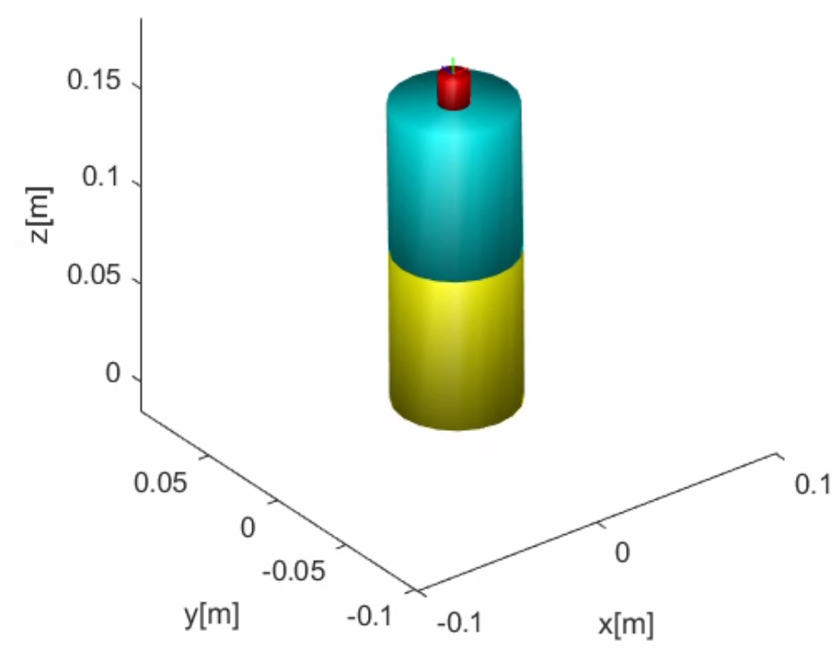
(a)
(b)
(c)

Slide 10
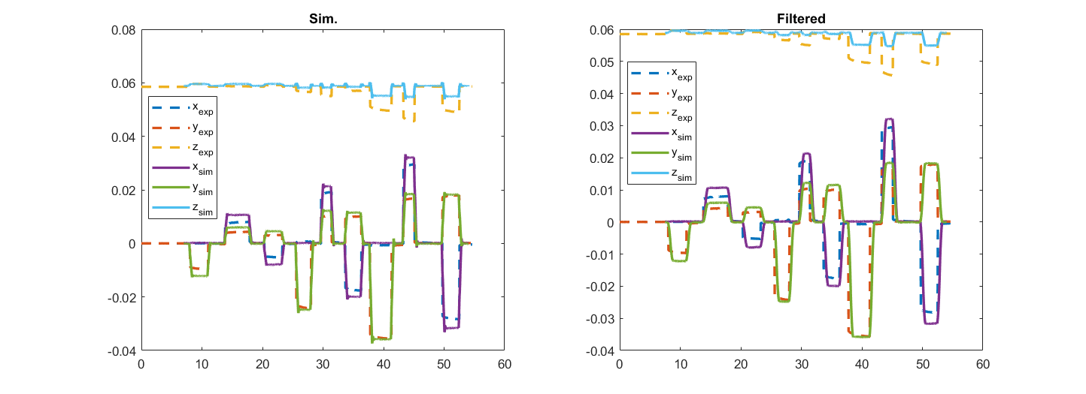
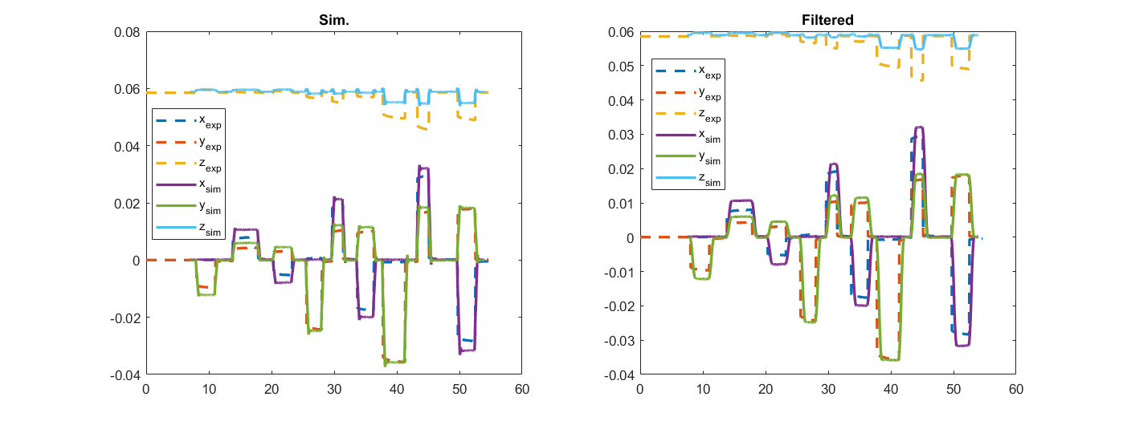
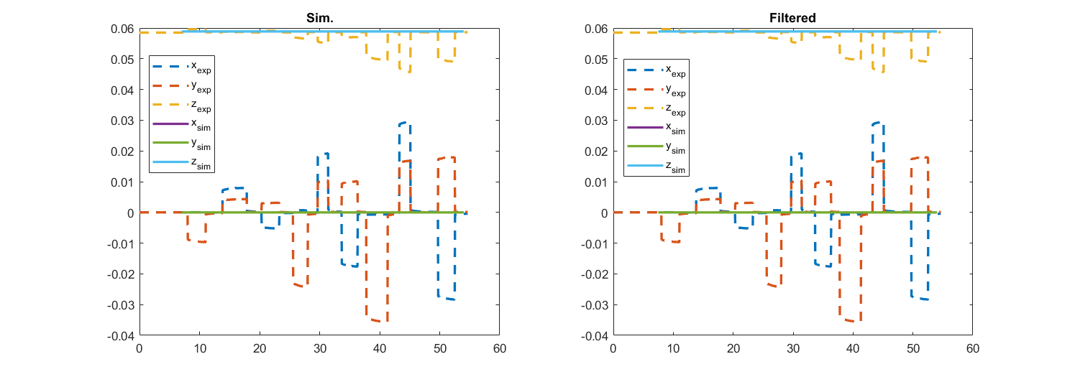
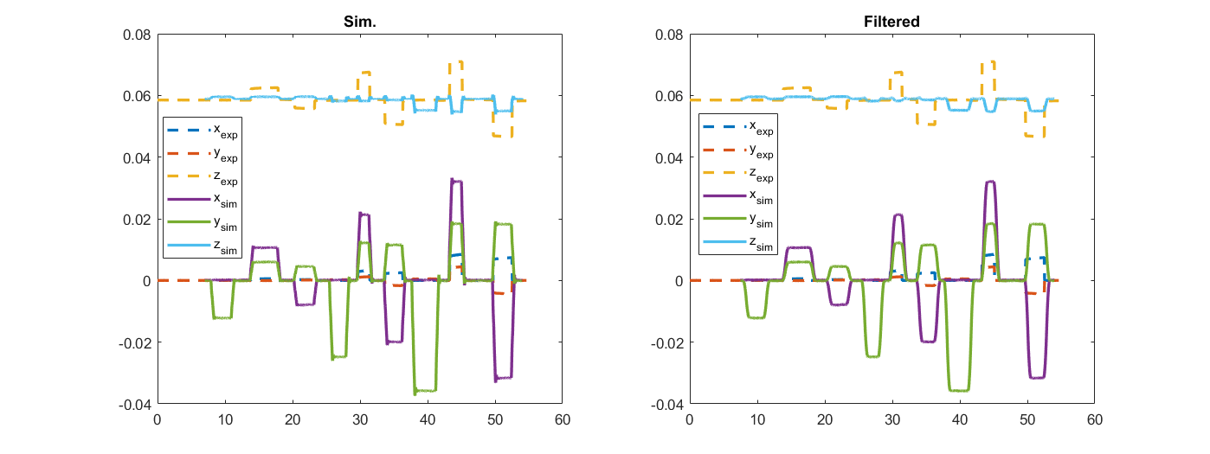
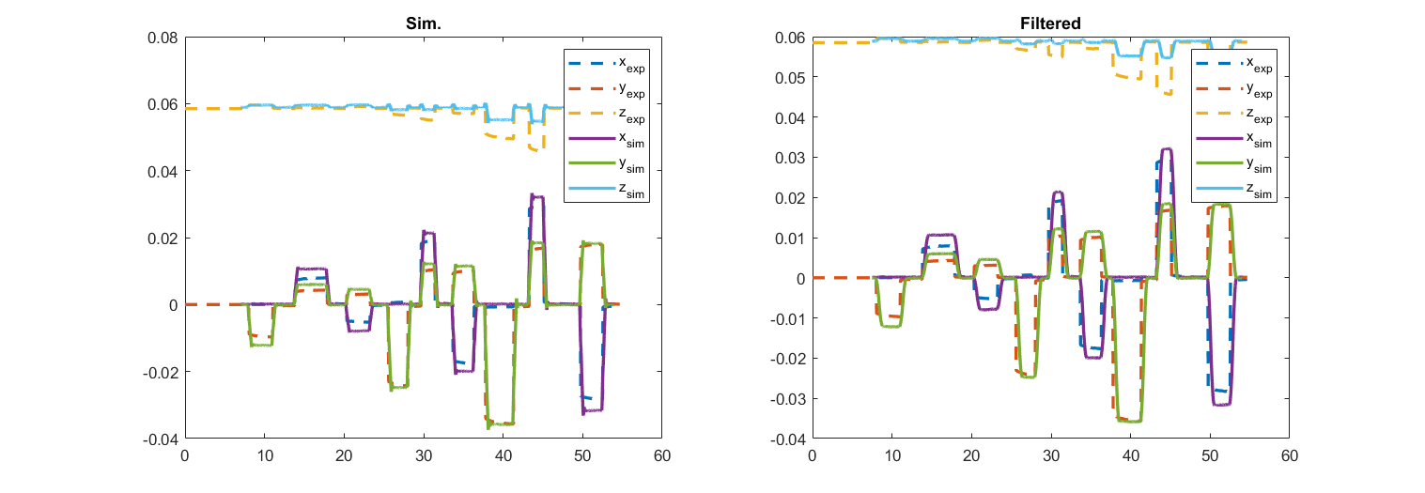
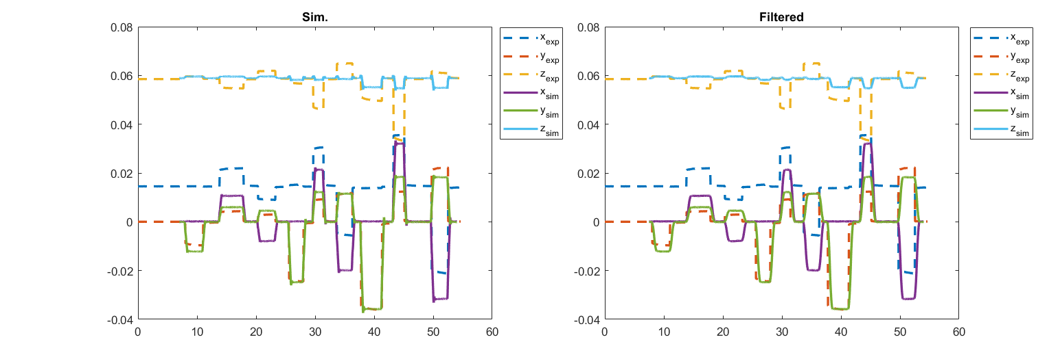
(a)
(d)
(b)
(e)
(c)
(f)

Slide 11
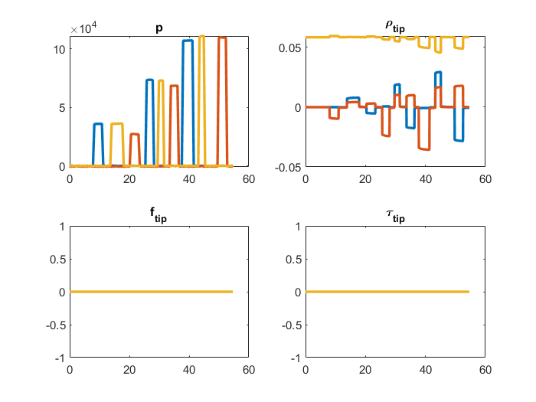
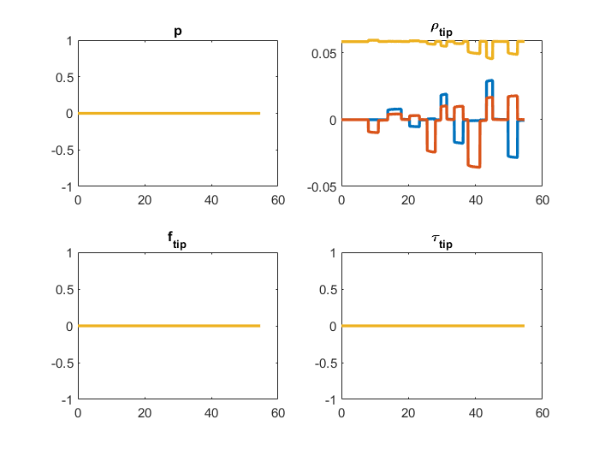
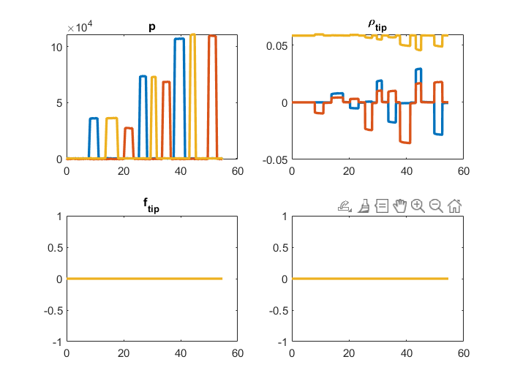

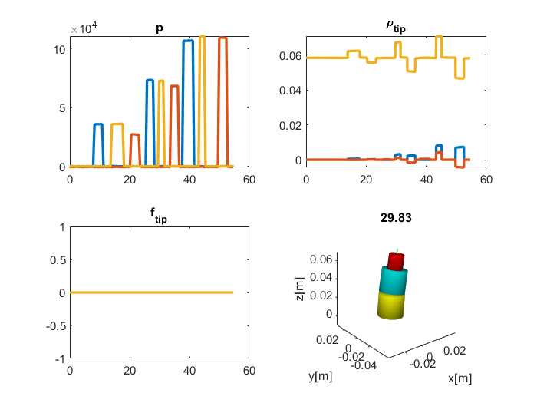
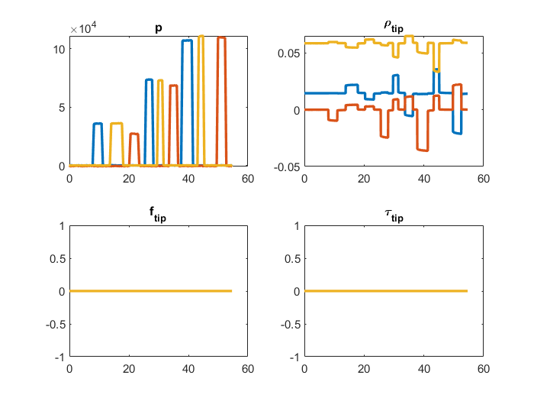
(a)
(b)
(c)
(d)
(e)
(f)

Slide 12
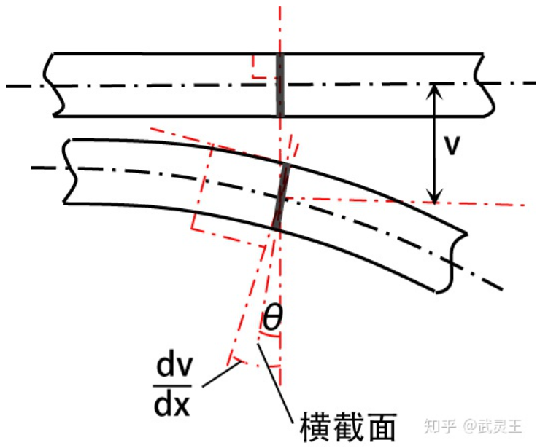
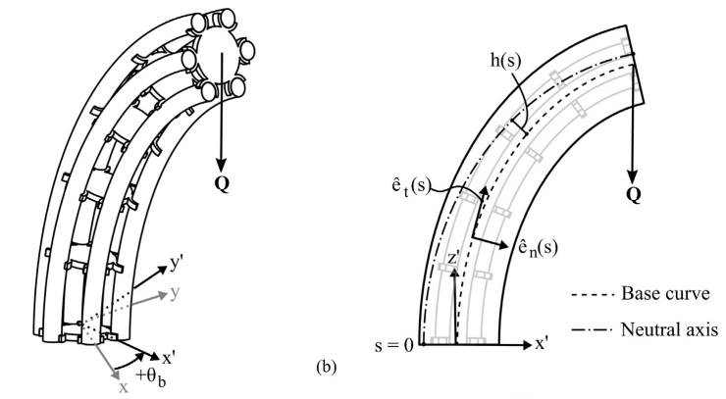

$$φ$$
Cross Section Area

Slide 13
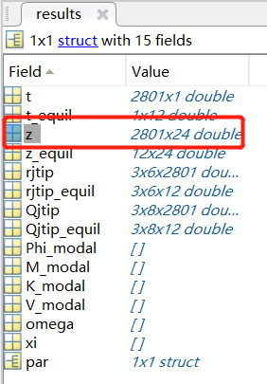
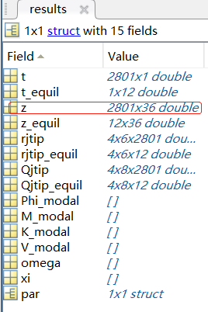
(a)
(b)

Slide 14









$$y_{1}$$
Joint
$$θ_{1}$$
$$c$$
$$x_{1}$$
$$k$$
$$π−θ_{2}$$
$$y_{2}$$
$$θ_{2}$$
$$x_{2}$$
Center of Mass
(COM)
Wall

Slide 15
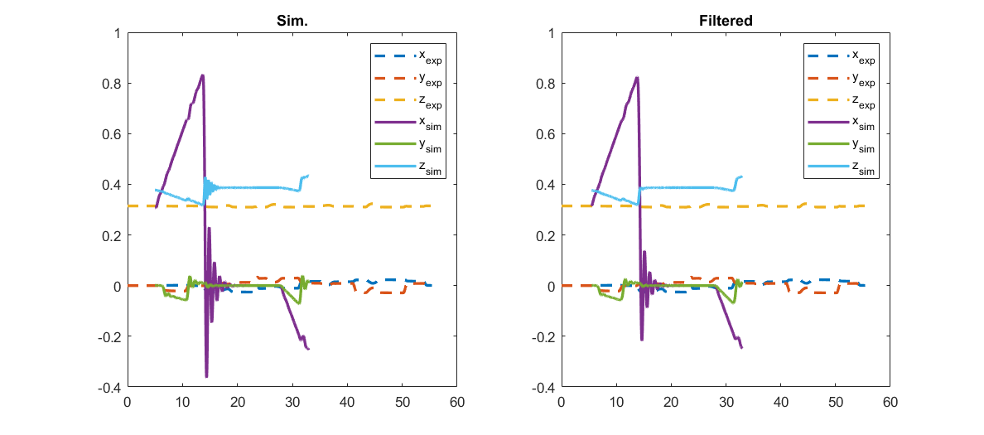
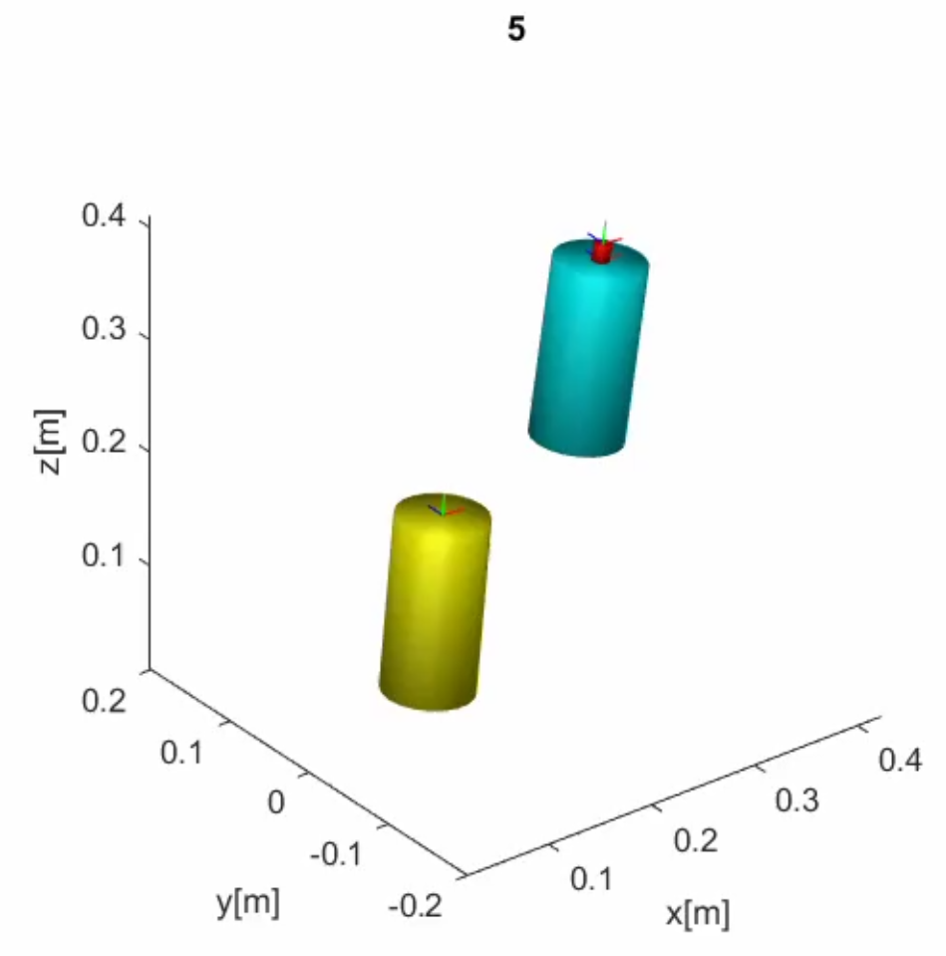
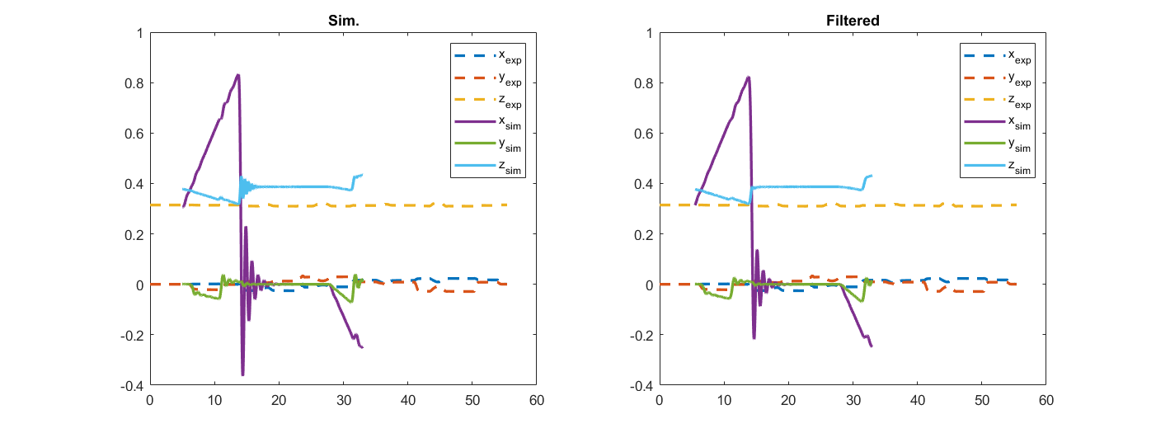
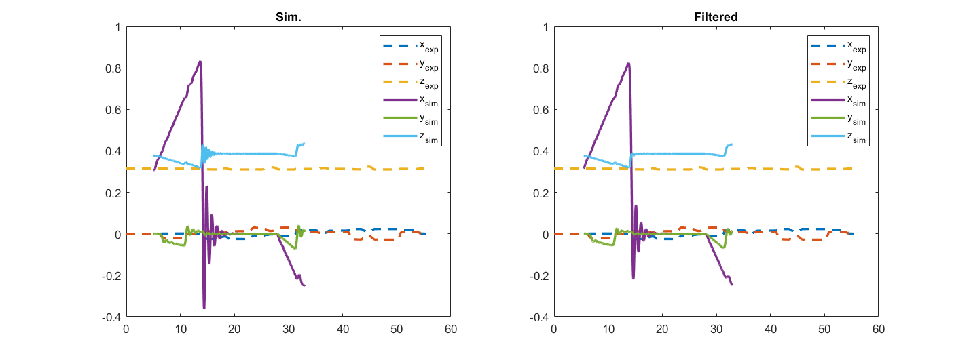
(a)
(b)
(d)
(c)

Slide 16
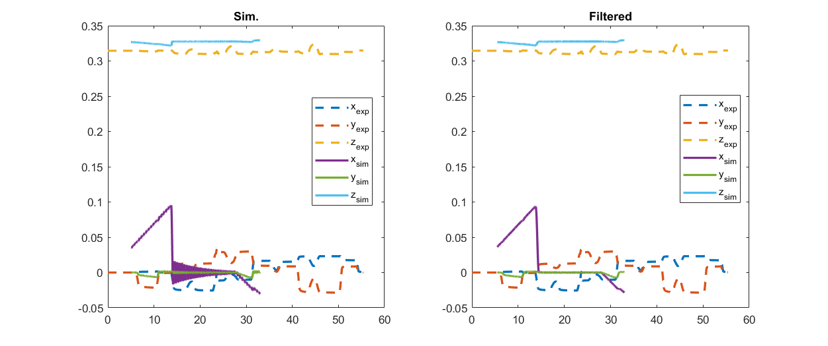
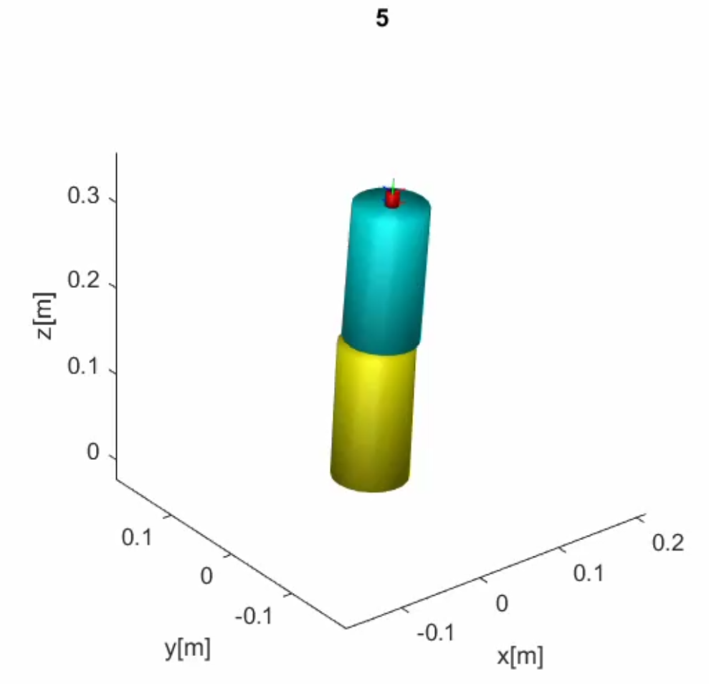
(a)
(b)

