Slide 1
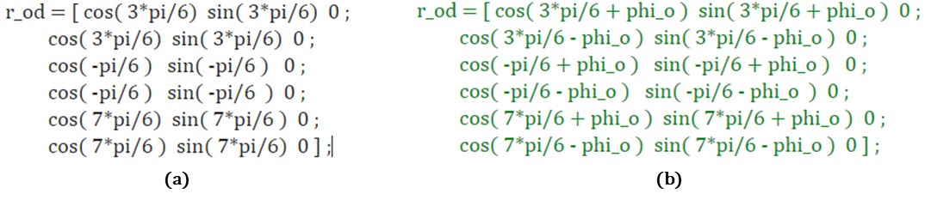
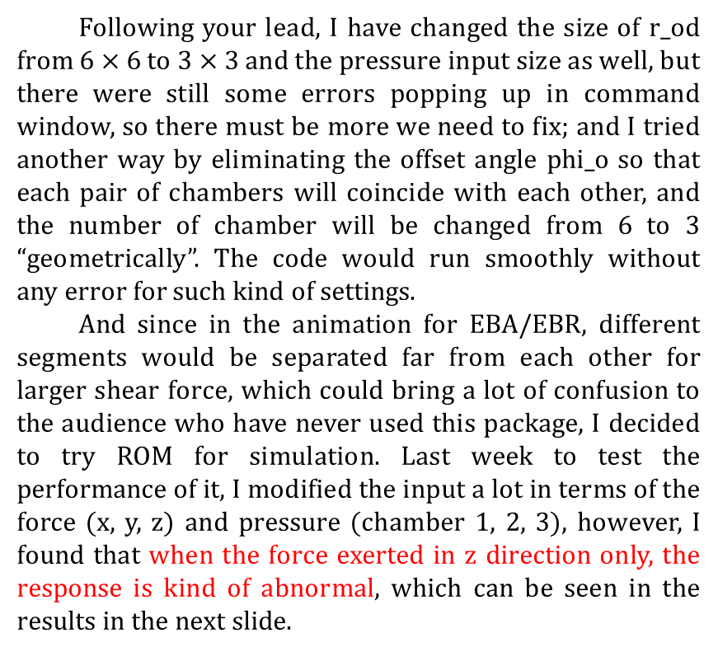
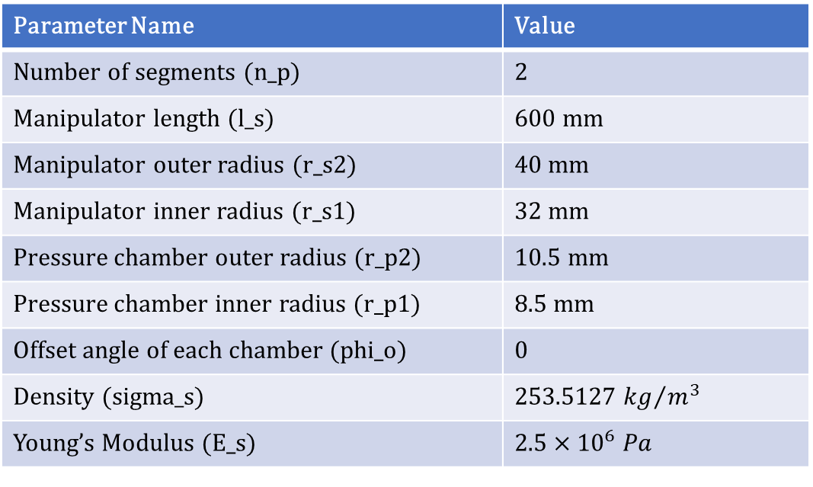
1. ROM simulation when force is exerted in z direction only
Following your lead, I have changed the size of r_od from $6×6$ to $3×3$ and the pressure input size as well, but there were still some errors popping up in command window, so there must be more we need to fix; and I tried another way by eliminating the offset angle phi_o so that each pair of chambers will coincide with each other, and the number of chamber will be changed from 6 to 3 “geometrically”. The code would run smoothly without any error for such kind of settings.
And since in the animation for EBA/EBR, different segments would be separated far from each other for larger shear force, which could bring a lot of confusion to the audience who have never used this package, I decided to try ROM for simulation. Last week to test the performance of it, I modified the input a lot in terms of the force (x, y, z) and pressure (chamber 1, 2, 3), however, I found that when the force exerted in z direction only, the response is kind of abnormal, which can be seen in the results in the next slide.
Parameter settings for ROM
Parameter Name | Value
Number of segments (n_p) | 2
Manipulator length (l_s) | 600 mm
Manipulator outer radius (r_s2) | 40 mm
Manipulator inner radius (r_s1) | 32 mm
Pressure chamber outer radius (r_p2) | 10.5 mm
Pressure chamber inner radius (r_p1) | 8.5 mm
Offset angle of each chamber (phi_o) | 0
Density (sigma_s) | 253.5127 ${kg}/{m^{3}}$
Young’s Modulus (E_s) | $$2.5×{10}^{6} Pa$$
Fig. 1-1 The amendment of r_od matrix. (a) After, (b) Before.

Slide 2
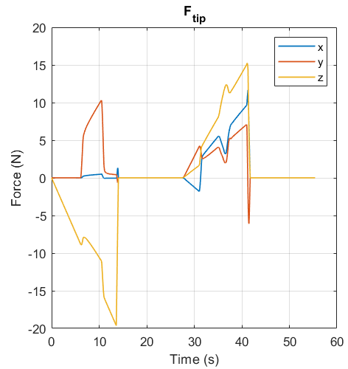
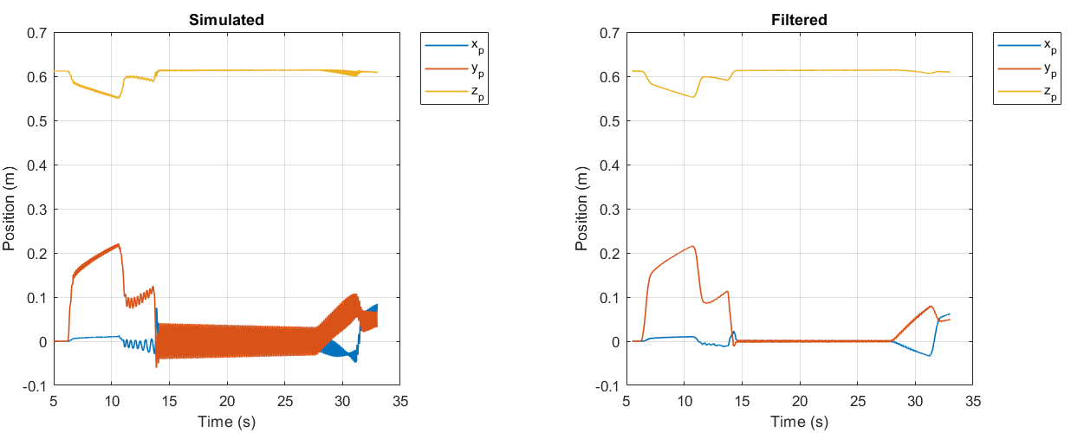
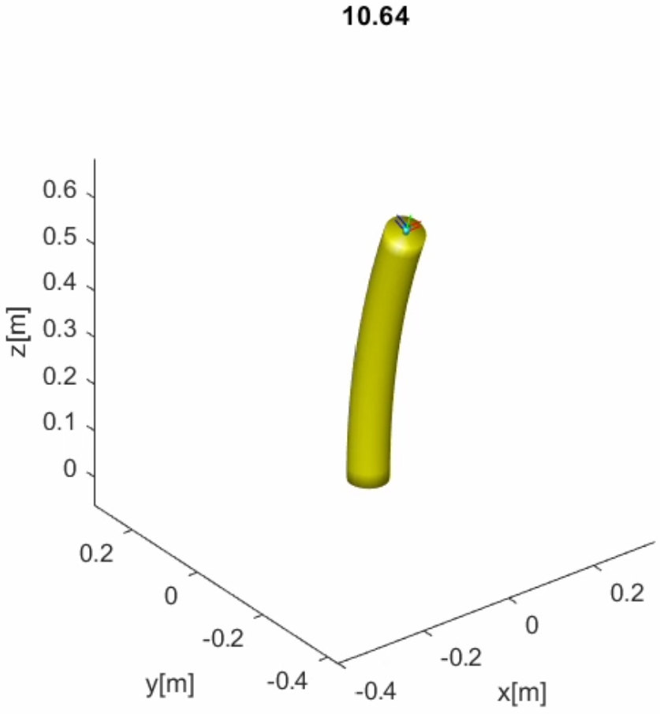
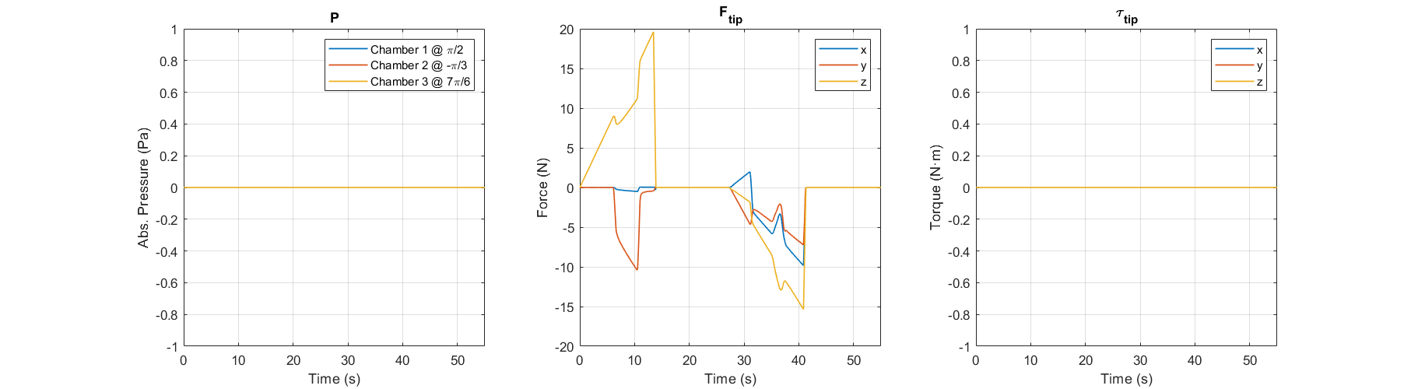
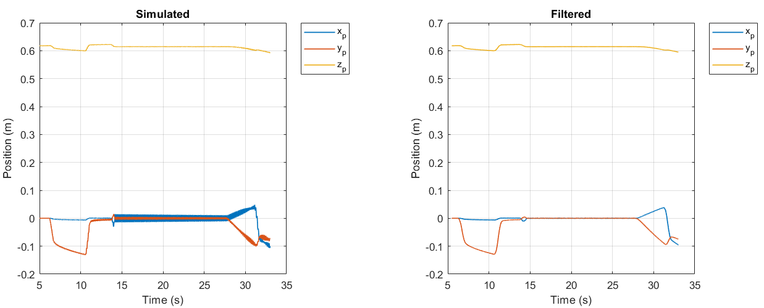
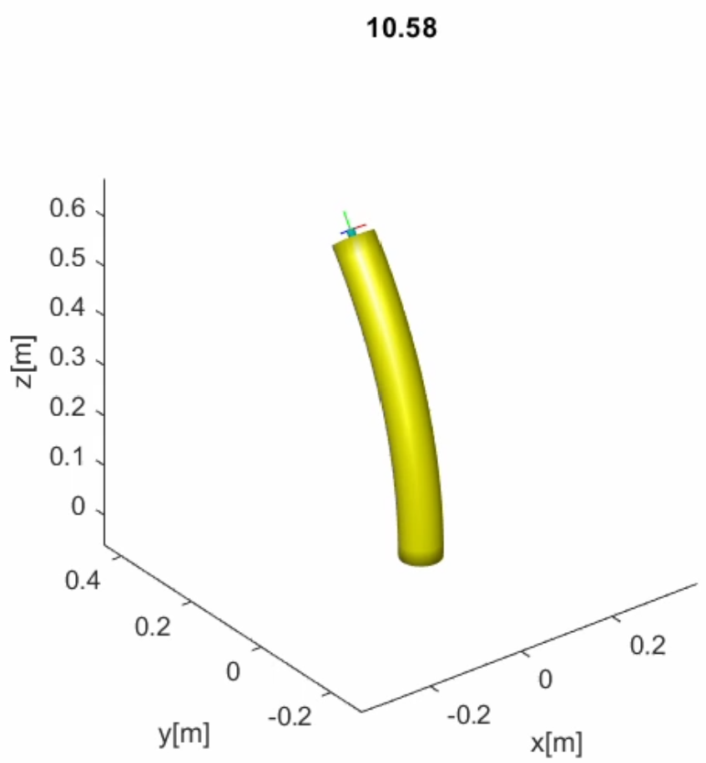


1. ROM simulation when force is exerted in z direction only
$$F_{z}$$
$$F_{z}$$

Slide 3
1. ROM simulation when force is exerted in z direction only
Question:
(1). The difference between desired and real force input
As shown in the figure in last slide, the force was applied in z direction only, the desired input should be shown as the figure in the right hand side, however, in the real input data, there is always a fluctuation in the region being circled, what could be any reasons behind?
(2). I can understand that when the force is along negative direction of z axis, the arm will be bended in an arbitrary direction (could be x or y), but why there will still be an extra force in y direction when the arm is extended rightly along the positive direction of z axis?

Slide 4
2. About animation
Since my project is basically about how to control two soft arms to grab something else in the 3D space, so I have the following questions based on the animation,
(1). For ROM simulation, are we still use tubeplot function to create the animation?
(2). Where can we modify the base position (the position it was fixed on the ground) for the SRA? I thought it should be in anim.m, but I’m not 100% sure about it.
(3). If I would like to add a secondary arm, which is exactly the same as the original one (the EOMs should be the same as well, only the force/pressure/torque input might be different), I just wonder which m files should we amend to achieve such goals?

Slide 5
3. About impact problem
For the third question, I’m not going to ask so much detail about how to model the impact process, to model it, we need to know the position impact happens and also the impact force, so my questions are based on these two aspects:
(1). Confirm the impact position
This week I have successfully add another cube in the 3D space, such space can be expressed by multiple inequalities, my guess is that if the intersection set of the cube space and the space forged by the robot arm is not empty, then we can say impact happens, so my question is whether the pipeline (the backbone) of the arm can be expressed by a certain equation in the simulation package? If not, what would you recommend to do to confirm the impact position for ROM?
(2). External force input exerted on an arbitrary position on the arm
As we know, the impact position can be anywhere on the arm, after computing the impact force at a certain known position, we can use analytical Jacobian to compute the equivalent force distribution on each joint (or can be COMs of each segment, it depends on how we model), what can I modify about the existing package for ROM?

