Slide 1
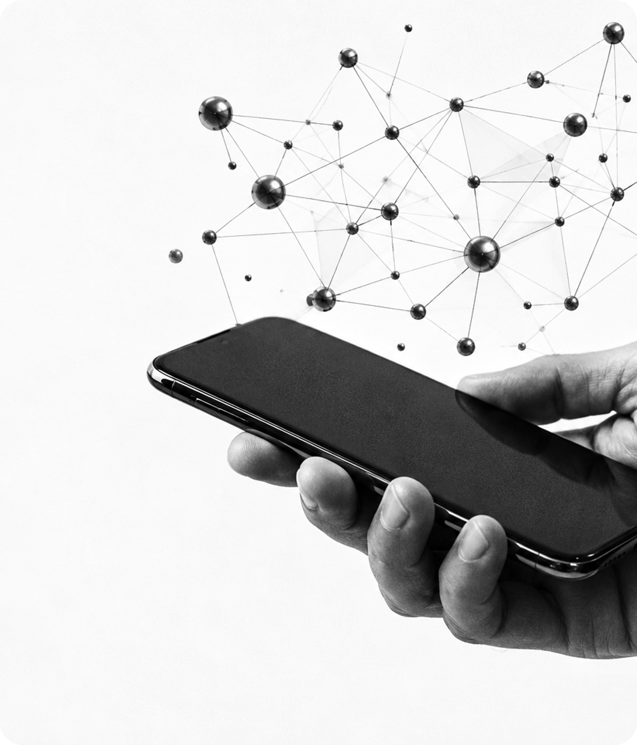
LINKEDIN
THE STORY
The story of the world’s biggest professional network.
2002–TODAY
Notes:
Hello, everyone! My name is [NAME]. Today I will tell you about LinkedIn. It is a famous website for work and careers. I will talk about how it started, how it grew, and why it is important today.

Slide 2

INTRODUCTION
LinkedIn is a social network for work and careers.
People make a profile, connect with colleagues, find jobs and learn new skills.
Companies use it to find and hire people.
1B+ MEMBERS
Notes:
LinkedIn is a social network, but it is not for photos or fun videos. It is for work. On LinkedIn, you make a profile — like an online CV. You connect with colleagues, you look for jobs, and you learn new skills. Companies also use it to find new workers. Today, LinkedIn has more than one billion members.

Slide 3
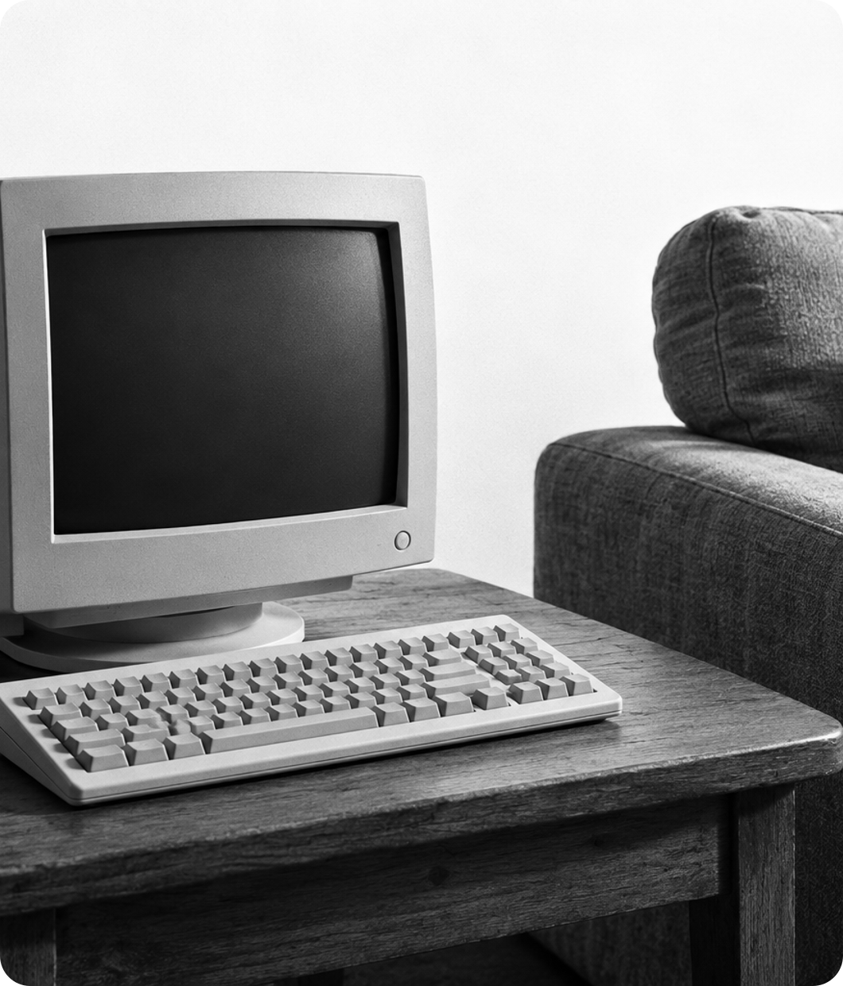
FOUNDING
EARLY YEARS
LinkedIn was founded in December 2002 by Reid Hoffman and a small team.
They worked from his living room in California. The site went live in May 2003.
05.05.2003
Notes:
The idea came from Reid Hoffman. He started the company in December 2002 with a small team of friends and colleagues. At first, they worked in his living room in California. The website started on the fifth of May, 2003. At the beginning, it was very small, and only a few people used it.

Slide 4
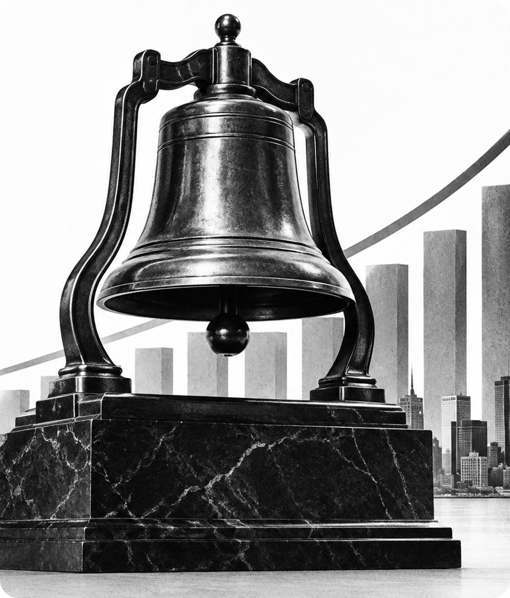
GROWTH
GOING PUBLIC
LinkedIn reached its first million members in 2004.
In May 2011, the company went public on the New York Stock Exchange.
The share price more than doubled on the first day.
2011 · IPO
Notes:
LinkedIn grew step by step. In 2004, it had its first million members. Then, in May 2011, the company went public. This means that anyone could buy its shares on the New York Stock Exchange. On the first day, the share price more than doubled. This showed that investors believed in the idea.

Slide 5
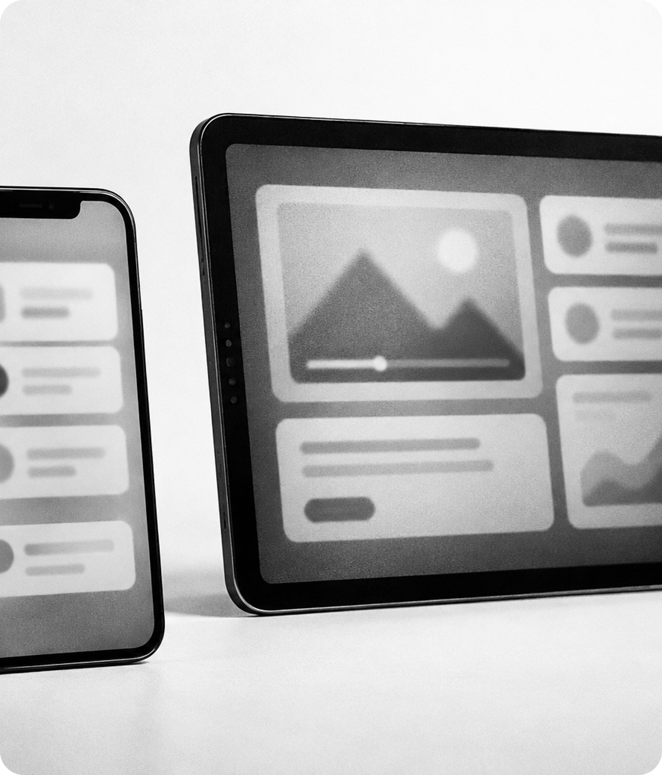
PRODUCTS
WHAT YOU CAN DO
Jobs – search and apply for work.
Learning – online courses. LinkedIn bought Lynda.com in 2015.
Sales Navigator – a tool to find business clients.
Ads & Company Pages – how brands talk to people.
Notes:
Today LinkedIn is much more than a profile. There is a Jobs section, where you can search and apply for work. There is LinkedIn Learning, with online courses. In 2015, LinkedIn bought a company called Lynda dot com for this. Sales Navigator helps people find business clients. And companies use pages and ads to show their brand.

Slide 6
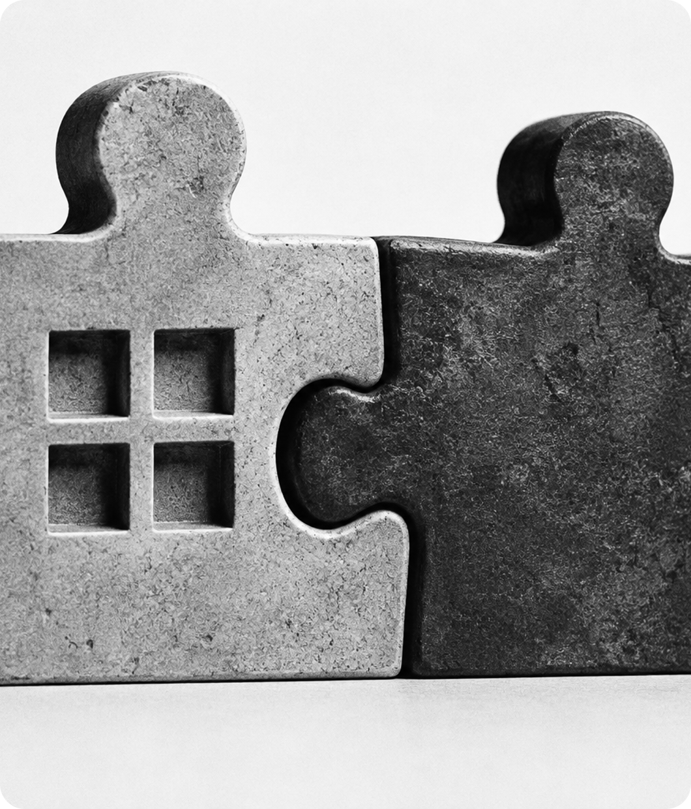
2016
MICROSOFT
In June 2016, Microsoft announced it would buy LinkedIn.
The deal cost about 26.2 billion dollars. It closed in December 2016.
LinkedIn kept its own name and brand.
$26.2B
Notes:
The biggest moment in the history of LinkedIn was 2016. In June, Microsoft announced that it would buy LinkedIn for about twenty-six point two billion dollars. The deal was finished in December. Important: LinkedIn kept its own name and brand, so we still use it as before.

Slide 7
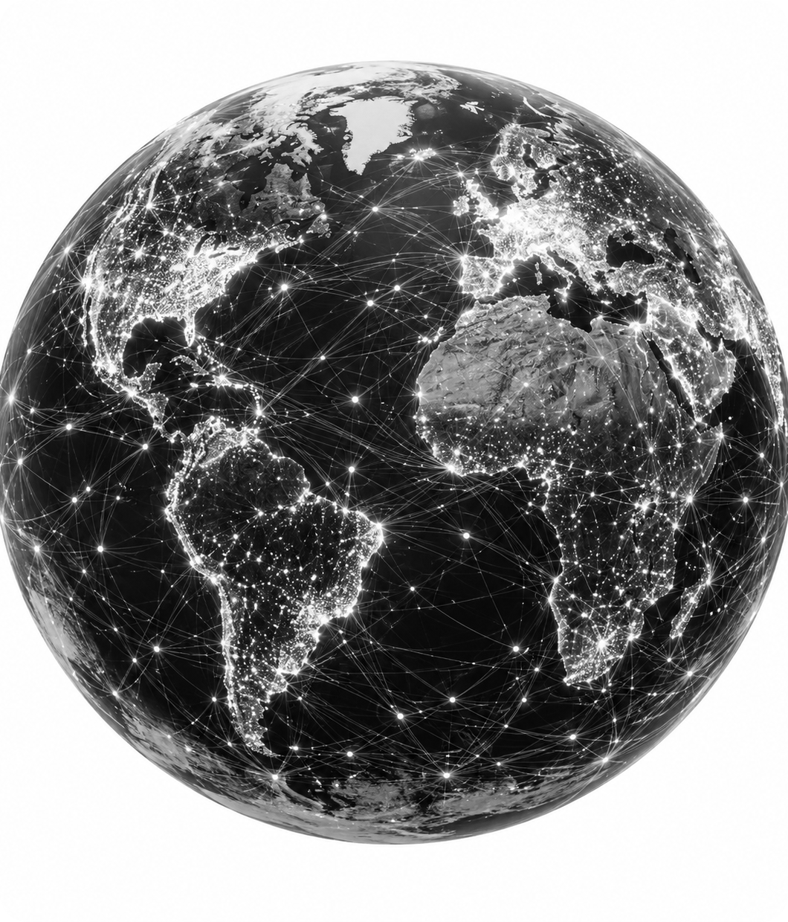
TODAY
LINKEDIN NOW
More than 1 billion members in over 200 countries and regions.
Headquarters: Sunnyvale, California. CEO: Ryan Roslansky.
It is the main place for hiring and professional news.
1,000,000,000
Notes:
Now LinkedIn is huge. It has more than one billion members in over two hundred countries and regions. The headquarters are in Sunnyvale, California. The CEO is Ryan Roslansky. For many professionals and companies, it is the main place to hire people and share business news.

Slide 8

IMPACT
WHY IT MATTERS
It helps people find jobs and companies find talent.
It lets you build your personal brand and grow your network.
Tip: add a photo and a clear headline to your profile.
Notes:
Why is LinkedIn important for us? First, it helps people find jobs and helps companies find good workers. Second, you can build your personal brand and meet people from your industry. A small tip for students: make a profile now, add a clear photo and a short headline. It will help you later when you look for an internship or a job.

Slide 9
CONCLUSION
THANK YOU!
Started in a living room in 2002.
Bought by Microsoft in 2016.
Today: 1 billion people connect for work and careers.
Any questions?
Notes:
To sum up: LinkedIn started in a living room in 2002. In 2016, Microsoft bought it. Today, one billion people use it to connect for work and careers. Thank you for listening! Do you have any questions?

