Slide 1

Crypto Signals Oracle
Using Chainlink to connect your dapp or app and get notifications when your trading signals trigger

Slide 2
Team :
Ken Gendrich: Oracle Source Developer / Product Manager
Brian Wentzloff: Oracle Adapter Developer / Blockchain Architecture
Ron Poletti: Dev Ops / Quality Assurance
Contact: info@thetokenfoundry.com
Oracles.NFTFactory.io

Slide 3
Problem: Current State of Crypto Trading or Defi Development
Centralized Crypto Trading Models (Trading Bots, Token Sets)
Build connections to Exchanges/Services that provide prices
Calculate trading decision points requires significant indicator build knowledge
Build Buy/Sell on that Centralized Exchange (eg: Coinbase)
Buy/Sell with connections to Decentralized Exchange (eg: Uniswap)
Decentralized Models (eg: Token Sets, Defi Contracts)
Use Oracles to Get Prices
Calculate trading conditions in your Dapp Contract
This is costly/requires persistent data updates and domain knowledge

Slide 4
Solution: Get Trading Signals from Oracle: simplify design
Supports Centralized and Decentralized Trading Models
Design your own trading signal requests on supported exchanges or sources of truth
Create a contract, or use a pre-built contract template to submit your conditions
NFTFactory Cyrpto Trading Signal Oracle
Receive a “Callback” that your technical market conditions have been met
Add your own additional logic, make trades on your exchange of choice
Benefits:
Less coding to create your Trading or Defi application
Less maintenance of core connections to Exchanges / Data Sources
Lowered Dapp costs for processing prices, updating contracts, calculating conditions, persistent data
Access to larger range of Technical Indicators over time

Slide 5
Components
Your Smart Contract on a Chainlink Connected Network
NFT Factory Chainlink Oracle Adapter on a Chainlink Node
Oracles.NFTFactory.io Signal Detection and Delivery

Slide 6
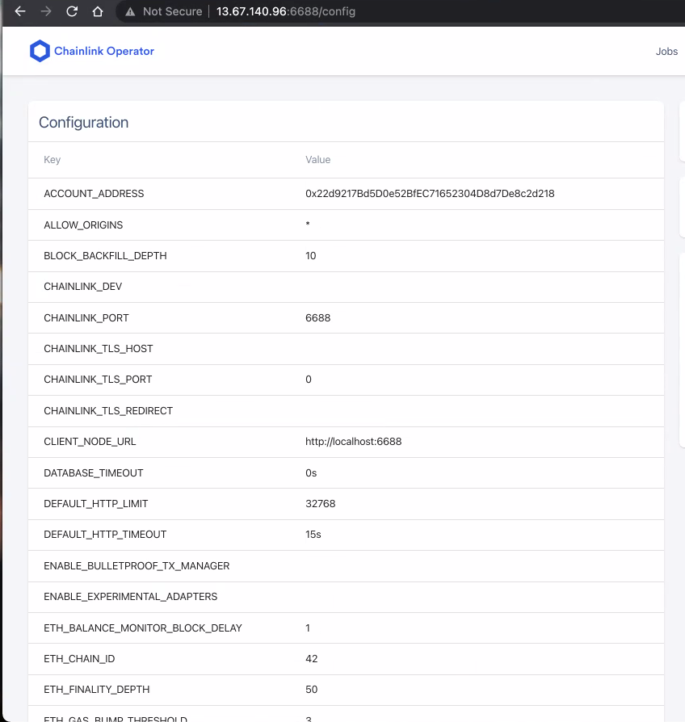
Build: Chainlink Test Node
In order to deploy, we needed a Chainlink Test Node
Build on Azure Ubuntu Server: Completed
Build Postgress database for Chainlink Test Node: Completed

Slide 7
Build: Chainlink oracle Adapter
The Oracle concept requires an adapter that is installed on any node that wants to validate oracles.
A Chainlink Adapter is an interface for Blockchain Smart Contracts to call, who then reach out to the attached source of truth (The Oracle)
Build an Oracle Adapter for the CryptoSignalOracle: Completed
Add the Oracle Adapter to the Node: In Progress
The adapter returns the signal to the Chainlink Network: In Progress

Slide 8
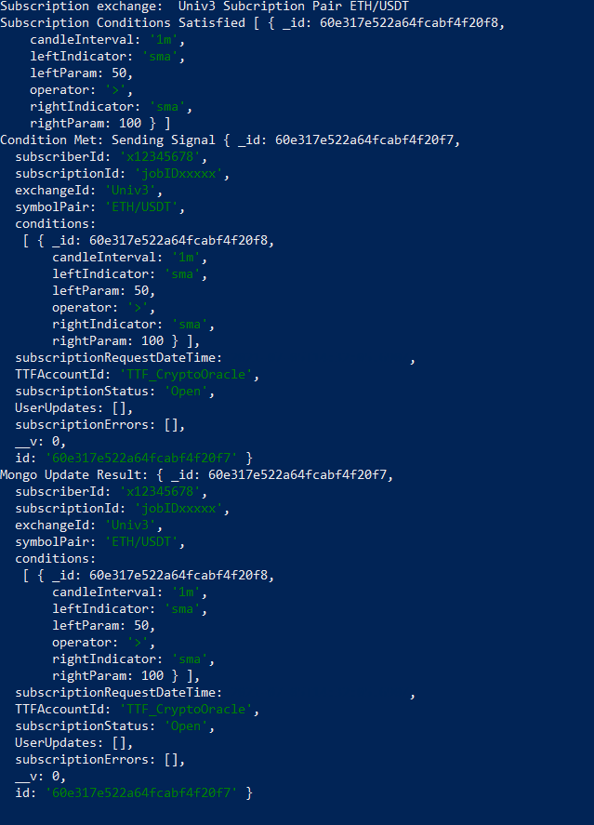
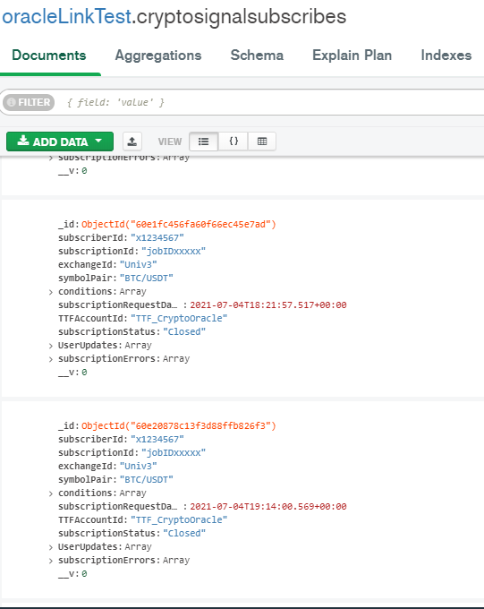
Build: Crypto Signal Oracle
Waits for Subscriptions from the Adapter (REST API) : Completed
Logs the Subscription and Conditions as “Open” : Completed
Calculates the indicators (SMA, RSI) for that coin : In Progress
Triggers a response to the adapter and closes the subscription: In Progress

Slide 9
Solution RoadMap : Crypto Signals Oracle
HackMoney Hackathon
Dev Prototype and Customer Focus Interest
Q3 2021
MVP Production
(One exchange,Two Indicators, Simple Frequency)
Q4 2021
Scaled Production
Scale-up related to market requirements and demand

Slide 10
Monetization
We are considering Several Models
Model | Pros | Cons
Tiered Pricing – higher frequency of candle frequency likely leads to higher risk trading but higher reward. Charge More for higher frequency (Seconds: Highest (1.00 LINK), Minutes, Days, Weeks, Months: Lowest .01 LINK). | Higher frequency triggers more subscriptions, leads to more revenue Higher price per condition leads to an exponential rev structure Higher frequency triggers cost more to implement | Customers may consider this too expensive for faster trading frequency events and the elevated price point may lead to lower adoption.
Tiered Pricing – lower frequency at lower cost (Months: Highest (1.00 LINK), Seconds: Lowest .001 LINK). | Higher frequency triggers more subscriptions, we gain revenue on volume Lower Frequency Triggers less subscriptions, we gain revenue on cost | If Volume is not constrained by price, revenue is reduced compared to the opposite approach.
Fixed Pricing -> Same Price per subscription. Ex: 0.10 link per subscription. | Simplistic pricing model Can adjust after 6 months | Not attempting to maximize revenue stream.
Free (Link Network Costs Only) until 2022. | Brings in Maximum Customers, allows us to assess the demand and can create price point with data, reduces customer expectations. | Low Revenue Stream, loss for 6 months May not attract serious customers.

Slide 11
How To Get Started:
Visit our GitHub account that we will populate with instructions, examples, and tutorials
NFTFactory Crypto Trading Oracle
https://github.com/nftfactory-io/hackmoney-oracle

Slide 12

Marketing
HackMoney Defi Hackathon
Social Media
Exchanges / B2B Trading Bot Builders

Slide 13

Reach out to us
Oracles.NFTFactory.io
Discord:
https://discord.gg/78VekUS5
Email:
Info@thetokenfoundry.com

