Slide 1


Small Project Demo
A user-centric contact management system
Group 20
Cole Crombie, Beile Han, Jordi Maldonado, Ryan Ramdihal, Colin Trinh

Slide 2


PM
Database
Cole
Beile
API
Front End
Cole & Ryan
Colin & Jordi

Slide 3


Database API Front End
MySQL Postman SwaggerHub Lighthouse
Communication & Collaboration Discord & github

Slide 4

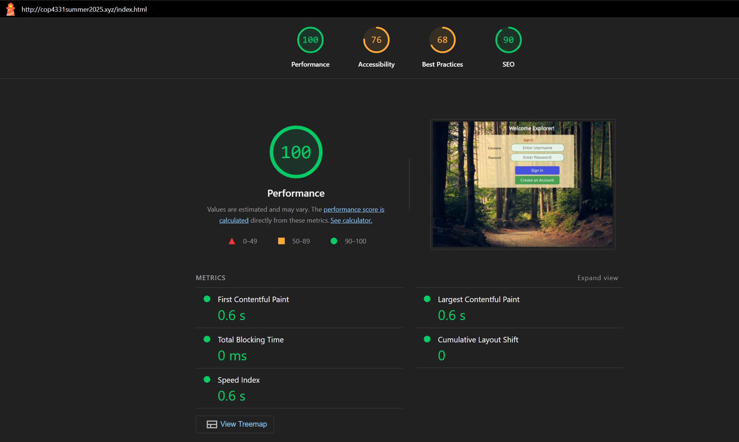
Lighthouse report

Slide 5
Things that went well
Database setup was nice and smooth
Initial Website Setup
Organization of the Gnatt Chart

Slide 6
Things that didn’t went well
Took some time to get members and roles assigned
Gnatt Pro Data Issue
Learning css

Slide 7

Last Name
First Name
Login
ID
Users
Password
1
1
N
UserID(fk)
N
Colors
Email
Contacts
Phone
ID
UserID(fk)
ID
Name
Last Name
First Name

Slide 8
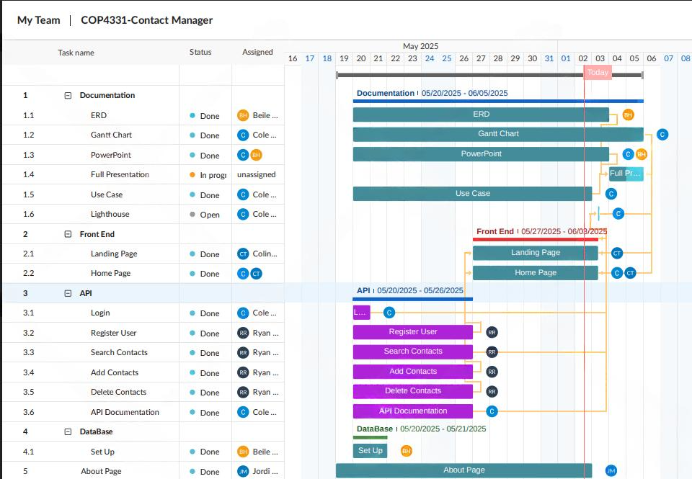

Slide 9
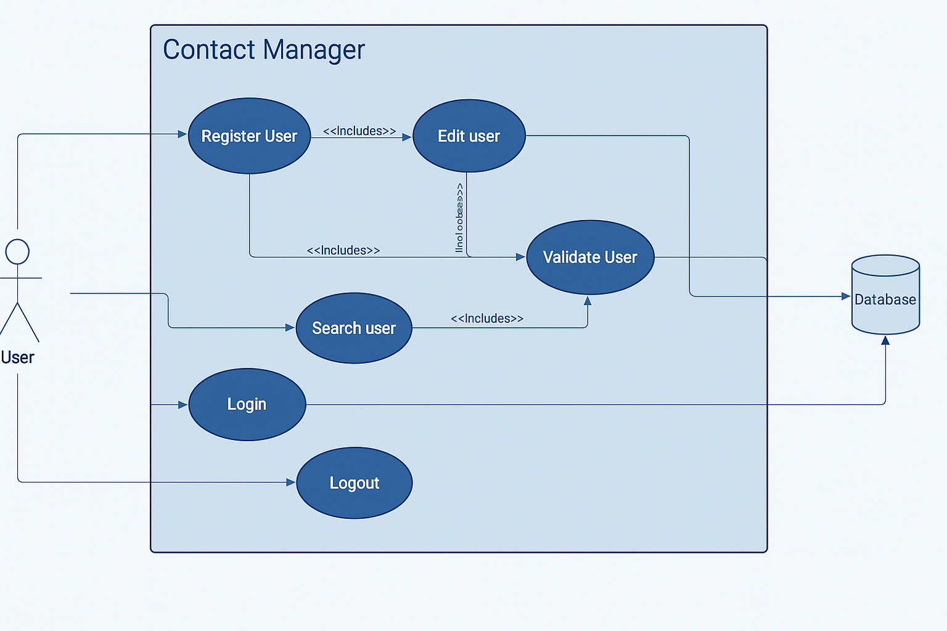

Slide 10
API demonstration

Slide 11
App demonstration

