Slide 1


Coders In The Wild Demo
A user-centric contact management system
Group 20
Cole Crombie, Beile Han, Jordi Maldonado, Ryan Ramdihal, Colin Trinh

Slide 2


PM
Database
Cole
Beile
API
Front End
Cole & Ryan
Colin & Jordi

Slide 3


Database API Front End
MySQL Postman SwaggerHub Lighthouse
Communication & Collaboration Discord & github

Slide 4

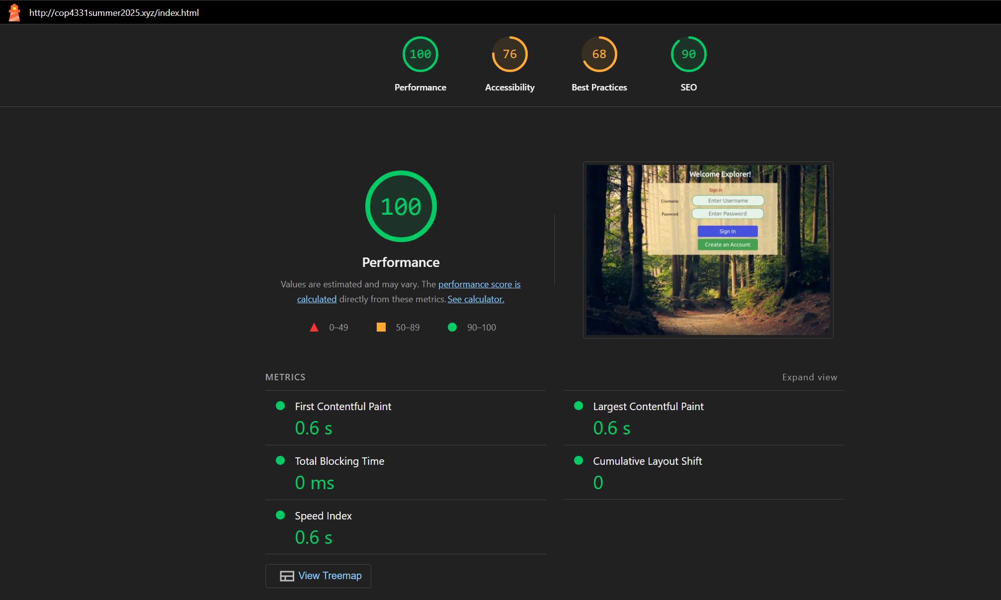
Lighthouse report
Performance: 100 – Fast load, no delays, stable layout
Accessibility: 76 – Needs better contrast or labels
Best Practices: 68 – Some outdated code or warnings
SEO: 90 – Mostly search-friendly
Visuals – Clean forest-themed login screen

Slide 5
Things that went well
Database setup
Initial Website Setup
Organization of the Gnatt Chart

Slide 6
Things that didn’t went well
Took some time to get members and roles assigned
Gnatt Pro Data Issue
Learning CSS

Slide 7

First Name
Last Name
ID
Login
Users
1
Password
UserID(fk)
N
Contacts
ID
Email
Phone
Last Name
First Name

Slide 8
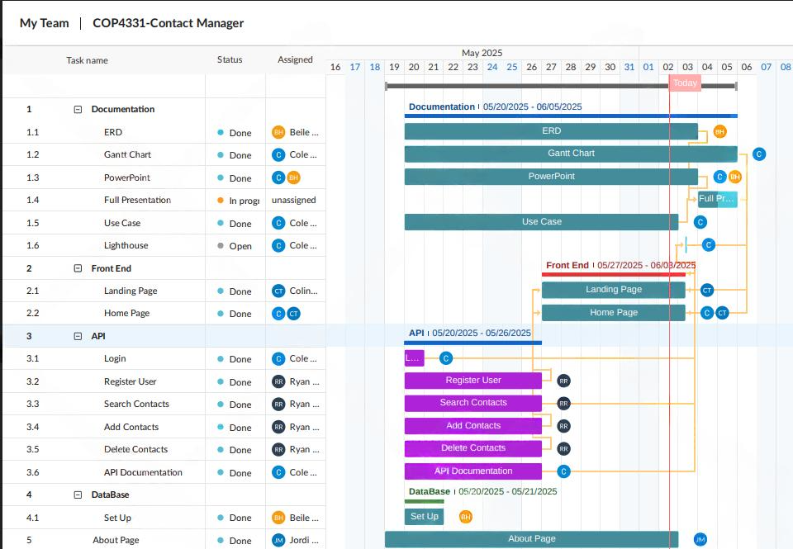

Slide 9
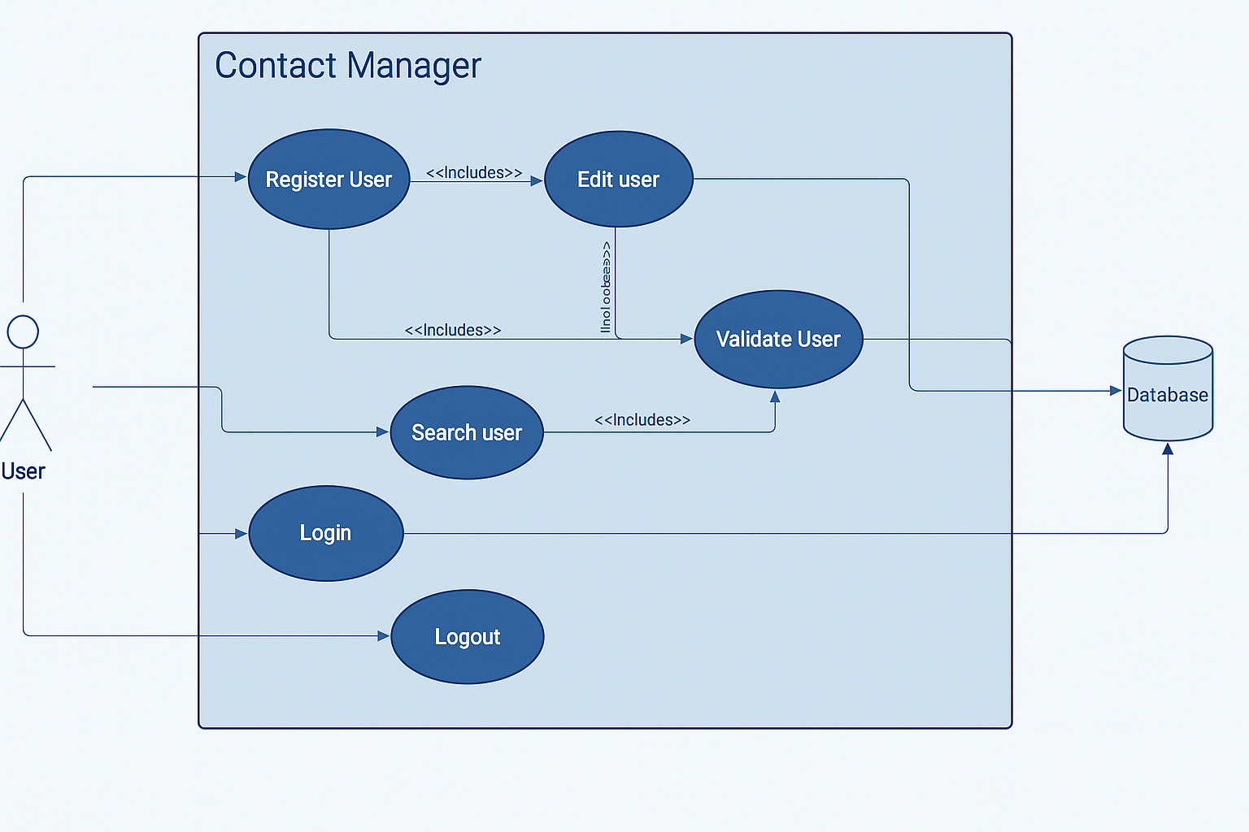

Slide 10
API Scripts
Login.php
SearchContacts.php
AddContacts.php
DeleteContacts.php
Register.php

Slide 11
API demonstration
https://app.swaggerhub.com/apis-docs/group20-12c/CodersInTheWild/1.0.0#/default/post_SearchContacts_php

Slide 12
App demonstration
http://cop4331summer2025.xyz/

